Slide 1
FSD2 LAB • EXPERIMENT 04
Experiment 04 — ExpressJS + Mongoose CRUD + RESTful API
Simple explanation • Clean code • Runtime pathway • Viva preparation
FSD2 Lab Materials

Slide 2
Syllabus tasks
•
`ECONNREFUSED`: start local MongoDB or supply a correct Atlas URI.
•
Invalid URI / Atlas timeout: recheck connection string and Atlas Network
Access.
•
Invalid product ID: API returns a 400 response.
•
Missing dependency: from repository root run `npm install`.

Slide 3
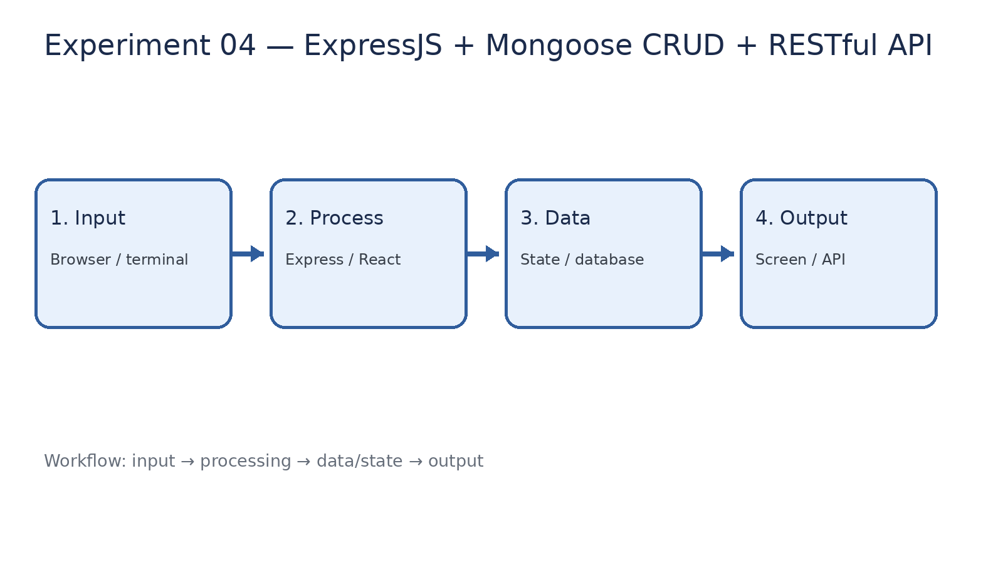
How it works
Input → processing → data/state → output

Slide 4
Code pathway 1
server.js • lines 1–10
1 /**
2 * Experiment 04: Express + Mongoose CRUD REST API with browser client.
3 *
4 * Default local database: mongodb://127.0.0.1:27017/fsd2lab
5 * Set MONGO_URI to use MongoDB Atlas.
6 * Run from the repository root:
7 * node 04-express-database-rest-api/server.js
8 */
9 const express = require('express');
10 const mongoose = require('mongoose');

Slide 5
Code pathway 2
server.js • lines 11–20
11
12 const app = express();
13 const PORT = Number(process.env.PORT) || 3004;
14 const MONGO_URI = process.env.MONGO_URI || 'mongodb://127.0.0.1:27017/fsd2lab';
15
16 app.use(express.json());
17 app.use(express.urlencoded({ extended: true }));
18
19 const productSchema = new mongoose.Schema({
20 name: { type: String, required: true, trim: true },

Slide 6
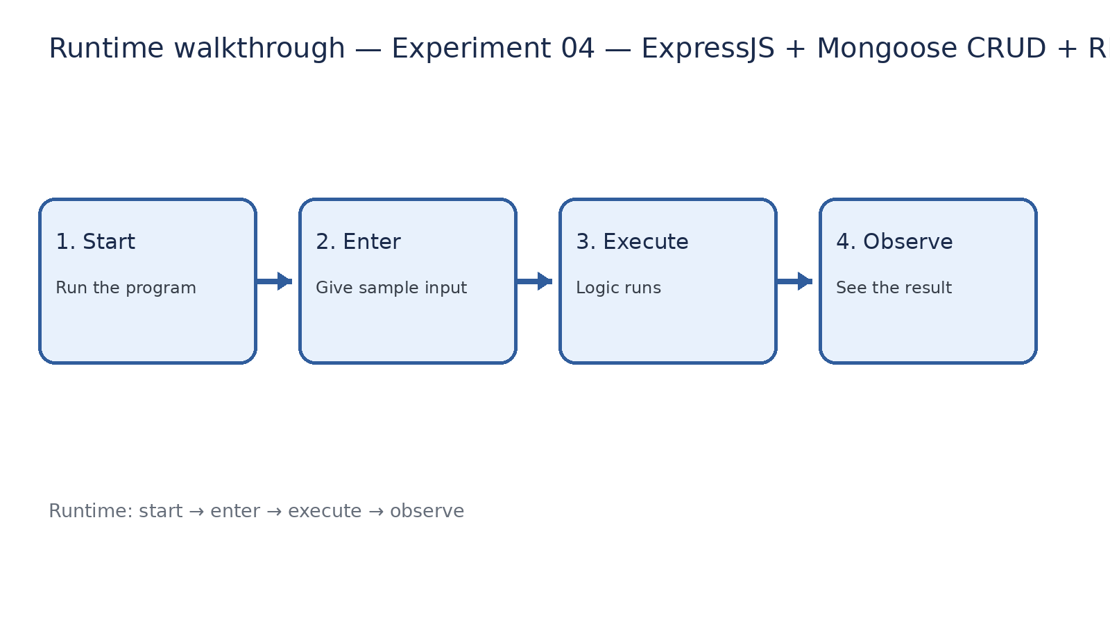
Runtime walkthrough
Start → enter input → execute → observe output

Slide 7
Expected result
Experiment 04 — ExpressJS + Mongoose CRUD + RESTful API
INPUT
PROCESS
OUTPUT
Enter the sample values or open the required page / route.
The Express route, React component, hook, or MongoDB command performs the task.
Check the browser, terminal, API response, or database result.
Verification checklist
•
No syntax errors appear in the terminal.
•
The requested feature responds to the input.
•
The displayed / returned value matches the operation.

Slide 8
Viva preparation
•
What is the purpose of this experiment?
•
Which input is required?
•
Which line or command performs the main operation?
•
What output should you observe?
•
What happens when the input changes?

