Slide 1
FSD2 LAB • EXPERIMENT 10
Experiment 10 — MongoDB Installation, Atlas Configuration and CRUD
Simple explanation • Clean code • Runtime pathway • Viva preparation
FSD2 Lab Materials

Slide 2
Syllabus tasks
•
See the experiment README for the exact syllabus task.

Slide 3
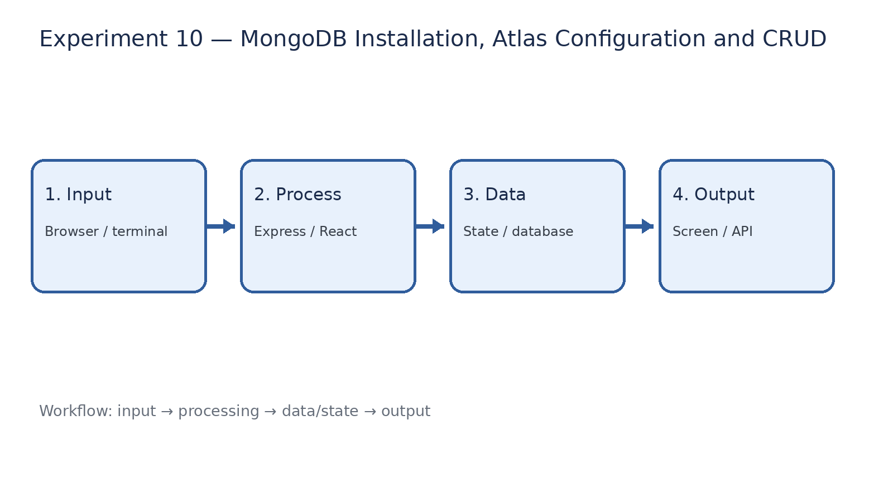
How it works
Input → processing → data/state → output

Slide 4
Code pathway 1
queries.js • lines 1–10
1 /**
2 * Experiment 10(b): MongoDB CRUD operations.
3 *
4 * Run from the repository root:
5 * mongosh --file 10-mongodb-installation-configuration-crud/queries.js
6 * To use Atlas, pass your connection URI before --file:
7 * mongosh "YOUR_ATLAS_URI" --file 10-mongodb-installation-configuration-crud/queries.js
8 *
9 * This script uses its own fsdLab sample database and prints important results.
10 */

Slide 5
Code pathway 2
queries.js • lines 11–20
11 db = db.getSiblingDB('fsdLab');
12
13 // Recreate predictable sample state by clearing only this lab collection.
14 db.students.deleteMany({});
15 print('CREATE: insert five sample students');
16 printjson(db.students.insert([
17 { name: 'Anitha', branch: 'CSE', year: 3, cgpa: 8.9 },
18 { name: 'Ravi', branch: 'ECE', year: 2, cgpa: 7.8 },
19 { name: 'Sneha', branch: 'CSE', year: 3, cgpa: 9.1 },
20 { name: 'Kiran', branch: 'MECH', year: 4, cgpa: 6.9 },

Slide 6
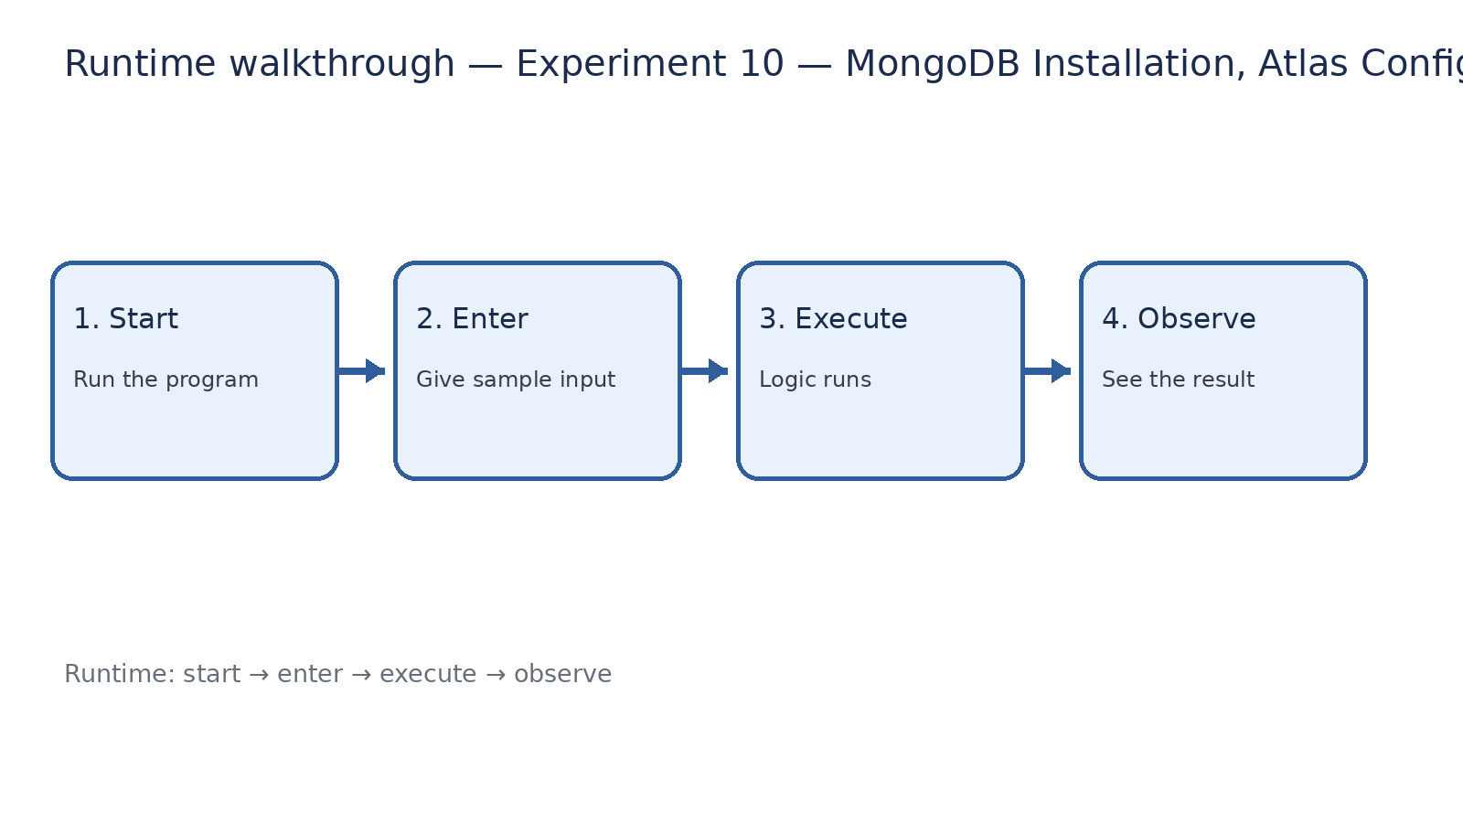
Runtime walkthrough
Start → enter input → execute → observe output

Slide 7
Expected result
Experiment 10 — MongoDB Installation, Atlas Configuration and CRUD
INPUT
PROCESS
OUTPUT
Enter the sample values or open the required page / route.
The Express route, React component, hook, or MongoDB command performs the task.
Check the browser, terminal, API response, or database result.
Verification checklist
•
No syntax errors appear in the terminal.
•
The requested feature responds to the input.
•
The displayed / returned value matches the operation.

Slide 8
Viva preparation
•
What is the purpose of this experiment?
•
Which input is required?
•
Which line or command performs the main operation?
•
What output should you observe?
•
What happens when the input changes?

