Slide 1
FSD2 LAB • EXPERIMENT 03
Experiment 03 — Cookies, Sessions and Authentication
Simple explanation • Clean code • Runtime pathway • Viva preparation
FSD2 Lab Materials

Slide 2
Syllabus tasks
Part 1
•
Display a login form.
•
Check demo username and password.
•
Store the logged-in user in a session.
•
Store a role value in a cookie.
•
Protect the profile route.

Slide 3
Syllabus tasks
Part 2
•
Destroy the session during logout.

Slide 4
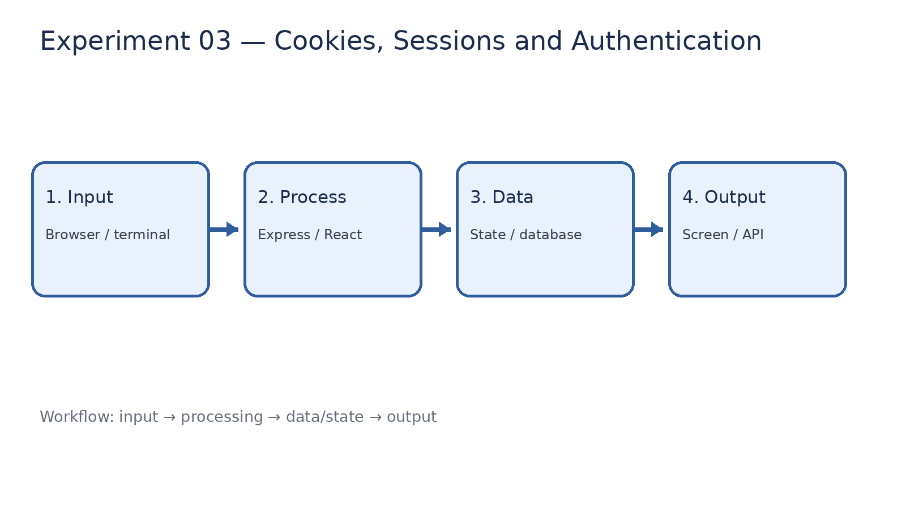
How it works
Input → processing → data/state → output

Slide 5
Code pathway 1
app.js • lines 1–10
1 /**
2 * Experiment 03: ExpressJS Cookies, Sessions and Authentication
3 *
4 * Demo credentials:
5 * Username: student
6 * Password: 1234
7 *
8 * What it demonstrates:
9 * - Form-data handling
10 * - Cookies

Slide 6
Code pathway 2
app.js • lines 11–20
11 * - Sessions
12 * - Login and logout
13 * - Protected profile route
14 */
15
16 const express = require('express');
17 const cookieParser = require('cookie-parser');
18 const session = require('express-session');
19
20 const app = express();

Slide 7
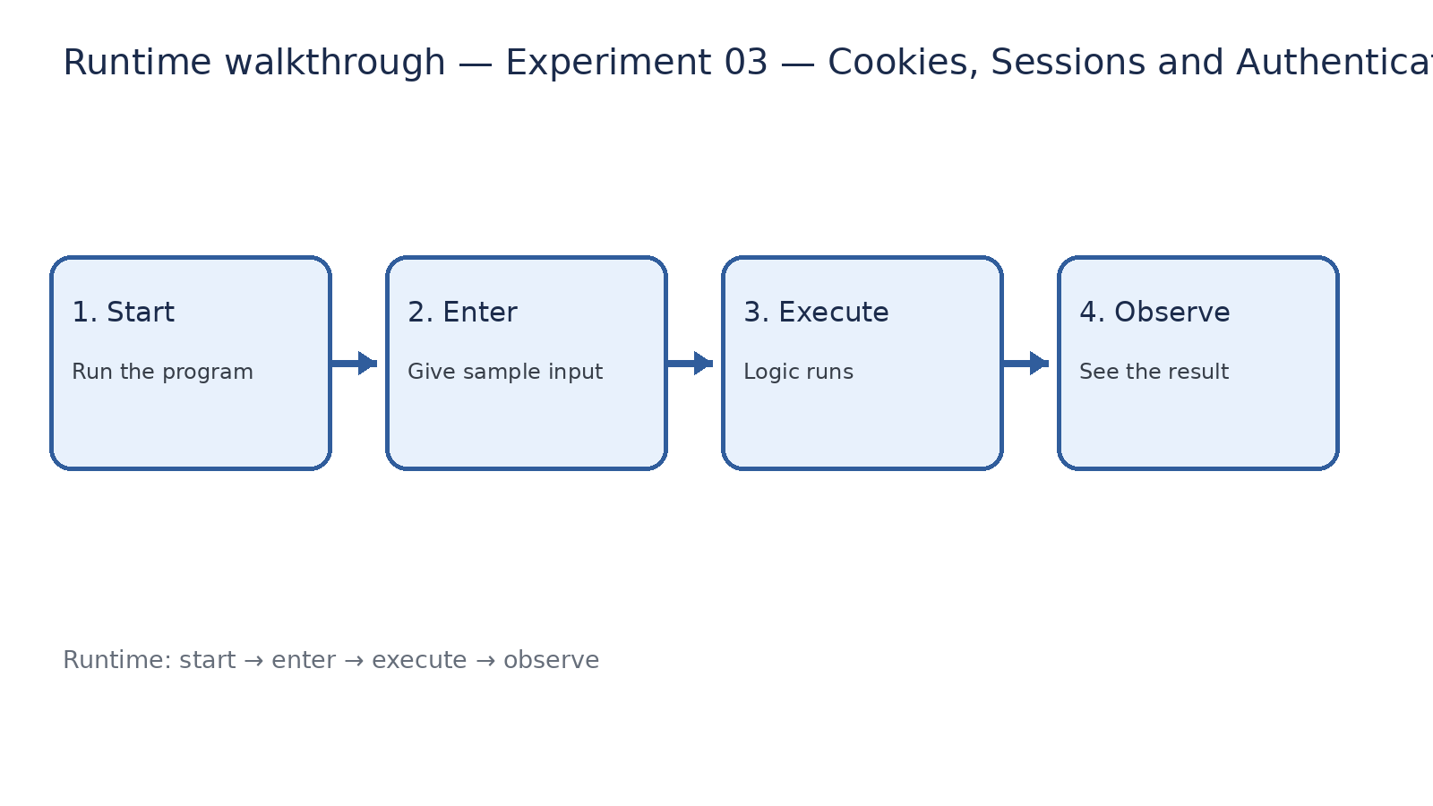
Runtime walkthrough
Start → enter input → execute → observe output

Slide 8
Expected result
Experiment 03 — Cookies, Sessions and Authentication
INPUT
PROCESS
OUTPUT
Enter the sample values or open the required page / route.
The Express route, React component, hook, or MongoDB command performs the task.
Check the browser, terminal, API response, or database result.
Verification checklist
•
No syntax errors appear in the terminal.
•
The requested feature responds to the input.
•
The displayed / returned value matches the operation.

Slide 9
Viva preparation
•
What is the purpose of this experiment?
•
Which input is required?
•
Which line or command performs the main operation?
•
What output should you observe?
•
What happens when the input changes?

