Slide 1
FSD2 LAB • EXPERIMENT 05
Experiment 05 — ReactJS, HTML, JSX and Components
Simple explanation • Clean code • Runtime pathway • Viva preparation
FSD2 Lab Materials

Slide 2
Syllabus tasks
Part 1
•
Render React into the HTML root element.
•
Display JavaScript values inside JSX.
•
Create function components.
•
Create a class component.
•
Reuse StudentCard as a child component.

Slide 3
Syllabus tasks
Part 2
•
Pass student information through props.
•
A React heading.
•
A function component card.
•
A class component card.
•
A StudentCard showing the supplied props.

Slide 4
Syllabus tasks
Part 3
•
main.jsx — application entry point and components.
•
StudentCard.jsx — reusable component.
•
index.html — React root page.

Slide 5
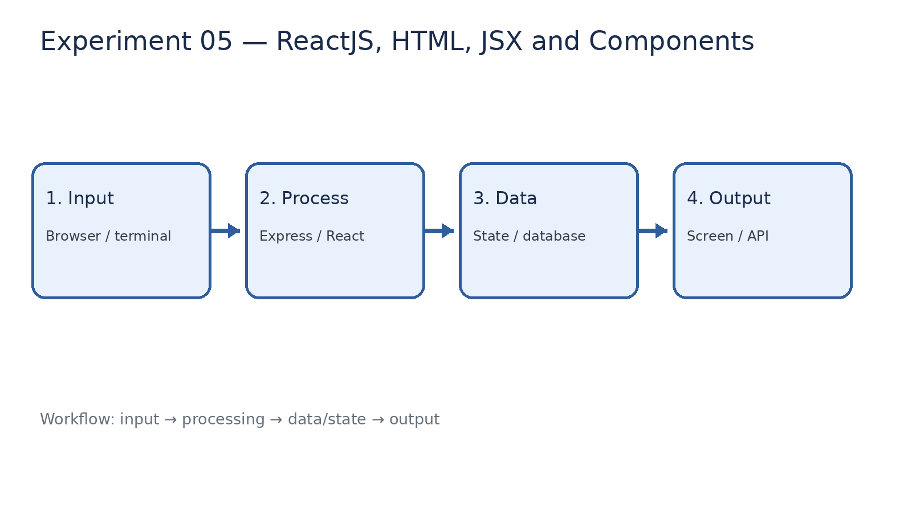
How it works
Input → processing → data/state → output

Slide 6
Code pathway 1
index.html • lines 1–10
1 <!DOCTYPE html>
2 <html lang="en">
3 <head>
4 <meta charset="UTF-8" />
5
6 <meta
7 name="viewport"
8 content="width=device-width, initial-scale=1.0"
9 />
10

Slide 7
Code pathway 2
index.html • lines 11–20
11 <title>
12 FSD2 React Experiment 05
13 </title>
14 </head>
15
16 <body>
17 <div id="root"></div>
18
19 <script
20 type="module"

Slide 8
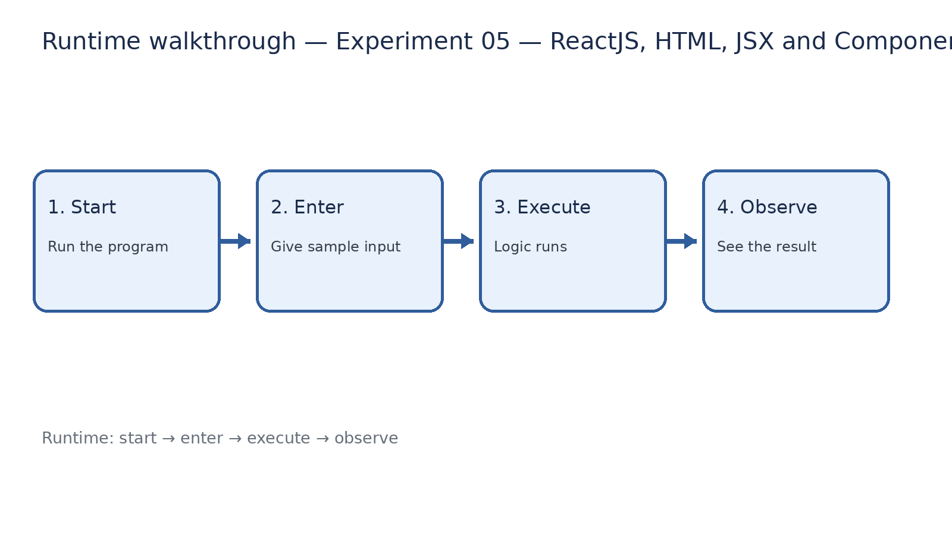
Runtime walkthrough
Start → enter input → execute → observe output

Slide 9
Expected result
Experiment 05 — ReactJS, HTML, JSX and Components
INPUT
PROCESS
OUTPUT
Enter the sample values or open the required page / route.
The Express route, React component, hook, or MongoDB command performs the task.
Check the browser, terminal, API response, or database result.
Verification checklist
•
No syntax errors appear in the terminal.
•
The requested feature responds to the input.
•
The displayed / returned value matches the operation.

Slide 10
Viva preparation
•
What is the purpose of this experiment?
•
Which input is required?
•
Which line or command performs the main operation?
•
What output should you observe?
•
What happens when the input changes?

