Slide 1
FSD2 LAB • EXPERIMENT 11
Experiment 11 — MongoDB Databases, Collections and Records
Simple explanation • Clean code • Runtime pathway • Viva preparation
FSD2 Lab Materials

Slide 2
Syllabus tasks
Part 1
•
Create a database context.
•
Create a students collection.
•
Insert multiple records.
•
Find records.
•
Limit the number of results.

Slide 3
Syllabus tasks
Part 2
•
Sort by marks.
•
Create an index.
•
Calculate average marks with aggregation.
•
Average marks for each branch.
•
Number of students in each branch.

Slide 4
Syllabus tasks
Part 3
•
Results ordered by average marks.
•
queries.js — sectioned MongoDB commands with comments.

Slide 5
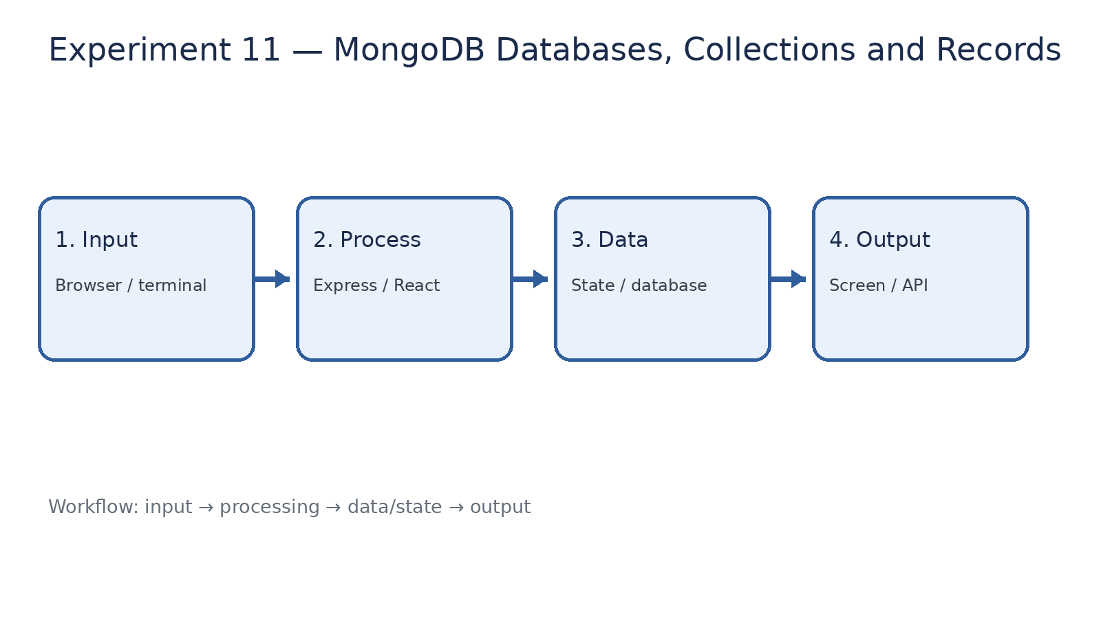
How it works
Input → processing → data/state → output

Slide 6
Code pathway 1
queries.js • lines 1–10
1 /**
2 * Experiment 11: MongoDB Databases, Collections and Records
3 *
4 * Run this file inside mongosh.
5 *
6 * Demonstrates:
7 * - Database and collection creation
8 * - Insert many records
9 * - Find
10 * - Limit

Slide 7
Code pathway 2
queries.js • lines 11–20
11 * - Sort
12 * - Index
13 * - Aggregation
14 */
15
16 // ------------------------------------------------------------
17 // Database and collection
18 // ------------------------------------------------------------
19
20 use fsd2records;

Slide 8
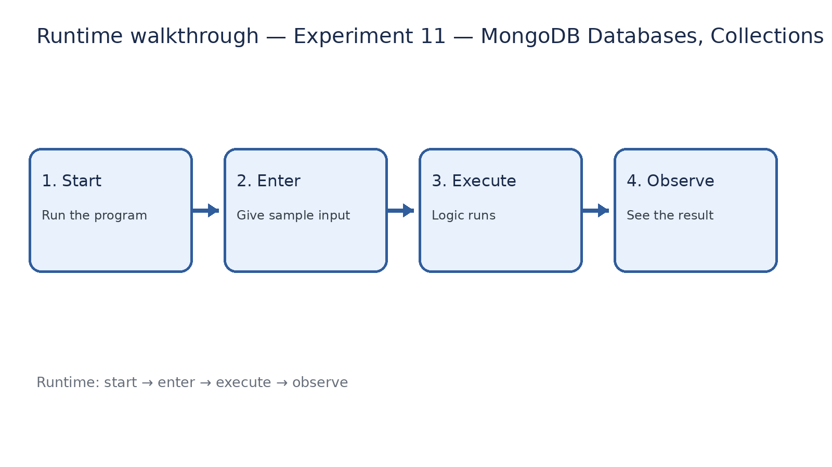
Runtime walkthrough
Start → enter input → execute → observe output

Slide 9
Expected result
Experiment 11 — MongoDB Databases, Collections and Records
INPUT
PROCESS
OUTPUT
Enter the sample values or open the required page / route.
The Express route, React component, hook, or MongoDB command performs the task.
Check the browser, terminal, API response, or database result.
Verification checklist
•
No syntax errors appear in the terminal.
•
The requested feature responds to the input.
•
The displayed / returned value matches the operation.

Slide 10
Viva preparation
•
What is the purpose of this experiment?
•
Which input is required?
•
Which line or command performs the main operation?
•
What output should you observe?
•
What happens when the input changes?

