Slide 1
FSD2 LAB • EXPERIMENT 03
Experiment 03 — ExpressJS Cookies, Sessions and Authentication
Simple explanation • Clean code • Runtime pathway • Viva preparation
FSD2 Lab Materials

Slide 2
Syllabus tasks
•
See the experiment README for the exact syllabus task.

Slide 3
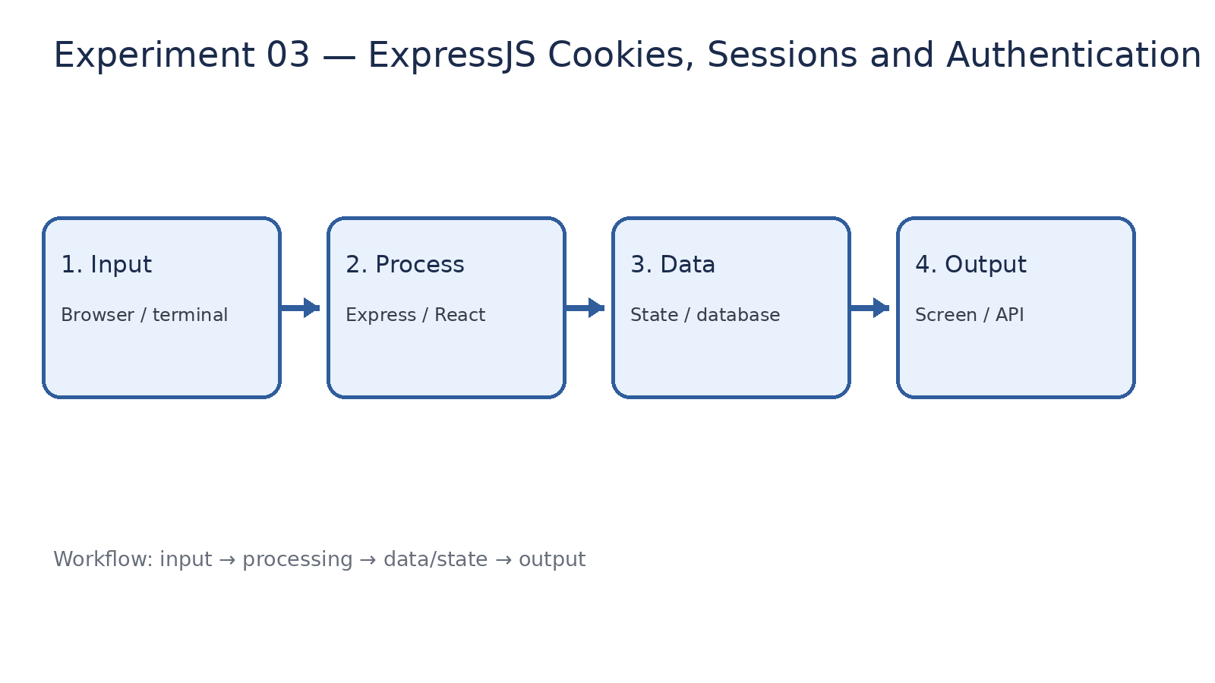
How it works
Input → processing → data/state → output

Slide 4
Code pathway 1
app.js • lines 1–10
1 /**
2 * Experiment 03(a): Cookie and session management.
3 *
4 * Run: node 03-express-cookies-sessions-authentication/app.js
5 * Open: http://localhost:3003
6 *
7 * Try /set-cookie, /get-cookie, /visit and /destroy-session.
8 */
9 const express = require('express');
10 const cookieParser = require('cookie-parser');

Slide 5
Code pathway 2
app.js • lines 11–20
11 const session = require('express-session');
12
13 const app = express();
14 const PORT = 3003;
15
16 app.use(cookieParser());
17 app.use(session({
18 secret: process.env.SESSION_SECRET || 'fsd2-classroom-session-secret',
19 resave: false,
20 saveUninitialized: false,

Slide 6
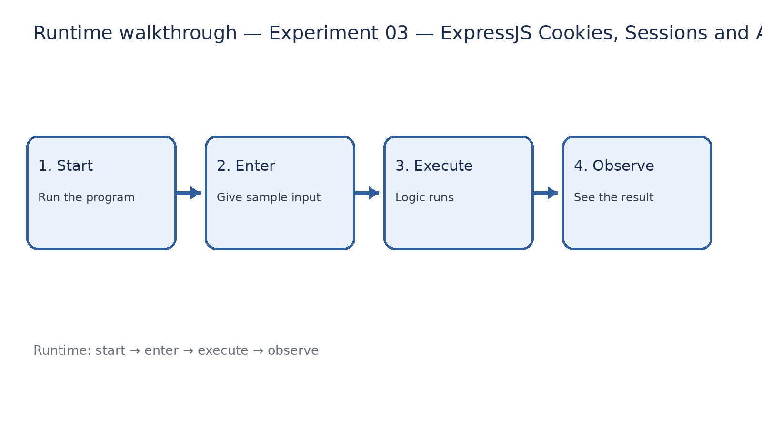
Runtime walkthrough
Start → enter input → execute → observe output

Slide 7
Expected result
Experiment 03 — ExpressJS Cookies, Sessions and Authentication
INPUT
PROCESS
OUTPUT
Enter the sample values or open the required page / route.
The Express route, React component, hook, or MongoDB command performs the task.
Check the browser, terminal, API response, or database result.
Verification checklist
•
No syntax errors appear in the terminal.
•
The requested feature responds to the input.
•
The displayed / returned value matches the operation.

Slide 8
Viva preparation
•
What is the purpose of this experiment?
•
Which input is required?
•
Which line or command performs the main operation?
•
What output should you observe?
•
What happens when the input changes?

