Slide 1
FSD2 LAB • EXPERIMENT 02
ExpressJS Templating, Form Data
Simple explanation • Clean code • Runtime pathway • Viva preparation
FSD2 Lab Materials

Slide 2
Syllabus tasks
•
Write a program using a templating engine.
•
Write a program to work with form data.

Slide 3
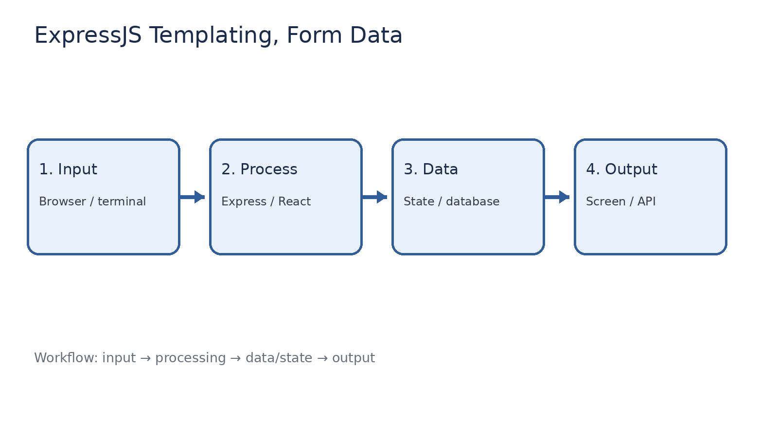
How it works
Input → processing → data/state → output

Slide 4
Code pathway 1
app.js • lines 1–10
1 const express = require('express');
2 const app = express();
3 const PORT = 3002;
4
5 app.set('view engine', 'ejs'); // Tell Express to use EJS templates.
6 app.use(express.urlencoded({ extended: true })); // Read form data.
7
8 app.get('/', (req, res) => {
9 res.render('index', { title: 'FSD2 Form', message: '' });
10 });

Slide 5
Code pathway 2
app.js • lines 11–19
11
12 app.post('/submit', (req, res) => {
13 // Values are received from the HTML form.
14 const name = req.body.name || 'Guest';
15 const course = req.body.course || 'Not selected';
16 res.render('index', { title: 'Form Result', message: `Hello ${name}. Course: ${course}` });
17 });
18
19 app.listen(PORT, () => console.log(`Server: http://localhost:${PORT}`));

Slide 6
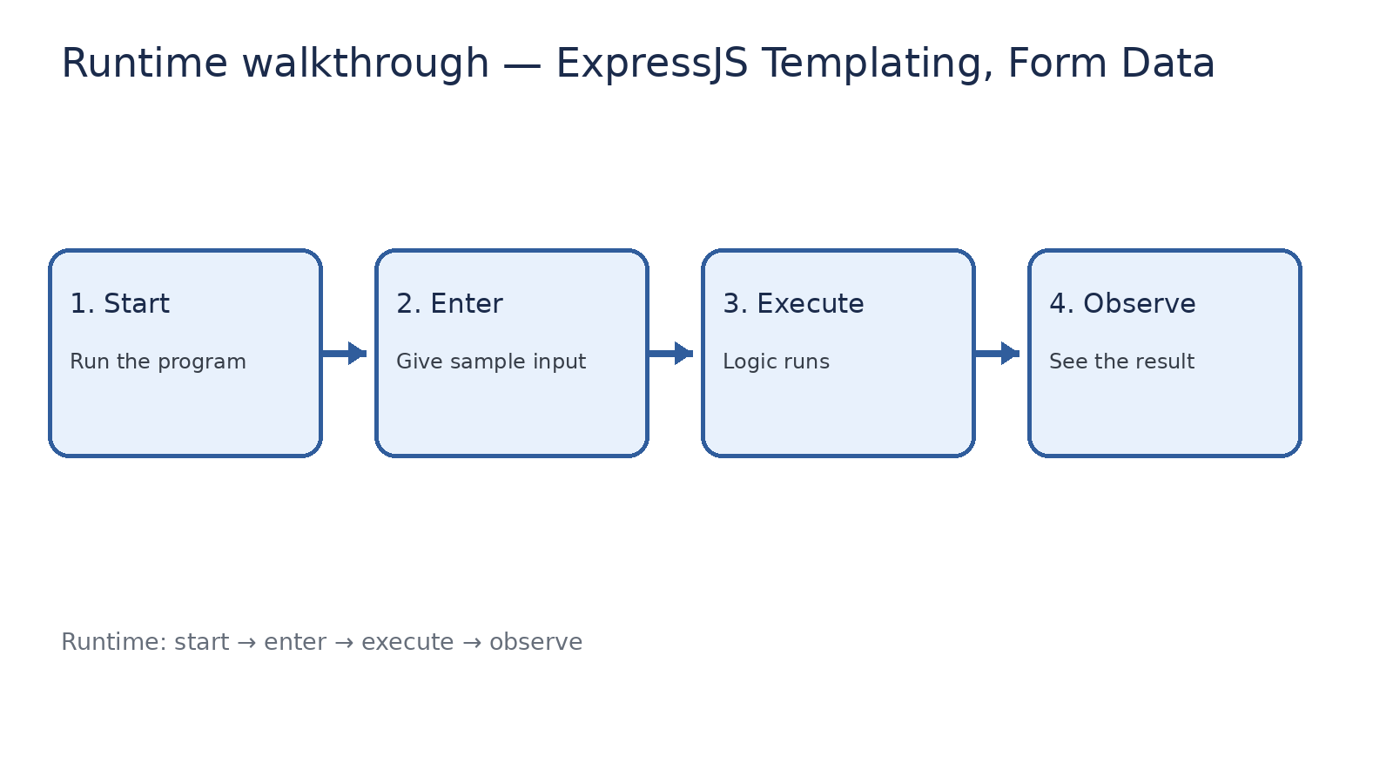
Runtime walkthrough
Start → enter input → execute → observe output

Slide 7
Expected result
ExpressJS Templating, Form Data
INPUT
PROCESS
OUTPUT
Enter the sample values or open the required page / route.
The Express route, React component, hook, or MongoDB command performs the task.
Check the browser, terminal, API response, or database result.
Verification checklist
•
No syntax errors appear in the terminal.
•
The requested feature responds to the input.
•
The displayed / returned value matches the operation.

Slide 8
Viva preparation
•
What is the purpose of this experiment?
•
Which input is required?
•
Which line or command performs the main operation?
•
What output should you observe?
•
What happens when the input changes?

