Slide 1
A
ARM
Akeepo Regulatory Manager
A role-based regulatory management platform — keeping companies synchronized with federal regulations, managing access, and ensuring the right people receive the right information.
Roles & Access
eCFR Sync
Notification Engine
Multi-Tenant
Azure Functions
Notes:
Welcome everyone. Today we'll walk through ARM — Argent Resource Management System — covering its roles, access model, and the key background functions that power it.

Slide 2
OVERVIEW
What is ARM?
ARM is a multi-tenant regulatory management platform built to help companies stay current with federal regulations while managing their users, workflows, and notifications in one place.
Role-Based Access Control — four distinct roles, each with carefully scoped permissions across the platform
The platform connects directly to the Electronic Code of Federal Regulations (eCFR), automatically syncing the latest regulatory data every 24 hours. When changes are detected, the right users are notified immediately through a reliable email delivery system.
Automated eCFR Sync — Azure Function fetches, compares, and updates regulatory records daily
Reliable Notification Engine — outbox pattern ensures no email is lost, with full retry and audit trail
4
24h
2m
User Roles
Sync Cycle
Email Check
Multi-Tenant Architecture — each company is an isolated tenant with its own data, users, and structure
Tailored Dashboards — every role sees a dashboard relevant to their scope and responsibilities
Notes:
ARM is a cloud-based regulatory management platform. At its core, it keeps companies synchronized with the latest federal regulations, manages user roles, and ensures the right people receive the right information at the right time.

Slide 3
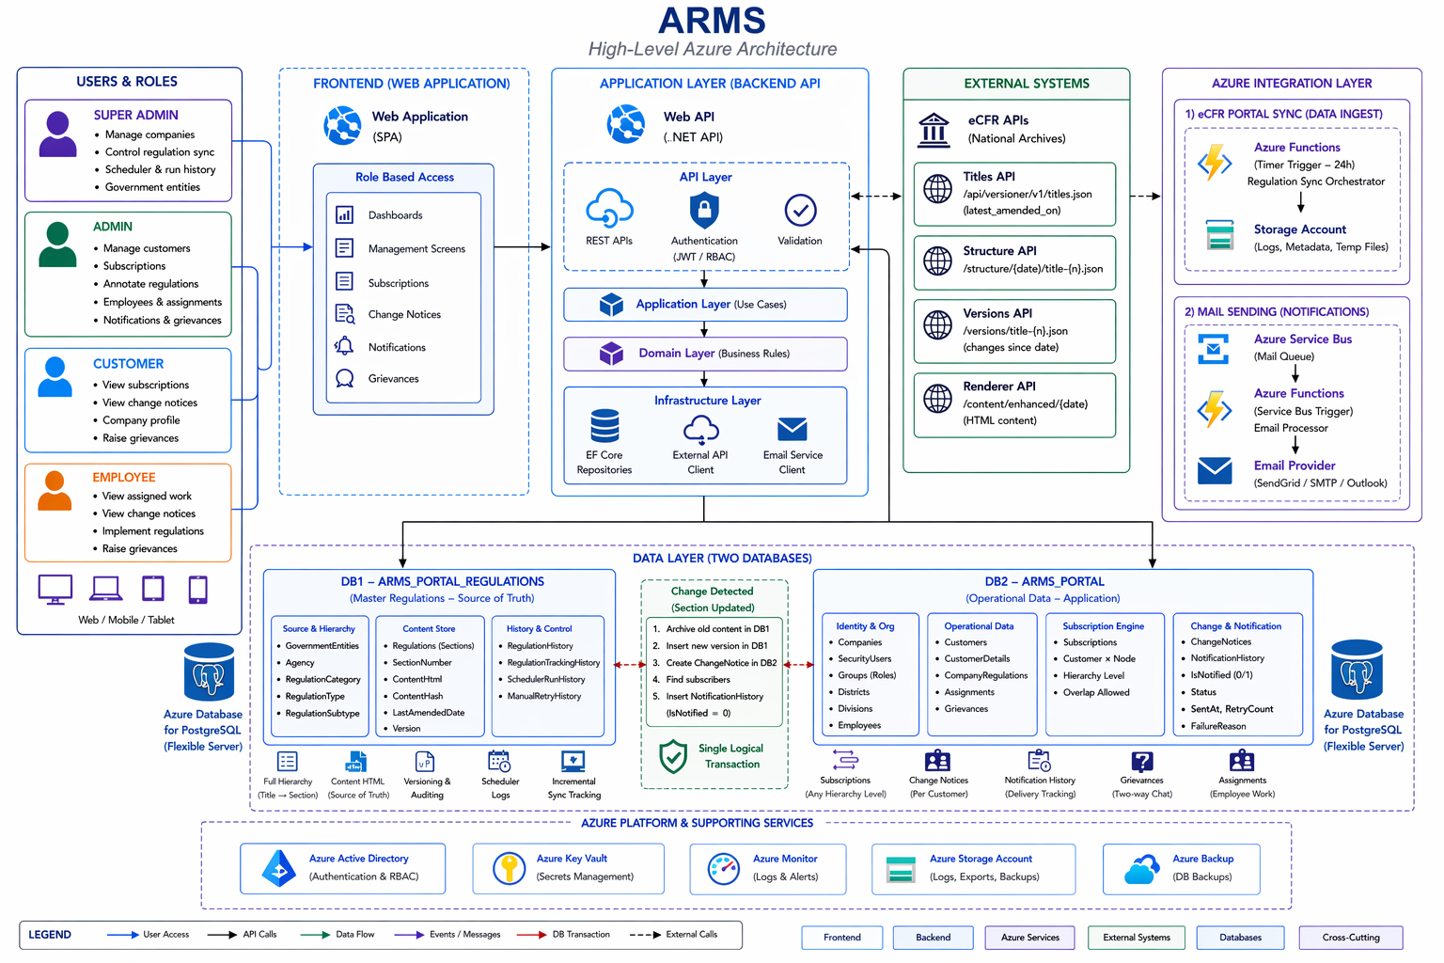
SYSTEM ARCHITECTURE
ARM – High-Level Azure Architecture
Notes:
The platform is built around four distinct roles. Each role has a carefully scoped set of permissions — from platform-wide control at the Super Admin level, down to task-focused access for Employees.

Slide 4
ACCESS MODEL
Four Roles, Defined Scope
🛡️
🏢
Super Admin
Admin
PLATFORM-WIDE
COMPANY-LEVEL
Manages the entire platform across all companies. Full visibility into all data, users, system configurations, and background processes. Not tied to any single company.
Represents a company owner or administrator. Manages everything within their own company — employees, customers, subscriptions, departments, divisions, and regulations.
All Companies
System Config
Global Users
Scheduler
Customers
Employees
Subscriptions
Org Structure
👤
⚙️
Customer
Employee
EXTERNAL USER
INTERNAL USER
An external user associated with a company. Interacts with subscribed regulatory content, receives change notices, and can raise grievances through the platform.
An internal user within a company. Works on assigned regulatory tasks, views regulatory updates relevant to their assignments, and interacts with company workflows.
Subscriptions
Change Notices
Grievances
Assignments
Regulations
Change Notices
Notes:
This matrix shows exactly which modules each role can access. Notice how access narrows as we move from Super Admin down to Customer and Employee — this is by design, ensuring data security and role clarity.

Slide 5
PERMISSIONS
Role × Feature Access
Feature
Super Admin
Admin
Customer
Employee
Dashboard
✓
✓
Limited
Limited
Companies
✓
—
—
—
Users / Groups
✓
Limited
—
—
Customers
—
✓
Self Only
—
Employees
—
✓
—
Self Only
Regulations
✓
✓
Subscribed
Assigned
Notifications
✓
✓
✓
✓
Grievances
✓
✓
✓
✓
Scheduler / Sync
✓
—
—
—
✓
Full Access
Limited
Scoped Access
—
No Access
Notes:
Each role sees a completely different dashboard tailored to their scope. Super Admin sees platform health across all companies. Admin sees their company operations. Customer sees subscriptions and notices. Employee sees their profile and assigned work.

Slide 6
DASHBOARDS
Each Role Sees a Different Dashboard
🛡️
Super Admin
🏢
Admin
👤
Customer
⚙️
Employee
Platform Overview
Company Overview
Personal Overview
Work Overview
12
348
84
26
👤
Account Info
⚙️
Employee Profile
Companies
Total Users
Customers
Employees
Profile & contact details
Dept · Division · District
5
✓
112
3
7
3
5
2
Grievances
Sync Status
Subscriptions
Grievances
Subscriptions
Change Notices
Assignments
Change Notices
Quick Access
Quick Access
Companies
Users
Customers
Regulations
Company: Argent Corp · Active
Groups
Notifications
Notes:
Super Admin operates at the platform level — managing all companies, users, and system configurations. Admin operates at the company level — handling everything from customers to organizational structure and regulatory subscriptions.

Slide 7
ROLE DEEP DIVE
Super Admin & Admin — Pages & Functions
🛡️
Super Admin
🏢
Admin
Platform-Wide Control
Company-Level Management
Dashboard
Dashboard
Platform metrics — total companies, users, grievance stats, system health
Company metrics — customers, employees, subscriptions, grievances
Companies
Customers
Create, update, activate/deactivate company tenants
Create, update, soft-delete and view customers within the company
Groups
Employees
Manage security groups, assign permissions and access levels
Manage employees, assign to departments, divisions, districts
Users
Org Structure
View and manage all Super Admins and Admins across the platform
Manage departments, divisions, and operational districts
Regulations
Subscriptions
View and manage all regulatory data across all companies
Manage regulatory subscriptions for customers
Sync & Scheduler
Regulations & Notices
Trigger regulation syncs and view background job history
Browse regulations and view regulatory change notices
Grievances
Notifications & Grievances
Monitor all grievances raised across every company
Manage system notifications and company grievances
Notes:
Customers interact primarily with their subscribed regulations and change notices. Employees focus on their assigned regulatory tasks. Both can raise grievances through the platform.

Slide 8
ROLE DEEP DIVE
Customer & Employee — Pages & Functions
👤
Customer
⚙️
Employee
External User
Internal User
Dashboard
Dashboard
Personal account info, subscription count, and received change notices
Employee profile, assigned work overview, and company details
Subscriptions
Regulatory Assignments
View and manage subscribed regulations and their details
View tasks and regulations specifically assigned to the employee
Change Notices
Change Notices
View updates and changes related to subscribed regulations
Regulatory updates relevant to assigned work and tasks
Regulations
Regulations
Browse regulations based on subscription access level
Browse regulations relevant to their assignments
Grievances
Grievances
Raise and track grievances through the platform
Raise and manage grievances through the platform
Notes:
Every 24 hours, an Azure Function reaches out to eCFR — the Electronic Code of Federal Regulations — fetches the latest data, compares it against what we have, and updates our records. If anything changed, it creates notification records for all affected subscribers automatically.

Slide 9
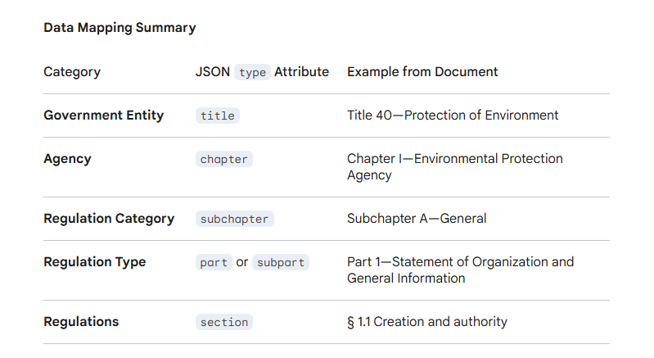

Slide 10

AZURE FUNCTION
eCFR Sync — Every 24 Hours
Runs every 24 hours automatically
Powered by Azure Timer Function
STEP 01
STEP 02
STEP 03
Trigger
Fetch from eCFR
Compare
Azure Timer Function fires on its 24-hour schedule, initiating the sync process
Pulls the latest regulatory data from the Electronic Code of Federal Regulations API
Fetched data is compared against existing records in the database to detect changes
STEP 04
STEP 05
Insert / Update
Create Notifications & Change Notices
New regulations are inserted; existing ones are updated to reflect the latest content
If changes are detected, notification records are created for all subscribed users and Change Notices are also inserted into the system automatically
Notes:
The notification system uses an outbox pattern — a proven approach for guaranteed delivery. Every notification gets queued in an Outbox table. A timer function runs every 2 minutes, picks up pending items, and dispatches emails. Every attempt — success or failure — is logged, with automatic retries. Nothing is lost.

Slide 11
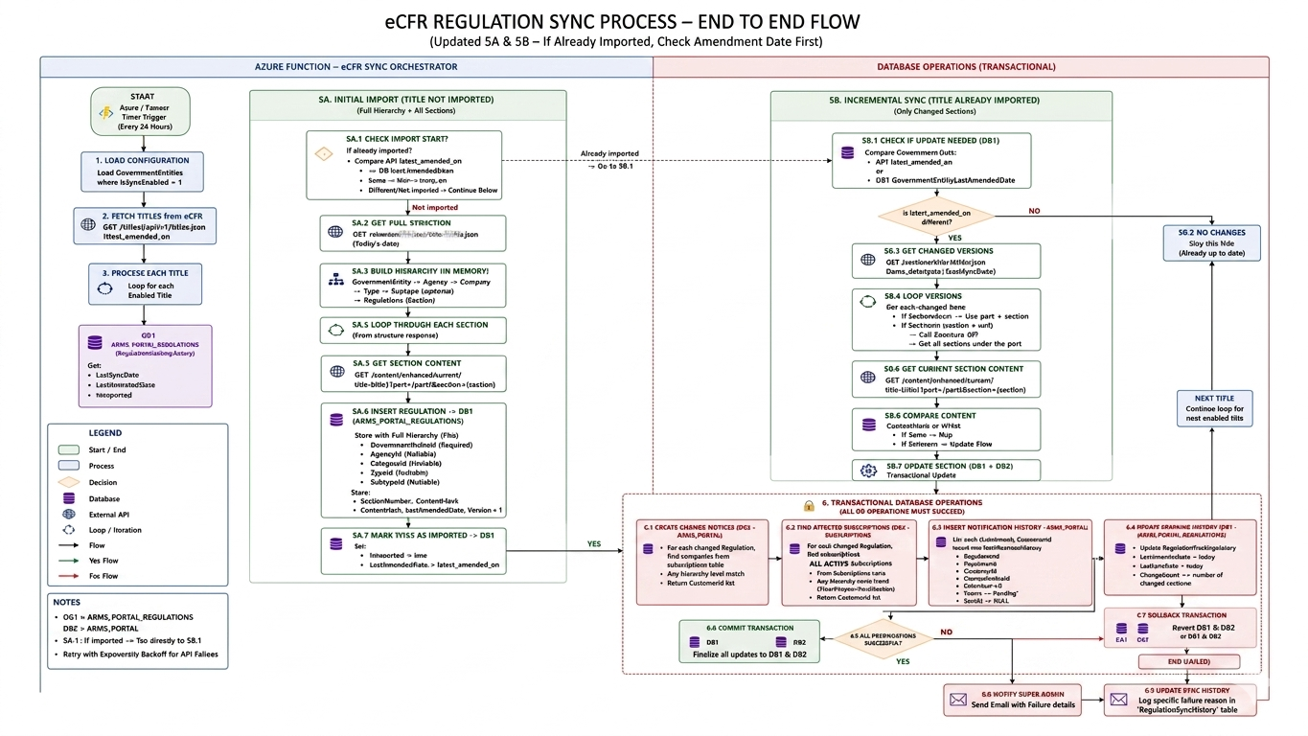
ECFR SYNC · END TO END FLOW
eCFR Regulation Sync Process

Slide 12
AZURE FUNCTION · OUTBOX PATTERN · SERVICE BUS
Notification Email Engine
1
Notification Created
4
Service Bus Triggered
A notification record is inserted into the Notification History table whenever a regulation change is detected
The Service Bus is triggered by the incoming message and dispatches it to the email service for processing
2
Outbox Entry Added
5
Email Sent
A corresponding record is added to the Outbox table — acting as a reliable queue for pending email messages
The email service attempts delivery. Each attempt — success or failure — is recorded in the Notification Sent History table
3
Timer Function → Service Bus
6
Retry on Failure
Azure Timer Function (every 2 min) polls the Outbox for pending records and publishes each message to the Azure Service Bus
If delivery fails, the system retries based on a configured retry count — every attempt logged for full traceability
7
Dead Letter Queue
If all retry attempts are exhausted and delivery still fails, the message is moved to the Dead Letter Queue for manual inspection and recovery
✓ No Lost Notifications
✓ Full Audit Trail
Outbox + Service Bus guarantee delivery
Every attempt logged with timestamp and outcome

Slide 13
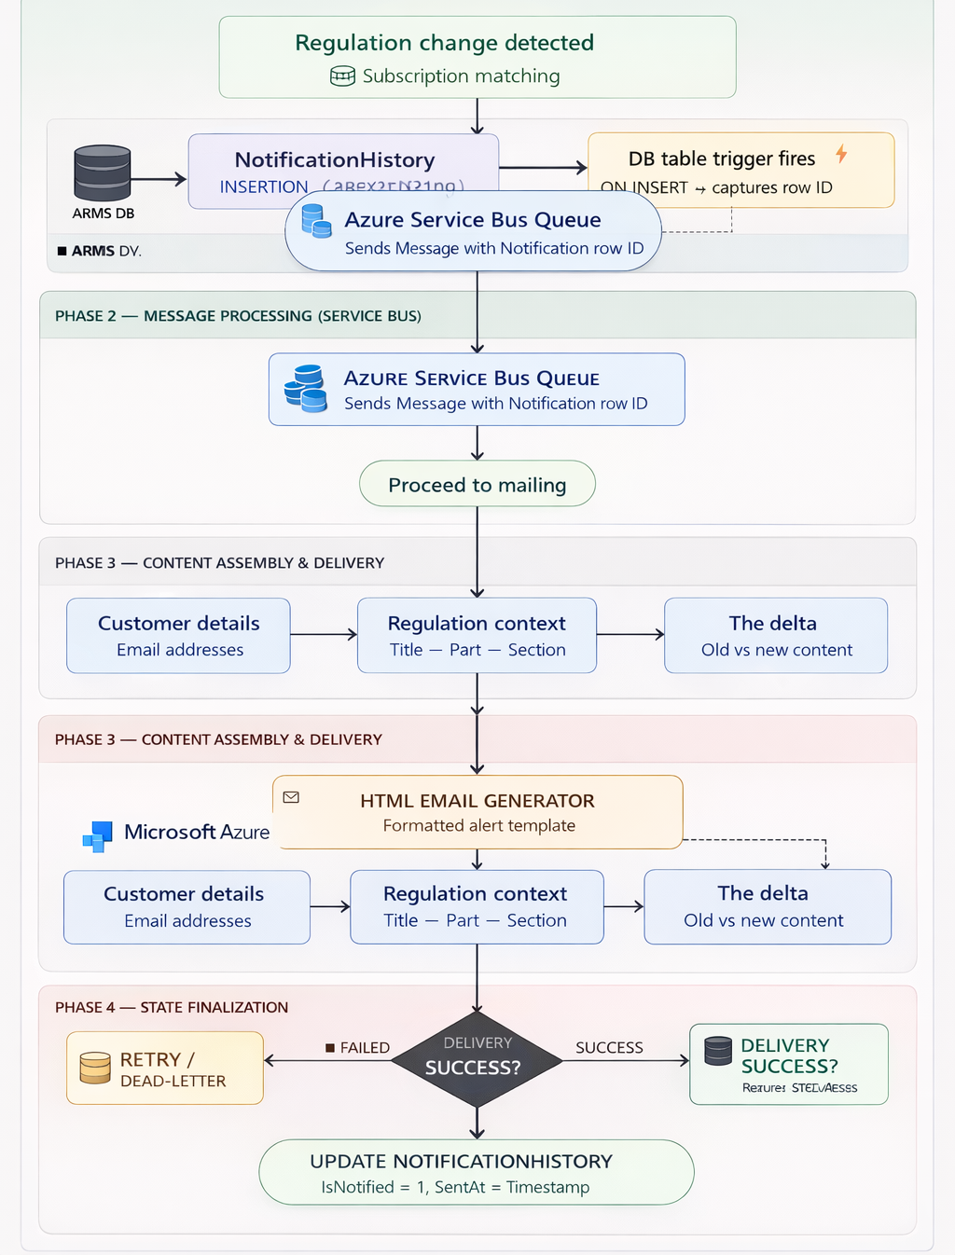
NOTIFICATION SYSTEM · ARCHITECTURE
Regulation Change Notification Overview

