Slide 1
SALES DATA OF THE CUSTOMERs
S.SHIVA SURYA PRAKASH
shivasuryaprakash@gmail.com
9123536083
Pga-20

Slide 2
Data description
This sales-data contains 5000 rows and 40 columns. The main aim is to identify potential customer segmentation and provide some meaningful insights from each segment.

Slide 3
ATTRIBUTE INFORMATION
1.Total Orders - Orders by this customer (Email on site)
2.Revenue - Total Revenue Inclusive Of Shipping
3.Average Order Value - Total Revenue / Count of Orders
4.Carriage Revenue - Total Value customer has spent on Shipping
5.First_Order_Date - Date Customer first ordered on site
6.Latest_Order_Date - Date Customer first ordered on site
7.AvgDaysBetween Orders Time between first and latest order divided by number of orders in days
8.Days Since Last Order - Date Difference between Today and when customers Latest_Order_Date
9.Monday_Orders - Orders Placed On a Monday
10.Tuesday _Orders - Orders Placed On a Tuesday

Slide 4
ATTRIBUTE INFORMATION
11.Wednesday_Orders - Orders Placed On a Wednesday
12.Thursday_Orders - Orders Placed On a Thursday
13.Friday_Orders - Orders Placed On a Friday
14.Saturday Orders - Orders Placed On a Saturday
15.Sunday Orders - Orders Placed On a Sunday
16.Monday Revenue - Revenue From Orders Placed On a Monday
17.Tuesday Revenue - Revenue From Orders Placed On a Tuesday
18.Wednesday Revenue - Revenue From Orders Placed On a Wednesday
19.Thursday Revenue - Revenue From Orders Placed On a Thursday
20.Friday Revenue - Revenue From Orders Placed On a Friday

Slide 5
ATTRIBUTE INFORMATION
21.Saturday Revenue - Revenue From Orders Placed On a Saturday
22.Sunday Revenue - Revenue From Orders Placed On a Sunday
23.WEEK1_DAY01_DAY07_ORDERS - Orders Placed In Week 1 of the Month Between Days 1 and 7
24.WEEK2_DAY08_DAY15_ORDERS - Orders Placed In Week 2 of the Month Between Days 8 and 15
25.WEEK3_DAY16_DAY23_ORDERS - Orders Placed In Week 3 of the Month Between Days 16 and 23
26.WEEK4_DAY24_DAY31_ORDERS - Orders Placed In Week 4 of the Month Between Days 24 and 31
27.WEEK1_DAY01_DAY07_REVENUE - Revenue From Orders Placed In Week 1 of the Month Between Days 1 and 7
28.WEEK2_DAY08_DAY15_REVENUE - Revenue From Orders Placed In Week 2 of the Month Between Days 8 and 15
29.WEEK3_DAY16_DAY23_REVENUE - Revenue From Orders Placed In Week 3 of the Month Between Days 16 and 23
30.WEEK4_DAY24_DAY31_REVENUE - Revenue From Orders Placed In Week 4 of the Month Between Days 24 and 31

Slide 6
ATTRIBUTE INFORMATION
31.TIME_0000_0600_ORDERS - Orders Placed Between the Hours of 0000 And O600
32.TIME_0601_1200_ORDERS - Orders Placed Between the Hours of 0601 And 1200
33.TIME_1200_1800_ORDERS - Orders Placed Between the Hours of 1200 And 1800
34.TIME_1801_2359_ORDERS - Orders Placed Between the Hours of 1801 And 2359
35.TIME_0000_0600_REVENUE - Revenue from Orders Placed Between the Hours of 0000 And O600
36.TIME_0601_1200_REVENUE - Revenue from Orders Placed Between the Hours of 0601 And 1200
37.TIME_1200_1800_REVENUE - Revenue from Orders Placed Between the Hours of 1201 And 1800
38.TIME_1801_2359_REVENUE - Revenue from Orders Placed Between the Hours of 1801 And 2359

Slide 7
procedure
Exploratory data analysis
Model building
Basic data check

Slide 8
Basic data check
Understanding the dataset
Describing the Categorical variable
Describing the Numerical Variable
Describing the data columns
Check the data types of variables
Checking the value counts of the dataset
Checking the shape of the data(Rows and Columns)

Slide 9
EXPLORATORY DATA ANALYSIS
Checking for the missing values
Analysing data by plotting the graph
Univariate Analysis
Multivariate Analysis

Slide 10
MODEL BUILDING
Building the PCA Model
Building the K-means clustering (using PCA dataset)
Building the K-means clustering (using Standardized data)
Building the Hierarchical clustering (using PCA dataset)
Building the Hierarchical Clustering (using Standardized data)

Slide 11
Steps
Checking the Size of the data
Checking the Rows and columns of the data
Viewing the column names in the data Frame
Checking the datatypes of the columns
Checking for the categorical and numerical variables
Checking for the missing value Analysis
Univariate Analysis

Slide 12
steps
Converting the First Order Date from object datatype to datetime datatype
Extracting the year from First Order Date
Extracting the Month from First Order Date
Extracting the day from First Order Date
Converting the Latest Order Date from object datatype to datetime datatype
Extracting the year from Latest Order Date
Extracting the Month from Latest Order Date
Extracting the day from First Latest Date

Slide 13
Steps
Plotting the univariate Analysis using
Countplot
Distributionplot
Histogram
Concatenating week Revenue from Monday Revenue to Sunday Revenue
Concatenating week Order from Monday Order to Sunday Order
Concatenating the Month order from WEEK1_DAY01_DAY07_order to WEEK4_DAY24_DAY31_order

Slide 14
steps
Concatenating the Month Revenue from WEEK1_DAY01_DAY07_REVENUE to WEEK4_DAY24_DAY31_REVENUE
Multi Variate Analysis using the Boxplot , heatmap and pairplot
Here we don’t do Outlier analysis because the outliers itself may become the one cluster
Dropping the columns like 'Customer ID','WEEK_ORDERS','WEEK_REVENUE', 'MONTHLY_ORDERS', 'MONTH_REVENUE', 'DAY_ORDER', 'DAY_REVENUE'

Slide 15
Steps
We are doing the feature Scaling
We are doing the standardization because ,we have the outlier in the column of data set. If there is no outliers we have to choose the normalization instead of standardization

Slide 16
Principal component analysis (PCA)
Principal component analysis (PCA) is a technique for reducing the dimensionality of such datasets, increasing interpretability but at the same time minimizing information loss. It does so by creating new uncorrelated variables that successively maximize variance
Generating the Covariance Matrix
PCA aims to minimize the distortions and to summarize the essential information in the data. These distortions (noise, redundancy, etc.) reflect in the off-diagonal values of the covariance matrix

Slide 17
PCA
use 'eig' function to compute eigenvalues and eigenvectors of the covariance matrix
Eigenvalues: The diagonal values of the diagonalized covariance matrix are called eigenvalues of the covariance matrix. Large eigenvalues correspond to large variances
Eigenvectors: The eigenvectors give directions of the new rotated axes
There are two ways to decide the number of principal components 1) eigenvalue-one criteria: Select the components that have eigenvalues greater than 1 2) Choose the number of components before the elbow point of the scree plot

Slide 18
pca
By this graph we can decide ,how many PCA columns to extract from the dataset by using the elbow method
Generate a new dataset of reduced dimensions by multiplying standardize data and set of eigenvectors
take the dot product of ‘df std' with 'eigenvector' to obtain new dataset
create a data frame of principal components
It consists of the 5 extracted features from the 40 features

Slide 19
K-means clustering(pca df)
Centroid-based clustering algorithms cluster the data into non-hierarchical clusters. Such algorithms are efficient but sensitive to initial conditions and outliers. K-means is the most widely-used centroid-based clustering algorithm
Building the k-means Model
Fitting the model with the PCA df
Checking the Unique values in the cluster
Adding the Cluster column in the PCA dataset

Slide 20
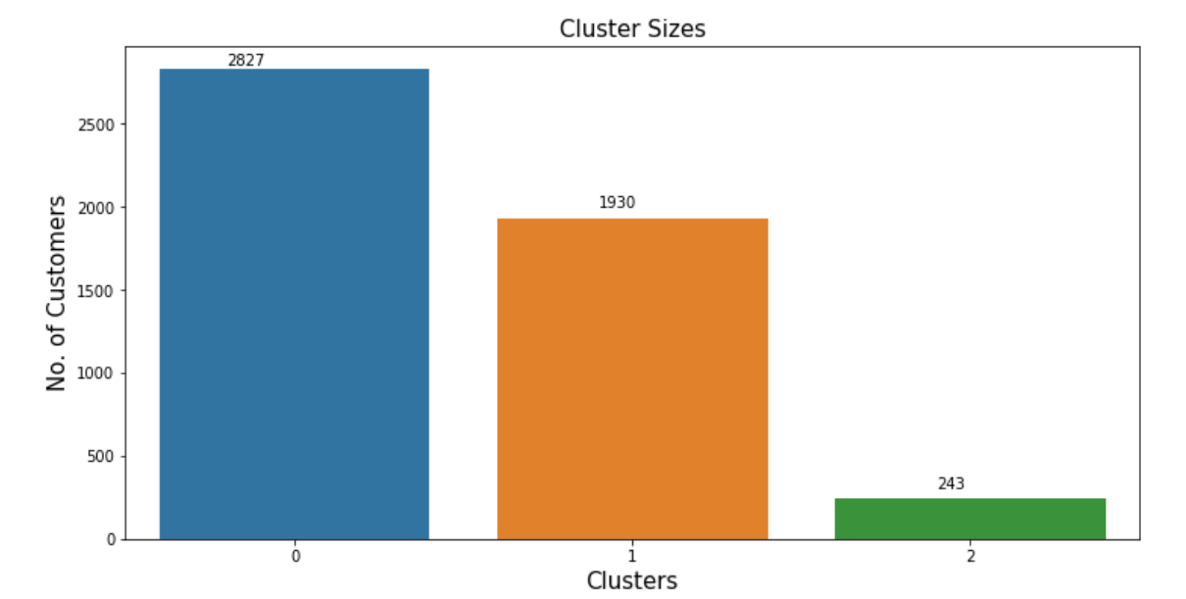
Size of the cluster

Slide 21
K-means(PCA-df)
'cluster-centers_' returns the co-ordinates of a cluster center
Renaming the column name
BY DESCRIBING THE EACH CLUSTER.. WE CAN DIFFERENTIATE WHICH CUSTOMER(0:"NEED_ATTENTION",1:"POTENTIAL_CUSTOMERS",2:"CHAMPIONS")BELONGS WHICH CLUSTER
NEED_ATTENTION Consists of 2027 customers
POTENTIAL CUSTOMERS Consists of 1930 customers
CHAMPIONS Consists of 243 Customers

Slide 22
K-Means Clustering using Standardized data
Building the k-means Model
Fitting the model with the Standardized data
Checking the Unique values in the cluster
Adding the Cluster column in the Standardized data
Viewing the number observation in each cluster

Slide 23
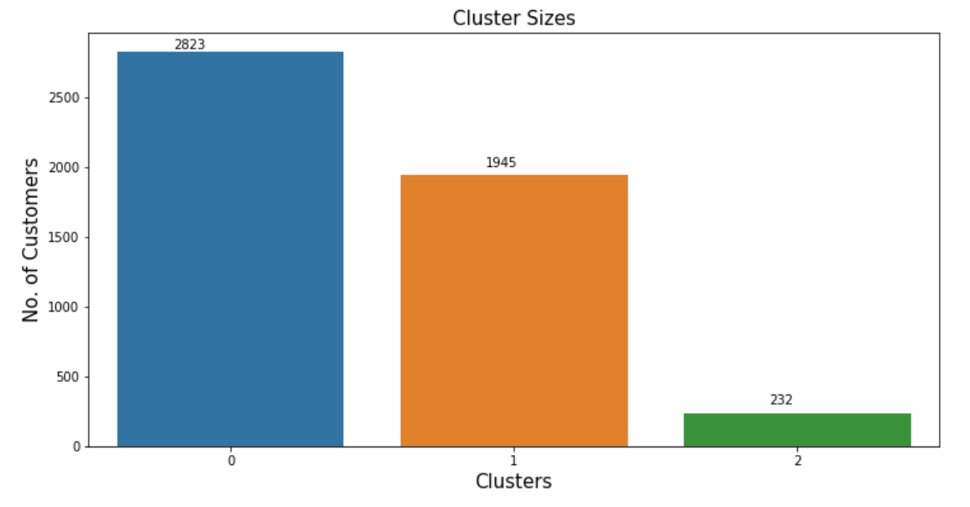
Viewing the K-MEans(std-data) cluster size

Slide 24
K-Means Clustering using Standardized data
'cluster-centers_' returns the co-ordinates of a cluster center
Renaming the column name
BY DESCRIBING THE EACH CLUSTER.. WE CAN DIFFERENTIATE WHICH CUSTOMER(0:"NEED_ATTENTION",1:"POTENTIAL_CUSTOMERS",2:"CHAMPIONS")BELONGS WHICH CLUSTER
NEED_ATTENTION Consists of 2023 customers
POTENTIAL CUSTOMERS Consists of 1945 customers
CHAMPIONS Consists of 232 Customers

Slide 25
Hierarchical Clustering using standardized data
Hierarchical clustering, also known as hierarchical cluster analysis, is an algorithm that groups similar objects into groups called clusters. The endpoint is a set of clusters, where each cluster is distinct from each other cluster, and the objects within each cluster are broadly similar to each other.
Creating an Agglomerative Clustering
Fitting the Standard data
create a column named "Cluster" and put the cluster labels in the standardized data
Extracting the Cluster 0,1 and 2 in the Standard data frame

Slide 26
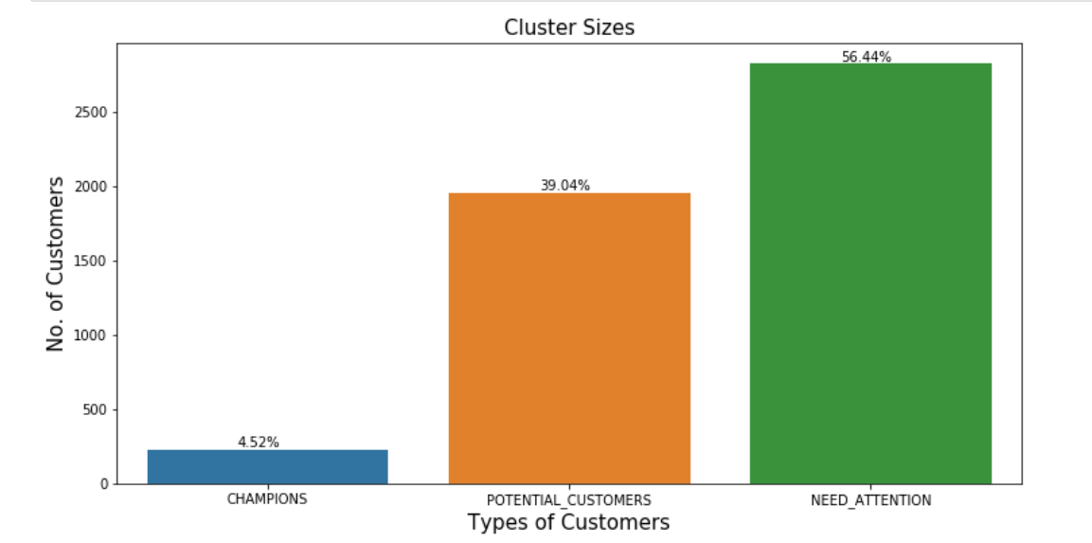
VISUALIZING THE SIZE OF CLUSTER(CUSTOMER)

Slide 27
Hierarchical Clustering using standardized data
Renaming the column name
BY DESCRIBING THE EACH CLUSTER.. WE CAN DIFFERENTIATE WHICH CUSTOMER(0:"NEED_ATTENTION",1:"POTENTIAL_CUSTOMERS",2:"CHAMPIONS")BELONGS WHICH CLUSTER
NEED_ATTENTION Consists of 2822 customers
POTENTIAL CUSTOMERS Consists of 1952 customers
CHAMPIONS Consists of 226 Customers

Slide 28
Hierarchical Clustering using PCA-df
Creating an Agglomerative Clustering
Fitting the PCA data
create a column named "Cluster" and put the cluster labels in the standardized data
Extracting the Cluster 0,1 and 2 in the Standard data frame

Slide 29
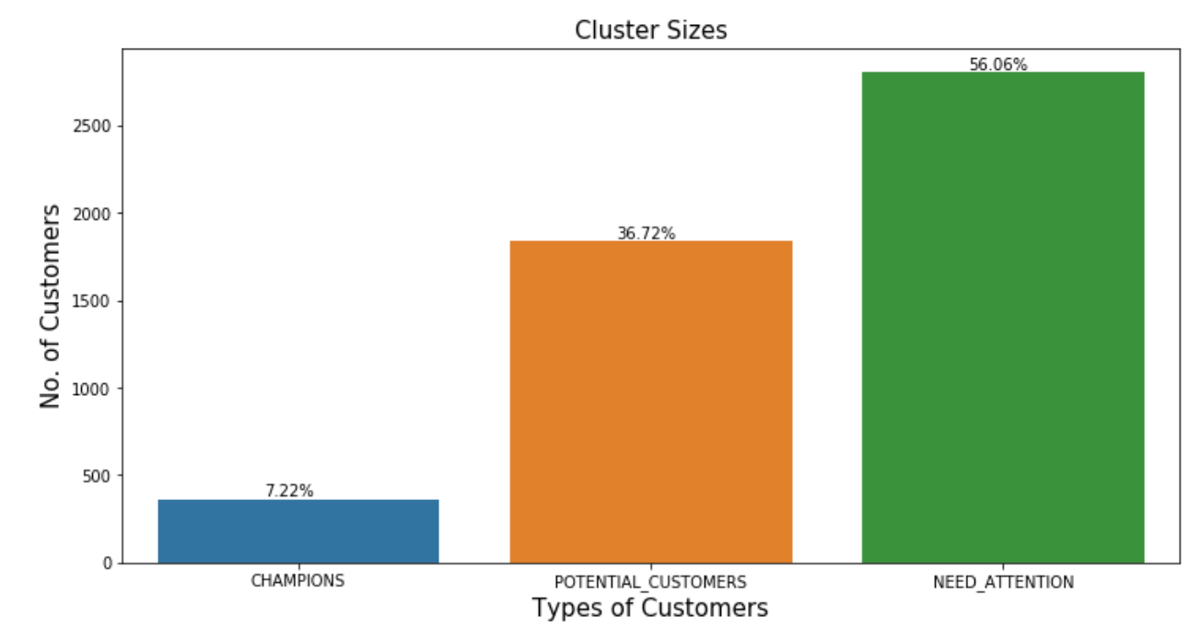
VISUALIZING THE SIZE OF CLUSTER(CUSTOMER)

Slide 30
Hierarchical Clustering using PCA data
Renaming the column name
BY DESCRIBING THE EACH CLUSTER.. WE CAN DIFFERENTIATE WHICH CUSTOMER(0:"NEED_ATTENTION",1:"POTENTIAL_CUSTOMERS",2:"CHAMPIONS")BELONGS WHICH CLUSTER
NEED_ATTENTION Consists of 2803 customers
POTENTIAL CUSTOMERS Consists of 1836 customers
CHAMPIONS Consists of 361 Customers

Slide 31
Data ANalysis
Before Clustering we have to convert all the object into numerical data
So we convert the object into date format , and then we extract the year ,month and day
Orders, Revenues plays the major role for separating the clusters
I have chosen PCA because we don’t know which feature is important and which is not
PCA converted all the 40 features into 5 features

Slide 32
Result
Model building using the K-means and Hierarchical clustering almost produces the same results
But K means clustering produces the best result compare to the hierarchical clustering
PCA(principal component Analysis) is used for the feature extraction technique(To reduce the number of the features in the data set, which produces the better result)
There is no Noticeable difference in this data set each produces the partially same results
But K means clustering with PCA extracted features produces the best result

