Slide 1
Loan Default Analysis Assignment
Team: Shankar Anand Nagalingam, Priyanshu Jain

Slide 2
Loan Default Analysis: Case Study
Problem Statement:
Any finance company specializing in lending various types of loans to customers. Two types of risks are associated with the decision to approve or reject the loan:
Applicant likely to repay
Refusal of loan
Loss of Business
Applicant not likely to repay
Approval of loan
Financial Loss
Objective:
Use the data provided to identify driving factors (or driver variables) behind loan default, so that the company can utilise this knowledge for its portfolio and risk assessment.

Slide 3
Data Cleaning
Dropped Columns with High Missing Data: Columns that had more than 50% missing data were removed to ensure data quality and integrity.
Removed Irrelevant Customer Behavior Variables: Variables like last_pymnt_amnt, last_pymnt_d, etc, were removed as they don't impact the loan status decision-making, which should occur before granting a loan.
Dropped Columns with Single Unique Value: Columns that contained only one unique entry throughout were dropped because they offer no variability for analysis.
Removed Redundant or Irrelevant Columns: Any columns that were duplicates or irrelevant to the goal of predicting loan defaults were removed. For example, columns that were duplicates or represented in other columns differently.
Manipulated Specific Columns: Columns like term, int_rate, and revol_util, were manipulated to extract relevant numerical values from their string-based formats.
Removed ‘Current’ Loan Status Rows: We deleted all rows where loan_status = 'Current' because we aim to predict loan defaults, and such rows don’t provide relevant historical data.
Loan Status Encoding: We encoded the loan statuses as follows:
Charged-off → False (Defaulted)
Fully Paid → True (Non-defaulted)
Outlier Treatment:
Outlier Correction for Continuous Variables: We handled outliers by removing any data points that were more than 1.5 times the interquartile range (IQR) from the median, ensuring that extreme values do not skew the results.

Slide 4
Dataset Overview
- Data Period: 2007–2011
- Number of Rows: ~40,000
- Number of Columns: ~50
- Key Attributes: Loan Amount, Loan Grade, Annual Income, etc.

Slide 5
Missing Data Summary
Columns with significant missing values were dropped or imputed.
Examples: 'mths_since_last_major_derog', 'next_pymnt_d'
Remaining columns cleaned for further analysis.

Slide 6
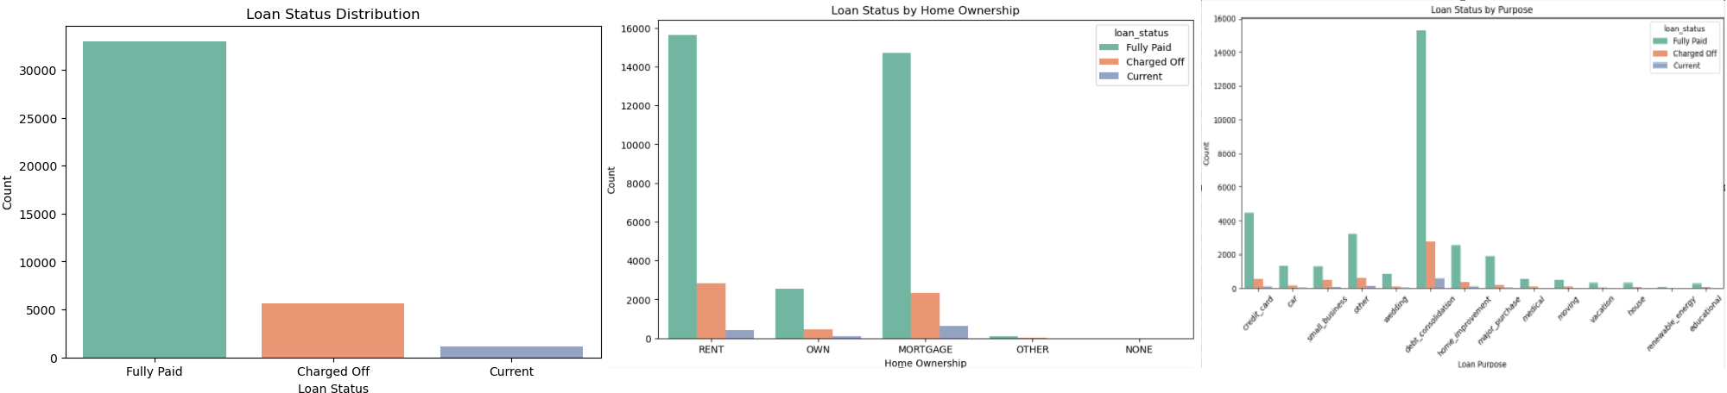
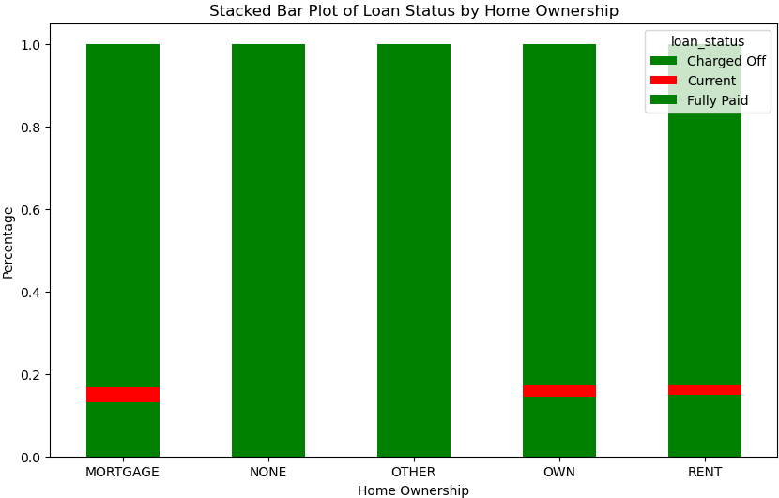
Observations from Categorical Variable Analysis

Slide 7
Conclusions from Categorical Variable Analysis
Purpose of Loan:
Small businesses are particularly risky, therefore loans for small businesses should be carefully evaluated and possibly sanctioned with caution. Given the higher likelihood of charge-offs in this category, approving small business loans requires more stringent checks and a higher interest rate to compensate for the risk.Debt consolidation loans are more common and have a relatively lower default rate. Since they often represent individuals trying to restructure their financial situation, these loans may be less risky and are typically more reliable, but it’s important to consider the overall financial health of the borrower.
Loan Status and Other Categories: Other categorical variables like home ownership and loan purpose can provide insight into the borrower's likelihood of default. For example, individuals with home ownership may have a lower likelihood of default as they possess more assets to back up their loan.

Slide 8
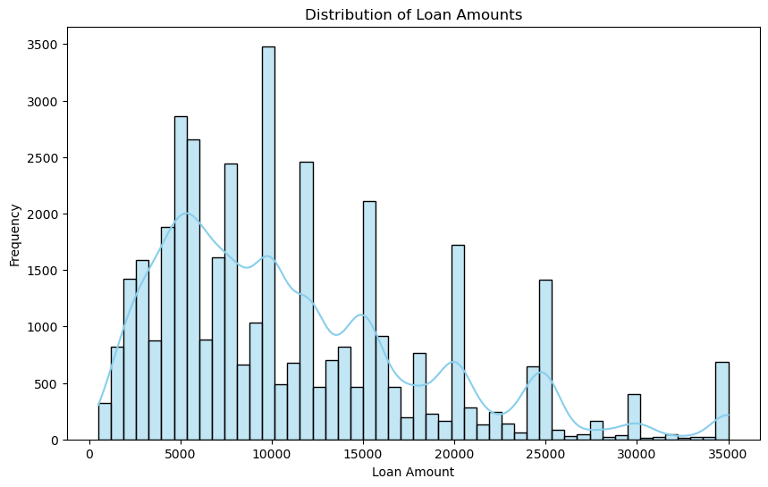
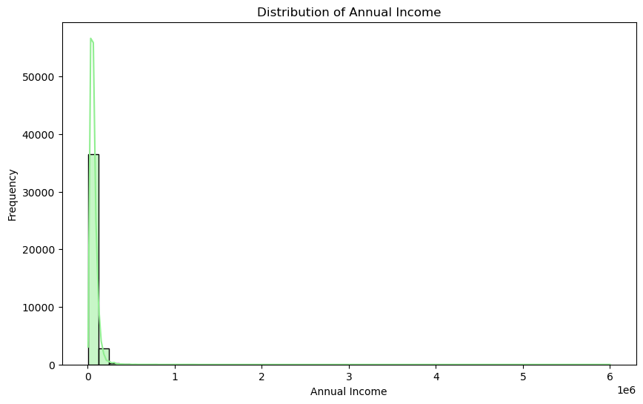
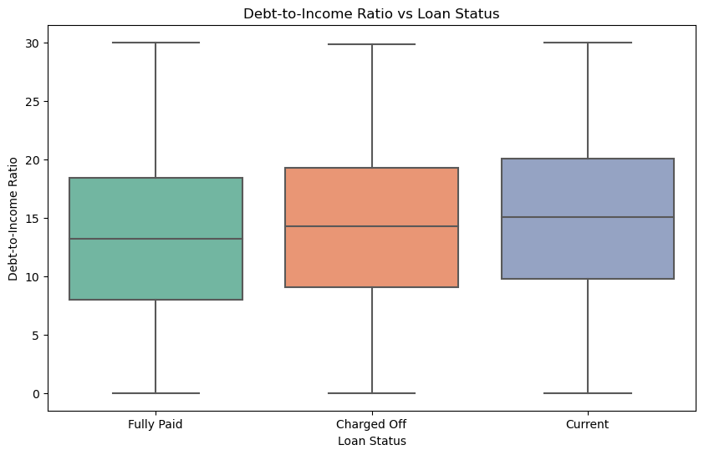
Univariate Analysis
Most loans are in the $5,000–$15,000 range.
Grade A loans are the most frequent, followed by B and C.
Higher debt-to-income (DTI) ratios show potential risks.

Slide 9
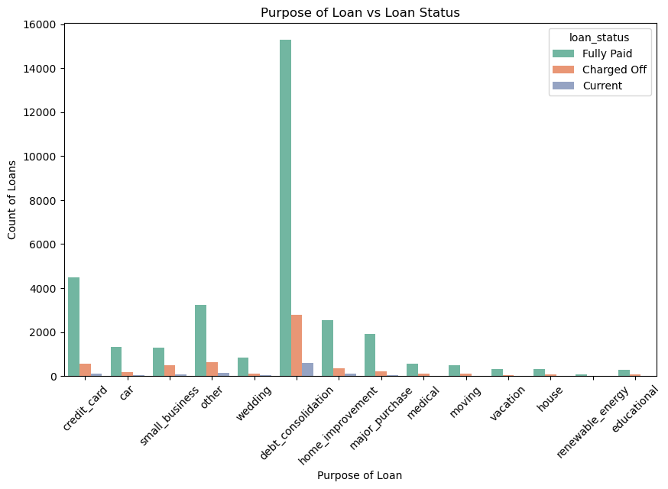
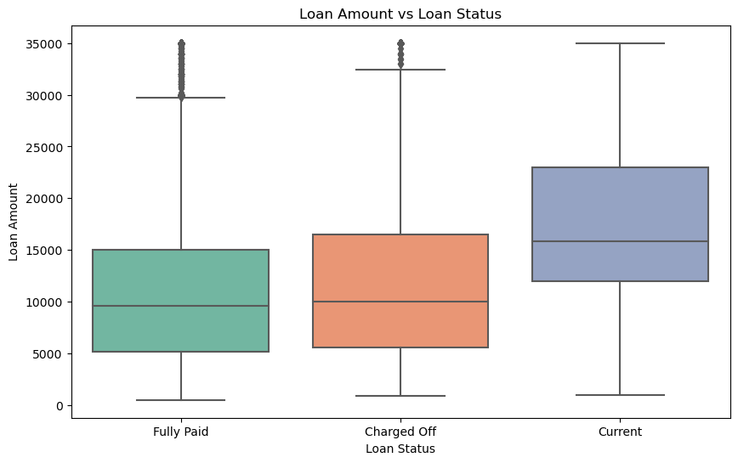
Bivariate Analysis
Loan Grade vs Default Rate: Grades E, F, G have higher defaults.
DTI vs Default Rate: Higher DTIs correlate with more defaults.
Employment Length vs Default: Lower employment stability increases risk.

Slide 10
Conclusions from Bivariate Analysis
Credit Score vs Loan Status:
A strong relationship is observed between credit score and loan status. Low credit scores tend to correspond with a higher chance of default. Borrowers with higher credit scores are less likely to default.
Loan Amount vs Loan Status:
Larger loan amounts are associated with a higher risk of default. It's important for the company to carefully evaluate loan amounts in relation to the applicant's financial health.
Interest Rate vs Loan Status:
Higher interest rates appear to be more common among defaulted loans. However, this relationship is not as strong as the others, suggesting that interest rate alone may not be a sufficient indicator of risk.
Purpose of Loan vs Loan Status:
Loans for small businesses are associated with a higher risk of default compared to loans for debt consolidation. This implies that small business loans should be more carefully scrutinized during the approval process

Slide 11
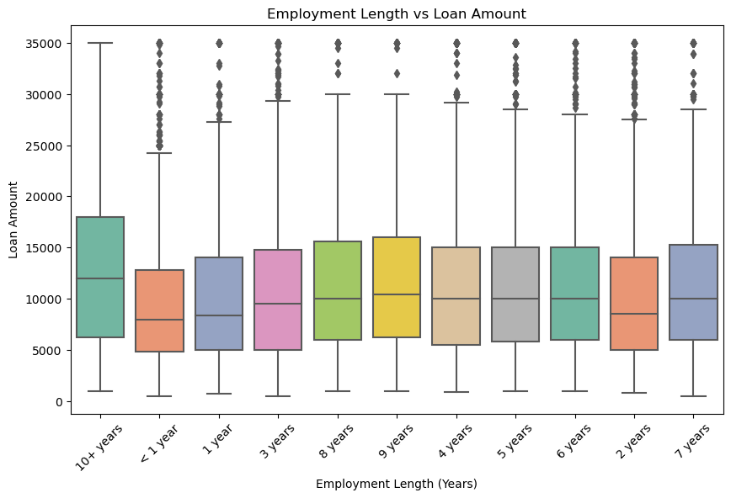
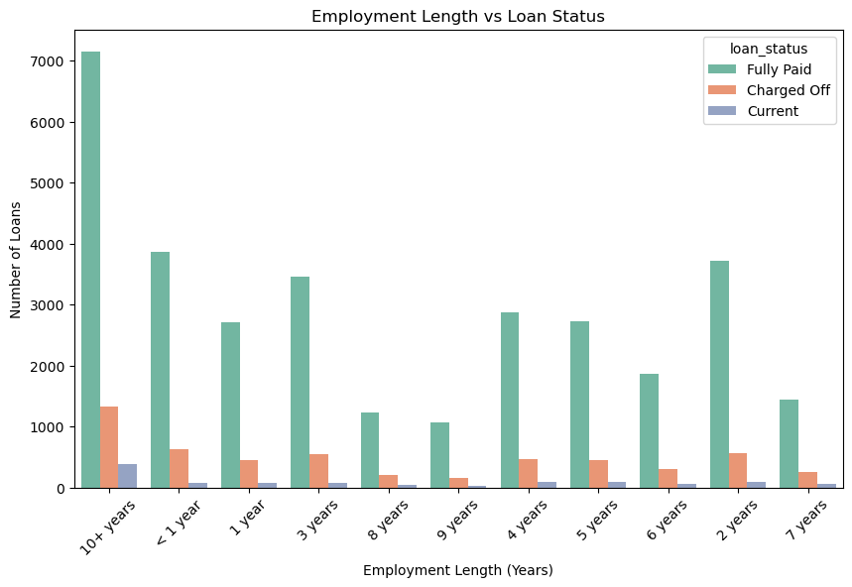
Employment Length Analysis
Applicants with less than 1 year of employment show higher defaults.
Stable employment (5+ years) reduces default risk significantly.

Slide 12
Conclusions from Employment Length Analysis
Short Employment Lengths:
Borrowers with shorter employment lengths (less than 3 years) are more likely to default on loans. This could indicate financial instability, which makes it harder for them to repay loans. These individuals may represent higher risk in terms of loan defaults, and extra scrutiny might be needed when approving loans for this group.
Long Employment Lengths:
Borrowers with longer employment histories are less likely to default on loans. This group typically has a more stable income and better financial security.Longer employment length is positively associated with full loan repayment, suggesting that it is a good indicator of financial reliability.
Loan Approval Strategy: For individuals with shorter employment histories, additional evaluation (such as analyzing their credit score, income stability, etc.) may be necessary before sanctioning loans. Individuals with longer employment histories may be more trustworthy and financially stable, making them better candidates for loan approval

Slide 13
Conclusions of Multivariate Analysis
Credit Score & Loan Amount: A positive relationship between credit score and loan amount is expected. However, loan status shows that high-risk borrowers tend to request larger loans, even with lower credit scores. Debt-to-Income (DTI) Ratio: A higher DTI ratio suggests that borrowers are spending a large portion of their income on debt repayment, which increases the likelihood of default.
Annual Income: Higher annual income often correlates with larger loan amounts and a reduced likelihood of default. However, it must be considered in conjunction with other factors, such as credit score and employment length.
Employment Length: Longer employment lengths are associated with better financial stability and a lower likelihood of loan default. Lenders should prioritize applicants with longer, stable employment histories when assessing loan risk.
Multivariate Relationships: Multiple variables, when combined, give a better understanding of default risk. For instance, a borrower with a high credit score, long employment length, and low DTI ratio is likely to be a low-risk borrower

Slide 14
Key Insights
Credit Score: A lower credit score is one of the strongest indicators of a higher likelihood of loan default.
Loan Amount: Larger loan amounts increase the likelihood of default, especially when income does not support the repayment.
Employment Length: Shorter employment history is associated with higher default risk due to financial instability.
Debt-to-Income Ratio: High DTI ratios indicate financial strain and are a strong predictor of loan default.
Loan Purpose: Debt consolidation and business loans are higher risk compared to other purposes like home improvement or education.
Interest Rate: Higher interest rates, often associated with higher-risk loans, can increase the likelihood of default.
Annual Income: Higher income generally reduces default risk but must be considered relative to the loan amount.
By understanding these key drivers of loan default, lenders can better assess the risk of lending to a borrower and make more informed decisions when processing loan applications. Identifying high-risk borrowers early in the loan process allows lenders to take proactive measures, such as offering more suitable loan terms or denying loans to high-risk applicants.

Slide 15
Recommendations
Focus on loan applicants with:
High debt-to-income ratios.
Low employment stability (less than 1 year).
Grades E, F, G loans.
Implement stricter credit checks and offer:
Reduced loan amounts for high-risk applicants.
Higher interest rates to offset risk.
Explore predictive modeling for automated risk assessment.

