Slide 1
Analysis of Google Play store dataset using Big data and performing sentimental analysis for the Hotel reviews
Big Data Final Project – Group 30
Submitted By
Pavan Sai Pottimuthi
Shirish kumar
Shiva Kumar Peddapuram

Slide 2
Contents
S.No | Topic Name | Page.No
1 | Introduction
2 | Problem Statement
3

Slide 3
Introduction:

Slide 4
Data attributes for google play store
App Name,
Category,
Ratings,
Reviews,
Installs,
Size,
Price,
Content Rating,
Last updated,
Minimum version,
Latest Version.

Slide 5
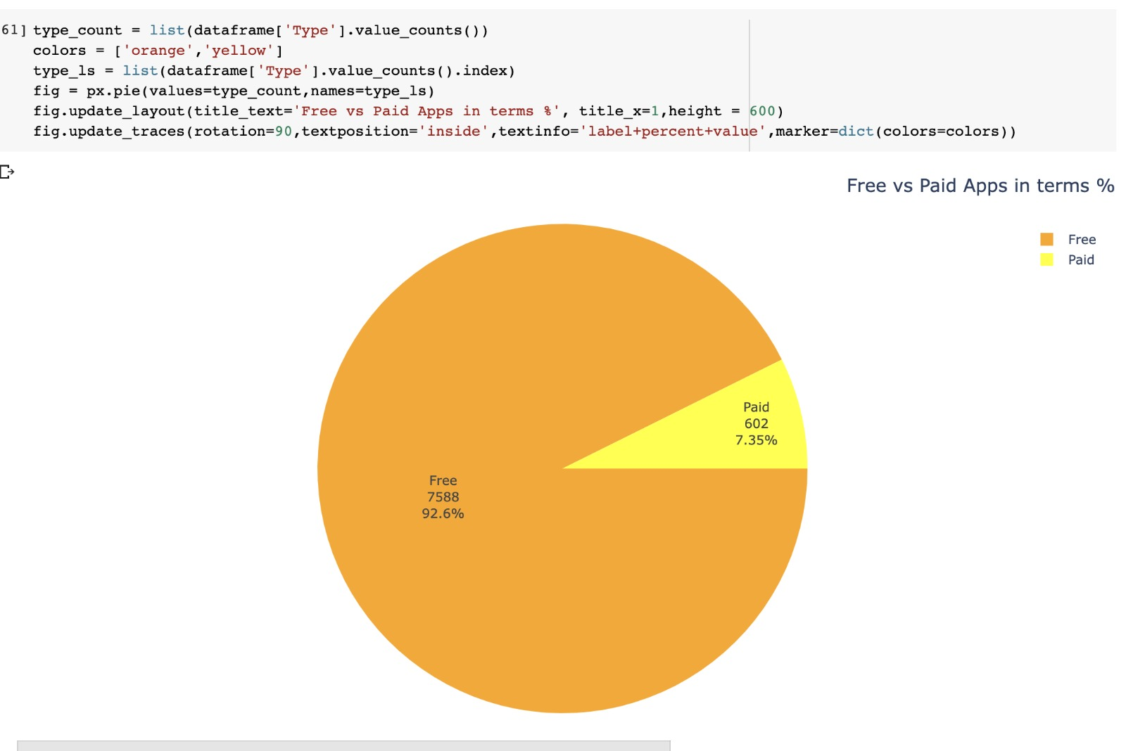
Visualizations for the Google Play store dataset
Notes:
From the above visualisation we can understand that apps with free access are downloaded a lot that is 7588 people has downloaded free versions of application whereas paid versions of application are downloaded over 603 that means it is around 7.35 percentage of the whole data available
Conclusion: from the above visualisation we can conclude that most of the people are giving preference for the free version of the applications.

Slide 6
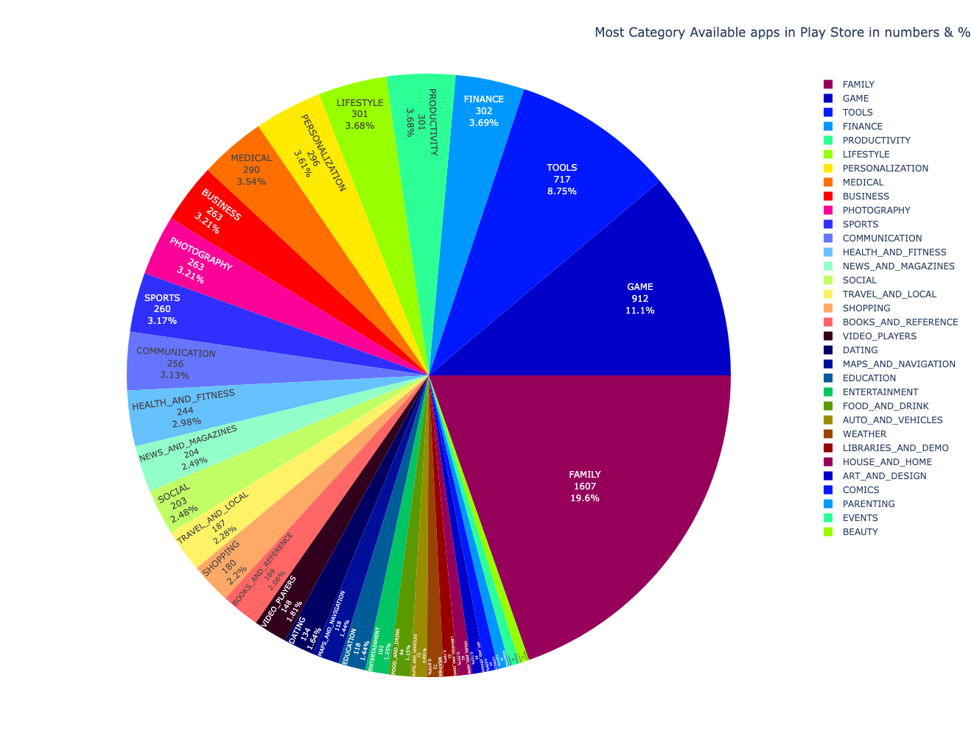
Mst category available apps in play store in numbers and in %
Notes:
In the above visualisation most category available apps are family based category with app count of 1607 second highest is with Game category with a app-count of 912 , and the least is with beauty related apps with a count of 42

Slide 7
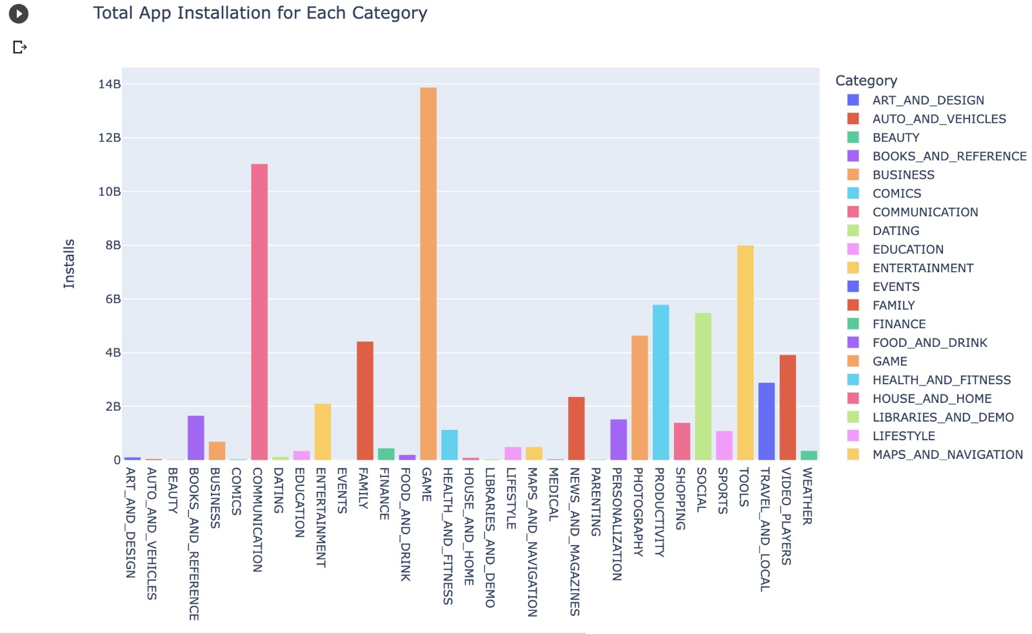
Total App installation for each category

Slide 8
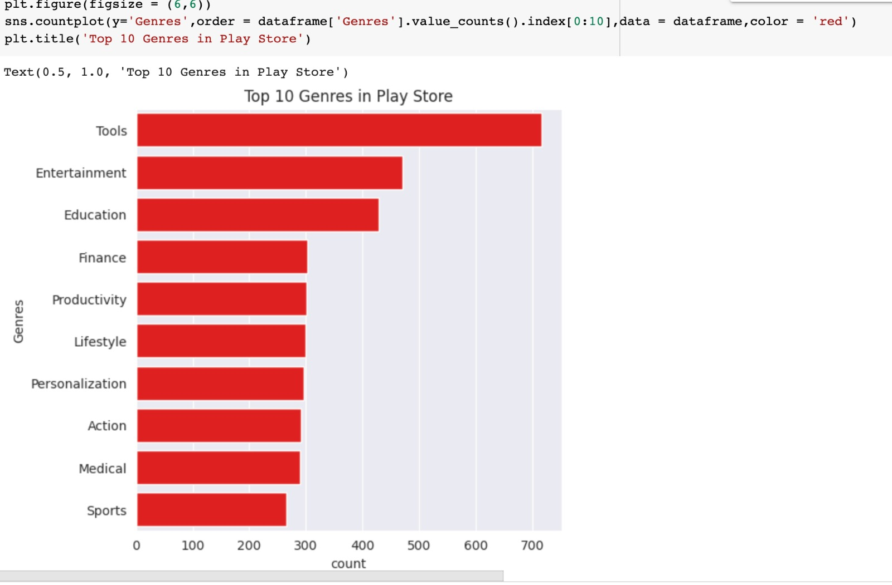
Highest number of genres in Playstore
Notes:
From the above visualisation we can observe that the highest number of application are with the Tools Genre. And the second highest is with Entertainment then follows education, finance, Productivity, lifestyle, Personalization and the last 3 genres are action medical sports with a count nearer to 300
So we can observe that tools genre has more than 700 application count
So, by this we can also come to know that a software developer can focus a lot on “Tools” side of genre so that they can get lot of downloads.

Slide 9
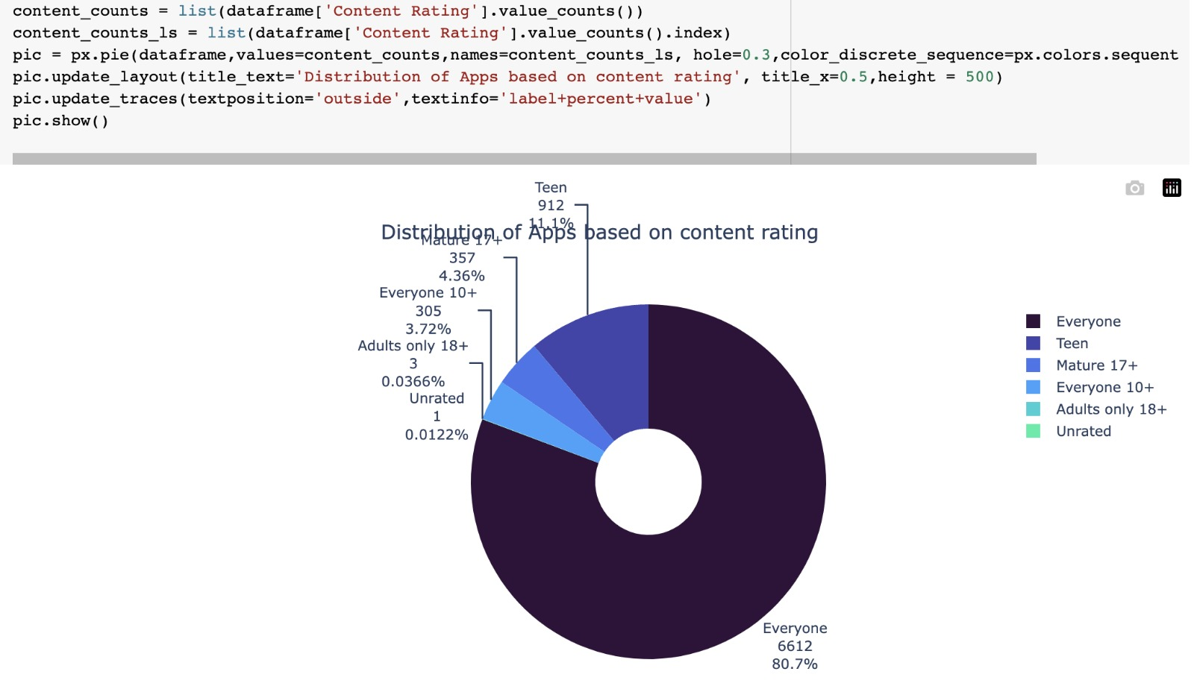
Distribution of apps based on rating
Notes:
From the above visualisation we can observe the distribution of apps based on rating and 6612 applications ca be used by everyone, apps related to teen are 912, 17+ is 357, everyone above 10+ years is 305, adults only 18+ are 3 apps and unrated is 1 app,

Slide 10
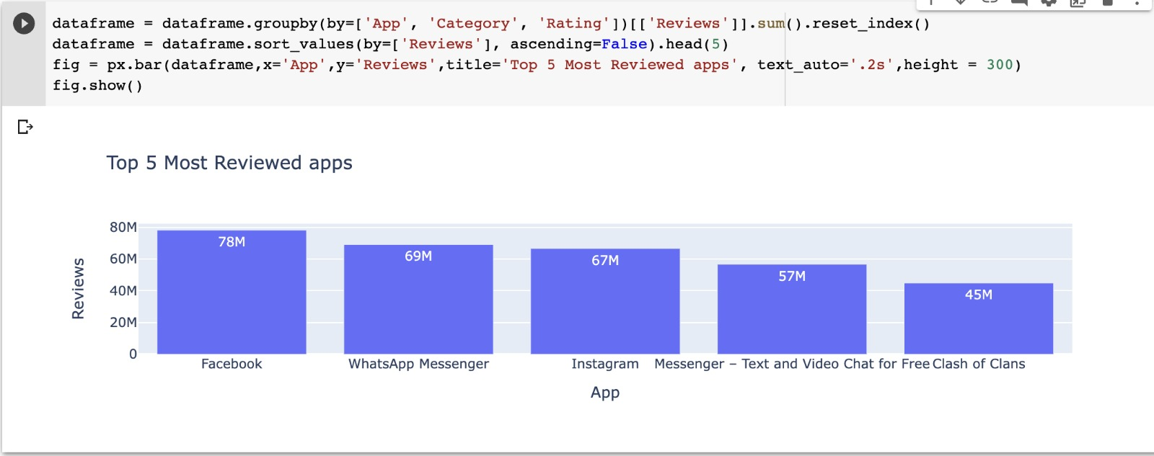
The Top 5 Most Reviewed Apps
Notes:
In the above visualisation it shows about the top 5 most reviewed apps they are: Facebook, WhatsApp Messenger, Instagram, messenger, Clash of clans.
Based on the above visualisation we can understand that most of the reviewed app was Facebook and the fifth most reviewed app was clash of clans which is a gaming application

Slide 11
What is hotel review?
A hotel review is generally described as the brief statement expressing a person's evaluation of their experience staying at a particular hotel
Hotel review evaluations typically contain feedback on the overall experience by the guests

