Slide 1

CMR COLLEGE OF ENGINEERING & TECHNOLOGY
Kandlakoya, Medchal, Hyderabad - 501401
Department of Artificial Intelligence & Machine Learning
Deep Learning-Based Cervical Spine Fracture Detection from CT scans for Automated Trauma Diagnosis and Clinical Decision Support
Batch No.: D-AIM5
Name of the students:
A. Shiva Shanker - 22H51A7301
E. Vamshi Krishna - 22H51A7322
G. Gouthami - 22H51A7323
Under esteemed guidance of
Guide Name: Mrs. K. Navaneetha (Assistant Professor)
Batch: 2022-2026 Major Project (A466803)/(A473803)

Slide 2
Outline
Problem Statement
Literature Review
Method - 01
Method - 02
Method - 03
Existing System
Implementation Of Existing System
Performance Evaluation Of Existing System
Proposed System
Methodology Of Proposed
References
Notes:
2

Slide 3
Problem Statement
Notes:
3

Slide 4
Problem Statement
Cervical spine fractures are serious injuries that can lead to paralysis or even death if not diagnosed early.
Manual diagnosis from CT or X-ray scans is time-consuming and prone to human error.
There is a lack of automated systems that can accurately and quickly identify cervical fractures.
An intelligent deep-learning model can help in early detection and localization of such fractures.
The main problem is to design an accurate, fast, and interpretable detection system to assist doctors.

Slide 5
Objectives of the Problem
Notes:
5

Slide 6
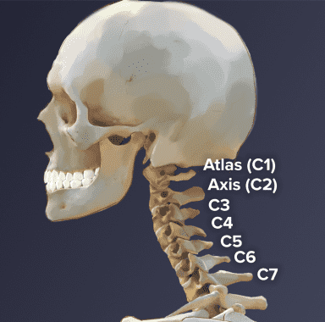
Objectives of the Problem
To develop an AI-based system capable of detecting cervical spine fractures from CT/X-ray images.
To enhance diagnostic accuracy and reduce time through automation.
To integrate image processing and deep learning techniques for effective feature extraction.
To provide a visual explanation (heatmap/localization) to support clinical decisions.
To evaluate the system using performance metrics like accuracy, precision, recall, and AUC.
Notes:
6

Slide 7
Literature Review
Notes:
7

Slide 8
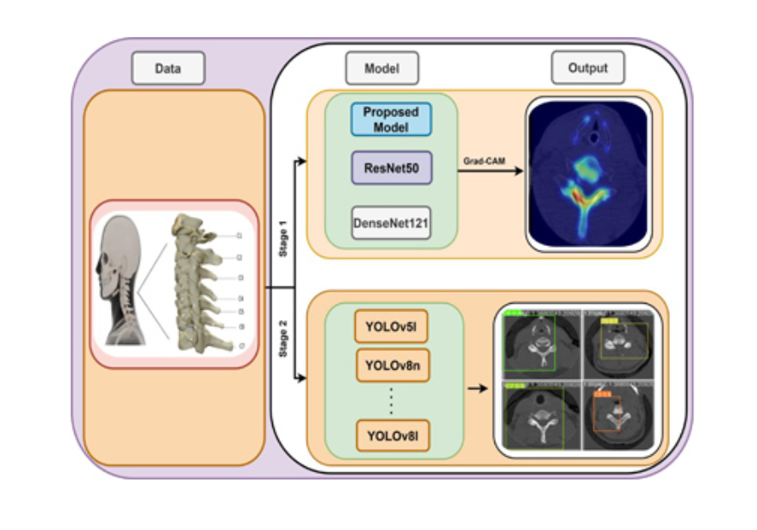
Method- 01
Base Paper:
“A Deep Learning-Based Two-Stage Approach for Detecting Cervical Spine Fractures” – IEEE ICCIAS 2024
Method/Model Used:
Two-Stage Deep Learning Pipeline (CNN + YOLOv5/YOLOv8 + Grad-CAM)
Procedure / Highlights:
A two-stage model was developed for automatic fracture detection from CT scan images.
Stage 1: CNN classifier predicts presence or absence of a fracture.
Stage 2: YOLOv5/YOLOv8 detects and localizes the exact vertebral level (C1–C7).
Grad-CAM is applied for visual explanation and region highlighting.
Reference: IEEE ICCIAS, 2024.
Notes:
8

Slide 9
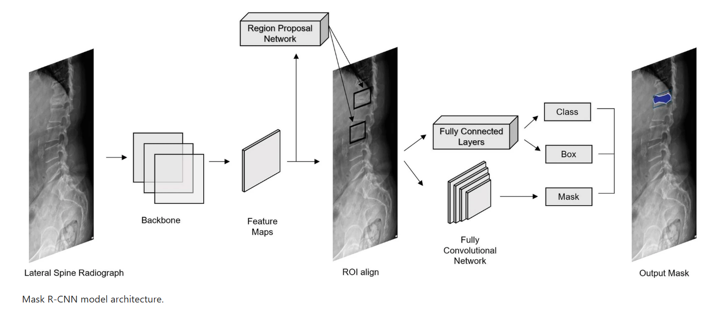
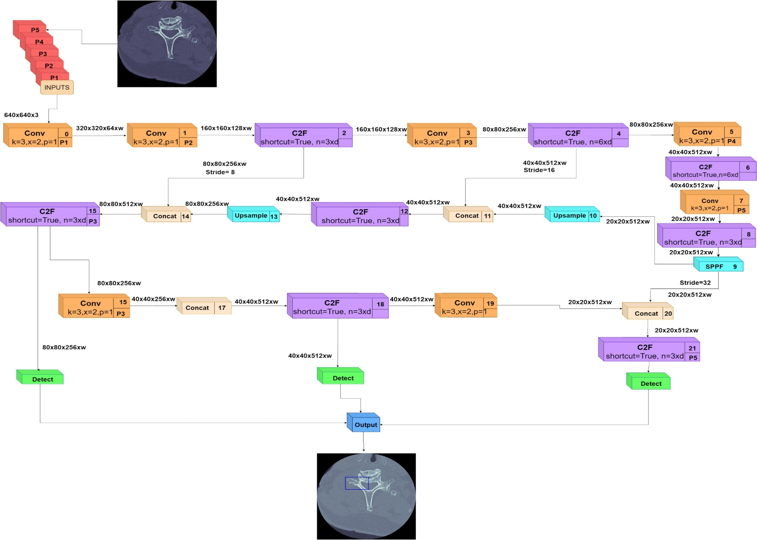
Method - 01
Notes:
9

Slide 10
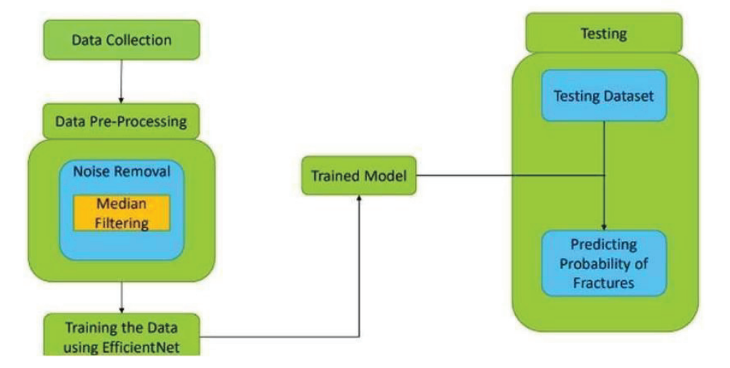
Method - 02
Base Paper:
“Cervical Spine Fracture Detection Using Deep Neural Networks on CT and MDCT Scans” – IEEE ICCMC 2024
Method/Model Used:
Multiple Deep Neural Network Models: EfficientNet, Vision Transformer (ViT), VGG, Inception, MobileNet, and DenseNet
Procedure / Highlights:
Multiple deep architectures were compared for fracture detection on CT and MDCT images.
Focused on early identification to prevent neurological complications.
EfficientNet and ViT achieved superior performance in terms of accuracy and generalization.
Models used transfer learning and fine-tuning on medical imaging data.
Reference: IEEE ICCMC, 2024.
Notes:
10

Slide 11
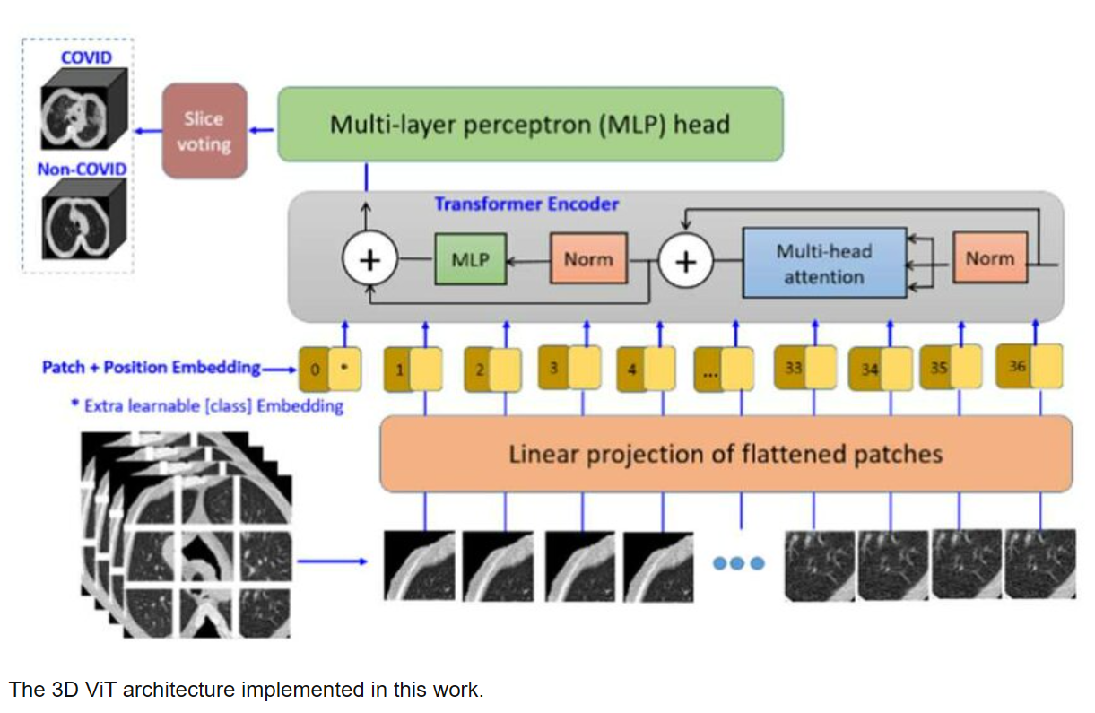
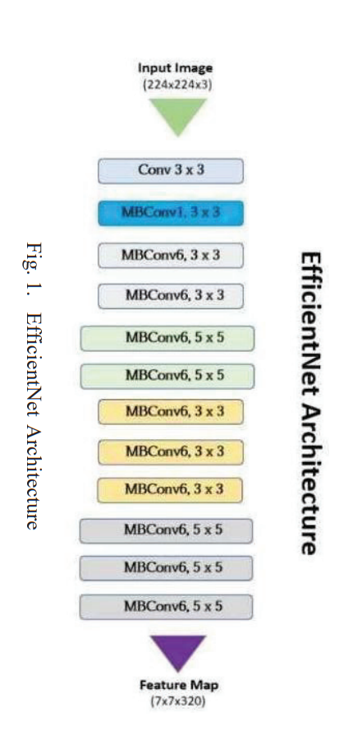
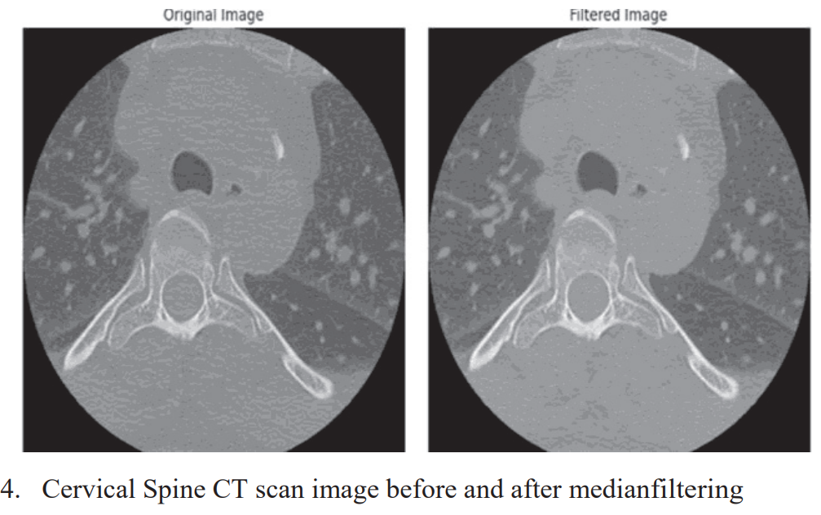
Method - 02
Notes:
11

Slide 12
Method - 03
Base Paper:
“Cervical Spine Fracture Detection Through Two-Stage Approach of Mask Segmentation and Windowing Based on Convolutional Neural Network – IEEE PlatCon 2023” – IEEE ICoNSCi 2023
Method/Model Used:
Two-Stage Deep Learning Framework (UNet-EfficientNet + CrackNet-LSTM)
Procedure / Highlights:
Proposed an advanced hybrid system combining segmentation (UNet) and sequence modeling (LSTM).
UNet-EfficientNet extracts spatial features and segment fracture-prone regions.
CrackNet-LSTM analyzes temporal patterns across CT slices for consistent prediction.
Aimed at improving diagnostic speed and reducing radiologist workload.
Achieved high sensitivity for detecting fractures caused by blunt trauma.
Reference: IEEE ICoNSCi, 2023.
Notes:
12

Slide 13
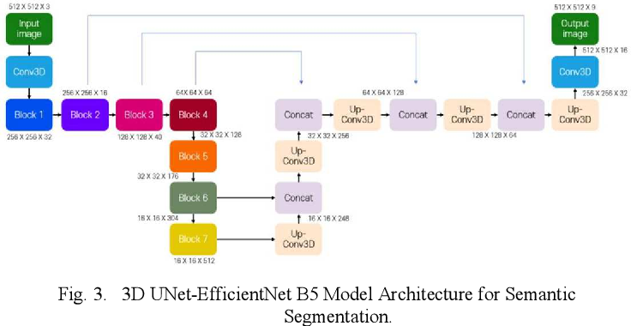
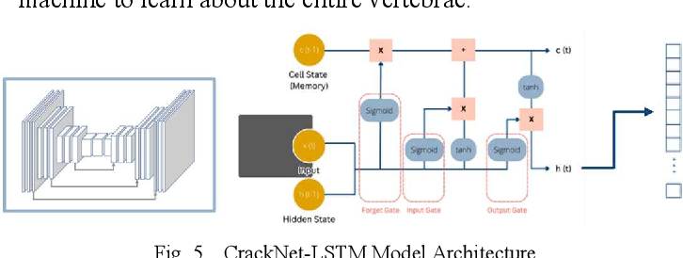
Method - 03
Notes:
13

Slide 14
Existing System
Notes:
14

Slide 15
Existing System
Base Paper:
Title: A Deep Learning-Based Two-Stage Approach for Detecting Cervical Spine Fractures Conference: IEEE ICCIAS 2024 Model Used: Two-Stage Deep Learning Pipeline — CNN + YOLOv5/YOLOv8 with Grad-CAM
Working / Overview
The system first uses a CNN classifier to determine whether a CT scan image indicates a cervical spine fracture.
If a fracture is detected, a YOLOv5/YOLOv8 detector localizes the specific vertebra (C1–C7) affected.
Grad-CAM visualization is applied to generate heatmaps showing the region of interest.
The approach provides both classification and localization, assisting radiologists with visual explanations.
It automates the detection workflow to reduce manual diagnostic effort and time.

Slide 16
Existing System
Advantages | Disadvantages / Limitations
High classification and localization precision due to two-stage approach | May still miss subtle fractures in 2D slices
Grad-CAM highlights affected vertebrae, aiding interpretability | Grad-CAM alone cannot confirm clinical correctness
Reduces manual scanning workload for radiologists | Computationally intensive; requires GPU resources
Detects exact vertebral level (C1–C7) | Limited to CT scans; not validated on other modalities (MRI/X-ray)
Compatible with modern CNN & YOLO models | Not optimized for real-time clinical deployment

Slide 17
Existing System
Why It Is Not Fully Suitable ?
Designed primarily for research-level evaluation, not for real-time hospital deployment.
Fails to integrate medical reasoning or multi-modal data (e.g., patient records, trauma notes).
Does not assess fracture severity or stability, which is clinically critical for treatment decisions.
Difficult to interpret for non-technical medical staff due to deep learning complexity.
Limited to CT scan input, lacking cross-validation with MRI or X-ray imaging.

Slide 18
Existing System
Required Improvements / Proposed Enhancements
Enhanced Grad-CAM & attention mapping: Generate quantitative heatmaps to estimate fracture size, region confidence, and probability.
Fracture type classification: Extend the system to identify specific fracture types (compression, teardrop, burst).
Region-based analysis: Automatically calculate fracture area and highlight multiple fractures in one scan.
Medical database integration: Provide vertebral-level information, symptoms, complications, and suggested treatments along with localization.
Improved preprocessing: Use image normalization, denoising, and augmentation to improve robustness across CT modalities and slice quality.

Slide 19
Implementation of Existing System
Notes:
19

Slide 20
Implementation of Existing System
Dataset Description
Source: RSNA 2022 Cervical Spine Fracture Detection Challenge dataset.
Content: 2019 CT scans of cervical spine (C1–C7), each scan contains 100–800 slices.
Annotations: Bounding boxes available for a subset of slices; segmentation labels for vertebrae (1–7), background = 0.
Segmentation: 3D U-Net generated, reviewed and corrected by radiologists for accuracy.
Data Preparation
Conversion: DICOM → PNG format for compatibility with deep learning models.
Windowing: Window center = 500, width = 2000 to enhance vertebral structures.
Labelling: Slices with bounding boxes = positive fracture cases; slices without = negative cases.
Class Balancing: Under-sampling applied to negative class to mitigate dataset imbalance (~7217 positive images).
Bounding Boxes: Generated from segmentations to localize vertebrae accurately for detection models.

Slide 21
Implementation of Existing System
Methods / Procedures
Classification Stage:
Resize images to 224×224 pixels.
Data split: 80% training, 20% validation.
Data augmentation: random flips, rotations, Gaussian blur to improve generalization.
Model Architecture:
Convolutional layers (Conv2D + ReLU) → MaxPooling → Flatten → Fully connected layers.
Output layer: 2 classes (fracture vs. non-fracture).
Models used: DenseNet, ResNet, and custom deep learning model.
Variables / Parameters
Input size: 224×224 pixels.
Batch size: 16–32 images.
Learning rate: 0.001 (initial), adaptive for fine-tuning.
Epochs: ~15–30 with early stopping.
Thresholds: For binary classification and fracture region detection.

Slide 22
Performance Evaluation Of Existing System
Notes:
22

Slide 23
Performance Evaluation Of Existing System
Aspect | Details / Values | Reasons / Observations | Improvement / Extension
Accuracy | 85–92% | Deep CNNs capture features; data augmentation improves generalization | Use multi-stage pipelines, fine-tuning, and attention mechanisms
Precision | 82–90% | Correctly predicts fractures among positive cases | Address class imbalance; combine with localization models (e.g., YOLOv8)
Recall / Sensitivity | 80–88% | Some subtle fractures missed; slices lack annotations | Use cross-validation, multi-view CT analysis, better data labeling
F1-Score | 81–89% | Balances precision & recall; affected by false negatives | Integrate Grad-CAM/attention maps for better fracture detection
AUC | 0.88–0.94 | Model distinguishes fracture vs. non-fracture well | Improve interpretability, segmentation-assisted bounding boxes

Slide 24
Proposed System
Notes:
24

Slide 25
Our Proposed System: Core Objective
Goal: To develop a single, end-to-end AI system that provides a complete diagnostic picture for cervical spine fractures.
Key Objectives:
High Accuracy: Target >95% detection rate, surpassing existing models.
Precise Localization: Show exactly where the fracture is using Grad-CAM.
Vertebra Identification: Automatically identify the affected level (C1-C7).
Instant Context: Deliver immediate medical info on risks and treatments for the identified vertebra.
Value: We close the gap between an AI's "yes/no" output and the radiologist's need for a "where, what, and why."

Slide 26
Methodology Of Proposed
Notes:
26

Slide 27
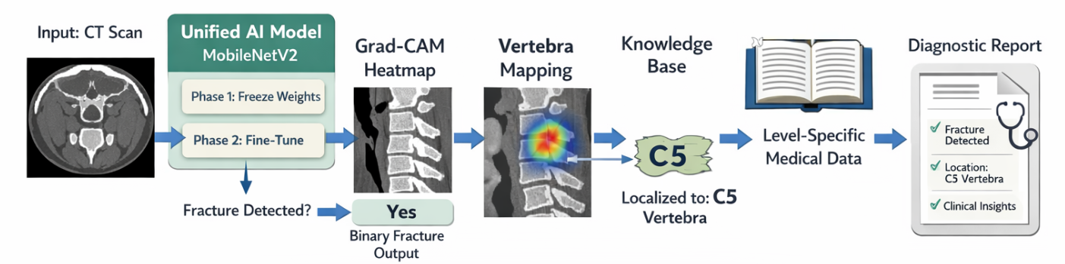
Our Superior Methodology
Architecture & Workflow:
Input: CT Scan
Unified AI Model (MobileNetV2):
Training: Advanced two-phase strategy (freeze → fine-tune) for maximum accuracy.
Output: Binary fracture detection.
If Fracture Detected:
Grad-CAM: Generates a heatmap to visually pinpoint the fracture.
Vertebra Mapping: Algorithm maps the heatmap location to a specific vertebra Knowledge Base: Pulls relevant, level-specific medical data for the clinician.
Output: A comprehensive diagnostic report with detection, localization, and context.

Slide 28
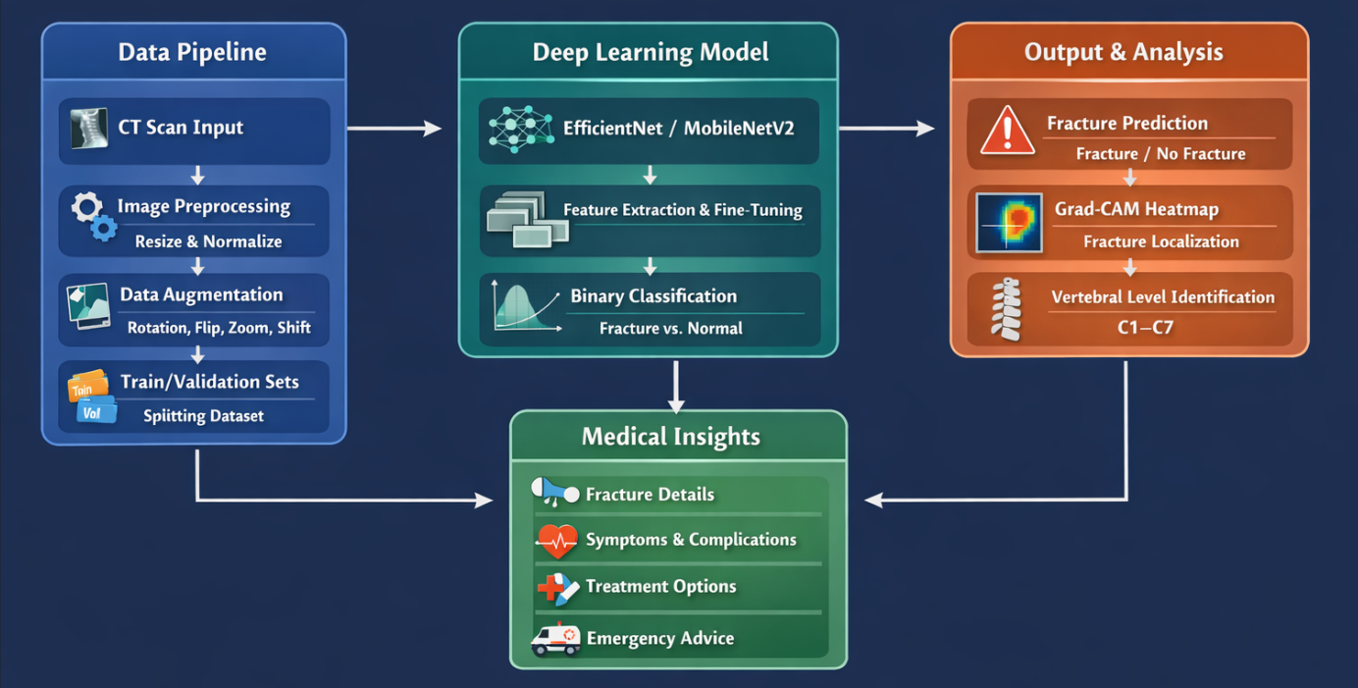
Methodology - Technical Pipeline

Slide 29
Methodology - Technical Pipeline
Systematic Processing Pipeline:
Data Collection: CT scan images from medical datasets
Preprocessing: Resizing (256×256), normalization, augmentation
Model Training: Two-phase approach (Feature extraction + Fine-tuning)
Prediction: Fracture probability calculation
Localization: Heatmap generation using Grad-CAM
Vertebral Identification: Anatomical mapping
Output Generation: Comprehensive report with visualization

Slide 30
Base paper (URL)
https://ieeexplore.ieee.org/document/10255157
https://ieeexplore.ieee.org/document/10522658
https://ieeexplore.ieee.org/document/10031629

Slide 31
References
S. M. Patil and A. S. Gawande, “Detection of Cervical Spine Fracture Using Deep Learning with CT Imaging,” in Proc. IEEE Int. Conf. on Smart Computing and Cyber Security (ICoNSCi), 2023, pp. 1–6, doi: https://ieeexplore.ieee.org/document/10255157.
M. G. Bhat et al., “A Deep Learning-Based Two-Stage Approach for Detecting Cervical Spine Fractures,” in Proc. IEEE Int. Conf. Computing, Communication and Intelligent Systems (ICCIAS), 2024, pp. 1–5, doi: https://ieeexplore.ieee.org/document/10522658.
K. R. Kavitha, M. S. Vijayalakshmi, and D. Manoharan, “Cervical Spine Fracture Detection using Deep Convolutional Neural Networks on CT Scans,” in Proc. IEEE Int. Conf. Communication and Signal Processing (ICCSP), 2023, pp. 1–5, doi: https://ieeexplore.ieee.org/document/10031629.
A. A. Shah et al., “Cervical Spine Fracture Detection Using Deep Neural Networks on CT and MDCT Scans,” in Proc. IEEE Int. Conf. Computing Methodologies and Communication (ICCMC), 2024, pp. 1–5, doi: https://ieeexplore.ieee.org/document/10426506.

Slide 32
References
Technical Foundations & Frameworks:
Howard, A. G., et al. (2017). MobileNets: Efficient Convolutional Neural Networks for Mobile Vision Applications. arXiv preprint arXiv:1704.04861.
Selvaraju, R. R., et al. (2017). Grad-CAM: Visual Explanations from Deep Networks via Gradient-Based Localization. IEEE International Conference on Computer Vision (ICCV).
Redmon, J., & Farhadi, A. (2018). YOLOv3: An Incremental Improvement. arXiv preprint arXiv:1804.02767.
Software & Libraries
TensorFlow & Keras Teams. TensorFlow: Large-Scale Machine Learning on Heterogeneous Systems. (2015). https://www.tensorflow.org/
Streamlit. Streamlit: The fastest way to build and share data apps. (2019). https://streamlit.io/

Slide 33
Thank You!

