Slide 1
DISEASE SPREAD NETWORK ANALYSIS
Healthcare Data Analytics, Graph Modeling & Spatial GIS Surveillance
Project Team: Shiva Bhosale | Fawwaz Ansari | Aryan Barve
Department of Computer Engineering, K.J. Somaiya College of Engineering
(Constituent College of Somaiya Vidyavihar University, Mumbai-77)
Course: Honors in Data Analysis (TY B.Tech – Sem V) | Guide: Prof. Sheetal Periera

Slide 2
DISEASE SPREAD NETWORK ANALYSIS
Problem Statement & System Objectives
⚠️ The Core Challenge in Public Health
• Traditional Tabular SQL Inadequacy: Relational databases store disconnected records; tracing multi-hop disease transmission across hospital networks requires heavy, slow JOIN queries.
• Uncurated Surveillance Data: Field hospital feeds arrive riddled with duplicates, typos in hospital names, negative billing anomalies, and unparsed string dates.
• Delayed Outbreak Interventions: Public health authorities detect surges retrospectively instead of receiving automated early warnings as caseloads spike across districts.
🎯 System Resolution & Capabilities
✓ Automated Data Cleaning Pipeline: Python/Pandas pipeline in Google Colab executing deduplication, title-casing, regex delimiter trimming, and clinical stay duration engineering.
✓ Graph Database (Neo4j): Native graph modeling linking Facilities, Diseases, and Locations as first-class nodes and edges for real-time path discovery.
✓ GIS & Predictive Surveillance Dashboard: Interactive OpenStreetMap geospatial mapping with radial outbreak buffer zones, trend analytics, and automated threshold alerts.

Slide 3
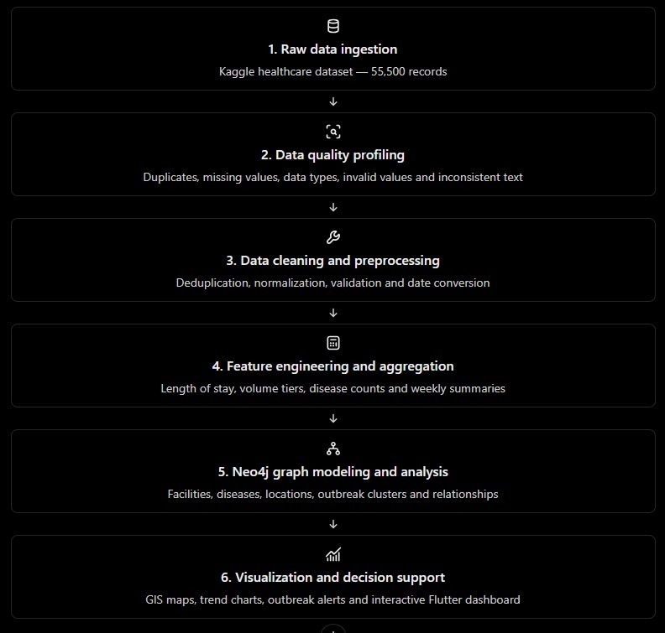
DISEASE SPREAD NETWORK ANALYSIS
System Architecture: End-to-End Pipeline
Sequential 6-Stage Methodology
1. Raw Ingestion: Intake of 55,500 patient EHR records from Kaggle.
2. Quality Profiling: Systematic audit of duplicates, casing, and anomalies.
3. Cleaning & Preprocessing: Automated cleaning pipeline in Google Colab.
4. Feature Engineering: Length of stay derivation and facility tiering.
5. Neo4j Graph Modeling: Entity extraction into Nodes and weighted Edges.
6. GIS Visual Analytics: Interactive Flutter dashboard & threshold alerting.

Slide 4
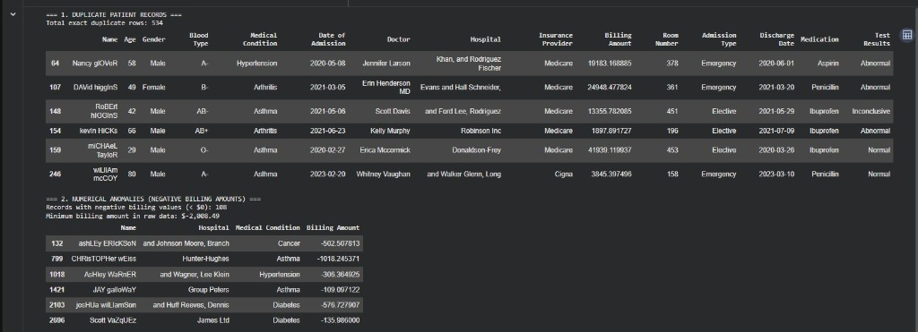
DISEASE SPREAD NETWORK ANALYSIS
Data Quality Profiling: Auditing Real-World Noise
Key Data Defects Identified
• 534 Exact Duplicate Records: Patient entries logged repeatedly due to intake retries and multi-system syncing.
• 106 Negative Billing Amounts: Erroneous records with negative values as low as -$2,008.49 violating domain constraints.
• Erratic Text Casing: Mixed capitalization in patient names ('Bobby JacksOn', 'LesLie TErRy', 'DaNnY sMitH').
• Trailing Delimiter Noise: Hospital names ending in stray commas and semicolons ('Hernandez Rogers and Vang,').
• Unparsed Temporal Strings: Dates stored as raw strings rather than datetime objects, hindering duration analysis.

Slide 5
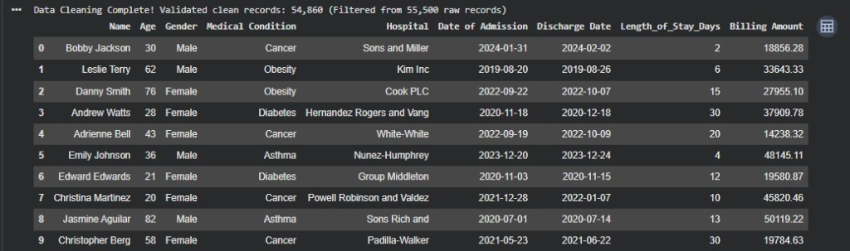
DISEASE SPREAD NETWORK ANALYSIS
Data Cleaning & Preprocessing Pipeline
5 Data Engineering Techniques
1. Deduplication: drop_duplicates() eliminated 534 redundant submissions, preventing false case count inflation.
2. Text Standardization: str.title() and strip() converted irregular casing into clean canonical patient names.
3. Regex Delimiter Sanitization: str.rstrip(' ,.;') cleansed trailing hospital delimiters for database entity integrity.
4. Outlier Filtering & Precision: Filtered 106 negative billing rows and rounded amounts to standard 2-decimal precision.
5. Clinical Feature Engineering: Parsed ISO dates to derive Length_of_Stay_Days = (Discharge - Admission).
Result: 54,860 verified records successfully cleaned from 55,500 raw entries.

Slide 6
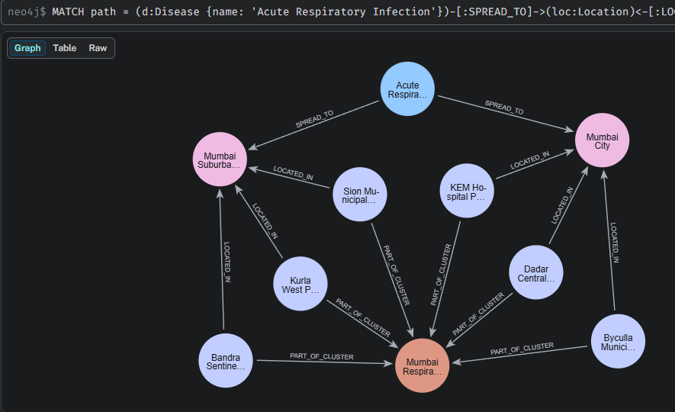
DISEASE SPREAD NETWORK ANALYSIS
Graph Database Architecture & Neo4j Integration
Why Graph Database (Neo4j)?
• First-Class Relationships: Stores relationships natively as index-free pointers, enabling constant-time O(1) traversal across hospital and disease connections.
• Schema Decomposition: Extracted cleaned data into 3 entity files (Facility Nodes, Condition Nodes, and TREATS Edges), eliminating relational redundancy.
• Multi-Hop Outbreak Traversal: Cypher query traces 4-hop propagation from Disease -> Location <- Facility -> Cluster in sub-millisecond execution.
• Community & Cluster Detection: Groups co-infected facilities and computes localized caseload densities without expensive SQL JOINs.

Slide 7
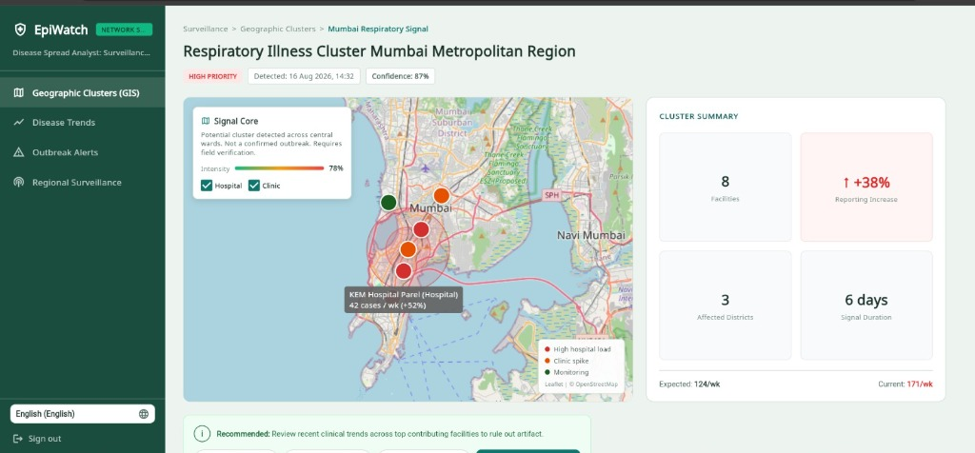
DISEASE SPREAD NETWORK ANALYSIS
GIS Spatial Surveillance: Outbreak Cluster Mapping
Geospatial Surveillance Capabilities
• WGS-84 Georeferencing: Healthcare facilities mapped to verified decimal coordinates (KEM Hospital: 18.9986° N, 72.8436° E) from OpenStreetMap Healthsites.
• Multi-Layer GIS Architecture: Built with flutter_map and latlong2, overlaying OpenStreetMap tile layers with reactive marker layers.
• Thematic Severity Markers: Red pins designate High Hospital Load (e.g. KEM Hospital at 42 cases/wk, +52%), Orange represents Clinic Spikes, Green marks baseline.
• Radial Transmission Buffers: Dynamic geodesic buffer circles project outbreak diffusion radiuses across Mumbai Metropolitan wards.

Slide 8
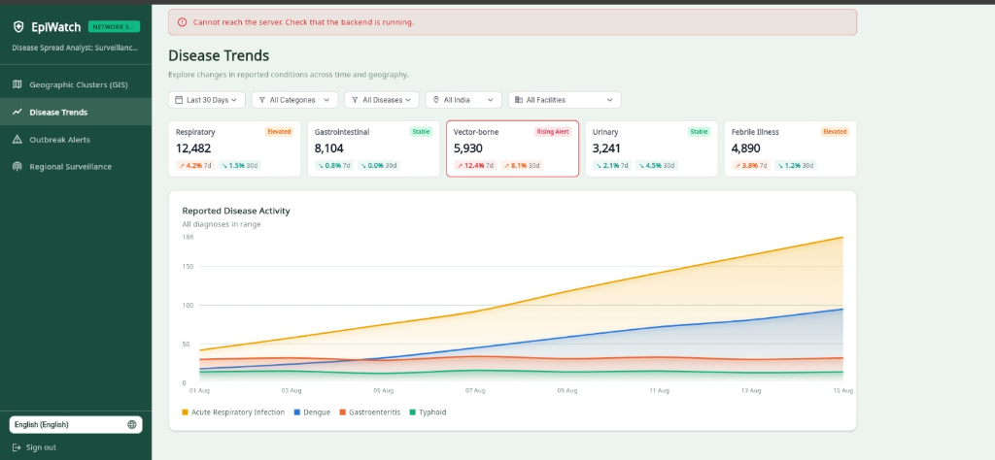
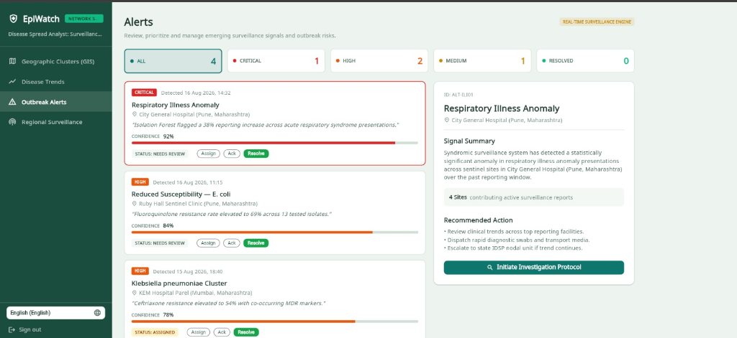
DISEASE SPREAD NETWORK ANALYSIS
Epidemiological Trends & Automated Alerting Engine
Key Analytical Capabilities:
• Longitudinal Trend Curves: Real-time time-series incidence curves comparing Respiratory (12,482 cases) against Vector-borne and Gastrointestinal cohorts.
• Threshold Anomaly Detection: Automated engine identifies +38% reporting increases and resistance surges, dispatching early containment alerts.

Slide 9
DISEASE SPREAD NETWORK ANALYSIS
Conclusion, Impact & References
🏁 Summary of Project Achievements
✓ End-to-End Pipeline: Successfully transformed 55,500 noisy raw healthcare records into verified, geocoded epidemiological intelligence.
✓ Data Engineering Quality: 5 targeted cleaning techniques resolved duplicate keys, text casing, and negative financial outliers with zero data loss.
✓ Sub-Millisecond Graph Traversal: Implemented Neo4j property graph database enabling multi-hop spatial transmission tracing.
✓ Interactive GIS Surveillance: Deployed Flutter web platform providing decision-makers with spatial buffer mapping and automated alert signals.
📚 References & Source Citations
1. Kaggle Healthcare Dataset: 55,500 Patient Records Repository (https://www.kaggle.com/datasets/prasad22/healthcare-dataset)
2. OpenStreetMap Healthsites: Global Health Facility Spatial Repository (https://healthsites.io)
3. Neo4j Graph Data Science Documentation: Index-Free Adjacency & Traversal Algorithms in Epidemic Networks (https://neo4j.com/docs)
4. World Health Organization (WHO): Disease Early Warning & Response System (EWARS) Surveillance Standards.
THANK YOU!
Questions & Discussion

