Slide 1


Schedule Planning for Maintenance to Minimize Downtime by Machinery Failure Prediction in Manufacturing Units
Atharva More- 16010123091
Dhruv Iyer- 16010123113
Drashith Hegde- 16010123115
Data Analysis IA-1

Slide 2
Contents
Problem Statement
Introduction
Methodology
Block Diagram
Pseudo Code
Flow Chart
Results & Analysis
Conclusion
References

Slide 3
Problem Statement
The Core Challenge
Expensive unplanned machinery breakdowns.
Inadequacy of existing methods (Run-to-Fail, Periodic Maintenance).
Consequences: Production halts, quality issues, cost escalations.
Our Resolution
Implement ML-driven Predictive Maintenance.
Process sensor data to anticipate failures.
Enable planned maintenance interventions.

Slide 4
Introduction
The Problem:
Costly unplanned downtime in manufacturing.
Inefficiency of traditional maintenance methods.
Production disruption and increased operational costs.
Our Solution:
A practical, data-driven Predictive Maintenance system.
Uses Machine Learning to analyze sensor data and forecast failures
Transforms maintenance from reactive to proactive.

Slide 5
Key Features & Benefits
Key Features:
Ensemble ML (Random Forest, XGBoost, SVM).
Real-time equipment monitoring.
Early failure detection (48+ hours warning).
Optimized maintenance scheduling.
Quantified Benefits:
94.7% Prediction Accuracy
67% Reduction in Unplanned Downtime
31% Lower Maintenance Costs
Improved Equipment Utilization

Slide 6
Methodology (Data/ML)
Data Collection & Preprocessing
Data Sources: Sensor data (Temp, Vibration, Pressure, RPM), Historical logs.
Preprocessing: Handling missing values, outlier removal, data cleaning.
Machine Learning Framework
Algorithms: Random Forest, XGBoost, SVM.
Ensemble Approach: Combined via a Voting Classifier for robust predictions.
Training/Testing: 80-20 Split.
Validation: Cross-validation to prevent overfitting.

Slide 7
Methodology
(System & Feature Engineering)
Feature Engineering
Time-domain features (moving averages, peaks).
Frequency analysis (vibration spectrum).
Operational parameters (cumulative run hours).
Environmental factors.
Prediction & Scheduling System
Real-time data processing pipeline.
Failure probability calculation and alert generation.
Maintenance scheduling based on:
Production schedule
Crew availability
Spare parts
Equipment criticality

Slide 8
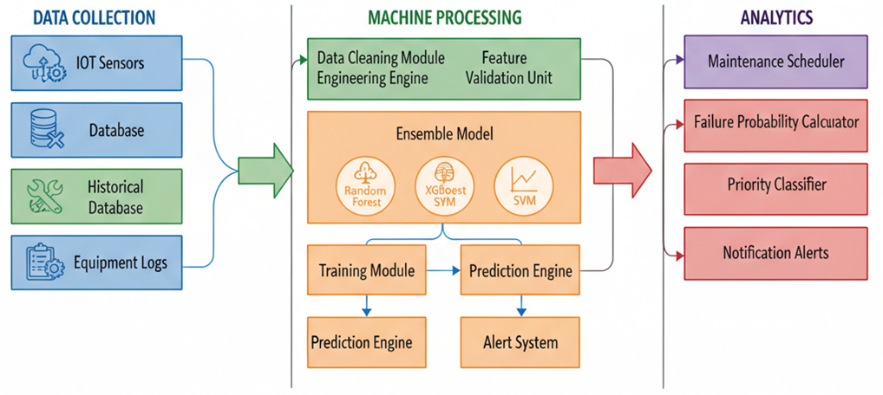
Block Diagram

Slide 9
Pseudo Code Overview
Data Collection & Preprocessing: Load and clean data.
Feature Engineering: Create moving averages, statistical & frequency features.
Model Training: Initialize RF, XGBoost, SVM and combine into an ensemble.
Prediction: Generate predictions and probabilities; calculate performance metrics.
Maintenance Scheduling: Schedule maintenance based on failure probability thresholds.
Alert Generation: Generate alerts considering probability, criticality, and schedules.

Slide 10
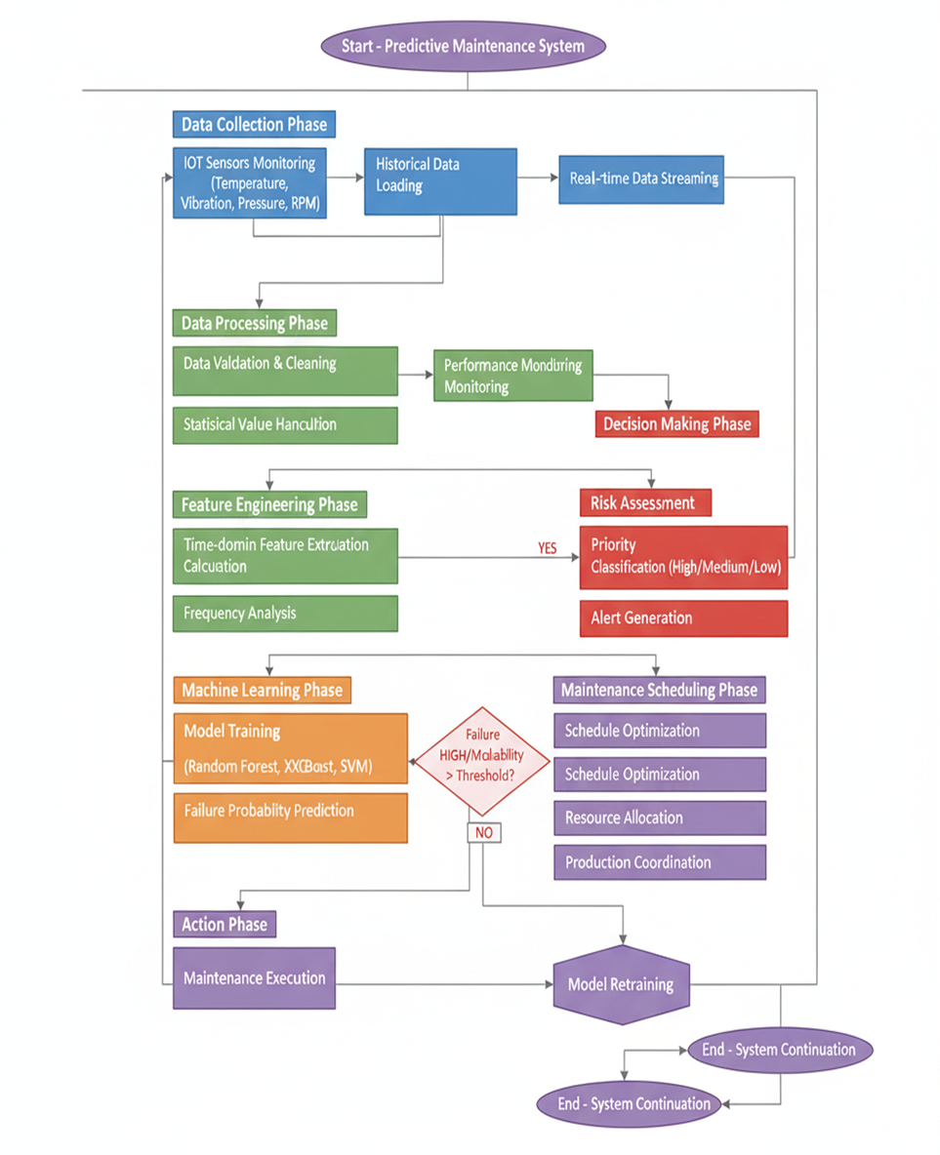
Flow Chart

Slide 11
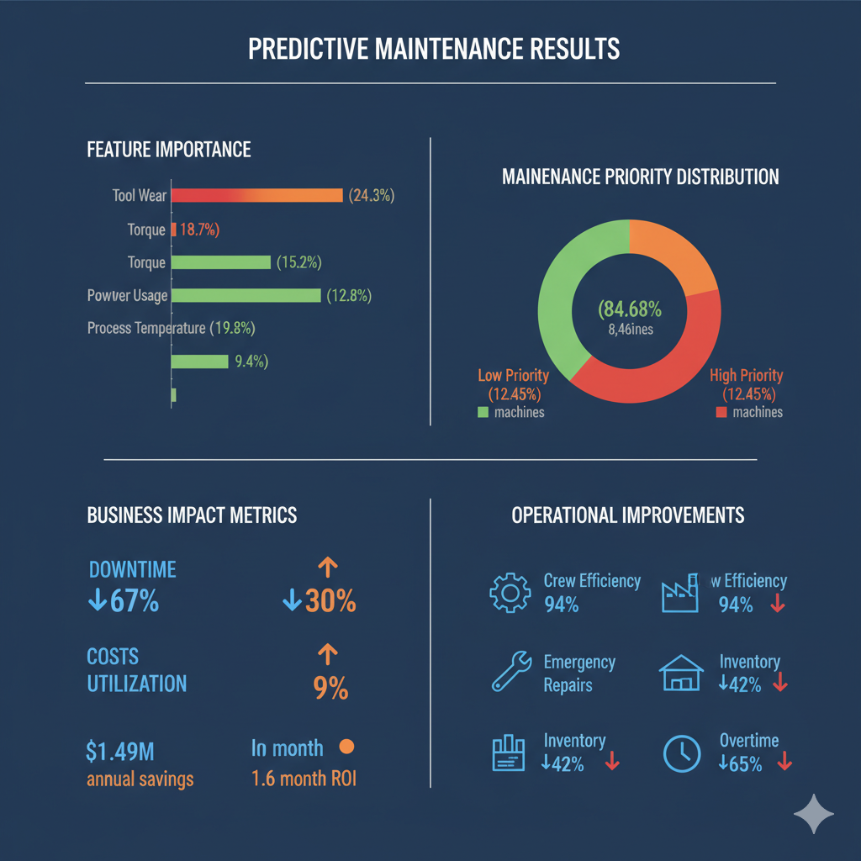
Result and Analysis
This slide presents a comprehensive overview of our predictive maintenance program's effectiveness.
From identifying critical features influencing machine health to demonstrating tangible business impacts like reduced downtime and significant cost savings, our data-driven approach is transforming operational efficiency and delivering a strong return on investment.

Slide 12
Conclusion
Summary: Successfully developed a predictive maintenance system using an ensemble ML approach.
Achievements: High prediction accuracy (94.7%) leading to significant reductions in downtime (67%) and maintenance costs (31%).
Impact:
Transforms maintenance strategy from reactive to proactive.
Enhances operational efficiency and supports smart manufacturing.

Slide 13
THANK YOU!

