Slide 1
Domain Graph Visualization for PTMs in PTM-WEB
Lab Meeting
Shiv Kumar
Sept 30, 2026

Slide 2
Contribution scope
My contribution: Domain Graph for protein domain/PTM mapping.
Interaction Network existed already; another contributor implemented it.

Slide 3
PTM-WEB context
PTM-WEB combines PTM knowledge with interactive protein views.
Domain Graph adds a residue-scale view beside the existing network.

Slide 4
The visualization gap
Networks show protein relationships, not sites along a protein.
Domain Graph aligns domain regions and PTMs by residue position.

Slide 5
Objective
Align protein domains and PTM sites on a residue-scaled track.
Add the graph to existing PTM-WEB query results.

Slide 6
Why sequence context matters
Domain annotations and PTM sites are both expressed in residue coordinates.
Placing them on one scale makes their positions and nearby regions visible at a glance.
The graph is an exploration aid; biological interpretation still depends on annotation evidence.

Slide 7
Design approach
Map residue coordinates to a shared horizontal scale.
Use distinct segments and markers; reveal details on hover or click.
Support navigation across long proteins with zoom and pan.

Slide 8
Data and method
Select a protein from the query results and use its UniProt accession.
Backend fetches sequence, domains, and PTM features.
D3.js draws tracks; zoom, pan, hover, and click reveal details.

Slide 9
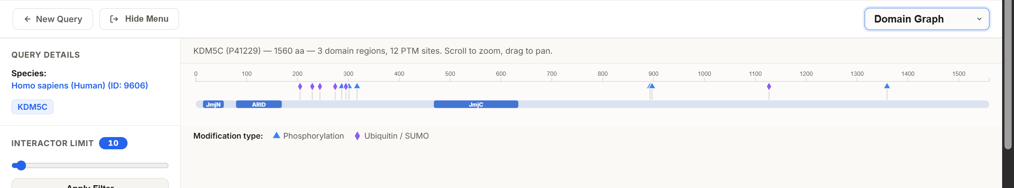
KDM5C example
Example shown: human KDM5C (P41229), viewed in the Domain Graph.

Slide 10
What the view shows
KDM5C (P41229): 1,560 aa, 3 domain regions, 12 PTM sites.
Regions: JmjN, ARID, and JmjC.
Visible PTMs: phosphorylation and ubiquitin/SUMO.

Slide 11
Contribution boundary
The Interaction Network was already part of PTM-WEB.
It was implemented by another contributor.
My contribution: Domain Graph and integration with query results.

Slide 12
Using the graph
Interaction Network remains a separate, existing view.
Choose Domain Graph and select a queried protein.
Click a PTM cell to show that protein’s graph.
Scroll to zoom; drag to pan; click a domain to view its sequence.

Slide 13
Current limitations
Backend currently returns UniProt domains only.
InterPro/Pfam retrieval is disabled in this code version.
Domain and PTM details require UniProt access.
If fetches fail, the UI can fall back to curated PTM-only data.

Slide 14
Work completed
26 Sep 2026 — first Domain Graph version committed.
28 Sep 2026 — follow-up: table navigation and graph refinements.

Slide 15
Possible next steps
Try multi-protein queries and varied annotation coverage.
Review InterPro/Pfam if retrieval is restored and verified.
Check the flow with representative proteins.

Slide 16
Thank you

