Slide 1
WEBPACK

Slide 2
What is webpack
Webpack is a powerful open-source JavaScript module bundler primarily used in modern web development. It takes modules with dependencies and generates static assets representing those modules.
webpack is a static module bundler for modern JavaScript applications. When webpack processes your application, it internally builds a dependency graph from one or more entry points and then combines every module your project needs into one or more bundles, which are static assets to serve your content from.

Slide 3
Webpack vs NPM
Feature | Webpack | NPM
Primary Function | Module bundler | Package manager
Installation Command | npm install --save-dev webpack | npm install <package-name>
Main Use | Bundles JavaScript files for browsers | Manages dependencies for Node.js
Compatibility | ES5-compliant browsers | Node.js environments
Advantages | Modular plugin system, loaders for file preprocessing | Package version management, wide repository of packages
Speed | Optimized bundling process | Yarn installs packages faster than NPM
Lock File | Not by default (can be configured) | package-lock.json (NPM), yarn.lock (Yarn)

Slide 4
Key Features of Webpack
Module Bundling: Webpack takes various modules (JavaScript, CSS, images, etc.) and bundles them into a smaller set of files. This is especially useful for managing dependencies and optimizing load times.
Code Splitting: It can split your code into smaller chunks, which can be loaded on demand or in parallel. This reduces the initial load time and improves performance.

Slide 5
Loaders: These are transformations that are applied to the source files of your project. For example, you can use loaders to transpile TypeScript to JavaScript, convert Sass to CSS, or load images as data URLs.
Plugins: Plugins are used to perform a wider range of tasks like bundle optimization, asset management, and injection of environment variables. Webpack's plugin system is very powerful and can be customized to fit any need.
Dev Server: Webpack Dev Server provides live reloading and other development features, making it easier to develop and test your applications locally.

Slide 6
Core Concepts
Entry
Output
Loaders
Plugins
Mode
Browser Compatibility

Slide 7
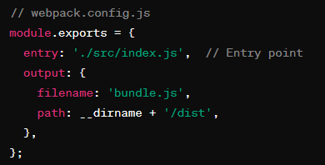
1.Entry Point
The entry point is the module where Webpack starts building the dependency graph. This is usually the main JavaScript file of the application.
In this example, webpack will start from ./src/index.js and include all dependencies starting from this file.

Slide 8
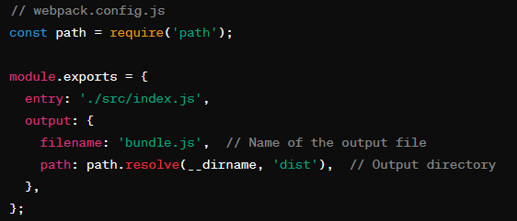
2. Output
The output property tells Webpack where to emit the bundles it creates and how to name these files.

Slide 9
3.Loaders
Loaders are transformations that are applied on the source files of your application. They allow us to preprocess files as we import or load them.
Loaders allow webpack to process other types of files and convert them into valid modules that can be consumed by your application and added to the dependency graph.
At a high level, loaders have two properties in your webpack configuration:
The test property identifies which file or files should be transformed.
The use property indicates which loader should be used to do the transforming.

Slide 10
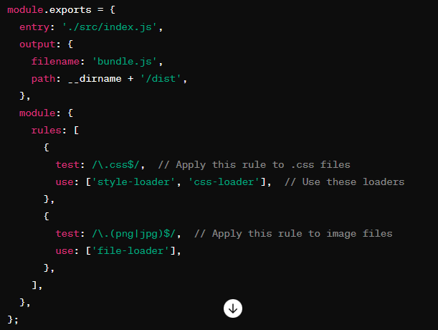

Slide 11
Commonly used Loaders
babel-loader: Transpiles modern JavaScript to older versions for compatibility.
css-loader: Resolves @import and url() in CSS files.
style-loader: Injects CSS into the DOM.
sass-loader: Compiles Sass/SCSS files to CSS.
less-loader: Compiles Less files to CSS.
ts-loader: Transpiles TypeScript to JavaScript.

Slide 12
Loaders
file-loader: Emits files and returns their URLs.
url-loader: Inlines files as base64 URLs if they are smaller than a specified limit.
html-loader: Exports HTML as a string and can handle image sources.
raw-loader: Loads file contents as a string.
json-loader: Loads JSON files.
vue-loader: Processes Vue.js single-file components.

Slide 13
Loaders
eslint-loader: Lints JavaScript files using ESLint.
babel-loader: Integrates Babel for JavaScript transpilation.
image-webpack-loader: Optimizes image files.
csv-loader: Loads CSV files and converts them to JSON.
xml-loader: Loads XML files and converts them to JSON.
graphql-tag/loader: Imports GraphQL files into JavaScript.

Slide 14
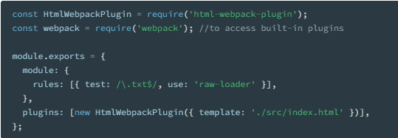
4.Plugins
While loaders are used to transform certain types of modules, plugins can be leveraged to perform a wider range of tasks like bundle optimization, asset management and injection of environment variables.

Slide 15
Plugin (continue).
In order to use a plugin, you need to require() it and add it to the plugins array. Most plugins are customizable through options. Since you can use a plugin multiple times in a configuration for different purposes, you need to create an instance of it by calling it with the new operator.

Slide 16
Name | Description
BannerPlugin | Add a banner to the top of each generated chunk
ChunksWebpackPlugin | Create HTML files with entrypoints and chunks relations to serve your bundles
CommonsChunkPlugin | Extract common modules shared between chunks
CompressionWebpackPlugin | Prepare compressed versions of assets to serve them with Content-Encoding
ContextReplacementPlugin | Override the inferred context of a require expression
CopyWebpackPlugin | Copies individual files or entire directories to the build directory

Slide 17
DefinePlugin | Allow global constants configured at compile time
DllPlugin | Split bundles in order to drastically improve build time
EnvironmentPlugin | Shorthand for using the DefinePlugin on process.env keys
EslintWebpackPlugin | A ESLint plugin for webpack
HotModuleReplacementPlugin | Enable Hot Module Replacement (HMR)
HtmlWebpackPlugin | Easily create HTML files to serve your bundles
IgnorePlugin | Exclude certain modules from bundles
LimitChunkCountPlugin | Set min/max limits for chunking to better control chunking

Slide 18
MinChunkSizePlugin | Keep chunk size above the specified limit
MiniCssExtractPlugin | creates a CSS file per JS file which requires CSS
NoEmitOnErrorsPlugin | Skip the emitting phase when there are compilation errors
NormalModuleReplacementPlugin | Replace resource(s) that matches a regexp
NpmInstallWebpackPlugin | Auto-install missing dependencies during development
ProgressPlugin | Report compilation progress

Slide 19
ProvidePlugin | Use modules without having to use import/require
SourceMapDevToolPlugin | Enables a more fine grained control of source maps
EvalSourceMapDevToolPlugin | Enables a more fine grained control of eval source maps
SvgChunkWebpackPlugin | Generate SVG sprites optimized by SVGO based on your entry point dependencies
TerserPlugin | Uses Terser to minify the JS in your project

Slide 20
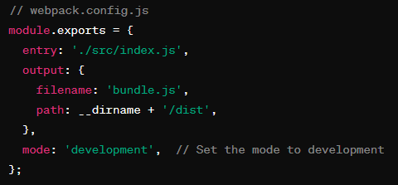
5. Mode
By setting the mode parameter to either development, production or none, you can enable webpack's built-in optimizations that correspond to each environment. The default value is production.

Slide 21
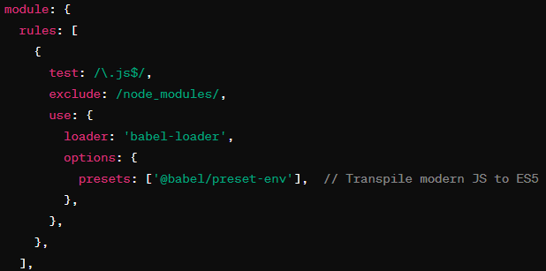
6. Browser Compatibility
Webpack helps ensure that the code is compatible with the target browsers. It works with tools like Babel to transpile modern JavaScript into a version that can run in older browsers.

Slide 22
complete Webpack configuration file
that incorporates all these concepts:

Slide 23
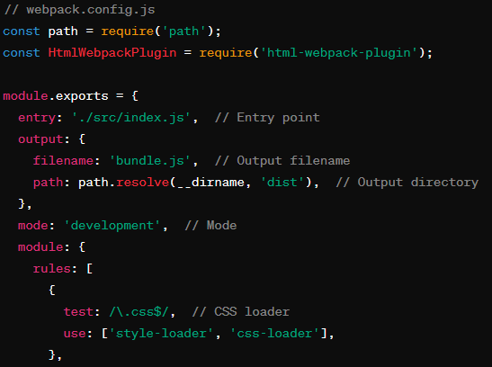

Slide 24
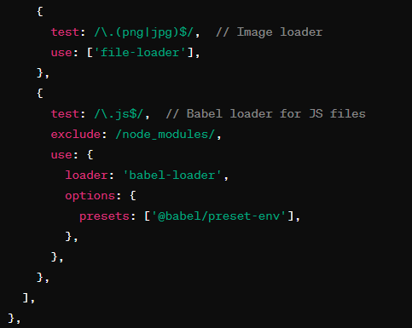
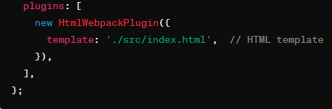
This configuration will take index.js as the entry point, process CSS and image files, transpile JavaScript for browser compatibility, and generate an HTML file with the bundled scripts.

Slide 25
Dependency Graph
Any time one file depends on another, webpack treats this as a dependency. This allows webpack to take non-code assets, such as images or web fonts, and also provide them as dependencies for your application.
When webpack processes your application, it starts from a list of modules defined on the command line or in its configuration file. Starting from these entry points, webpack recursively builds a dependency graph that includes every module your application needs, then bundles all of those modules into a small number of bundles - often, only one - to be loaded by the browser.

Slide 26
comparison of web development workflows with and without Webpack

Slide 27
Aspect | Without Webpack | With Webpack
File Management | Manual inclusion of separate files | Single entry point with automatic bundling
Dependency Management | Manual order management | Automated dependency graph
Transpiling/Preprocessing | Separate tools for Babel, Sass, etc. | Loaders for transpiling and preprocessing
Code Splitting | No code splitting | Automatic code splitting
Initial Load Time | Slower, multiple HTTP requests | Faster, fewer HTTP requests
Optimizations | Manual optimizations | Automatic minification, tree shaking, etc.
Development Server | Manual setup | Webpack Dev Server with HMR
File Inclusion in HTML | Manual script/style tags in HTML | HtmlWebpackPlugin for automatic injection
Error Prone | More error-prone | Less error-prone, automated processes
Build Process | More time-consuming | Efficient, streamlined build process

Slide 28
Benefits of Using Webpack
Efficiency: It helps in optimizing the assets of your application, resulting in faster load times.
Modularity: Encourages a modular approach to development, where each part of the application can be developed, tested, and maintained independently.
Ecosystem: A vast ecosystem of loaders and plugins that can be used to tailor the build process to specific needs.
Community Support: Strong community support with extensive documentation and a wealth of tutorials and resources.

Slide 29
React- Part II

Slide 30
Best Resource
https://react.dev/learn/thinking-in-react

Slide 31
Topics
How to create and nest components
How to add markup and styles
How to display data
How to render conditions and lists
How to respond to events and update the screen
How to share data between component

Slide 32
Creating and nesting components
React apps are made out of components.
A component is a piece of the UI (user interface) that has its own logic and appearance
function MyButton() {
return ( <button>I'm a button</button> );
}

Slide 33
Virtual DOM
React JS Virtual DOM is an in-memory representation of the DOM.
DOM refers to the Document Object Model that represents the content of XML or HTML documents as a tree structure
The programs can be read, accessed and changed in the document structure, style, and content.

