Slide 1
CASE STUDY SUBMISSION
By: SHIVA BALIYAN

Slide 2
There are 3 dataframes here:
df_app contains 'application_data.csv’ data
df_prev contains 'previous_application.csv’ data
df_merged contains merged data
In EDA, we have removed all the columns with missing values more than 25%
Also we have removed columns which were less informative
We have replaced missing values with Mode for categorical columns
We have replaced missing values with median for continuous columns since there were lot of outliers

Slide 3
Analysis For 'application_data.csv’

Slide 4
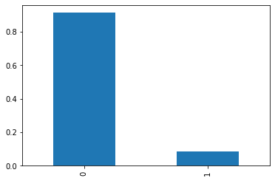
Data Imbalance:
There are only 8.63% applicants which are having loan payment difficulty (TARGET==1)

Slide 5
In next few slides,
Left side plot shows contribution of each category of the column
(to check data imbalance)
Right side plot shows percentage of applicants with payment difficulty of each category of the column

Slide 6
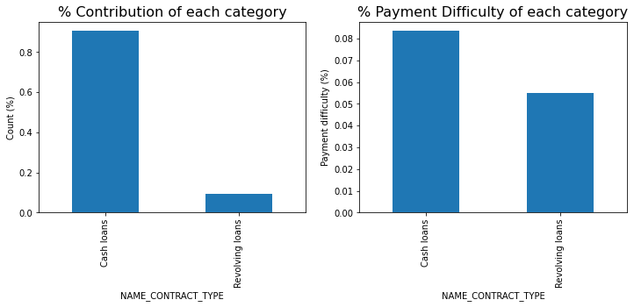
Observation: Applicants with contract product type as 'Cash' are more likely to have loan payment difficulty (around 8%)

Slide 7
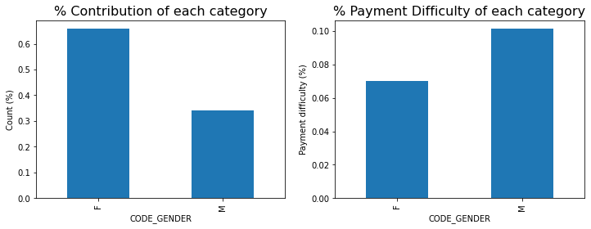
Observation: Males more likely to have loan payment difficulty (around 10%)

Slide 8
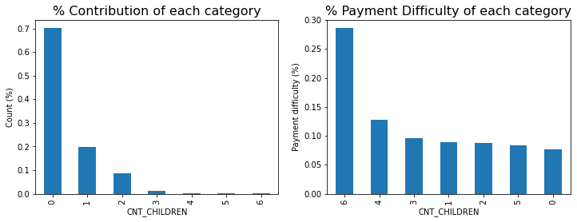
Observation: Applicants with children >= 6 have double or triple loan payment difficulty than applicants with children <= 5
(around 28%)

Slide 9
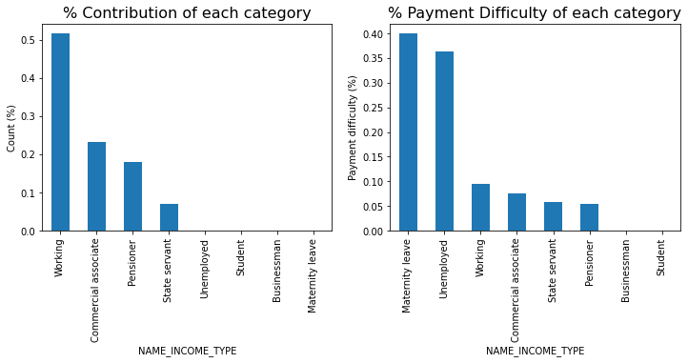
Observation: Applicants which are on maternity leave or are unemployed have almost 4 times loan payment difficulty than other income source applicants (around 35%-40%)
Observation: businessman people do not have difficulty in loan payment

Slide 10
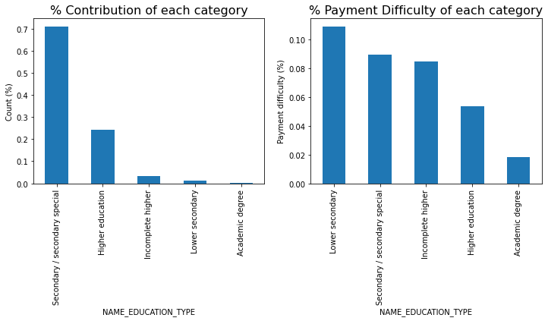
Observation: Applicants with lower secondary education level have loan payment difficulty (10%+)
Observation: Applicants with Higher education level or having Academic degree have very less loan payment difficulty

Slide 11
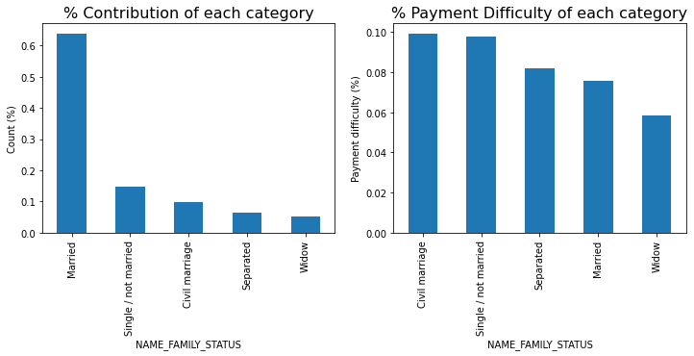
Observation: widows are less likely to face loan payment difficulty (interesting)

Slide 12
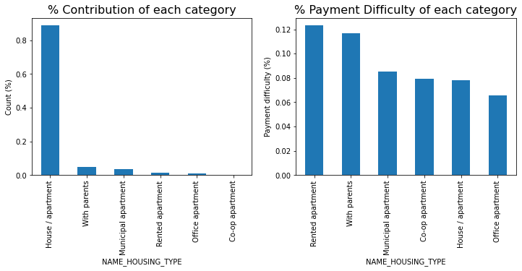
Observation: Applicants which are living in rented apartments or living with parents have more loan payment difficulty

Slide 13
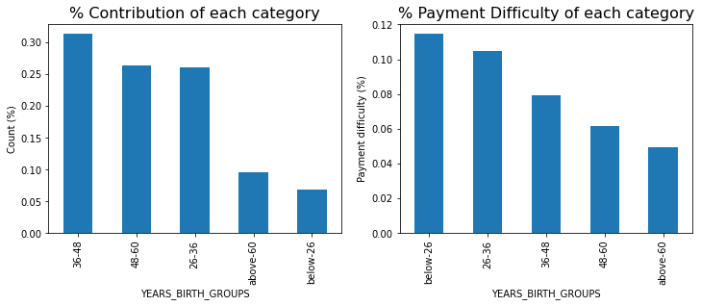
Observation: smaller the age, more will be the loan payment difficulty

Slide 14
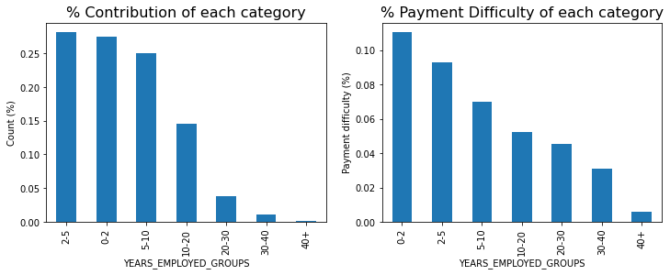
Observation: People with higher employment years have lesser loan payment difficulty

Slide 15
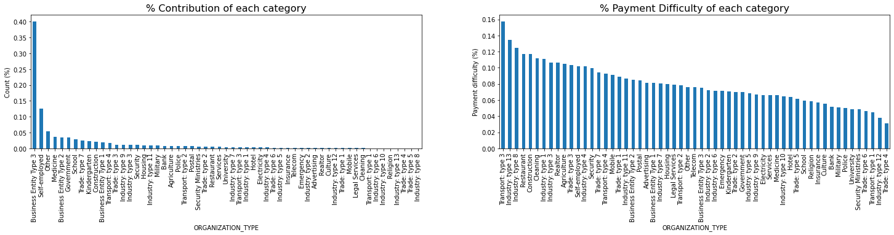
Plot for % payment difficulty for each organization type

Slide 16
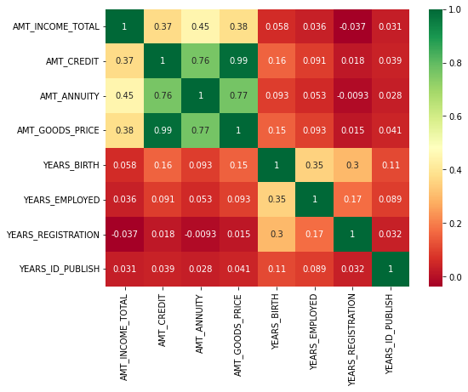
Correlation Heatmap for all numerical columns of all the rows of applicant’s dataset
(TARGET == 1 as well as TARGET == 0)

Slide 17
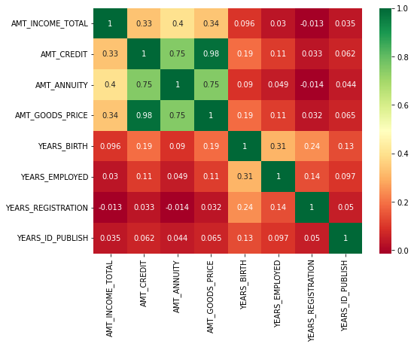
Correlation Heatmap for all numerical columns of all the rows of applicant’s dataset where TARGET == 1
(WITH LOAN PAYMENT DIFFICULTY)

Slide 18
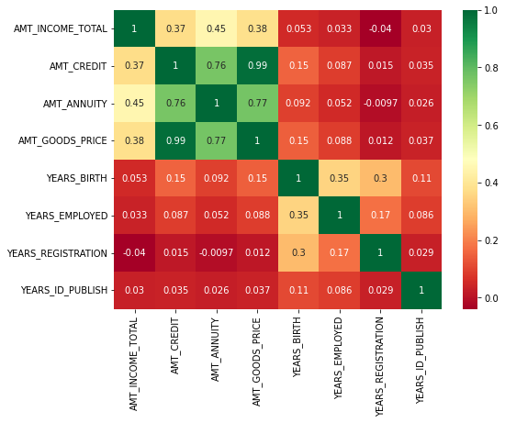
Correlation Heatmap for all numerical columns of all the rows of applicant’s dataset where TARGET == 0 (ALL OTHER CASES)
It can be observed that all 3 Correlation heatmaps are almost identical

Slide 19
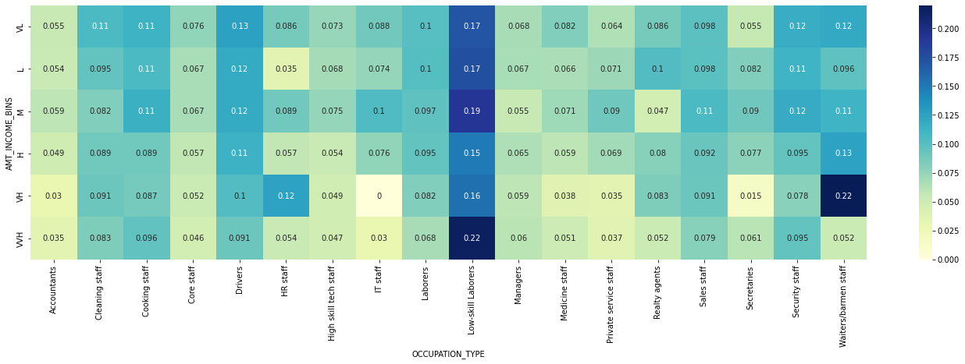
Heatmap with X axis= Type of occupation, Y axis= Income bins, Values= loan Payment difficulty
Observation 1: Lower skilled laborers have maximum loan payment difficulty, even true when they are having higher income.
Observation 2: Accountants have least difficulty in loan payments

Slide 20
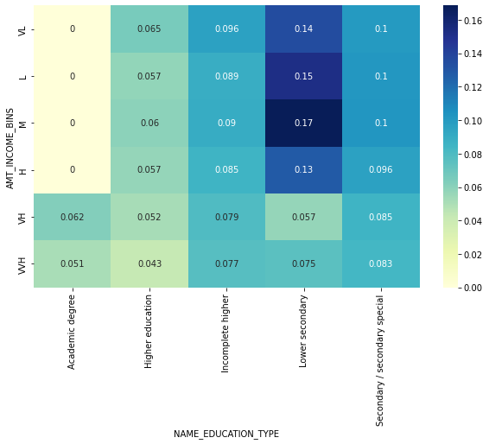
Heatmap with X axis= Type of education, Y axis= Income bins, Values= loan Payment difficulty
Observation: people with lower secondary type of education have maximum loan payment difficulty until they don’t have a very high income

Slide 21
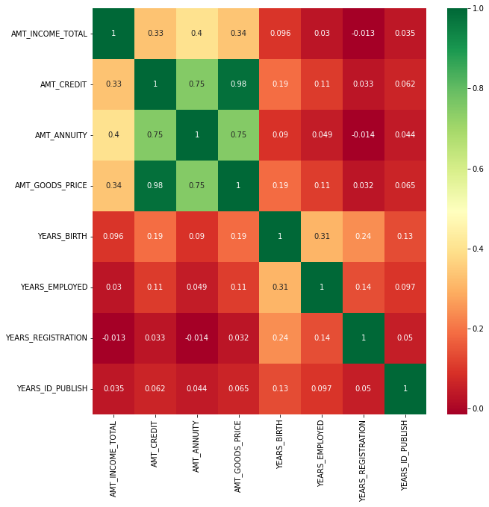
Finding 10 Highest correlations between two variables in the applicant’s data
(we will only consider data where TARGET == 1)
From this heatmap, it can be concluded that top 10 correlation variable pair are: (Variable1, Variable2, Correlation)
1) AMT_CREDIT & AMT_GOODS_PRICE : 0.98
2) AMT_ANNUITY & AMT_GOODS_PRICE : 0.75
3) AMT_CREDIT & AMT_ANNUITY : 0.75
4) AMT_INCOME_TOTAL & AMT_ANNUITY : 0.40
5) AMT_INCOME_TOTAL & AMT_GOODS_PRICE : 0.34
6) AMT_INCOME_TOTAL & AMT_CREDIT : 0.33
7) YEARS_BIRTH & YEARS_EMPLOYED : 0.31
8) YEARS_BIRTH & YEARS_REGISTRATION : 0.24
9) AMT_CREDIT & YEARS_BIRTH : 0.19
10) AMT_GOODS_PRICE & YEARS_EMPLOYED : 0.11

