Slide 1

Jain College of Engineering & Research,
Udyambag, Belagavi
NBA Accredited Programs: ECE & MECH
Department of Computer Science And Engineering
HackVally Presentation
“Urban Pulse: Intelligent Ride Matching & Dynamic Driver Allocation”
  Problem Statement 02 · TEAM ID: ________
  Team Zorvice
Team Members:
Salman K.
Member 2
Member 3
Member 4

Slide 2
Problem Statement
Ride-hailing in tier-2 cities like Belagavi still runs on “send the nearest driver”, and that breaks in four ways
1
Unfair, blind matching
2
Demand caught off guard
Nearest-driver dispatch ignores workload and idle time: some captains are overloaded, others sit idle.
Rain, station rushes and events create zone shortages; captains are in the wrong place and riders wait.
3
Failed rides strand riders
4
Safety and trust gaps
A decline, timeout or cancellation leaves the rider to rebook by hand with no recovery.
Riders can’t ask for a woman driver, and fares or surge feel opaque and arbitrary.

Slide 3
Proposed Solution
Urban Pulse picks the best captain with an explainable score, moves captains before demand peaks, and recovers every failed ride automatically
1
2
3
4
5
Smart Dispatch
Demand Forecast
Zone Balancing
Auto Reassign
Safety & Sharing
ETA + workload + reliability + idle-time score, run inside Postgres
ML model predicts each zone’s demand 30 min ahead
Shortage zones pull idle captains, with cooldown and no herding
Declines, timeouts, offline or cancelled captains: the next best is offered
“Prefer a woman driver” hard filter, rider chat, shared cab at 25% off

Slide 4
Proposed Solution: Smart Dispatch
1
Filter: Same vehicle type, online, fresh location, within 2/3/5 km, free, not already tried, preference respected
Captain score weights
2
Shortlist: Only the 8 nearest eligible captains are scored
3
Score: Explainable weighted score; every decision is stored for audit
4
Offer: Row lock + single pending offer; captain has 10 s to accept
5
Recover: Decline or timeout: exclude that captain, offer the next best (up to 5 tries)
Each part is normalised 0–1 across eligible captains. Gender is never scored.

Slide 5
Technology Stack
Frontend
Backend & Data
React 19 + TypeScript + Vite
Tailwind CSS v4 + shadcn/ui
React-Leaflet + OpenStreetMap
Supabase: Postgres + PostGIS
Auth, Realtime, RLS policies
Dispatch logic in SQL RPC functions
Machine Learning
Testing & Quality
Python + scikit-learn
HistGradientBoosting (Poisson)
30-min zone demand forecast
Vitest unit tests, Playwright E2E
SQL safety, privacy, smoke suites
16 concurrency scenarios
No separate API server: riders and captains call secure database functions directly, so every rule is enforced in one place.

Slide 6
Implementation
Rider app
Supabase RPCs
request_ride → _dispatch
respond_offer, retry_ride
sweep every 10 s: timeouts, reassign, reposition
Postgres + PostGIS
rides, offers, zones
zone_balance()
dispatch_audit
ML forecasts
Captain app
Judge console
Ride lifecycle (every transition validated and logged, live via Realtime)
Requested
Offered
Accepted
Arriving
On trip
Completed
Auto-reassign on: decline · timeout · captain offline or stale GPS · captain cancels · late to pickup · preference withdrawn

Slide 7
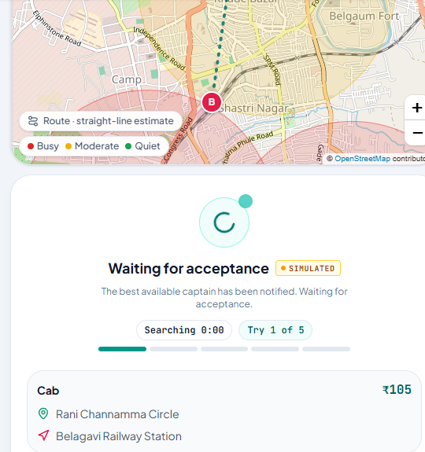
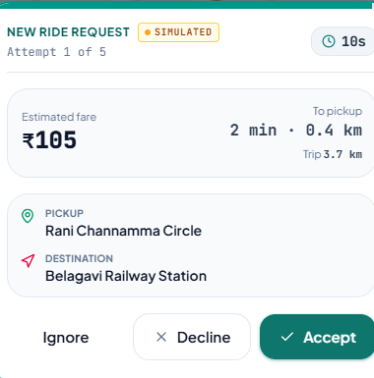
Implementation: Working Prototype
Also built
Judge console: “Why this captain?” scores
Chaos Mode: inject failures live
Dispatch Arena: 3 policies, same requests
What-If lab: rain, concert, rush hour
Zone map: busy / moderate / quiet areas
Captain: 10-second ride offer with fare and pickup
Rider: live search, “Try 1 of 5”

Slide 8
Implementation: Results
Demand forecast error (MAE, lower is better)
0
women-preference violations across all policies and seeds
4.65 → 2.33
min pickup wait at 250 cabs after the 8-nearest shortlist fix
~75%
fewer repositioning km with the zone planner, so captains earn more
88
SQL tests (safety, privacy, smoke) plus 16 concurrency scenarios
22.4% more accurate than the seasonal baseline, 30 min ahead
Dispatch Arena: same requests, 3 policies, 20 scenarios × 10 seeds. All demand and drivers are simulated.

Slide 9
Applications and Real-World Impact
Tier-2 city mobility
Fleet operators
Captain livelihoods
Bike, auto and cab booking for cities like Belagavi, with fares following the Karnataka app-cab tariff.
Drop-in dispatch engine: fair allocation, auto-recovery and a full audit trail of every decision.
Workload and idle-time balancing spreads trips fairly; fewer empty kilometres means higher net earnings.
Women’s safety
Peaks & events
City planning
Same-gender driver preference as a strict filter, private opt-in, safety feedback and reports.
Stations, stadiums and rain: forecasts move captains into shortage zones before queues build.
Zone-level demand forecasts help plan stands, shared rides and public-transport feeders.

Slide 10
Conclusion
What we delivered
What’s next
End-to-end rider, captain and judge apps, live on real-time data
Explainable, auditable dispatch that never strands a rider
ML demand forecast driving proactive zone repositioning
Safety-first design, honestly benchmarked in Dispatch Arena
3–5 s batch matching window (cut pickup wait up to 4 min in tests)
Real GPS and road routing instead of straight-line estimates
Train on real Belagavi demand and verify local auto tariffs
Pilot with a local auto / cab union
Urban Pulse: Smart Rides. Smarter City. Thank you!

