Slide 1

SUPERSTORE SALES ANALYSIS AND BUSINESS INSIGHTS

Slide 2

Business Objective
Analyze sales and profit performance
Identify profitable categories/regions
find factors affecting profit
Provide business recomendations

Slide 3

Dataset Overview
Superstore sales dataset containing retail transaction records
Includes sales, profit, discount, category, region, and customer segment data
Dataset used to analyze sales performance and business trends
Data cleaning and preprocessing performed for accurate analysis

Slide 4

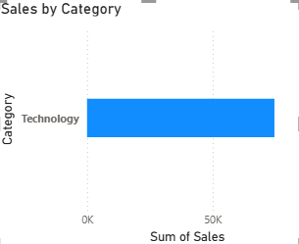
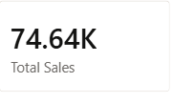
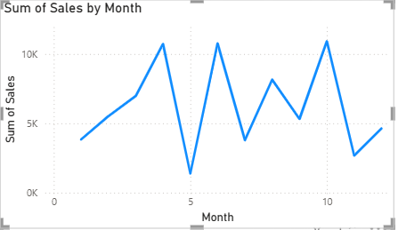
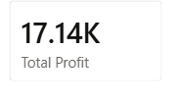
Sales Analysis
82%
Sales showed steady growth over time
Technology category generated highest sales
West region contributed maximum revenuet

Slide 5

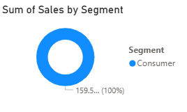
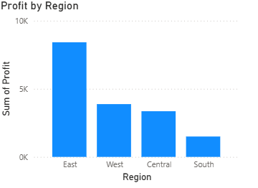
Regional and Segement Analysis
West region had highest sales
South region showed lower performance
Consumer segment contributed most sales
Corporate segment generated good profit

Slide 6
Key Insights
Technology category generated highest profit
High discounts reduced profit
West region had highest sales
Furniture category showed low profitability
Sales increased during certain months

Slide 7
Business Recommendations
Reduce excessive discounts
Focus on profitable categories
Improve low-performing regions
Optimize pricing strategy
Target high-value customers

Slide 8
Conclusion
Sales and profit trends were successfully analyzed
Technology category and West region performed best
Discounts had a significant impact on profit
Data-driven insights helped identify business improvement areas
Recommendations were provided to improve overall profitability

Slide 9

THANK YOU

