Slide 1
Expense & Reimbursement Agent
An AI that reads the bills and reads the policy — from a pile of receipts to ready to submit
Competition prototype · all data synthetic · Pydantic AI + Claude · FastAPI

Slide 2
The problem
Reimbursement is a tax on every employee and every finance reviewer
• Collect and key in bills — photos, PDFs, foreign currency, crumpled paper
• Categorise each one — and guess which policy bucket it belongs in
• Look up the limits — policies live in long documents that change
• Avoid duplicates and missing details — or the claim bounces back
• Re-submit after rejection — the employee finds out too late
Our goal
Drop in the bills. Get a policy-checked, explained, submission-ready claim — answering only what the system cannot work out itself.

Slide 3
How it works
Six steps, three of them use AI
1
2
3
4
5
6
Drop bills
AI reads bills
AI reads policy
Classify & check
Ask only gaps
Submit
photos, PDFs
vendor, date, total, items
limits, grades, clauses
category, eligible amount, duplicates
5 questions, not 24 forms
mock finance system
Steps 2–4 use LLMs; every amount is computed by deterministic code, and every AI-extracted rule must quote the policy verbatim.

Slide 4
Where AI is used — and where it is not
LLMs interpret and judge; plain code does the money
Component | Technique | Why
Receipt extraction | LLM (vision) | Messy photos and PDFs
Policy interpretation | LLM + grounding check | Prose in, structured limits out; quotes stop invented rules
Clause lookup for answers | RAG (BM25 over clauses) | Cites the exact clause; offline and free
Bill classification | LLM with reasoning | A judgement call that must be explained
Eligible amount, caps, partial pay | Deterministic | Financial accuracy, reproducible
Duplicates, grouping, claim state | Deterministic | Auditable (image hashing was tested and rejected)
Chat assistant | Agent with tools | Open-ended follow-ups; reads decisions, never makes them

Slide 5
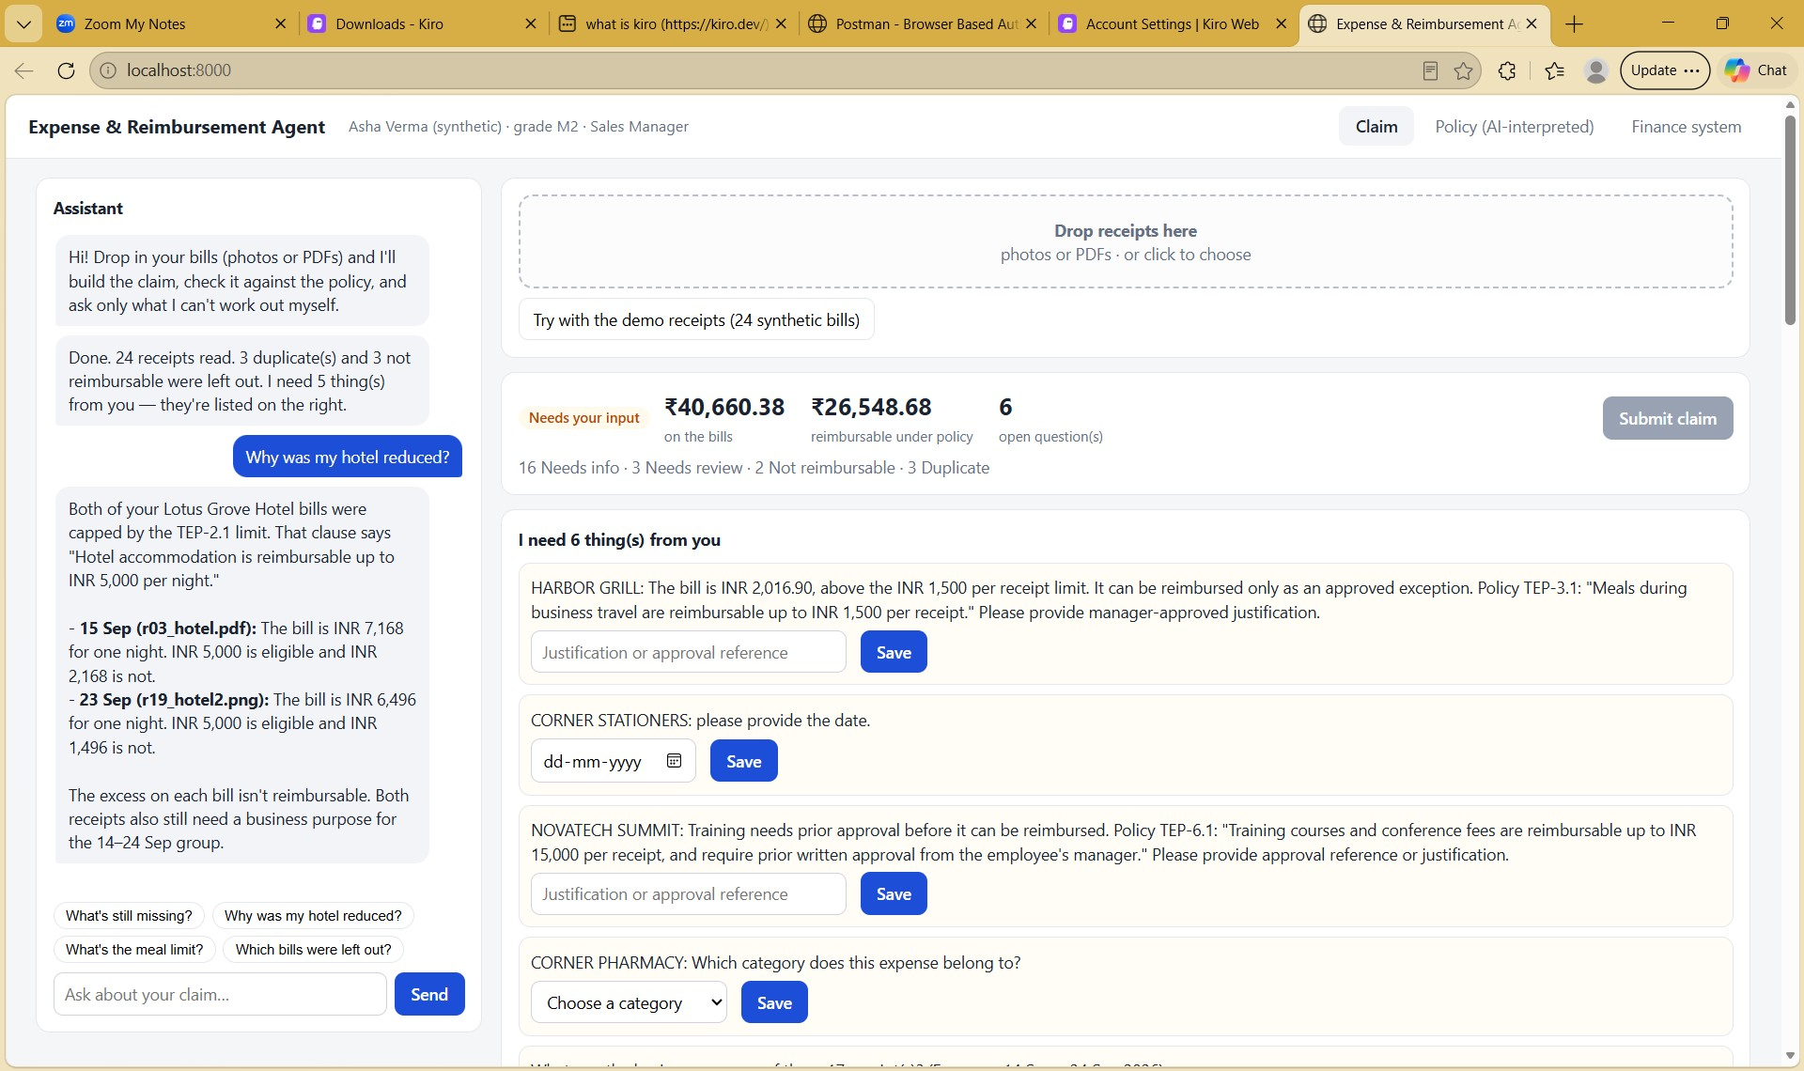
Policy is a document, not code
Edit one sentence — the claim updates, no release needed
• AI reads the policy files — limits, grades, units, partial-pay rules
• Each rule carries a verbatim quote — checked against the clause; numbers must appear in the quote
• Hotel limit 5,000 → 7,000 — reimbursable total moves ₹23,053 → ₹26,549
• No code changed — interpretation is cached by document hash
[screenshot placeholder: 04_policy_changed_no_code.jpg]

Slide 6
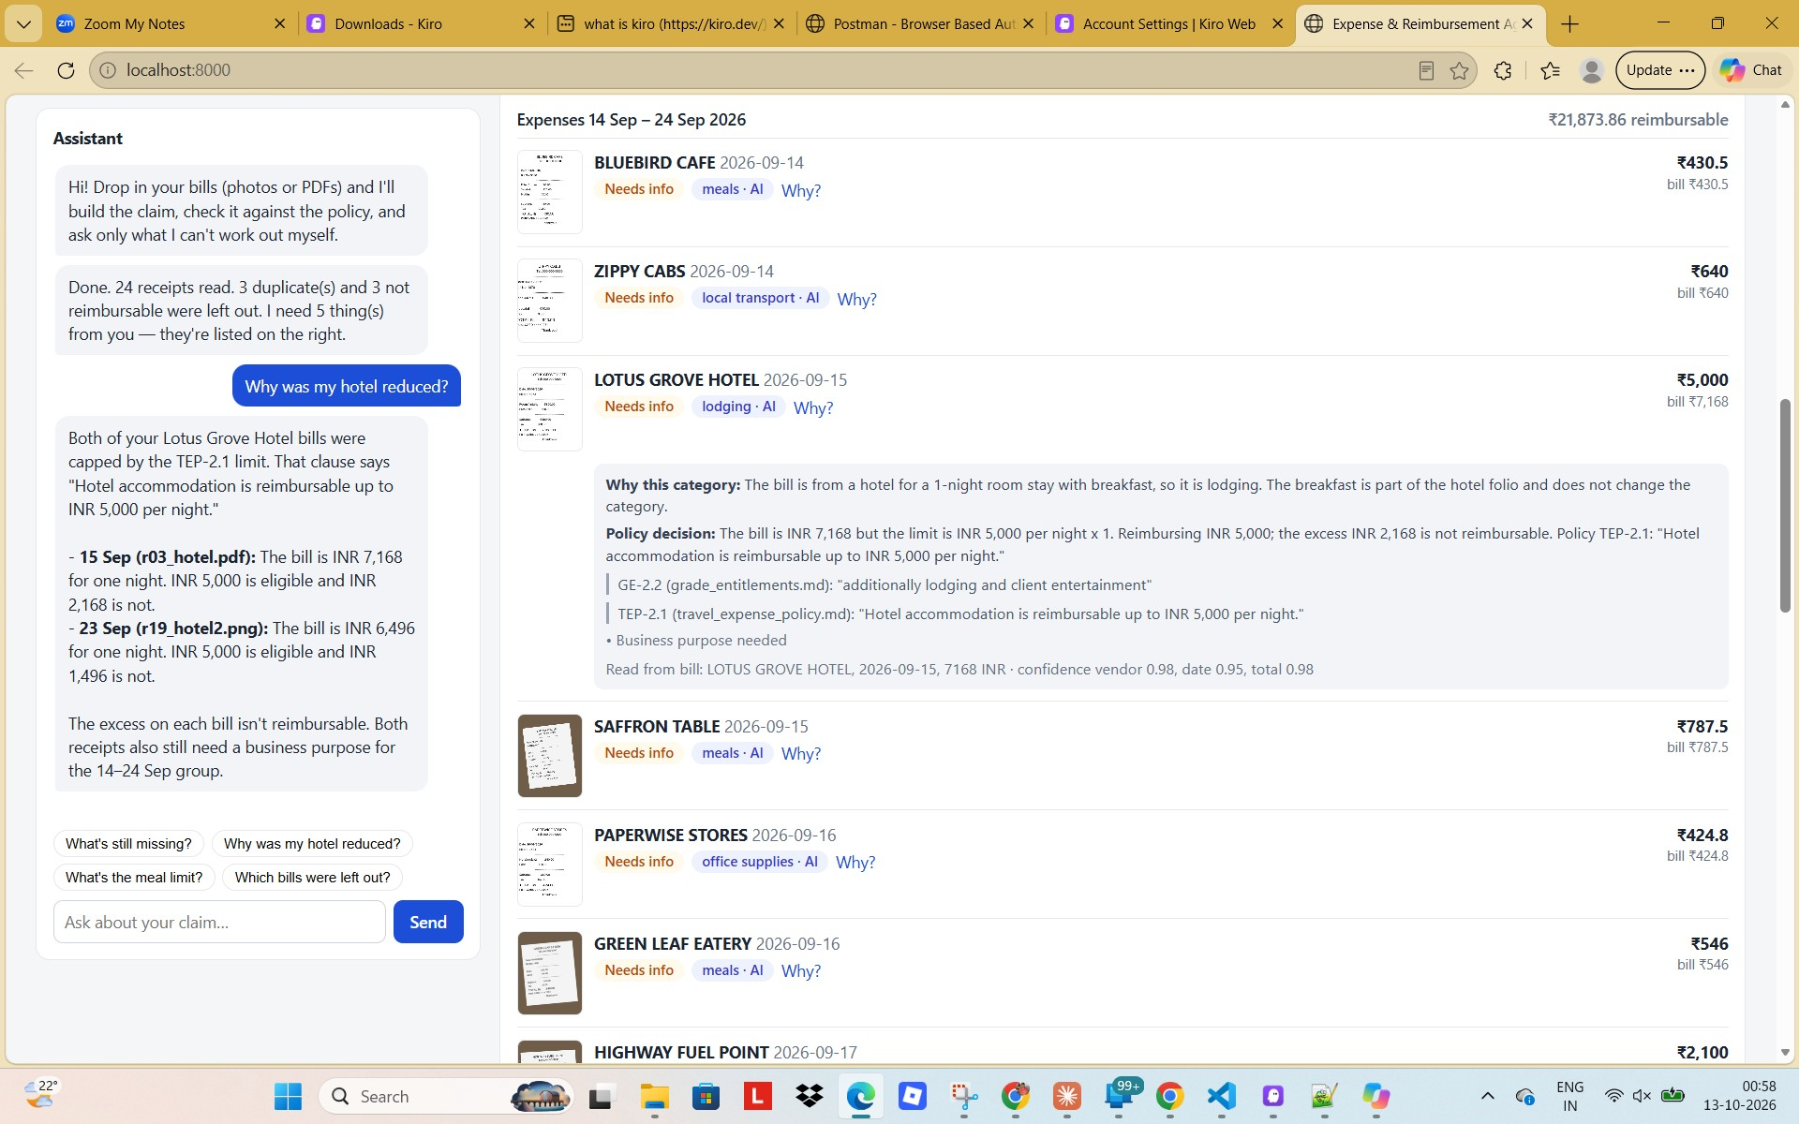
Every decision is explained
Category, clause, quote, arithmetic and what is still needed
• Why this category — the AI's reasoning
• Which clause — TEP-2.1 and GE-2.2, with quotes
• What is eligible — ₹5,000 of ₹7,168; excess not reimbursable
• What is needed — shown as a question, once
[screenshot placeholder: 02_explainable_decision.jpg]

Slide 7
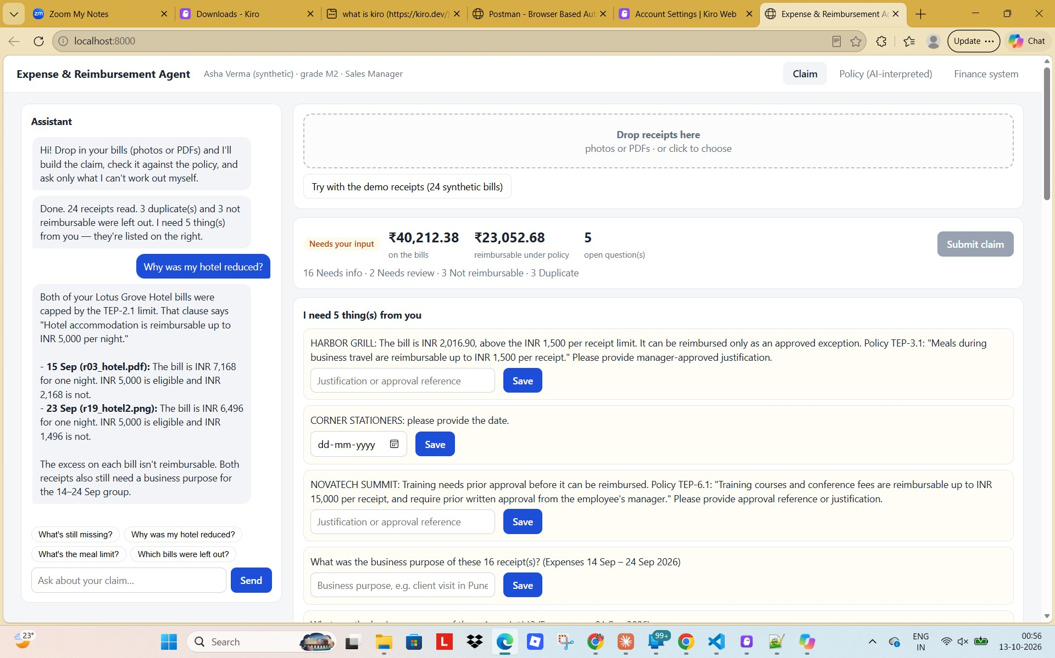
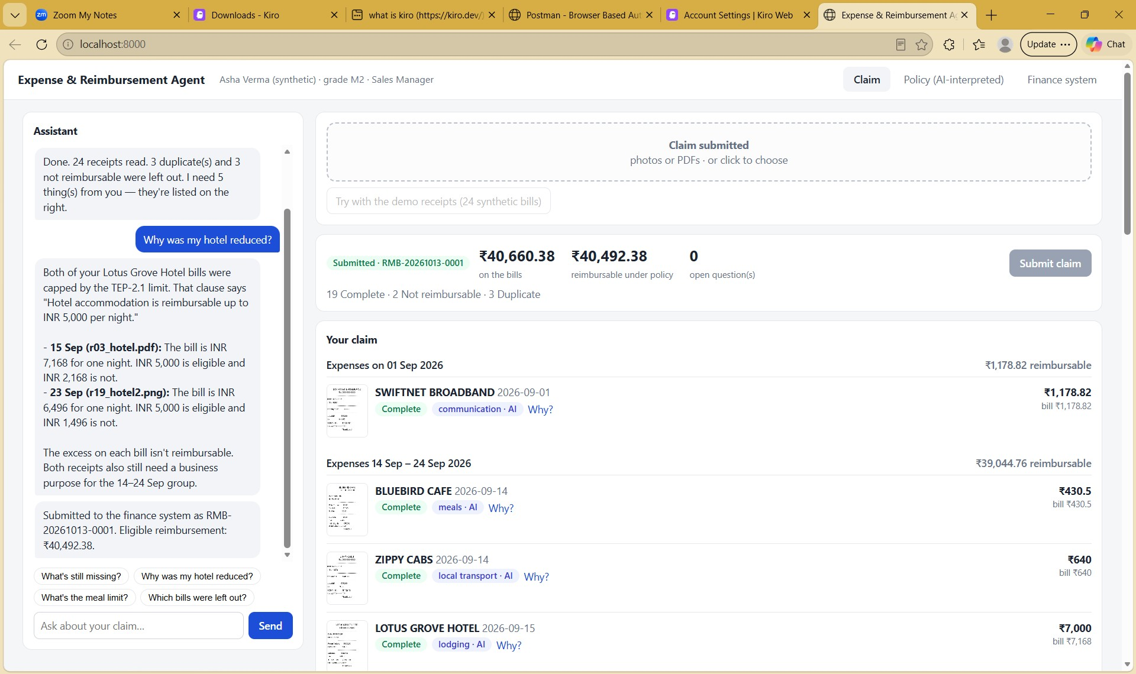
The experience
Chat on the left, claim on the right
[screenshot placeholder: 01_claim_and_chat.jpg]
[screenshot placeholder: 05_submitted.jpg]

Slide 8
Results on 24 synthetic receipts
Measured with Claude Sonnet 5.5; 133 automated tests pass, 100% coverage
Measure | Result
Vendor, date, total, currency extracted | 24 / 24
Category classification | 23 / 24
Duplicates found (incl. re-photographed) | 3 / 3, no false alarms
Bills auto-excluded with clause | 3 (expired, personal, over limit)
Questions asked | 5 for 24 receipts
Policy edit applied without code | Yes
Free-tier check
Gemini 3.8 Flash interpreted the policy identically; the 5 receipts it processed were all correct. 3 hit HTTP 503 overload, so no full-set figure is claimed.

Slide 9
Business impact
Illustrative model — assumptions are stated and editable
24 receipts | Time
Manual (assume 4 min per receipt) | ~96 min
With the agent (5 answers + 3 min review) | ~7 min
Saved per claim | ~89 min (≈90%)
• Fewer rejected claims — employees see the eligible amount first
• Reviewers stop re-checking limits and duplicates
• Policy changes ship as a document edit
• Full audit trail — clause, quote and maths per item
Time figures come from an assumption (4 min per receipt by hand, 30 s per question), not from measurement. See docs/BUSINESS_IMPACT.md.

Slide 10
Honest limits and next steps
• Synthetic bills only — real receipts are messier
• One employee profile and one policy set
• Static illustrative FX rates; no authentication
• Policy parsing assumes numbered clauses
• Free LLM tiers rate-limit; results are cached
• Next — real HRMS grades and location tiers
• Next — embeddings RAG for large policy libraries
• Next — multi-category bills and trip-level caps
• Next — approval workflow and finance integration

