Slide 1
ML CS6375 Project Demo Pump It Up: Data Mining the Water Table
Presented by:
Ankita Patil
Abhilash Gudasi
Shiva Ranga Chawala
Spring 2018

Slide 2
Source of the Project
DrivenData Competition
https://www.drivendata.org/competitions/7/pump-it-up-data-mining-the-water-table/
Datasets link
https://www.drivendata.org/competitions/7/pump-it-up-data-mining-the-water-table/data/

Slide 3
Goal
The data is from Taarifa waterpoint dashboard which aggregates the data from the Tanzanian Ministry of Water
Goal is to predict the operating condition of waterpoint.
Basically, we will try to predict which water pumps are functional, which need some repairs and which don’t work at all.

Slide 4
Dataset Description
Dataset contains about 59400 instances and about 40 features.
Detailed description of the dataset in the next slide
By looking at the dataset we observe that,
Few features of the dataset contain numerical data whereas few features of the dataset contain categorical data.
For few features, values are missing.
Hence, in preprocessing of the data we need to address the points which are stated above.

Slide 5
Feature | Description
amount_tsh | Total static head (amount water available to waterpoint)
date_recorded | The date the row/record was entered
funder | Who funded the well
gps_height | Altitude of the well
installer | Organization that installed the well
longitude | GPS coordinate
latitude | GPS coordinate
wpt_name | Name of the waterpoint if there is one
num_private | -
basin | Geographic water basin
subvillage | Geographic location
region | Geographic location
region_code | Geographic location (coded)
district_code | Geographic location (coded)
lga | Geographic location
ward | Geographic location
population | Population around the well
public_meeting | True/False
recorded_by | Group entering this row of data
scheme_management | Who operates the waterpoint
scheme_name | Who operates the waterpoint
permit | If the waterpoint is permitted
construction_year | Year the waterpoint was constructed
extraction_type | The kind of extraction the waterpoint uses
extraction_type_group | The kind of extraction the waterpoint uses
extraction_type_class | The kind of extraction the waterpoint uses
management | How the waterpoint is managed
management_group | How the waterpoint is managed
payment | What the water costs
payment_type | What the water costs
water_quality | The quality of the water
quality_group | The quality of the water
quantity | The quantity of water
quantity_group | The quantity of water
source | The source of the water
source_type | The source of the water
source_class | The source of the water
waterpoint_type | The kind of waterpoint
waterpoint_type_group | The kind of waterpoint
Labels | Description
functional | the waterpoint is operational and there are no repairs needed
functional needs repair | the waterpoint is operational, but needs repairs
Non-functional | the waterpoint is not operational

Slide 6
Number of Features | 40
Number of Labels | 3
Number of instances | 59400
 | Total
Features | 40
Labels | 3
Instances | 59400

Slide 7

Data Exploration
Univariate analysis for few features

Slide 8
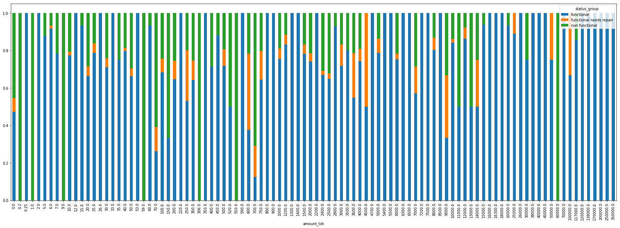
Amount_tsh vs Status_group

Slide 9
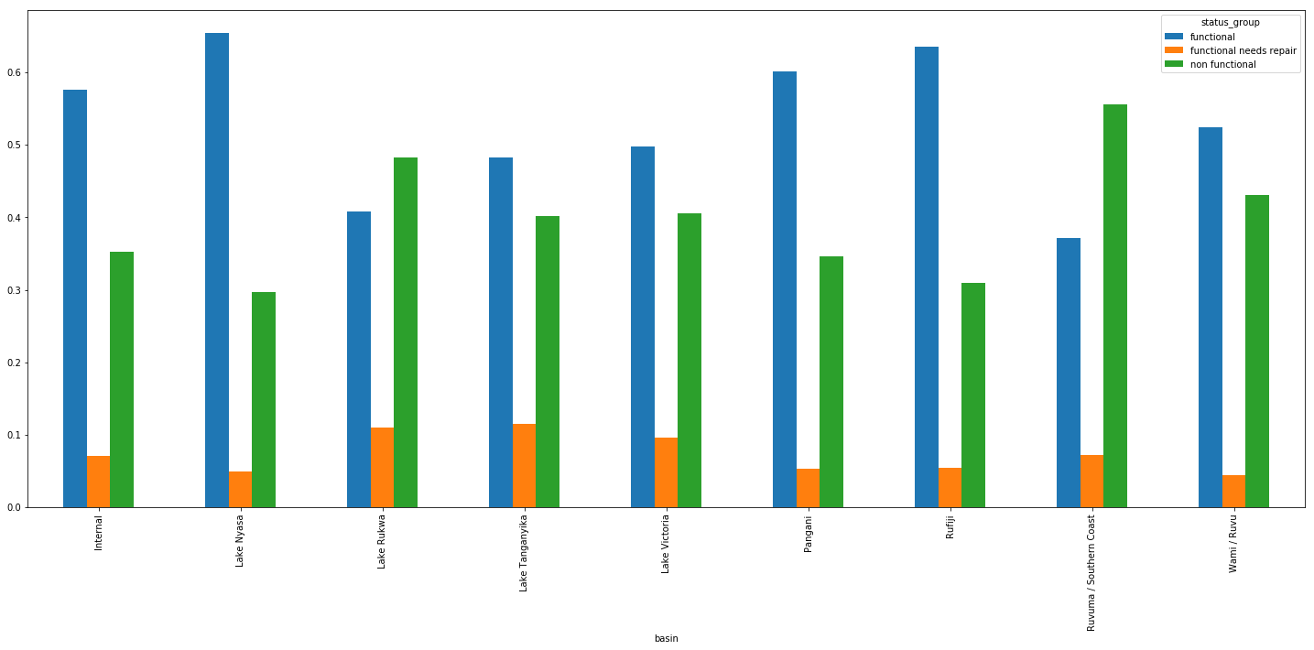
Basin vs Status_group

Slide 10
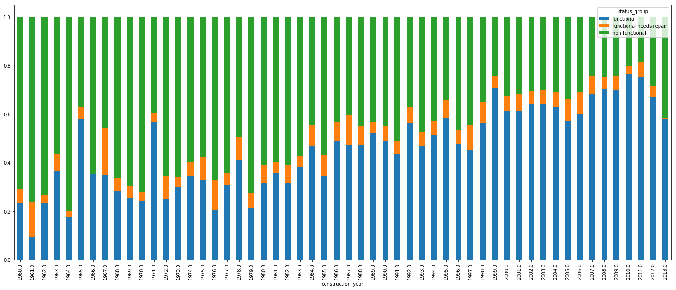
Construction_year vs Status_group

Slide 11
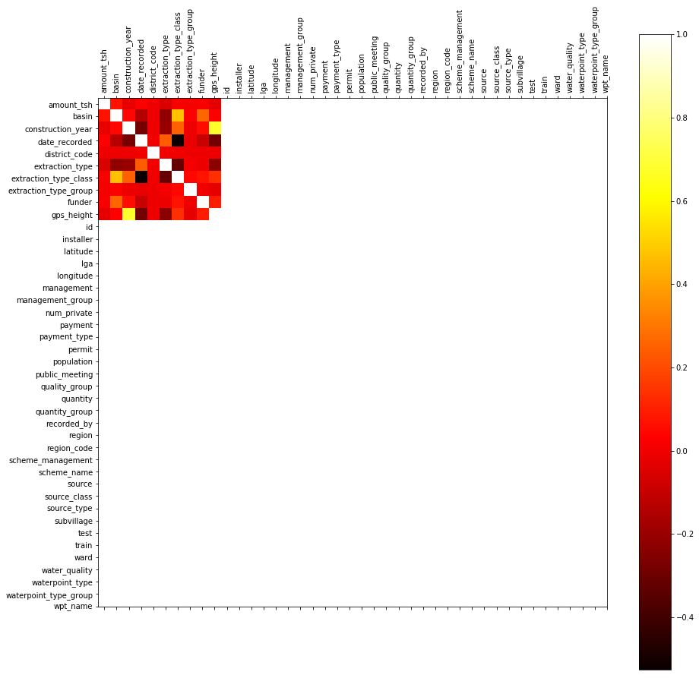
Initial Correlation Graph
From the graph, we observe that many features are highly correlated.

Slide 12
Feature Engineering
Dealing With Missing values
for columns gps_height, latitude, longitude using Geocoder
Normalization using MinMaxScaler
Dealing with categorical variables with LabelEncoder
Merged construction_year and date_recorded
Reduced number of features from 40 to 26

Slide 13
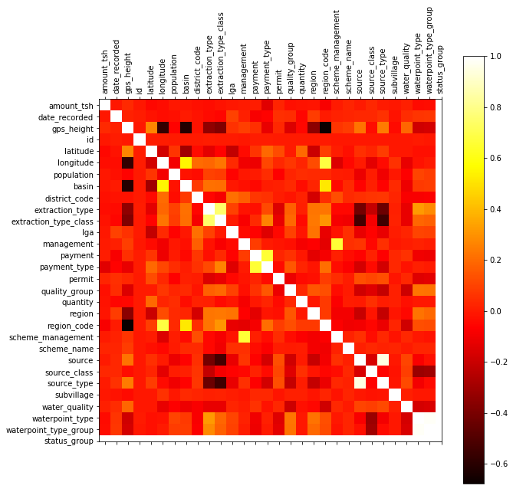
Correlation graph after pre-processing

Slide 14
Algorithms Implemented
Logistic Regression
Support Vector Machine
Adaboosting
Deep Learning
Random Forest

Slide 15
Language, Tools, Packages
Python 3.6
Sci-kit learn
Anaconda
Jupyter Notebook
Geocoder

Slide 16
Workflow
After data exploration and pre-processing of the data, we built classifiers based on Scikit learn documentation
For parameter estimation, use of GridSearchCV
Using best parameters from GridSearch, we improved the accuracy of the model by tunning the features.
Cross-validation using K-fold

Slide 17
Data Exploration: Univariate Analysis, Correlation Graph
Pre-processing/Feature Engineering
Algorithm Implementation
Model training and parameter tuning using GridSearchCV
With train-test split
With k-fold cross validation
With the trained model, predict the accuracy on the test data

Slide 18
Results
Algorithm | Accuracy
Logistic Regression | 68.53%
Support Vector Machine | 56.16%
Adaboosting | 77.50%
Deep Learning | 66.67%
Random Forest | 82.35%

