Slide 1


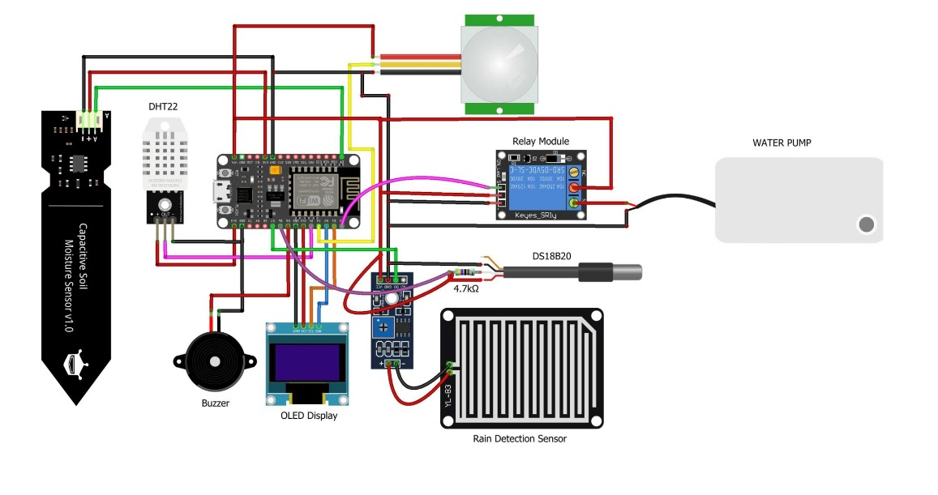

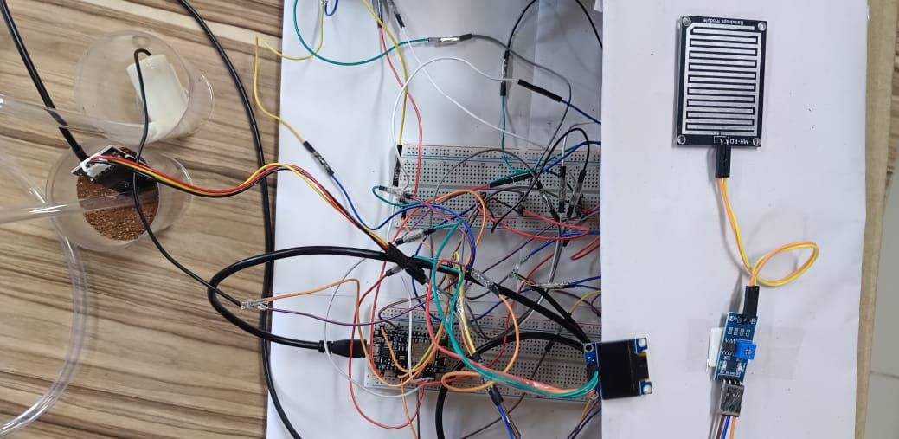


AGRICULTURE AUTOMATION SYSTEM.
UE22CS251B : MPCA
CONDENSED ABSTRACT
Block Diagram :
This project is an agricultural automation system built with an ESP8266 microcontroller and various sensors. The system monitors soil moisture, temperature (ambient and soil), humidity, and rainfall. It then processes this data to control irrigation automatically and trigger alerts for abnormal conditions.
.
NAME : SHIVADARSHAN
SRN : PES1UG22CS560
.
.
Actual Model:
NAME : SHIVALING
SRN : PES1UG22CS561
t.
Guided By : -
MISS DEEPASHREE .H.L.
NAME : SRINIVAS
SRN : PES1UG22CS584

