Slide 1
ICCCA- 2025
2025 IEEE 7TH International Conference on Computing, Communication and Automation (#66364)
Paper ID: 1864
Paper Title: Credit Card Fraud Detection
Track Name: Main Track
Presenter Name: Shivadhar Reddy Gade
Affiliation: Student, Chandigarh University.

Slide 2
Outline
Introduction
Existing Approaches/ Related Work
Problems in Existing Approaches
Proposed Methodology
Results
Conclusion and Future Work
References

Slide 3
Introduction
Credit cards are widely used globally, increasing convenience but also fraud risks.
Rising online payments have led to major financial losses and reduced consumer trust.
Traditional rule-based and manual systems fail to detect evolving fraud techniques.
Machine Learning(ML) enables smart, data-driven fraud detection techniques.
Individual ML models struggle with imbalanced datasets and dynamic fraud patterns.
The proposed Hybrid ML Model combines supervised and unsupervised learning to enhance accuracy, scalability, and reduce false positives.

Slide 4
Existing Approaches / Related Work
Rule-Based Systems: Use predefined transaction limits and patterns; easy to implement but lack adaptability to new frauds.
Supervised Machine Learning Models: Algorithms like Logistic Regression, Decision Trees, Random Forest, SVM, and Gradient Boosting use labeled data to classify transactions.
Unsupervised Methods: Techniques such as Autoencoders, Isolation Forest, and K-means detect anomalies without labels but generate higher false alarms.
Deep Learning Approaches: ANN, CNN, and RNN models capture complex patterns yet require heavy computation and large datasets.
Hybrid Machine Learning Models: Combine supervised and unsupervised learning to balance accuracy, scalability, and adaptability for real-time fraud detection.

Slide 5
Problems in Existing Approaches
High False Alarms: Frequent false positives and negatives reduce system reliability.
Imbalanced Data: Fraud cases are rare, causing biased model predictions.
Lack of Adaptability: Existing systems fail to detect new and evolving fraud patterns.
High Computational Cost: Deep and complex models require significant processing power.
Limited Real-Time Scalability: Most models cannot handle large-scale, real-time transaction data efficiently.
Poor Scalability and Integration: Existing models lack flexibility and scalability for deployment in real-world financial systems.

Slide 6
Proposed Methodology
Dataset & Preprocessing: Used the Kaggle Credit Card Fraud Dataset(284,807 transactions, 492 frauds). Missing values were handled, data normalized, and classes balanced using SMOTE and undersampling to address imbalance.
Feature Optimization: Applied Principal Component Analysis(PCA) to eliminate redundant features, reduce dimensions, and enhance model efficiency.
Hybrid Model Design: Combined supervised algorithms(Random Forest, SVM, Gradient Boosting) with unsupervised methods(Autoencoder, Isolation Forest) for improved fraud detection accuracy and adaptability.
Evaluation Metrics: Performance measured using Accuracy, Precision, Recall, F1-score, and AUC-ROC, emphasizing reduced false positives and missed frauds for real-time scalability.

Slide 7
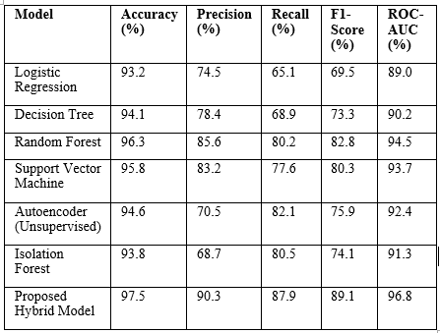
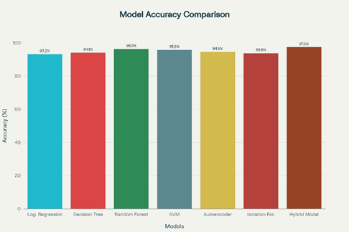
Results

Slide 8
Conclusion and Future Work
The hybrid ML model effectively combines supervised and unsupervised algorithms to improve fraud detection accuracy and reduce false positives/negatives.
Results demonstrate higher precision, recall, F1-score, and ROC-AUC, proving superiority over traditional single models.
The system offers real-time scalability, making it suitable for large-scale financial and online transaction monitoring.
Incorporating blockchain and federated learning can ensure secure, transparent, and privacy-preserving fraud detection.
Future work aims to use online and reinforcement learning for adaptive, self-evolving detection against new fraud patterns.

Slide 9
References
[1] E. A. L. M. Btoush, X. Zhou, R. Gururajan, K. C. Chan, R. Genrich, and P. Sankaran, ‘A systematic review of literature on credit card cyber fraud detection using machine and deep learning’, PeerJ Comput Sci, vol. 9, p. e1278, Apr. 2023, doi: 10.7717/PEERJ-CS.1278/TABLE-7.
[2] M. A. Alrasheedi, ‘Enhancing Fraud Detection in Credit Card Transactions: A Comparative Study of Machine Learning Models’, Comput Econ, pp. 1–27, Aug. 2025, doi: 10.1007/S10614-025-11071-3/TABLES/12.
[3] V. Chang, B. Ali, L. Golightly, M. A. Ganatra, and M. Mohamed, ‘Investigating Credit Card Payment Fraud with Detection Methods Using Advanced Machine Learning’, Information 2024, Vol. 15, Page 478, vol. 15, no. 8, p. 478, Aug. 2024, doi: 10.3390/INFO15080478.
[4] M. Shanaa and S. Abdallah, ‘A Hybrid Anomaly Detection Framework Combining Supervised and Unsupervised Learning for Credit Card Fraud Detection’, F1000Research 2025 14:664, vol. 14, p. 664, Jul. 2025, doi: 10.12688/f1000research.166350.1.

