Slide 1
Harvesting Insights: A Predictive Model for Crop Production
Submitted in the partial fulfillment for the award of the degree of
BACHELOR OF ENGINEERING
IN
Information Security & Big Data
Submitted by:
G. Shivadhar Reddy(22BIS70026) A. Ashwik Reddy(22BDA70116) T. Anshik Srishanth(22BIS70115)
Under the Supervision of:
Mr. Harjot Singh
(E17695)
Department of AIT-CSE
DISCOVER . LEARN . EMPOWER

Slide 2
Outline
Introduction to Project
Problem Formulation
Objectives of the work
Methodology used
Results and Outputs
Conclusion
Future Scope
References

Slide 3
Introduction to Project
Overview The project aims to create a predictive model that utilizes historical agricultural data to improve accuracy in crop production forecasting.
Importance Accurate forecasting helps farmers make informed decisions, optimize resources, and mitigate risks associated with crop failure.
Key Stakeholders The project involves collaboration with agricultural experts, data scientists, and local farmers to ensure practical applicability.

Slide 4
Problem Formulation
Current Challenges Traditional methods of crop forecasting often lack accuracy due to unpredictable climatic factors and insufficient data analysis.
Data Limitations Inadequate data collection methods and a lack of integration between various datasets hinder effective predictive modeling.
Need for Innovation There is a pressing need to adopt advanced analytics and machine learning techniques to enhance forecasting capabilities.

Slide 5
Objectives of the Work
Model Development To develop a robust predictive model that can accurately forecast crop yields based on historical data and environmental variables.
Data Integration To integrate diverse agricultural datasets, including weather patterns, soil conditions, and crop management practices.
Validation and Testing To validate the model using real-world scenarios and assess its predictive performance against current methods.

Slide 6
Methodology used
Data Collection Gathering historical yield data, meteorological data, and agronomic practices from multiple sources for comprehensive analysis
Predictive Modeling
Techniques Employing machine learning algorithms, such as regression analysis, time series forecasting, and neural networks, for prediction tasks.
Evaluation Metrics Utilizing metrics like RMSE(Root Mean Square Error) and R-squared for assessing model accuracy and reliability

Slide 7
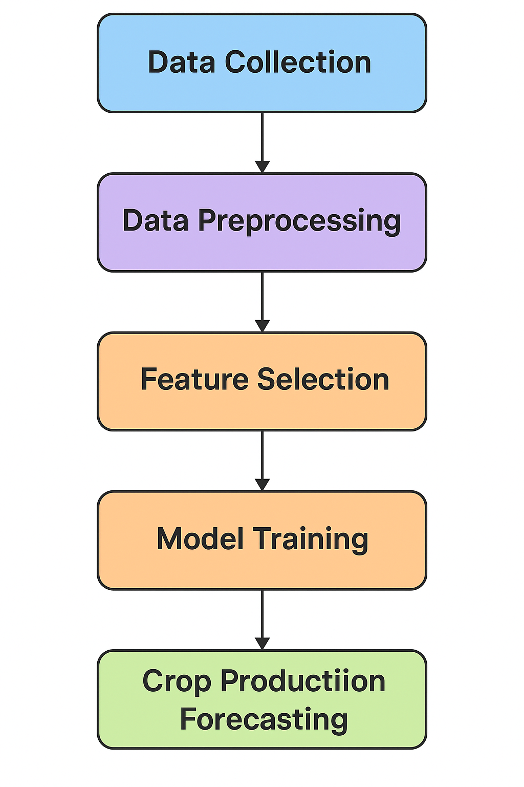
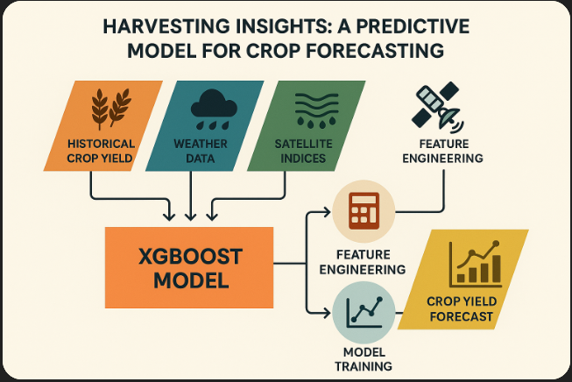
System Architecture of the XG Boost-Based Crop Forecasting Model
Workflow of Crop Production Forecasting Model

Slide 8
Results and Outputs
Model Performance The developed model demonstrates a significant improvement in forecasting accuracy compared to traditional methods, with lower RMSE.
Case Studies Successful case studies show how the model influenced crop management decisions in pilot regions, resulting in increased yields.
Visualization Tools Interactive dashboards and visualizations were created to present forecasting results and underlying data trends to stakeholders.

Slide 9
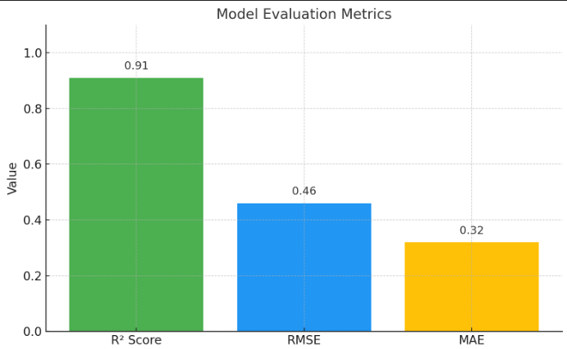
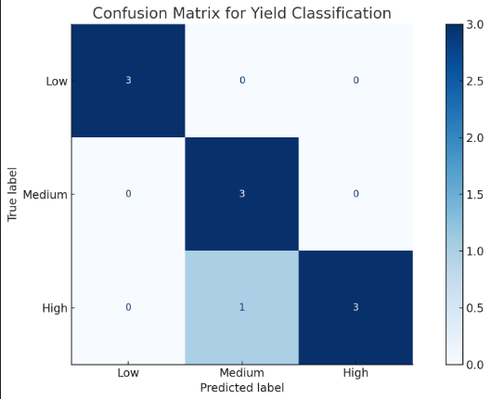
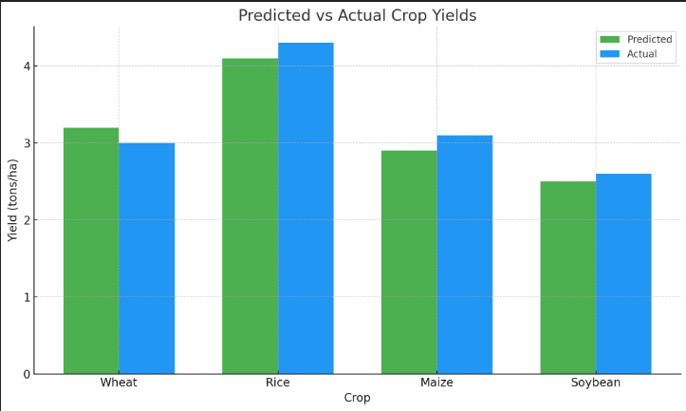
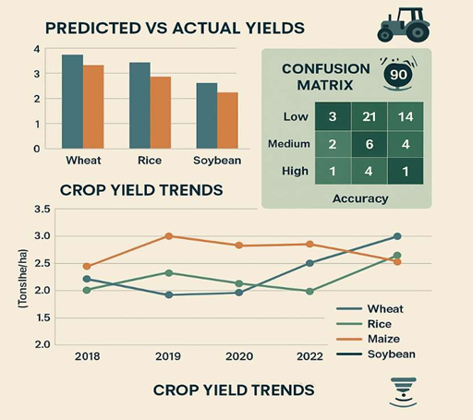

Slide 10
Conclusion
Key Findings The predictive model provides valuable insights, enabling better decision-making in crop production.
Implications for Agriculture The integration of predictive analytics can transform agricultural practices, enhancing productivity.
Call to Action Encouragement for stakeholders to adopt data-driven approaches in agricultural planning.

Slide 11
Future Scope
Model Enhancement Plans to refine the model by incorporating real-time data streams and advanced algorithms for continuous improvement.
Broader Applications Exploring the application of the model across different crops and geographical regions to enhance global agricultural productivity.
Collaborative Efforts Encouraging partnerships with research institution's and agricultural organizations to further validate and expand the model’s capabilities.

Slide 12
References
[1]FAO, “The future of food and agriculture,” UN FAO, Rome, 2017.
[2]A. Ray et al., “Climate change impact on crop yield,” Sci. Total Environ., vol. 718, 2020.
[3]S. Jagtap and J. L. Jones, “Adaptation of the CROPGRO- soybean model,” Agric. Syst., vol. 46, no. 2, pp. 245–258, 1994.
[4]R. K. Aggarwal et al., “Crop yield estimation using remote sensing and weather data,” Remote Sens. Environ., vol. 100, no.3, pp. 351–365, 2006.
[5]M. Kamilaris and F. X. Prenafeta-Boldú, “Deep learning in agriculture: A survey,” Comput. Electron. Agric., vol. 147,
pp. 70–90, 2018.
[6]J. Jeong et al., “Random forest-based crop yield prediction,” Agric. For. Meteorol., vol. 233, pp. 233–243, 2017.
[7]M. Shankar et al., “Ensemble methods for agricultural data mining,” Expert Syst. Appl., vol. 145, 2020.
[8]R. Belgiu and L. Drăguţ, “Random forest in remote sensing: A review,” ISPRS J. Photogramm. Remote Sens., vol. 114, pp. 24–31, 2016.

Slide 13
[9] A. Rembold et al., “Use of NDVI for early warning,” Int.
[10] J. Remote Sens., vol. 34, no. 13, pp. 4531–4556, 2013.
[11] S. K. Srivastava and P. Singh, “Geospatial technologies in yield forecasting,” Curr. Sci., vol. 112, no. 6, pp. 1234– 1240, 2017.
[12] T. Chen and C. Guestrin, “XGBoost: A scalable tree boosting system,” in Proc. 22nd ACM SIGKDD Conf., 2016,
pp. 785–794.
[13] Y. Liang et al., “Crop yield estimation using Sentinel-2 imagery,” Remote Sens., vol. 12, no. 3, pp. 547–560, 2020.
[14] N. Kussul et al., “Predicting crop yields from satellite data,” Cybern. Syst. Anal., vol. 51, no. 1, pp. 121–129, 2015.

