Slide 1
Email Spam Classifier
Shivam N. Gadekar

Slide 2
About Project
An email classifier based on machine learning is a system that uses algorithms to categorize incoming emails into predefined categories.

Slide 3
Introduction
It uses machine learning techniques such as supervised and unsupervised learning to train the classifier and improve its accuracy over time. The classifier analyzes various features of an email such as subject line, sender, content, and keywords to determine its category. Common categories include spam, promotional, personal, and important. The classifier then sorts the emails into the appropriate category, allowing the user to easily manage their inbox and prioritize their emails. The use of machine learning in email classification ensures that the system is dynamic and adapts to changes in email patterns and behavior.

Slide 4
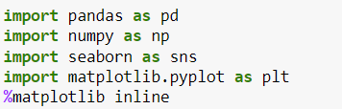
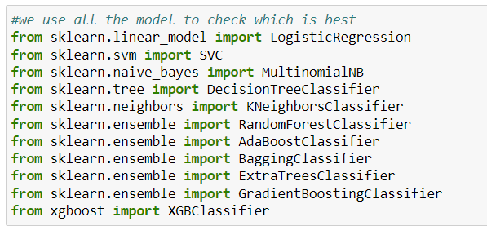
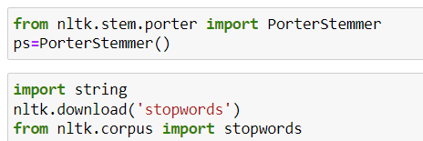

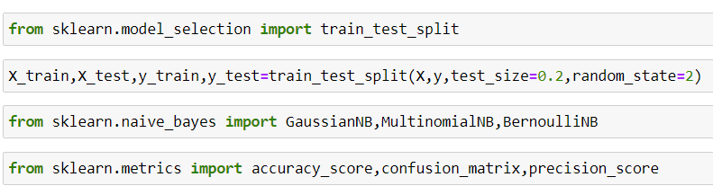
USED libraries

Slide 5
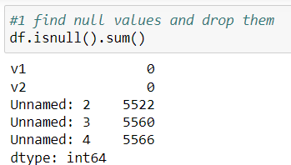
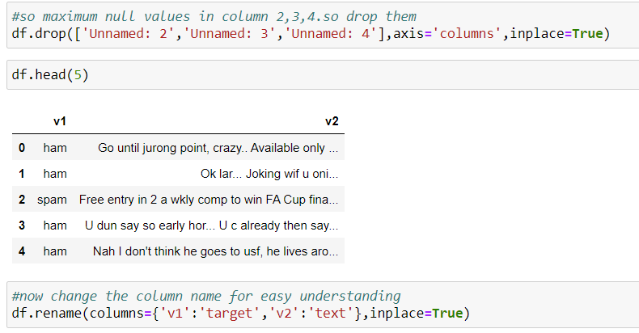
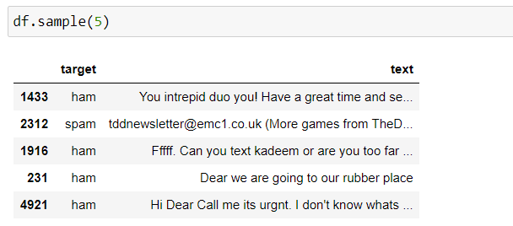
Data Cleaning

Slide 6
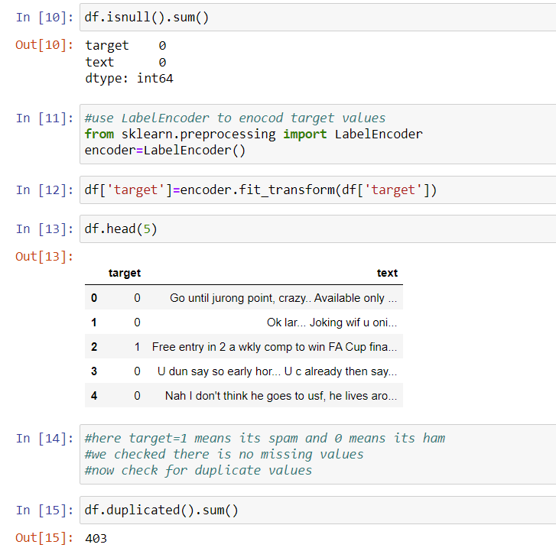
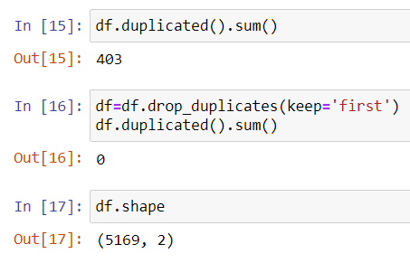
Data Cleaning

Slide 7
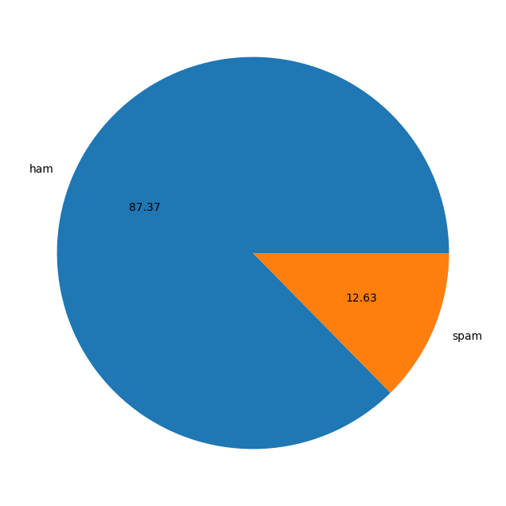
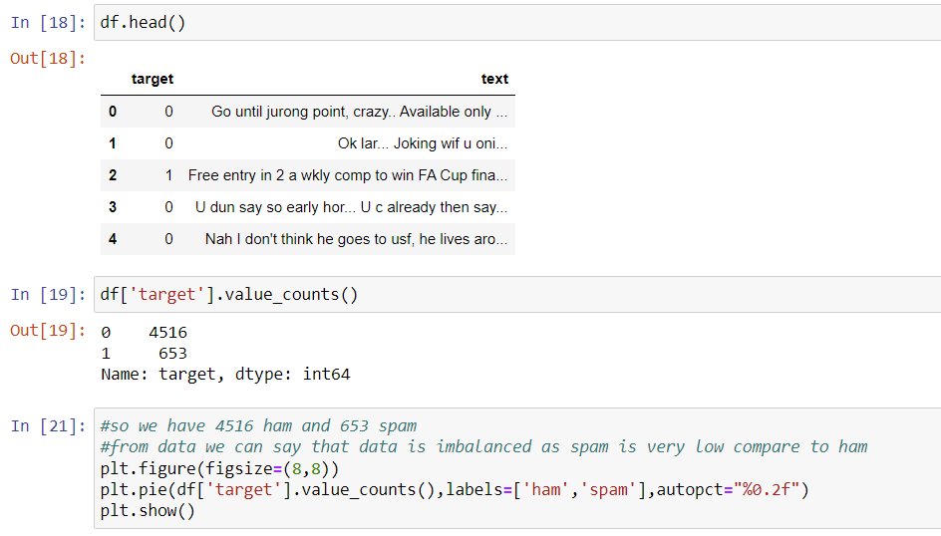
EDA

Slide 8
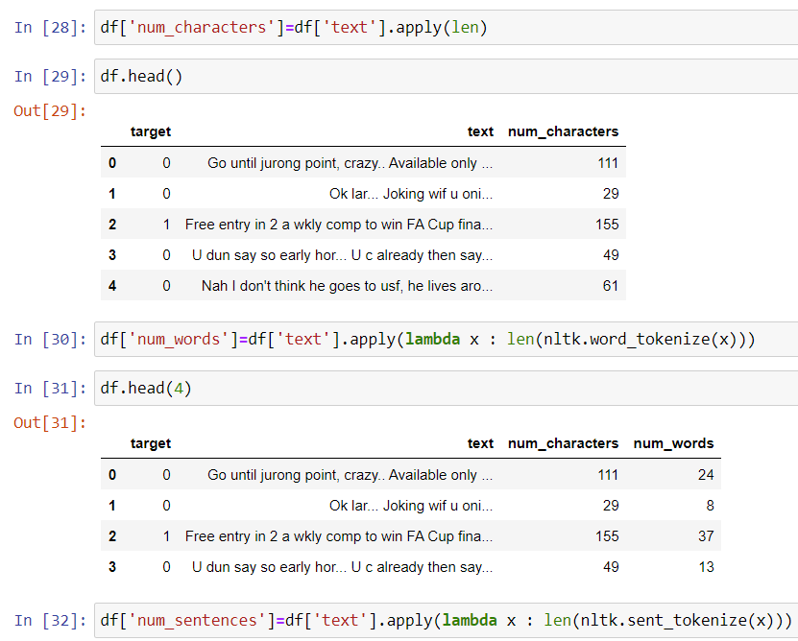
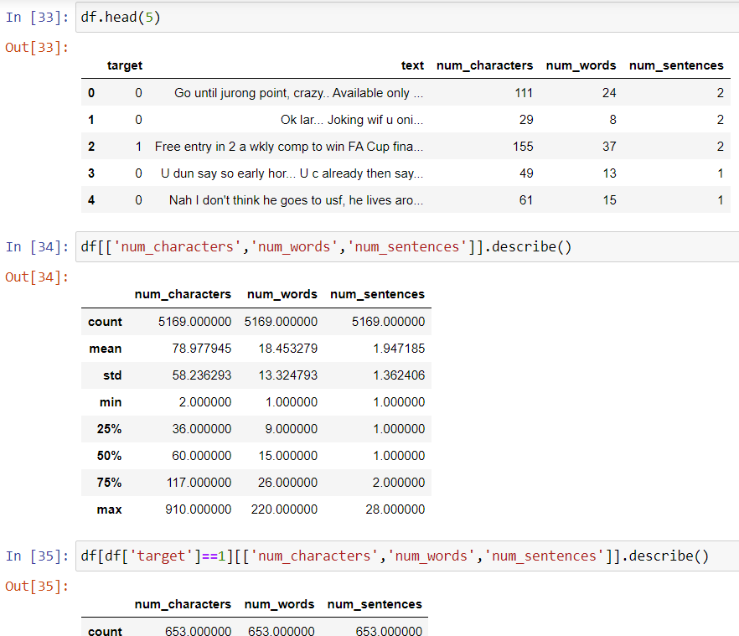
EDA

Slide 9
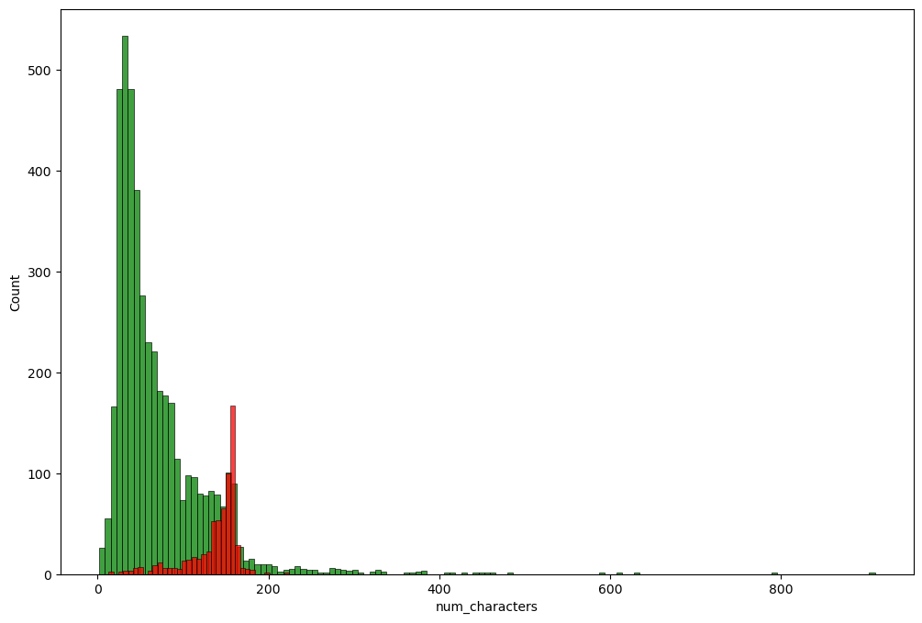
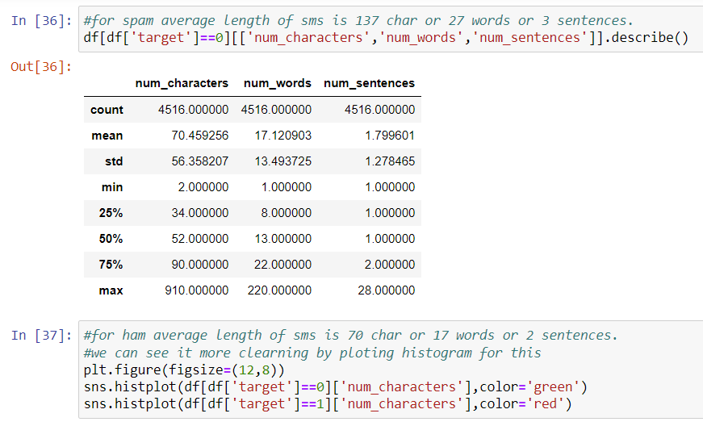
EDA

Slide 10
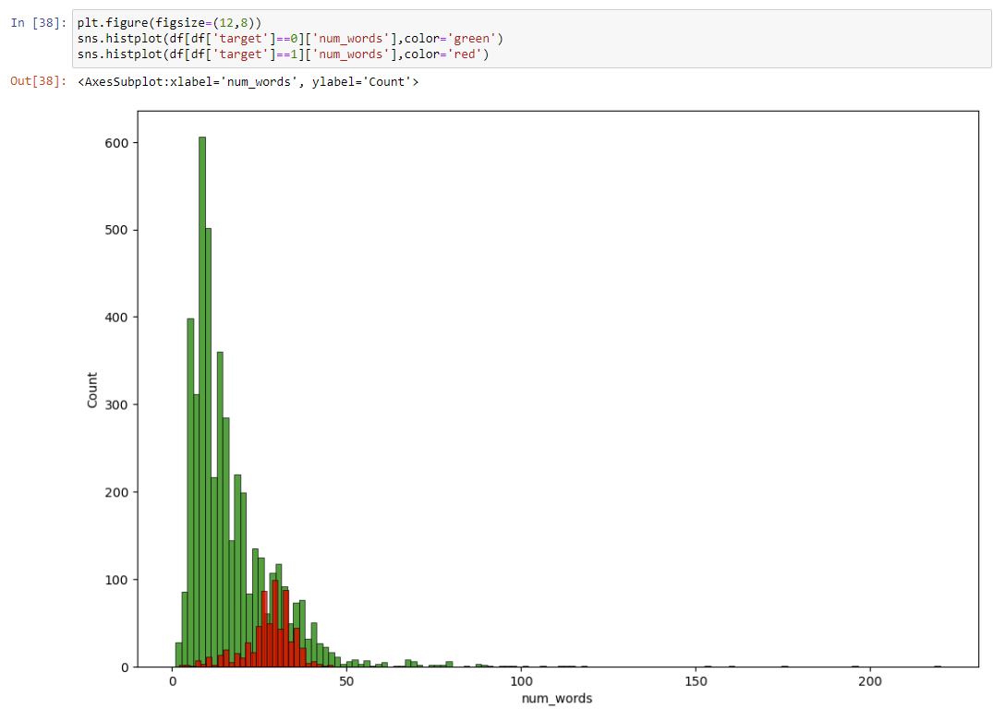
EDA

Slide 11
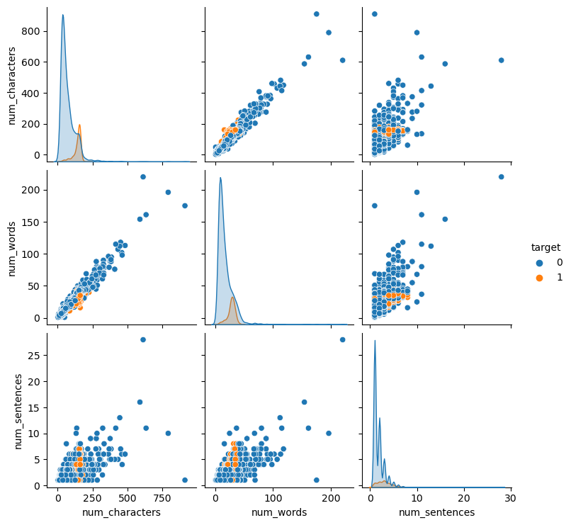
EDA

Slide 12
EDA

Slide 13
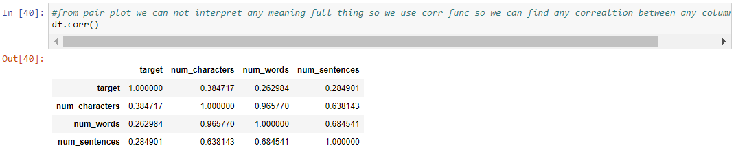
EDA

Slide 14
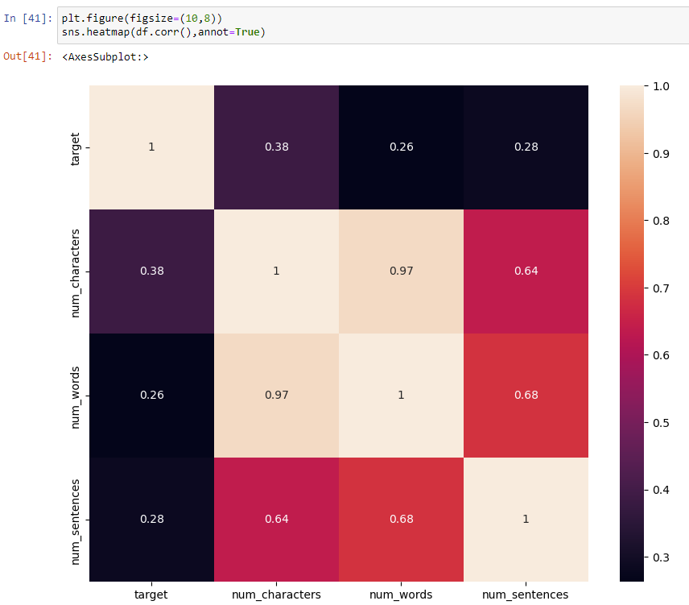
EDA

Slide 15
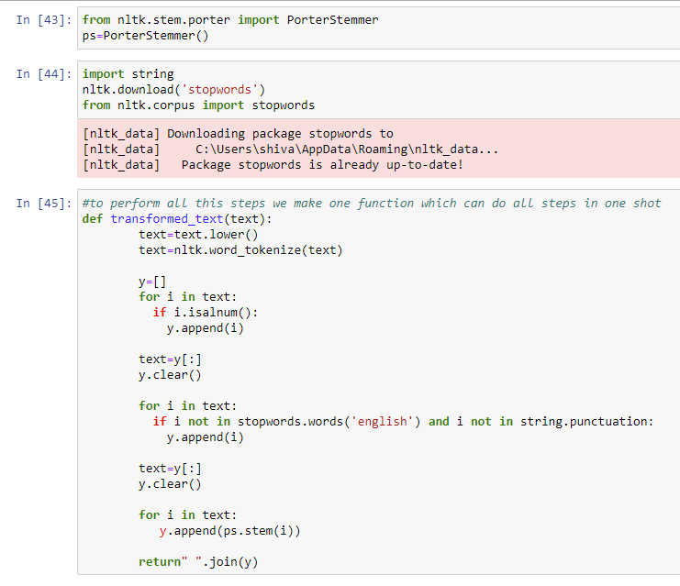
Data Preprocessing
lower case
Tokensization
Removing special characters
Removing stop words and punctuation
stemming(covert same type of words in one)

Slide 16
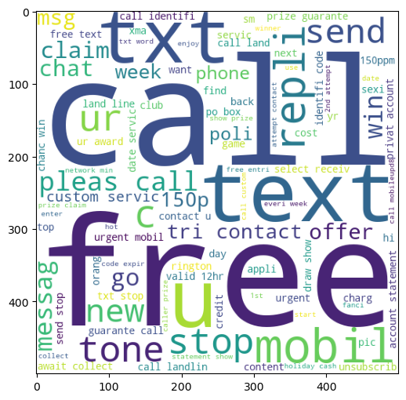
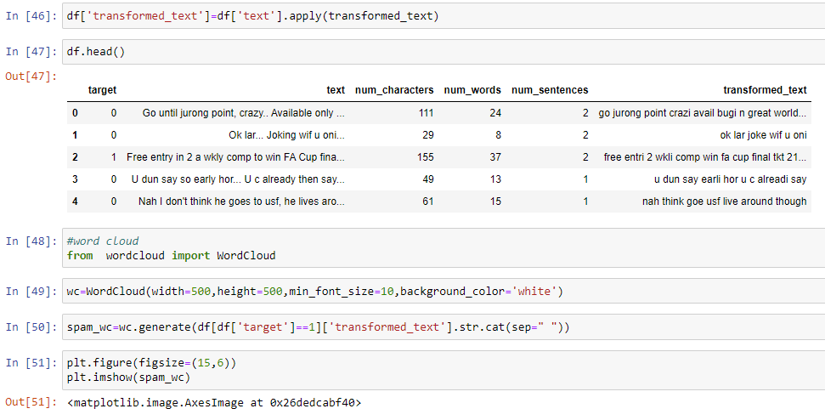
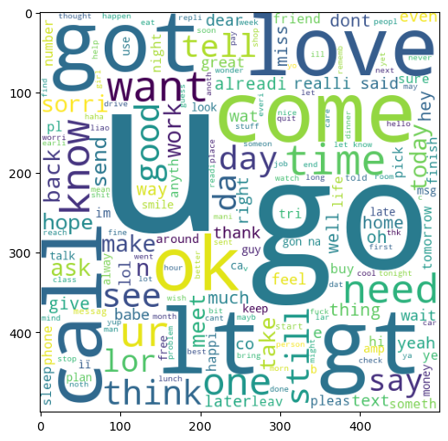
Data Preprocessing

Slide 17
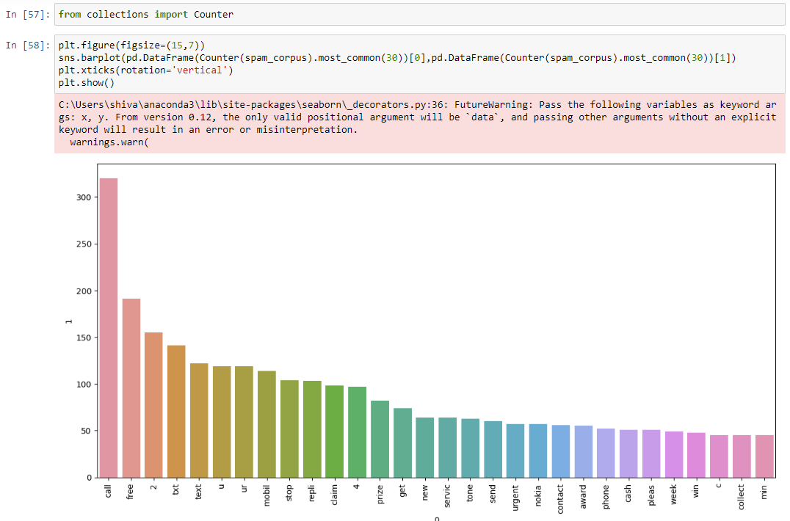
Data Preprocessing

Slide 18
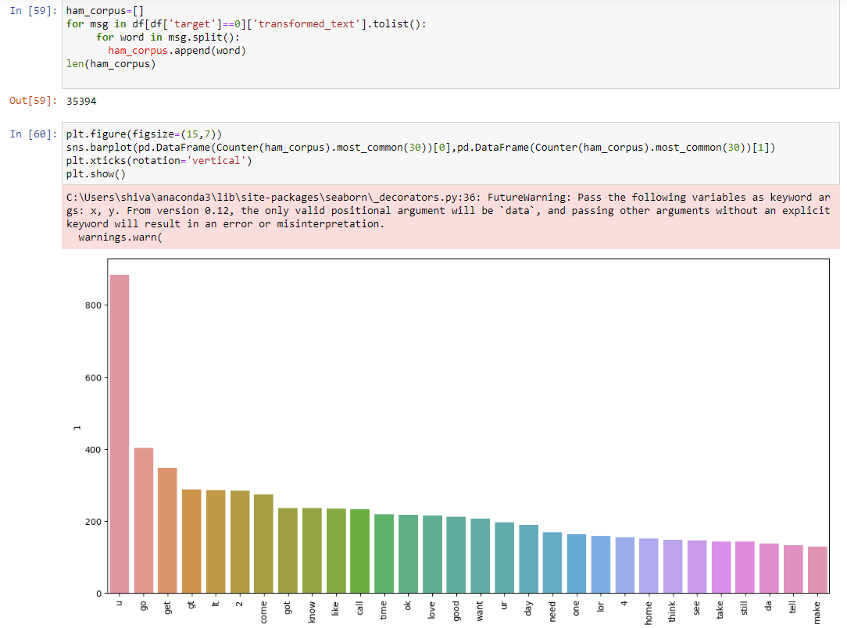
Data Preprocessing

Slide 19
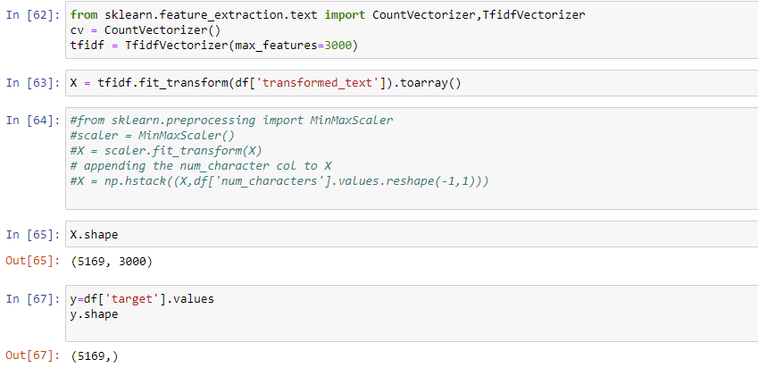
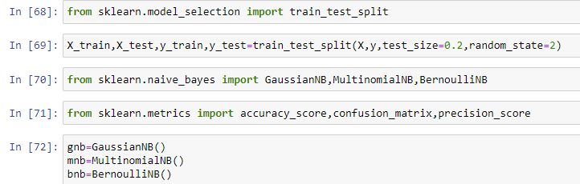
Model preparation and data splitting

Slide 20
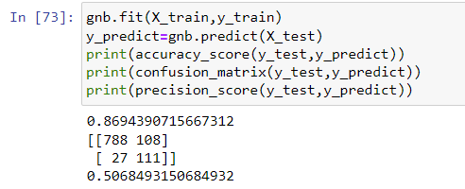
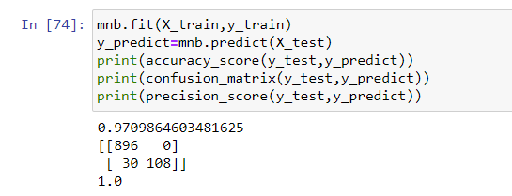
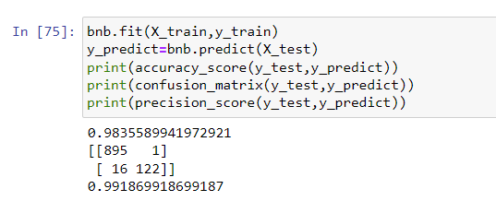
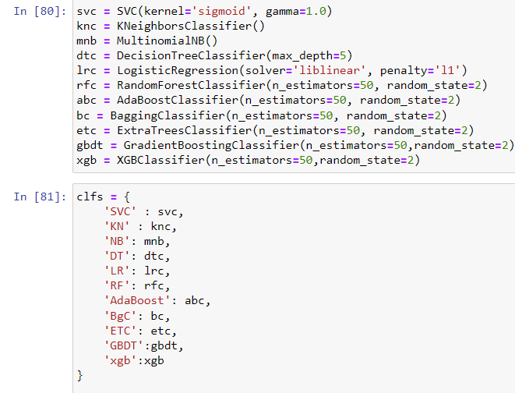
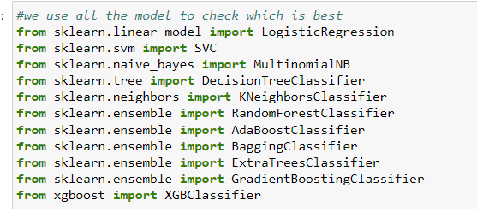
Model preparation and data splitting

Slide 21
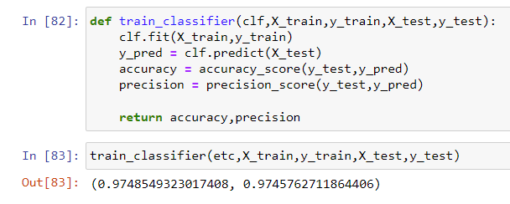
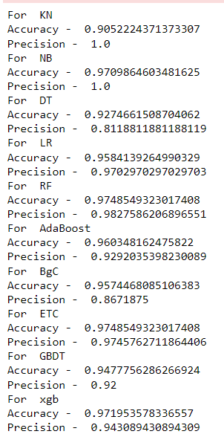
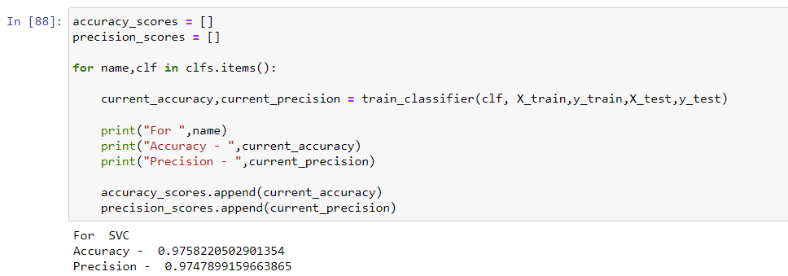
Model preparation and data splitting

Slide 22
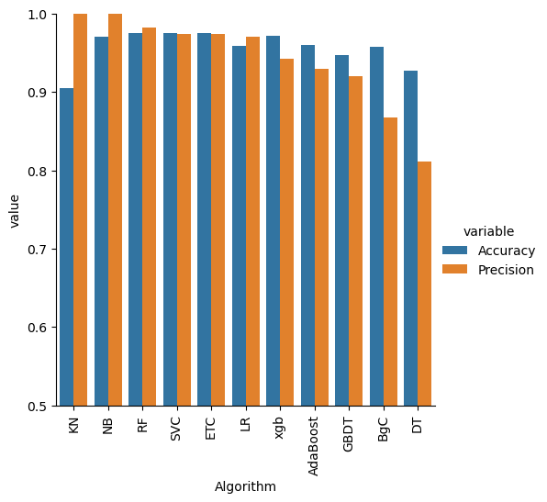
Model preparation and data splitting

Slide 23
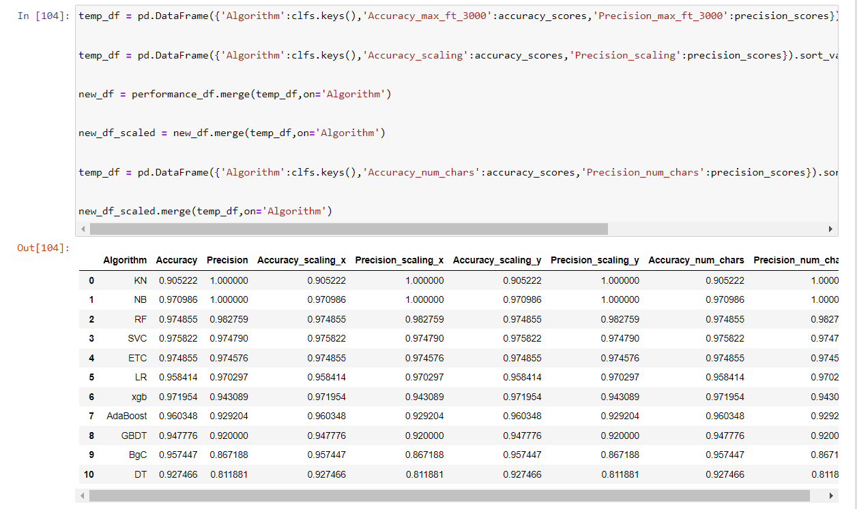
Model preparation and data splitting

Slide 24
SUMMARY
An email classifier based on machine learning is a system that uses algorithms to categorize incoming emails into predefined categories. It uses machine learning techniques such as supervised and unsupervised learning to train the classifier and improve its accuracy over time. The classifier analyzes various features of an email such as subject line, sender, content, and keywords to determine its category. Common categories include spam, promotional, personal, and important. The classifier then sorts the emails into the appropriate category, allowing the user to easily manage their inbox and prioritize their emails. The use of machine learning in email classification ensures that the system is dynamic and adapts to changes in email patterns and behavior.

Slide 25
THANK YOU
Shivam Gadekar

