Slide 1
HELIX IT / SERVICE OPERATIONS
PHASE 2 · DATABASE DESIGN
PROJECT 39
IT Helpdesk &
Asset Support
Management System
Logical schema · functional dependencies · normalization · SQL reports
Prepared by Kothuru Shiva Ganesh
Woxsen University · School of Technology · DBMS PBL · AY 2026–27
DESIGN • DATA • SERVICE

Slide 2
HELIX IT / PROJECT 39 / PHASE 2
Implementation architecture and DBMS choice
The running prototype was verified in a local browser using Flask and SQLite.
WEB UI
APPLICATION
RELATIONAL DB
REPORTING
→
→
→
HTML · CSS · Vanilla JS
Jinja templates
Flask routes · validation
SQLite parameterized queries
SQLite 3 · 15 tables
Foreign keys + indexes
SQL joins · aggregation
Ageing · workload · warranty · CSV
DBMS accuracy note
SQLite is the active database used by the Flask app (`instance/helpdesk.db`). `sql/mysql_schema.sql` is a MySQL 8 reference/migration artefact, not the DBMS connected to the current UI.
Data integrity
Transaction-aware operations
Foreign keys enabled, unique keys, CHECK / NOT NULL / DEFAULT constraints and indexed lookup paths.
Assignment, status history and resolution updates are performed through server-side SQL operations and application rules.
Woxsen University · School of Technology · DBMS PBL · AY 2026–27
02 / 07

Slide 3
HELIX IT / PROJECT 39 / PHASE 2
Logical schema — 15 relations
Normalization separates independent facts and preserves history without repeating data.
IDENTITY / LOOKUPS
ASSET MANAGEMENT
TICKETS / HISTORY
departments
assets
tickets
users
warranties
incidents
asset_categories
maintenance_records
service_requests
ticket_categories
support_staff
priorities
ticket_assignments
ticket_status_history
resolutions
Subtype rule: `incidents.ticket_id` and `service_requests.ticket_id` are PK/FK references to `tickets.ticket_id`.
Woxsen University · School of Technology · DBMS PBL · AY 2026–27
03 / 07

Slide 4
HELIX IT / PROJECT 39 / PHASE 2
Functional dependencies and 3NF rationale
Illustrative dependencies from docs/DATABASE_DESIGN.md; complete schema is in sql/schema_sqlite.sql.
FUNCTIONAL DEPENDENCIES
NORMALIZATION CHECK
•
ticket_id → ticket_number, requester_id, asset_id, category_id, priority_id, status, timestamps
1NF · Atomic values
•
ticket_number → ticket_id and common ticket attributes (unique alternate key)
No lists of assignees, events, warranty periods or maintenance rows stored in a single field.
•
employee_code / email → user identity attributes
2NF · No partial dependency
•
asset_tag → asset identity, category, department, status and model attributes
Relations use single-column keys for core entities; subtype attributes depend on the ticket_id key.
•
priority_id → priority_name, SLA hours and sort order
3NF · Separate determinants
•
ticket_id → resolution record (ticket_id is unique in resolutions)
Departments, categories, priorities, staff profiles, resolutions and event histories are stored separately.
Woxsen University · School of Technology · DBMS PBL · AY 2026–27
04 / 07

Slide 5
HELIX IT / PROJECT 39 / PHASE 2
Integrity constraints and business rules
Database-level constraints are complemented by application-level workflow checks.
UNIQUE
NOT NULL
ticket_number, asset_tag, employee_code, email; optional serial_number / warranty reference.
Required names, ticket title/description, key references and dates.
CHECK
FOREIGN KEY
Allowed ticket status/type; priority levels; asset/maintenance states; non-negative maintenance cost.
Users ↔ departments; assets ↔ categories/departments; tickets ↔ requesters, assets, categories and priorities.
DATE RULES
WORKFLOW LOGIC
Warranty end must be on/after warranty start; date fields must parse as valid dates.
Resolution notes are required before resolve; invalid status transitions are rejected by Flask logic.
Indexes cover frequent ticket status/date filters, requester, asset, priority, active assignments, status history, warranty expiry, asset tags and maintenance history.
Woxsen University · School of Technology · DBMS PBL · AY 2026–27
05 / 07

Slide 6
HELIX IT / PROJECT 39 / PHASE 2
SQL queries and report outputs
The script sql/report_queries.sql contains representative joins, aggregation, nested selection and date calculations.
Open-ticket ageing
First-assignment time
Technician workload
JOIN users + priorities; filter unresolved statuses; compute age in days; order by age and priority.
Aggregate MIN(assigned_at) by ticket; LEFT JOIN to tickets; average elapsed hours.
GROUP BY support staff; COUNT DISTINCT active and resolved tickets.
Asset history
Warranty expiry
Recurring categories + SLA
LEFT JOIN ticket and maintenance history; aggregate counts and most recent ticket time.
Join warranties, assets and departments; calculate days remaining / expiring within 90 days.
GROUP BY category with HAVING count ≥ 2; identify unresolved tickets past due_at.
Export evidence: the browser-generated CSV includes ticket number, type, title, status, priority, category, requester and created / due / resolved timestamps.
Woxsen University · School of Technology · DBMS PBL · AY 2026–27
06 / 07

Slide 7
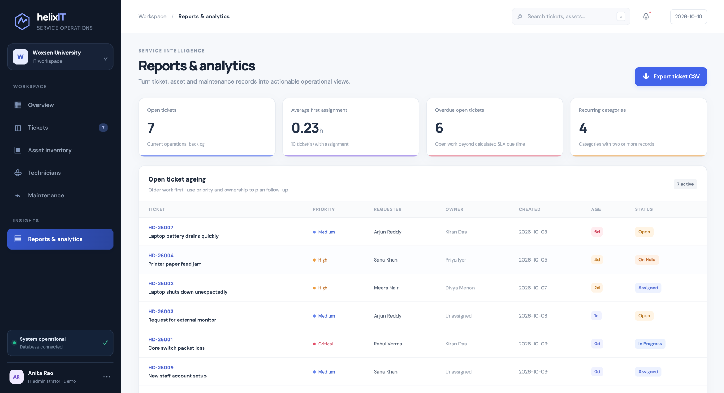
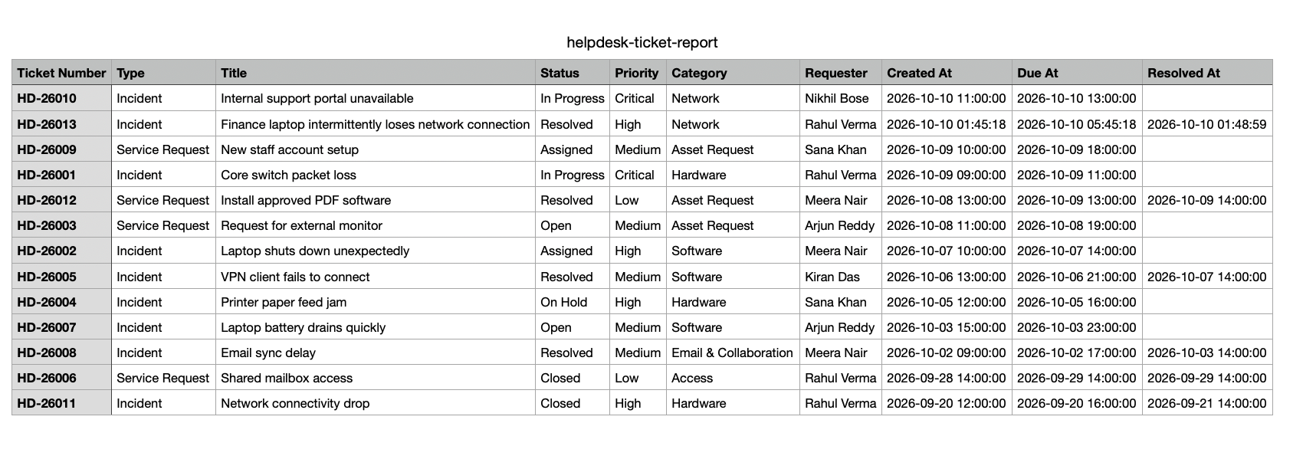
HELIX IT / PROJECT 39 / PHASE 2
Database prototype — observed reporting evidence
These screenshots were captured from the running local prototype; sample records are synthetic.
Ticket CSV export
Exported fields
Ticket number · type · title · status · priority · category · requester · created / due / resolved timestamps.
Reports & analytics — ageing, first-assignment time, overdue work and recurring categories
Automation note: unit tests are included in tests/test_app.py. Run `python -m unittest discover -s tests -v` before final submission and record the actual output.
Woxsen University · School of Technology · DBMS PBL · AY 2026–27
07 / 07

