Slide 1
HELIX IT / SERVICE OPERATIONS
PHASE 3 · APPLICATION DEMONSTRATION
PROJECT 39
IT Helpdesk &
Asset Support
Management System
Working prototype · CRUD workflows · reports · testing · future scope
Prepared by Kothuru Shiva Ganesh
Woxsen University · School of Technology · DBMS PBL · AY 2026–27
DESIGN • DATA • SERVICE

Slide 2
HELIX IT / PROJECT 39 / PHASE 3
Application architecture
A lightweight local web application connected to a relational database.
PRESENTATION
APPLICATION
DATA ACCESS
DATABASE
→
→
→
Browser UI
HTML · CSS · JavaScript · Jinja
Flask route handlers
Input validation · workflow rules
sqlite3 connection
Parameterized SQL · transactions
SQLite file
15 tables · keys · indexes · history
Running configuration
Python 3.10+ · Flask 3.x · SQLite 3 · local URL http://127.0.0.1:5000 · generated database at instance/helpdesk.db
MySQL distinction
Academic prototype
sql/mysql_schema.sql is a migration/reference script; the running app is SQLite-backed.
Synthetic records; no production authentication, email integration or deployment setup.
Woxsen University · School of Technology · DBMS PBL · AY 2026–27
02 / 08

Slide 3
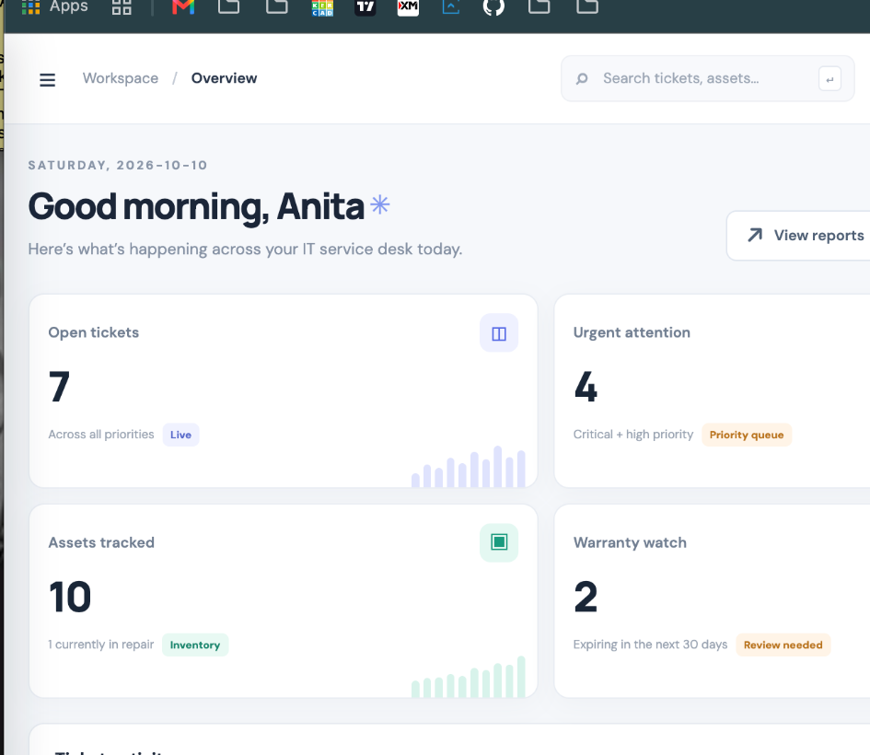
HELIX IT / PROJECT 39 / PHASE 3
Overview dashboard
The dashboard summarizes ticket backlog, urgent work, inventory and warranty attention.
WHAT IT SURFACES
•
Open and urgent ticket counts for triage
•
Asset inventory and devices currently in repair
•
Warranty watch for approaching expiry dates
•
Recent ticket activity, status and ownership
•
Direct entry to ticket creation and analytics
Dashboard evidence
Woxsen University · School of Technology · DBMS PBL · AY 2026–27
03 / 08

Slide 4
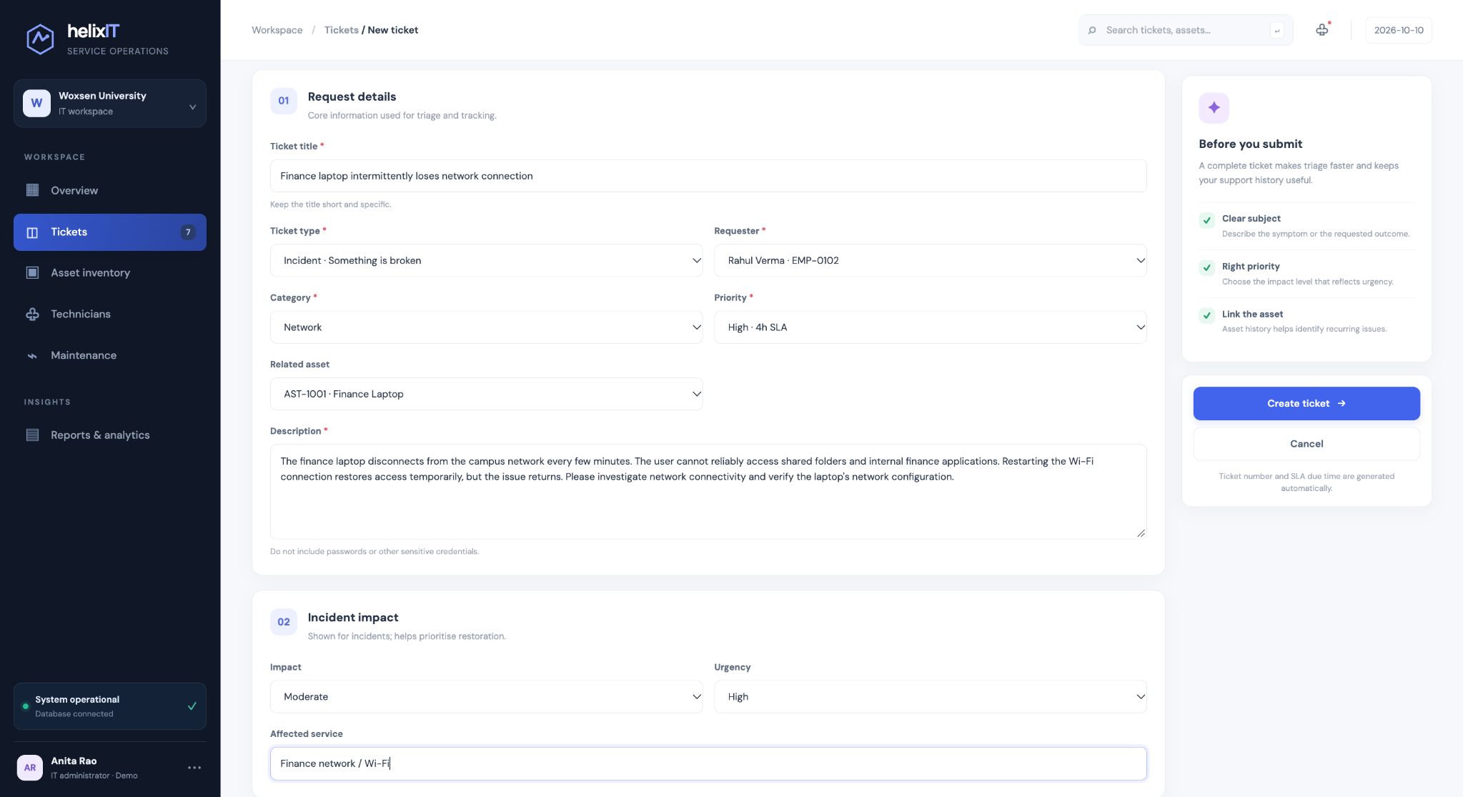
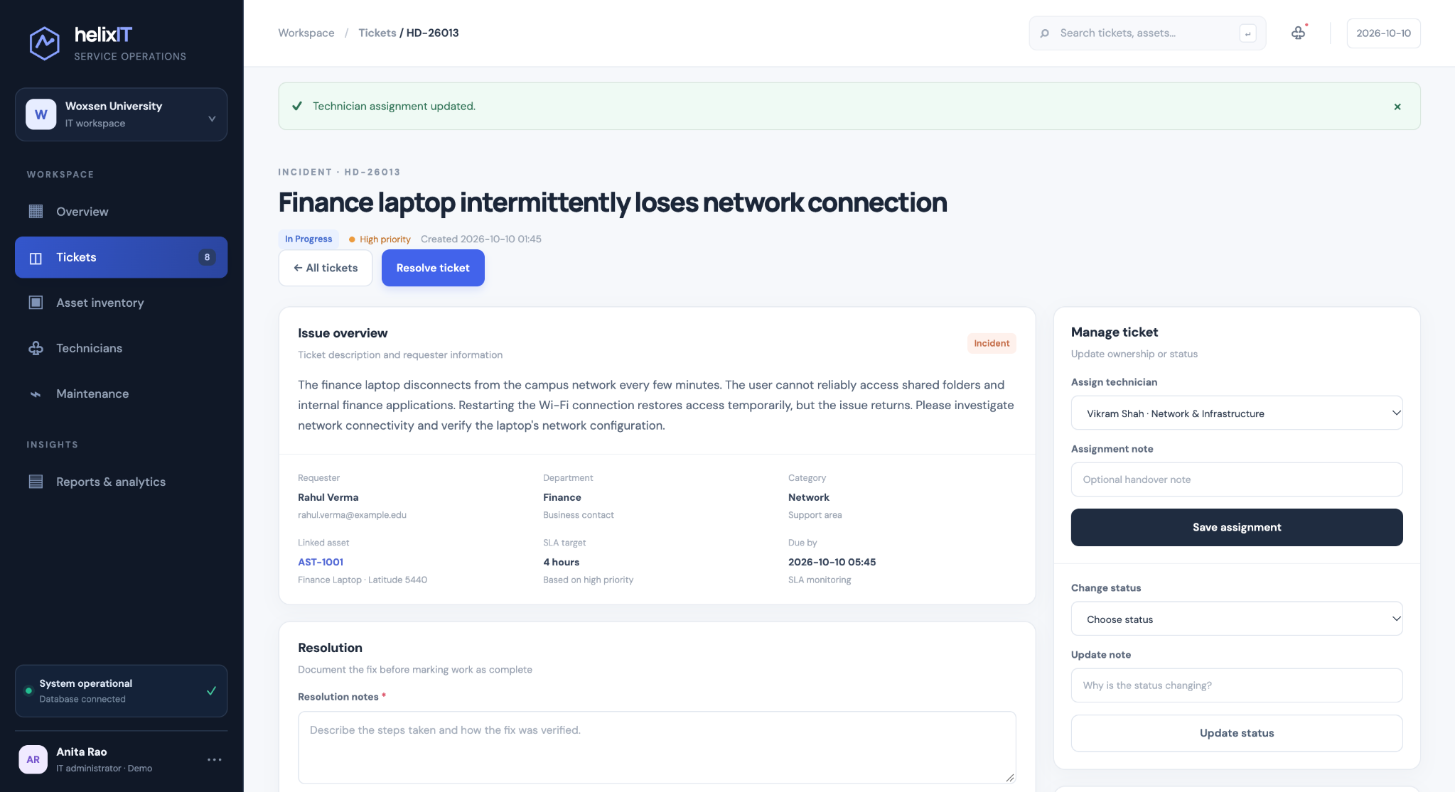
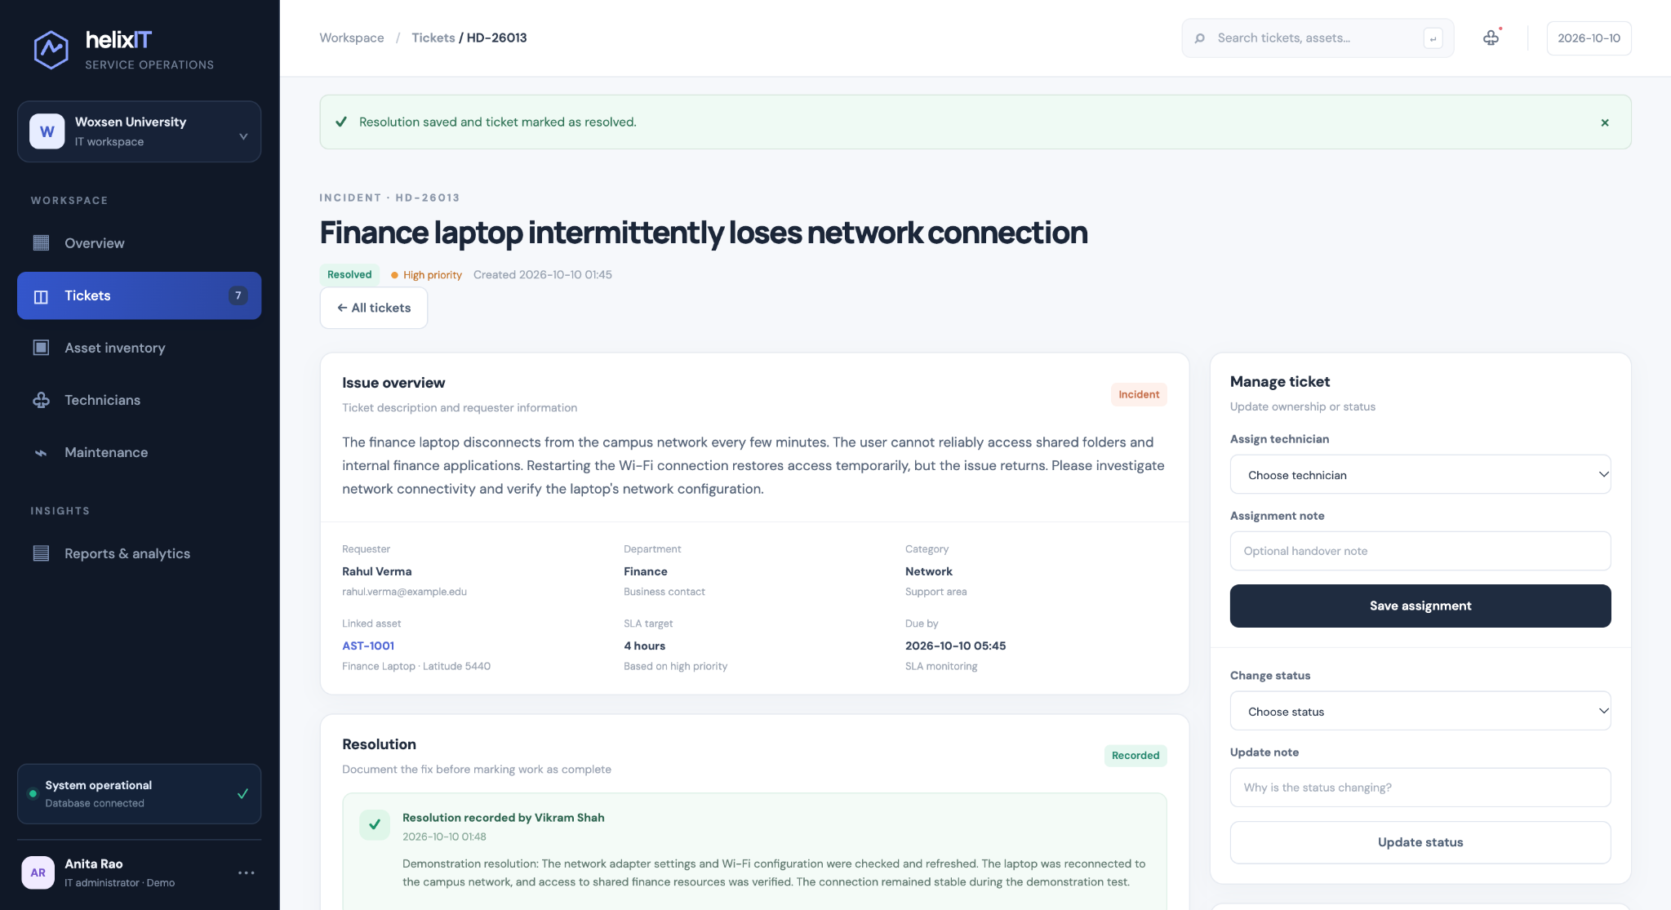
HELIX IT / PROJECT 39 / PHASE 3
Ticket lifecycle — create, assign, update, resolve
Walkthrough example: HD-26013, Finance laptop network issue. The resolution is recorded as demonstration data.
01 · Request details and incident impact
02 · Technician assignment saved
03 · Resolution saved and status = Resolved
DATABASE CONCEPTS DEMONSTRATED
CREATE: ticket row + initial history • READ: ticket detail + asset/requester • UPDATE: assignment and valid status transitions • RESOLUTION: required text saved to resolutions with timestamps
The new record is ticket HD-26013; its priority is High and it is linked to asset AST-1001.
Woxsen University · School of Technology · DBMS PBL · AY 2026–27
04 / 08

Slide 5
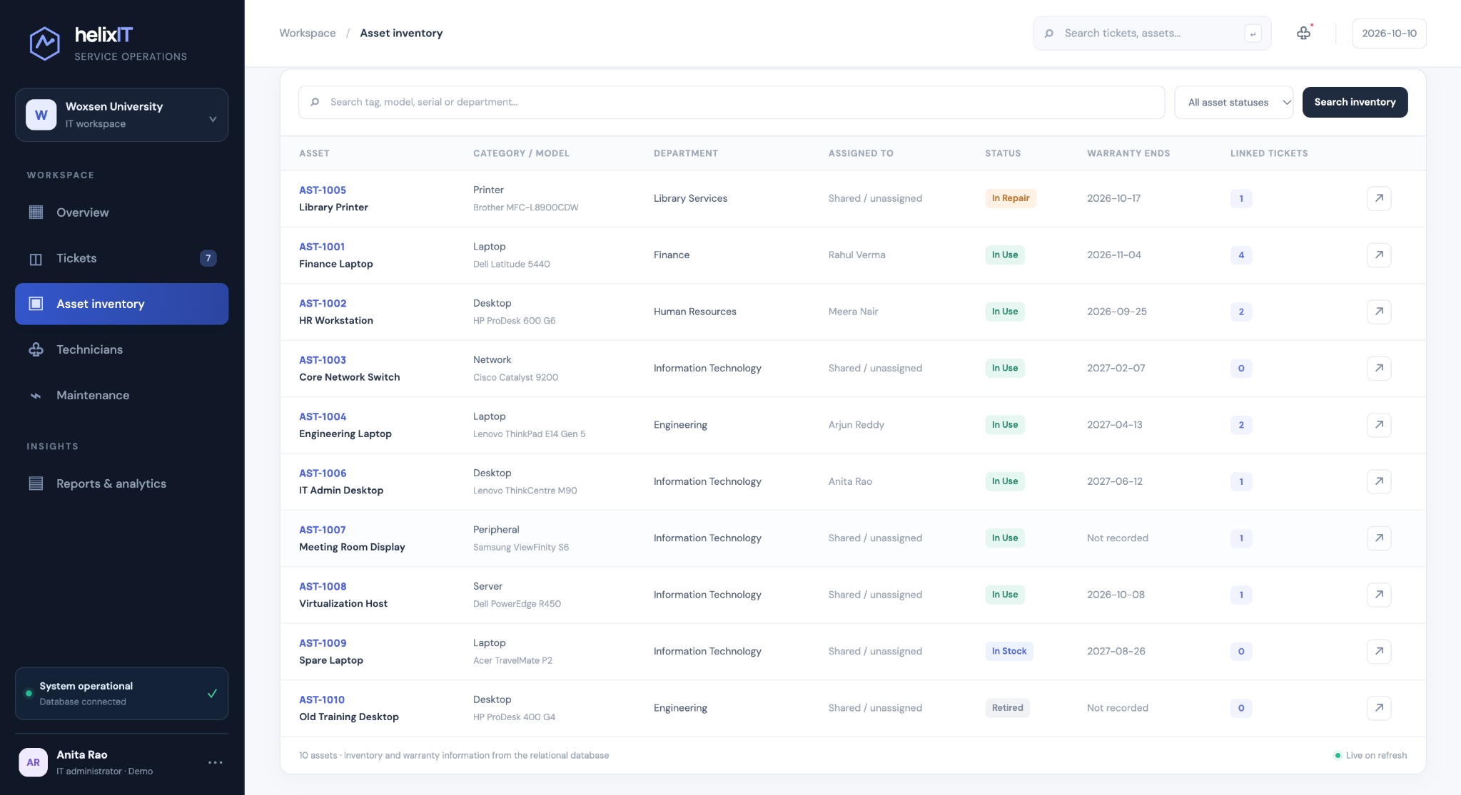
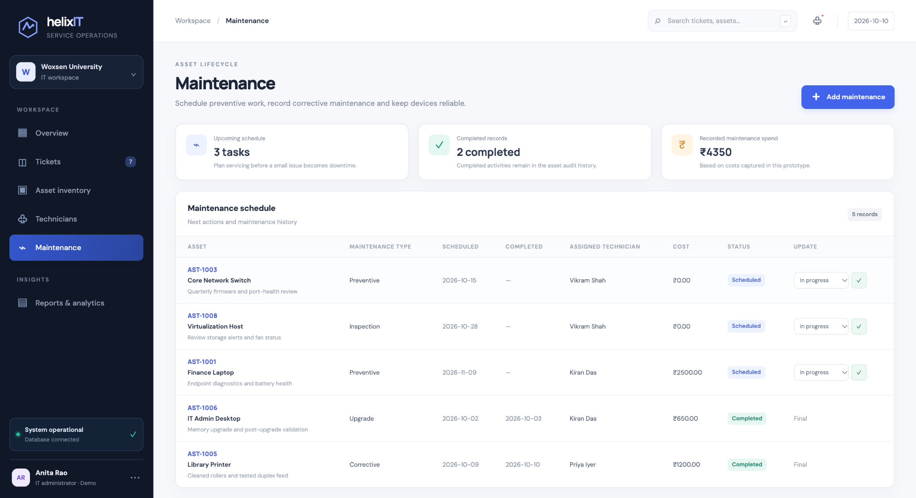
HELIX IT / PROJECT 39 / PHASE 3
Asset inventory and maintenance tracking
Asset lifecycle information is kept separate from the ticket record while related through foreign keys.
Asset inventory — tags, category/model, department, owner, status, warranty and linked tickets
Maintenance schedule — planned/completed tasks, assigned technician, cost and status
ASSET INTEGRITY · Unique asset tag; ordered warranty dates; protect assets referenced by tickets.
MAINTENANCE INTEGRITY · Non-negative cost; constrained dates and status values.
Woxsen University · School of Technology · DBMS PBL · AY 2026–27
05 / 08

Slide 6
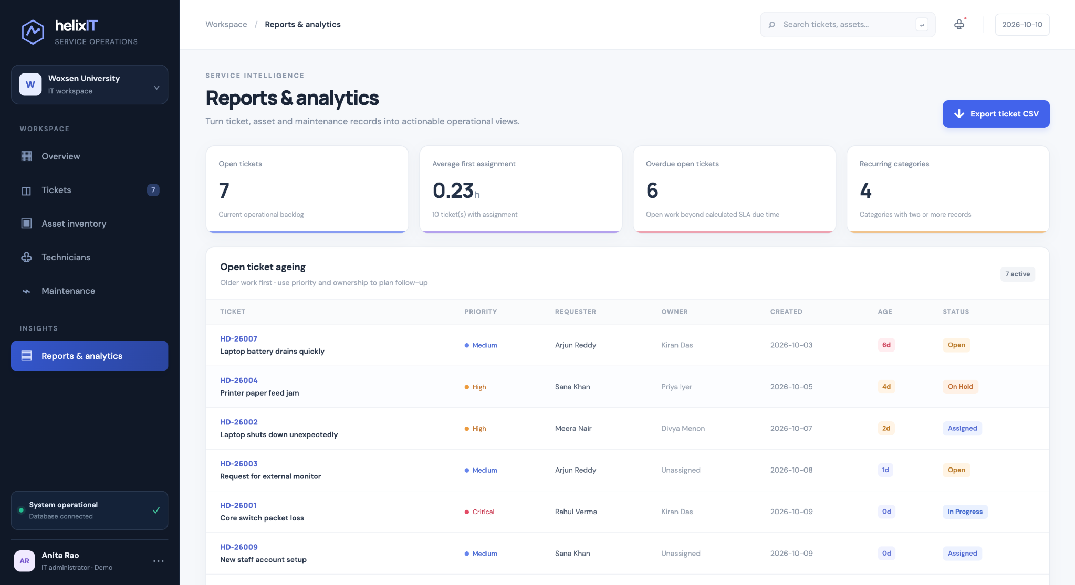
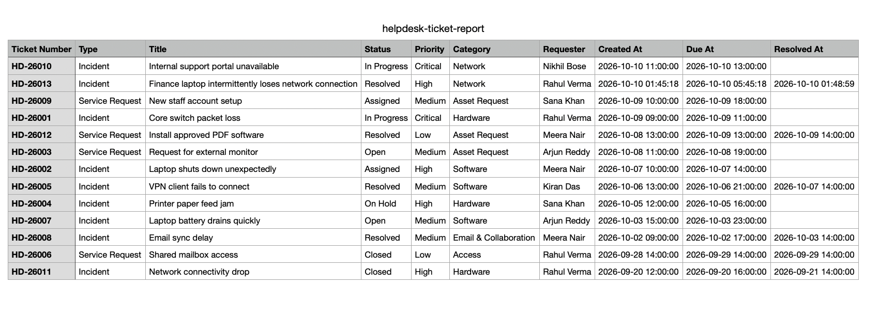
HELIX IT / PROJECT 39 / PHASE 3
Reporting and export
Operational reports turn normalized ticket and asset data into actionable lists.
Exported ticket report CSV
Report query families
JOINs · GROUP BY / HAVING · date-difference calculations · grouped first-assignment lookup · CSV export.
Reports page — open ticket ageing, first assignment, overdue open tickets and recurring categories
Reports support ageing, response time, workload, asset history, warranty expiry, recurring issues and SLA breaches.
Woxsen University · School of Technology · DBMS PBL · AY 2026–27
06 / 08

Slide 7
HELIX IT / PROJECT 39 / PHASE 3
Validation and testing evidence
Observed manual walkthrough and automated tests included in the repository are kept distinct.
Feature / test | Evidence status | Observation / expected result
Dashboard + DB health | Observed in browser | 200 response / dashboard rendered
Create ticket HD-26013 | Observed in browser | Success message; ticket appears in CSV
Assign technician + update status | Observed in browser | Success banners; status changed to In Progress
Record resolution | Observed in browser | Success banner; Resolved status and resolution details
Asset search + status filter | Observed in browser | AST-1001 search and In Repair filter returned a matching row
Reports + CSV export | Observed in browser | Reports page loaded after template/query fix; CSV opened as table
Duplicate asset tag / invalid transition | Automated tests included | Run test suite and record actual output before final submission
Run before submission: `python -m unittest discover -s tests -v` — do not report unexecuted tests as passed.
Woxsen University · School of Technology · DBMS PBL · AY 2026–27
07 / 08

Slide 8
HELIX IT / PROJECT 39 / PHASE 3
Conclusion, limitations and future scope
Key takeaways and next steps
•
A local DBMS application now demonstrates ticket creation, assignment, status history, resolution, asset search, maintenance, reports and CSV export.
NEXT
Before submission: push the latest local reports fix, add screenshots and the three decks to GitHub, run the test suite, record the 5-minute video, and publish its viewer link.
•
The relational design separates lookup, user, asset and ticket-history facts and uses PK/FK, UNIQUE, CHECK, NOT NULL and DEFAULT constraints.
•
Current limits: no real authentication / role access, email notifications, production hosting or real operational data.
•
Future work: MySQL deployment if required, login and role-based permissions, email/SLA notifications, additional validation and a broader regression suite.
PROJECT 39
Woxsen University · School of Technology · DBMS PBL · AY 2026–27
08 / 08

