Slide 1
Circuit Theory Project
Team Members
Eshanth reddy (230102005)
Shiva Gupta(230102045)
Raghavendra reddy(230102050)
Ajay karthik(230102030)

Slide 2
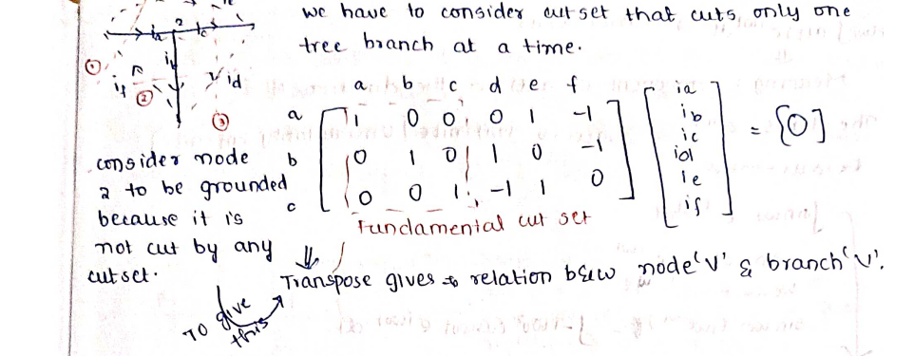
FROM WHERE TO START
/02
SIR NOTES
FIRST AIM>>WE NEED TO GET THE ABOVE FUNDAMENTAL CUT SET
THE STATEMENT TRANSPOSE OF CUT SET MATRIX GIVES RELATION BETWEEN BRANCH VOLTAGE AND CURRENT VOLTAGE IS VERY IMPORTANT

Slide 3


METHOD OF APPROACH
/03
genratiing fundamental cut
set matrix then ,Z,Y (laplaced)
matrices as diagonal matrices
finding current ,voltage
using the above matrices
TAKE INPUTS
(nodes data,elements)
generating branches,
graph as objects
converting into time domain
using inverse laplace and
plotting the voltage and
currents of each branches in
time domain
generate graph with
nodes and their
connections
branch is an object with
data such as source
node ,dest node,
direction with key value
generate tree,links and
corresponding loops

Slide 4
CODE EXECTUTION STREAM FLOW
/04
V,I VALUES,
MATRICES
RUN FILE
CALCULATION FILE
GRAPH FILE
GRAPHS,OBJECTS
TREE,LINKS,LOOPS
LAPLACE TRANSFORM
OF ELEMENTS
LAPLACE FILE
ELEMENTS AND
THEIR VALUE’S LISTS
UTILS FILE

Slide 5
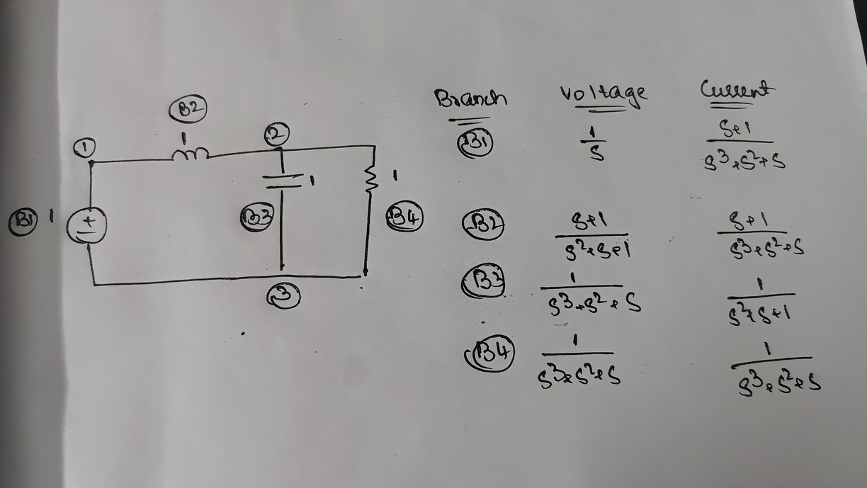
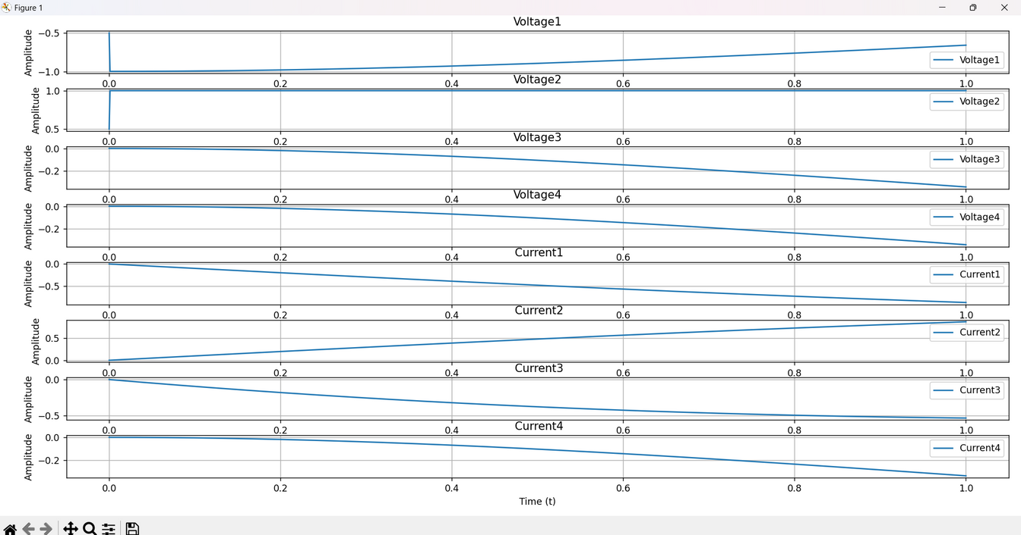
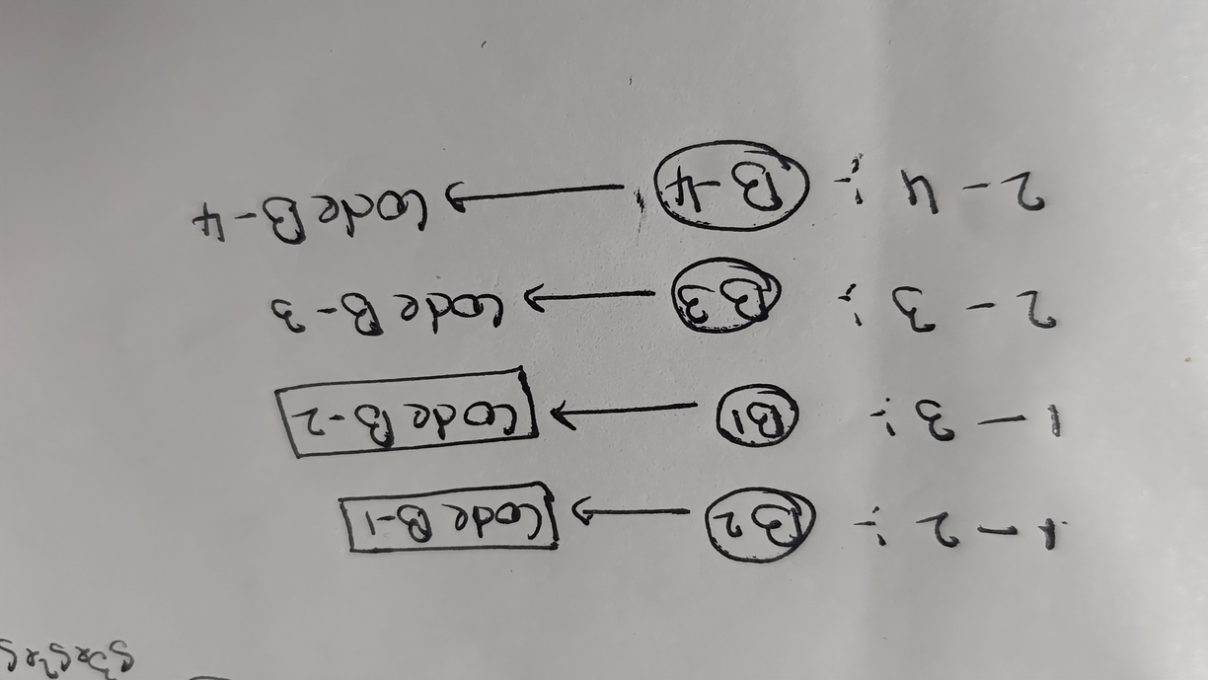
TEST CIRCUIT
/05

