Slide 1


IN BLACK AND WHITE 23/11/2018 A market technician’s view FX INDICES EQUITIES

Slide 2
IMPORTANT DISCLAIMER
The information in this report is of a general nature only. It is not personal financial product advice. It does not take into account your objectives, financial situation, or needs.
You should therefore consider the appropriateness of this information in light of these.
The Australian school of technical analysis ( ASTA ) recommend that you refer to the Product Disclosure Statements of any financial products which are discussed in this report before making any investment decisions.
ASTA accepts no responsibility for your actions and recommends you contact a licensed advisor before acting on any information contained in this general information report.

Slide 3
The information contained in this material is intended for general advice only. It does not take into account your investment objectives, financial situation or particular needs. FP Markets has made every effort to ensure the accuracy of the information as at the date of publication. FP Markets does not give any warranty or representation as to the accuracy, reliability or completeness of the information contained in this material. Examples included in this material are for illustrative purposes only. To the extent permitted by law, FP Markets and its employees shall not be liable for any loss or damage arising in any way (including by way of negligence) from or in connection with any information provided in or omitted from this material. Features of the FP Markets products including applicable fees and charges are outlined in the Product Disclosure Statements available from FP Markets’ website www.fpmarkets.com and should be considered before deciding to deal in those products. Derivatives can be risky; losses can exceed your initial payment. FP Markets recommends that you seek independent advice. First Prudential Markets Pty Ltd trading as FP Markets ABN 16 112 600 281, Australian Financial Services Licence Number 286354.

Slide 4
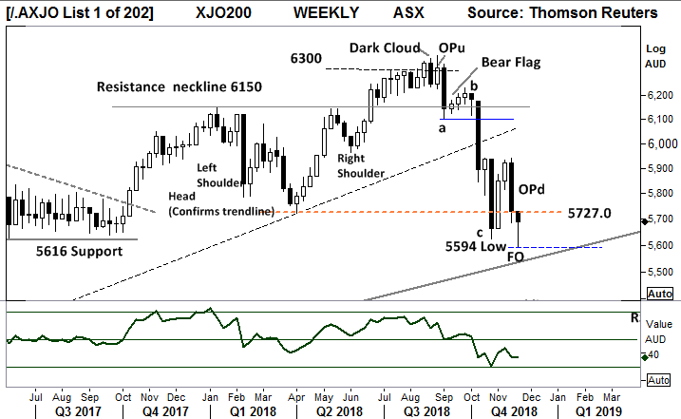
Aussie 200 index - Weekly
It is important to notice the Relative strength Indicator remains below the key “50” level.
Index weekly chart remains in a Primary DOWN Trend.
This weeks FO bar (incomplete) a test of 5600 and so far showing a high close, is encouraging for a retest of 5930 highs.
Comments from last week:
Further closes below this level bring the long term trend line into play at 5600 points.

Slide 5
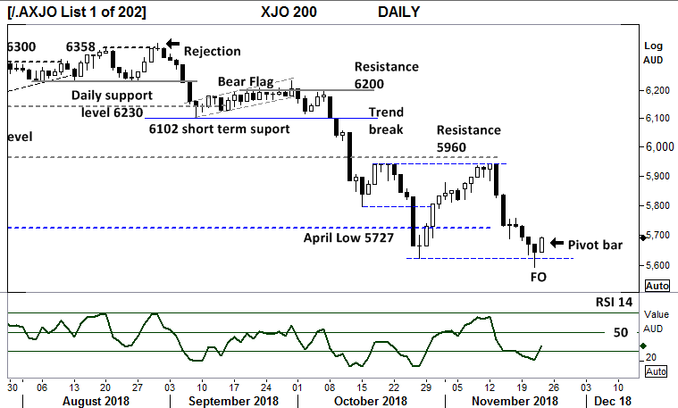
Aussie 200 index - Daily
Primary trend remains down.
Resistance remains at 5960 points.
The daily chart requires a close over this key level to confirm a bullish case.
Thursday’s pivot bar completes a short term reversal, the next trading days will be critical to maintain support at this 5700 level.
The Relative strength indicator has swung below the “50 level”, yesterday turned sharply higher above the “30” level.
Comments from Last week.
Yesterdays close over 5727 is an important step with follow through pivot point completion required to build a view for the retest of 5960 point resistance.

Slide 6
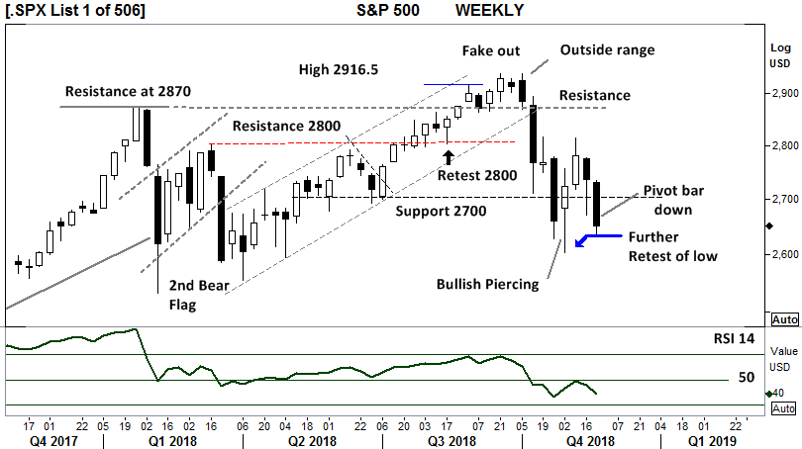
S&P 500 Index - Weekly
PRIMARY TREND REMAINS UP in this “corrective move”.
This week with a further retest of the low underway, with a closing price towards the low of the range.
A break of this weeks low in the coming week would be very bearish and suggest a continued move lower below 2600.
Relative strength (14) had moved below the key “50” level reflecting the current weeks price weakness.
Comments from last week.
2670.75 points, the current weeks low, a further break of this level would be very bearish and suggest a continued move lower.

Slide 7
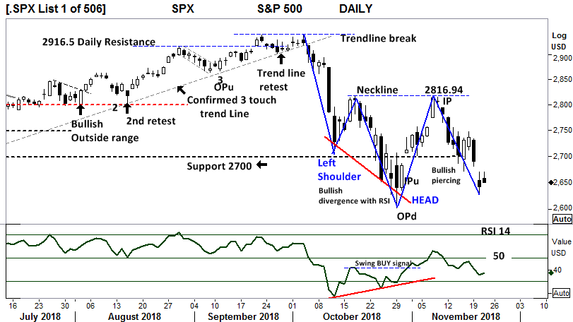
S&P 500 Index - Daily
US markets closed 22/11
The potential inverse Head and Shoulder pattern remains in place.
A further closing price blow 2603 points would signal a potential retest of 2550 points
RSI is moving below the “50” level but turned higher on the current price move.
The RSI bullish divergence although complete is often a precursor to a new primary trend.
Comments from last week.
A potential Inverse head and shoulder pattern will now be monitored for a break of the neckline.
A close over 2816.94 is required to reaffirm the bullish case.

Slide 8
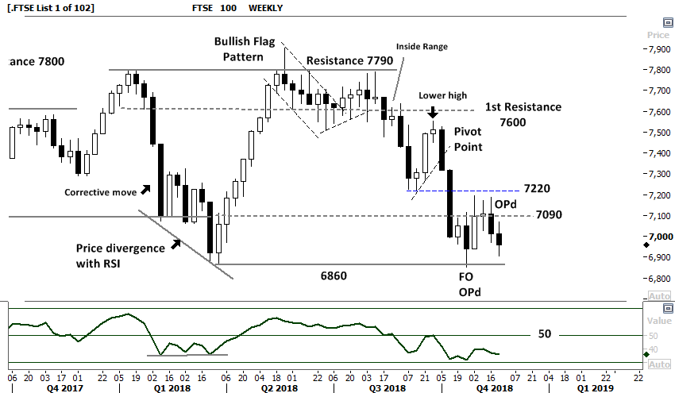
FTSE 100 Index - Weekly
FTSE 100 weekly:
The Primary down trend in the FTSE remains.
Continuation of the down trend is expected.
A further closing price over 7220 is required to confirm a bullish view.
The Relative strength indicator 14 has remained below the “50” level, showing negative price momentum.
Comments from last week: This weeks OPd (outside period) is confirming the bearish case.

Slide 9
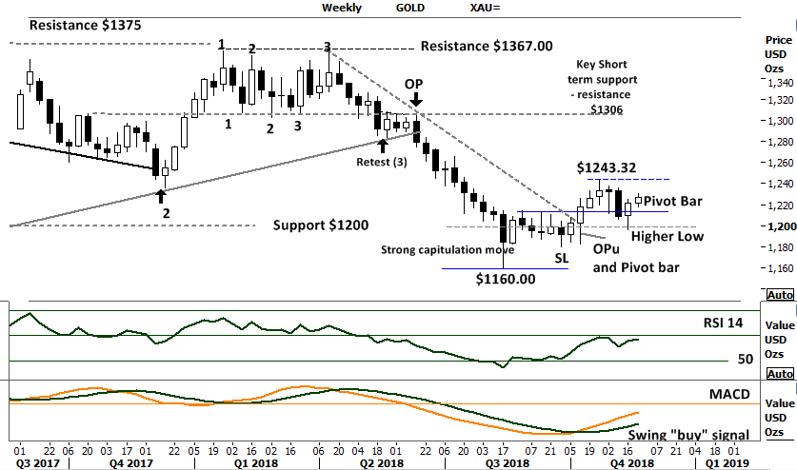
GOLD Weekly
Gold has changed the Primary trend to UP.
The current consolidation around the $1200 can viewed as “Gold is building a base”.
The new Higher low in place with the pivot bar further builds the bullish case for Gold making a move over $1243.32
RSI remains over the key “50” level.
MACD swing buy signal remains in place.
Comments from last week:
A retest of the $1200 level this week remains bullish for Gold.
This secondary type of price movement can be the precursor to higher prices with a closing candle above $1243.32 required to confirm.

Slide 10
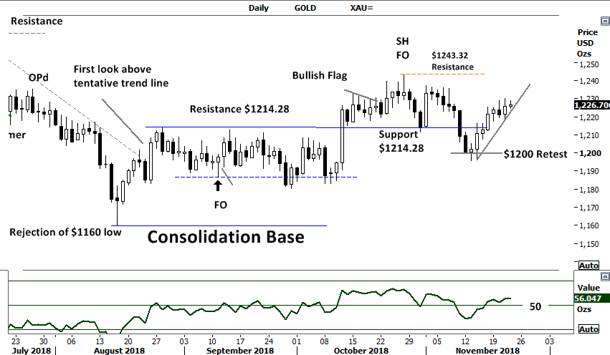
Gold Daily
Gold has the potential to push higher into the $1266 level. Look for a daily closing price above $1243.32 to confirm the bullish movement underway.
This daily movement has entered into a downtrend with the new low again testing the key $1200 support level.
RSI remains above the “50” level indicating positive price momentum.
Comments from last week:
Gold has the potential to push higher into the $1266 level. Look for a daily closing price above $1243.32 to confirm the bullish movement underway.

Slide 11
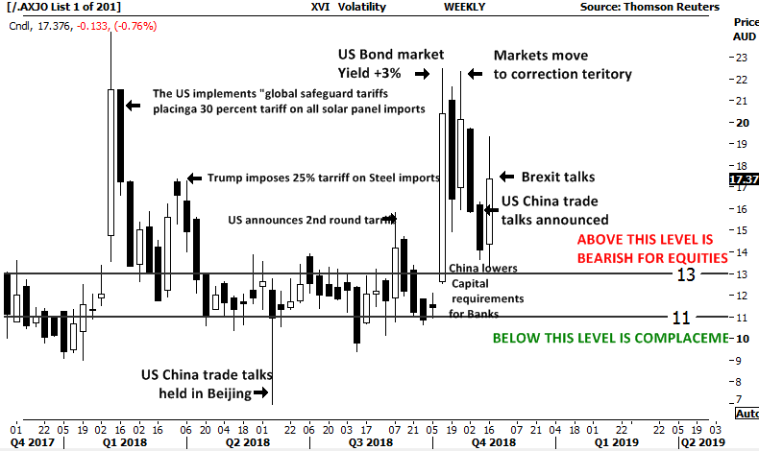
Australian Volatility Index
Volatility is falling, currently 17.0 down from the 19.3 high this week.
The Australian market has a volatility indicator XVI.
The XVI is the difference of 1 month forward pricing of ETO Options against current month.
As markets anticipate events, the forward priced option volatility changes, hence as forward price changes, this “skew” is pricing is measured in this XVI.
The XVI value works as an inverse observation to the underlying market.
An XVI over “13” is generally bearish for equities.

Slide 12
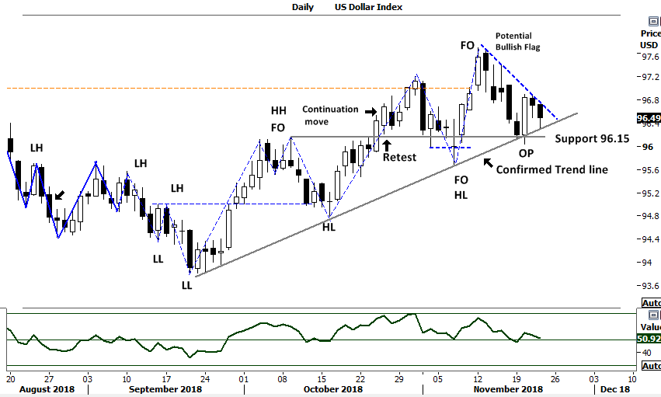
US Dollar Index
This week saw the retest of the trend line and support at 96.15. The consolidation of the past 2 trading periods remain bullish for a breakout higher.
With RSI remaining above the key “50” level further positive price momentum is expected.
The US Dollar index is weighting of the US Dollar against a basket of other currencies. The Euro, Japanese yen, British pound, are just a few.
An increase in the “Value” of the US dollar Index is indicative of the strength of the US Dollar.
As the US dollar rises other currencies decline in relative “value” and visa versa.
Comments last week. The confirmed trend line is now in place in this primary UP trend. Look for a retest of the trend line towards the 97 level.

Slide 13
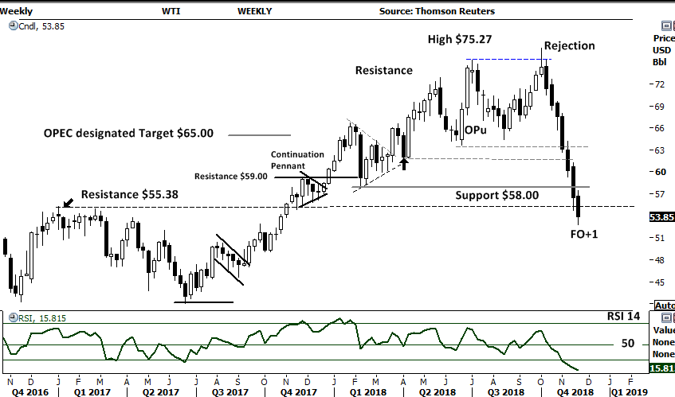
WTI Oil WEEKLY
Weekly OIL
Oil remains in a *“corrective” move with a closing price first below the 22nd June low of $63.59 and the 17th August $64.43 low, and this week moving below the key $58.00 support level. The $55.38 level is now broken this $53.85 closing price could see WTI into the $40’s.
The Relative strength indicator moving below the “30” level may now offer a potential divergence signal in the coming weeks.
*A corrective movement shows price moving below previous low points without making retracements. This type of movement does not change the current primary trend ( UP).
Comments from last week.
The $55.38 level is now in play, a closing price below this level could see WTI into the $40’s.

Slide 14
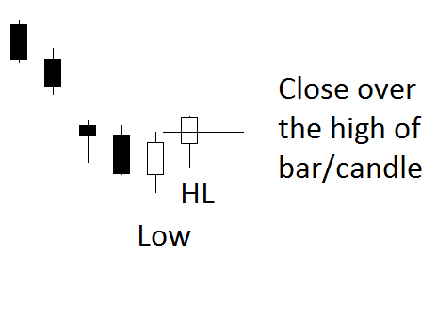

The technical setups. The Pivot point reversal
High
Can also be the
exit signal
for a short position.
HL

Slide 15
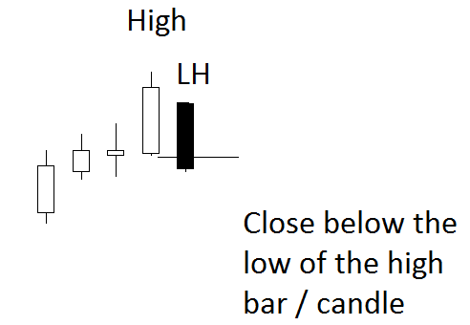
The technical setups Pivot point reversal
LH
Low
Can also be an
exit signal
for a long position.

Slide 16
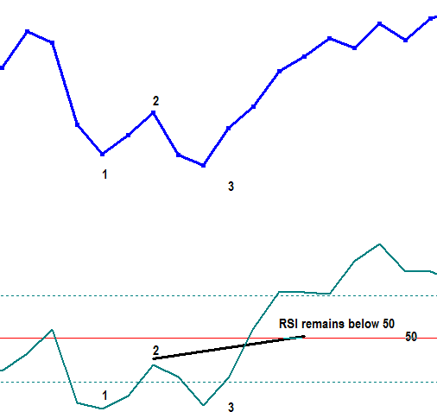
THE TECHNICAL SETUPS Relative Strength
Relative Strength Indicator
SWING BUY SIGNAL.
Market makes a low, (1) RSI swings below the 30 level. (1)
Market closes higher, (2) RSI moves higher but not over the “50” level. (2)
Market makes new lower low, (3) RSI makes a higher low (3)
The swing buy signal occurs when the RSI moves and finishes over point 2

Slide 17
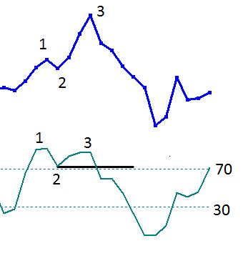
THE TECHNICAL SETUPS Relative Strength
The RSI Failure Swing 1. Market makes high price. 2. Retracement RSI remains above “50” (2) 3. Market makes higher high. 3. RSI makes lower high. (3) Must be over the 70 level. ** The Swing failure sell signal occurs as RSI swings below “2”**
Swing failure is identified with the break of point 2 on RSI

Slide 18





The technical setups Outside period Opu and OPd
A price range larger than the previous range often indicates a market turning point. (Krastins research) The outside period can mark a significant market turning point at or within 3 bars ( 93%).
Opu is an up close bar Opd is a down close bar.
The OP period comes in all shapes and sizes.

Slide 19
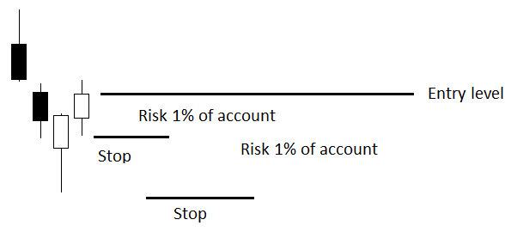
Position size and management guidelines
Position size by account size Building a trading system on simple rules requires a money management process. As an example, should 1% of the account size be risked on an individual position, the position size can be
calculated. Here is the guideline, this allows the trader to build an R- (risk) based return.
The distance-to-stop is the $ amount risk. Dividing the distance to stop into 1% of the account size gives the position size. The lower stop displayed will have a smaller position size. Profit taken on the trade can then be measured against the risk. For example:
The distance-to-stop is 20 cents and the account size is 10,000.
Using 1% ($100) of the account, divide the $100 by 20c. This gives a position size of 500 units.
The lower stop loss is 50 cents away. Using the same methodology of a 1% of account risk, the position size is 200 units.

Slide 20
Comments and Feedback: support@fpmarkets.com

Slide 21
First Prudential Markets Pty Ltd
Level 5, 10 Bridge Street
Sydney NSW 2000
Phone: +61 2 8252 6800
www.fpmarkets.com
ABN 16 112 600 281
AFS Licence No. 286354

Slide 22
THANK YOU

