Slide 1


IN BLACK AND WHITE 02/11/2018 A market technician’s view FX INDICES EQUITIES

Slide 2
IMPORTANT DISCLAIMER
The information in this report is of a general nature only. It is not personal financial product advice. It does not take into account your objectives, financial situation, or needs.
You should therefore consider the appropriateness of this information in light of these.
The Australian school of technical analysis ( ASTA ) recommend that you refer to the Product Disclosure Statements of any financial products which are discussed in this report before making any investment decisions.
ASTA accepts no responsibility for your actions and recommends you contact a licensed advisor before acting on any information contained in this general information report.

Slide 3


Slide 4
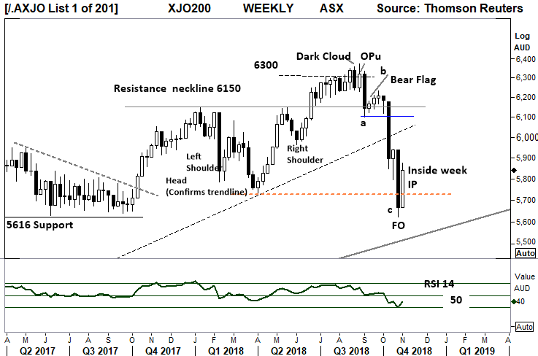
Aussie 200 index - Weekly
The Weekly chart shows the Opu from 5 weeks ago signalling the “high” price level. (Krastins research)
Currently, this a,b,c pattern has played out with an Inside period this week.
This week the close is above the 5724 April low, a continuing closing price above this level would be a positive sign for the Bulls.
This weeks uptick may have resolved the low. With last weeks down close range providing a FO ( Fake out ) of the November 2017 low
Index remains in a Primary DOWN Trend.
The Relative strength Indicator remains below the key “50” level indicating a loss of upside price momentum,
Comments from last week:
The Relative strength Indicator remains below the key “50” level indicating a loss of upside price momentum

Slide 5
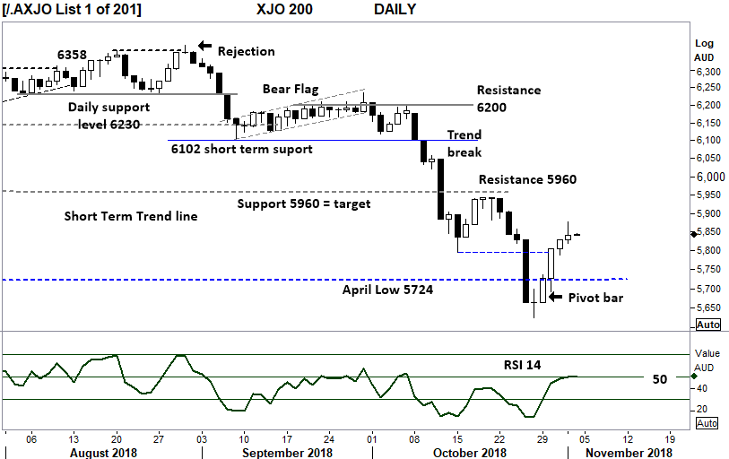
Aussie 200 index - Daily
This week has posted a pivot point reversal, and confirmed with good follow through.
A retest of the 5960 resistance would be a bullish sign, should a close over this level occur.
Primary trend remains down.
The Relative strength indicator has swung from below the “30 level”, and has moved over the key “50” level,
This indicates positive price momentum.
Comments from Last week.
Capitulation day with price movement below the April low, in the short term a closing price above this key level would be bullish.

Slide 6
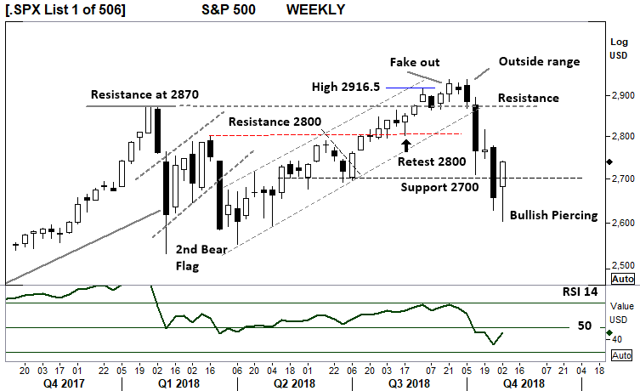
S&P 500 Index - Weekly
PRIMARY TREND REMAINS UP in this “corrective move”.
With the closing price retreating from the lows and back above the key 2700 level, a small win for the Bulls is in place.
This is now a significant support level and will be the level to watch should any further breakdown of price occur.
The “Piercing” range of this week is a good sign of further gains with the 2940 high within range.
Relative strength (14) had moved below the key “50” level showing a loss of positive price momentum, however the current upturn is a positive sign.
Comments from last week.
To support a bullish view price consolidation above 2700 is required.

Slide 7
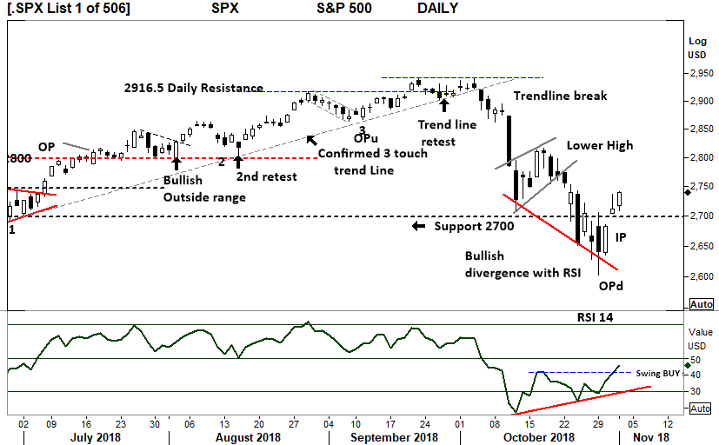
S&P 500 Index - Daily
The Index on target to reach 3000 points. Has met significant resistance.
There is nothing else to see on this chart except the bullish divergence between the RSI and Price. The RSI has now moved over the 42 level (b) a swing buy signal is in place.
The IP this week following the OPd (29/11) suggests the low is in place.
Currently the daily price chart is in a down trend and a further “higher low and higher high” is required to confirm an up trend.
Comments from last week.
There is nothing else to see on this chart except the bullish divergence between the RSI and Price.

Slide 8
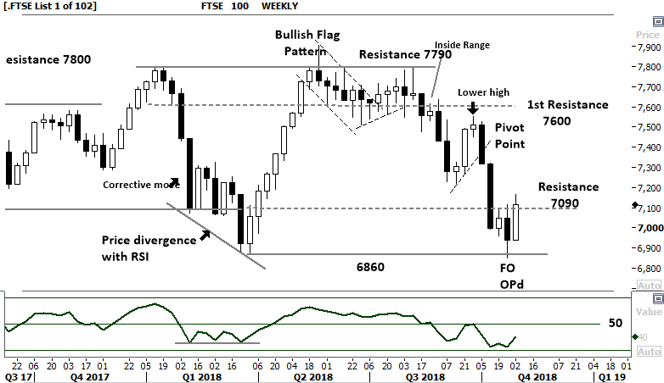
FTSE 100 Index - Weekly
FTSE 100 weekly:
The Primary trend in the FTSE remains down.
The test of the 6860 low is complete with a high range close on the final price line. 7090 remained the key resistance level, and this closing price over this level is offering a short term bullish view.
The Relative strength indicator 14 has moved below the “50” level, showing negative price momentum. Although the indicator has turned up this shows a slowing downward momentum only.
Comments from last week: This week small range candle with a retest of 7090 is not a strong indication of bullish price recovery.
Continuation lower is expected to test 6860.

Slide 9
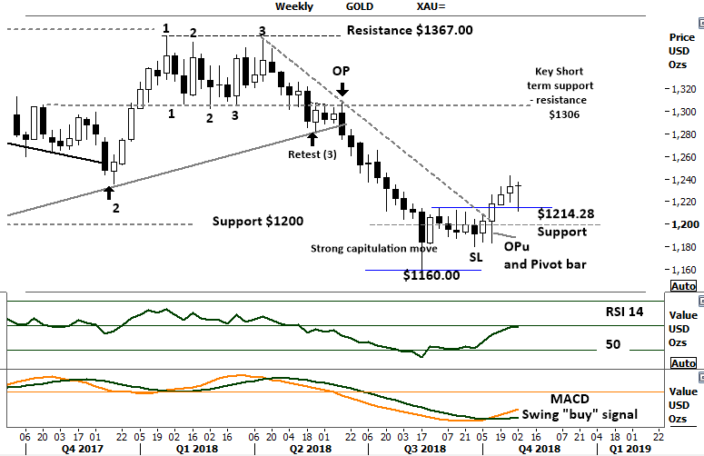
GOLD Weekly
Gold has changed the Primary trend to UP.
The current consolidation around the $1200 can viewed as “Gold is building a base”.
Last weeks price breakout has moved lower to retest the current 1214.28 support level, with a strong lower shadow and high close the weekly candle is considered bullish for further gains.
In the case of price weakness ( below $1214) the $1200 level will be key support in the coming weeks.
Comments from last week:
The current consolidation around the $1200 can viewed as “Gold is building a base” within the down trend.

Slide 10
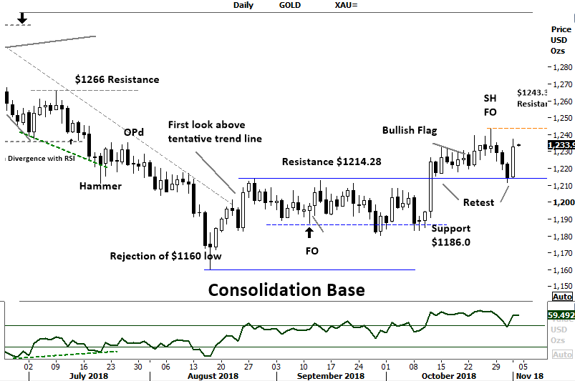
Gold Daily
This week has seen further consolidation above the $1214.28 level.
Gold has the potential to push higher into the $1266 level. The daily Fake out (FO) with a high of 1243.34 moved lower to retest the breakout with immediate buyer support. ( Very bullish sign )
Look for a daily closing price above $1243.34 to confirm the bullish movement underway.
RSI has turned higher above the “50” level indicating positive price momentum.
Comments from last week:
The daily Fake out (FO) with a high of 1239.68 requires a further higher closing price to confirm any short term bullishness of GOLD. Failure to move above this level could result in a retest of $1214.28 support.
.

Slide 11
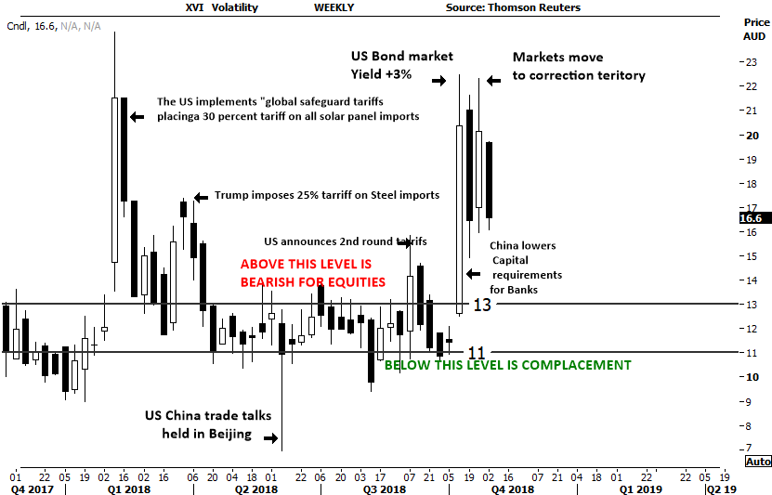
Australian Volatility Index
Volatility is falling currently 16.6
The Australian market has a volatility indicator XVI.
The XVI is the difference of 1 month forward pricing of ETO Options against current month.
As markets anticipate events, the forward priced option volatility changes, hence as forward price changes, this “skew” is pricing is measured in this XVI.
The XVI value works as an inverse observation to the underlying market.
A high XVI over “13” is generally bearish for equities.

Slide 12
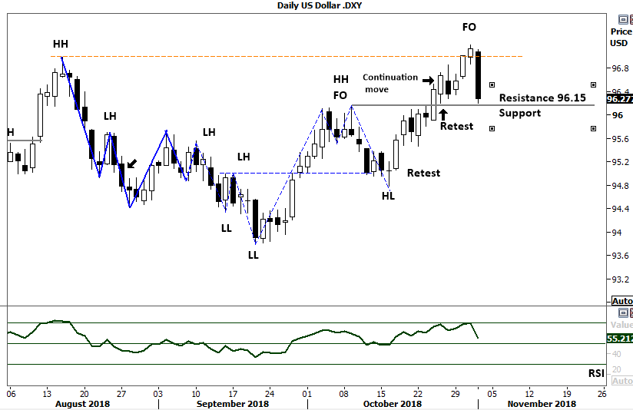
US Dollar Index
The Relative strength Indicator ( 14) has turned higher confirming of upward momentum. A retest of the key 95 level on a very strong range, is now complete.
Current breakout sets the 97 level target. RSI suggests momentum is very positive with levels over the key 50 mark.
The US Dollar index is weighting of the US Dollar against a basket of other currencies. The Euro, Japanese yen, British pound, are just a few.
An increase in the “Value” of the US dollar Index is
indicative of the strength of the US Dollar.
As the US dollar rises other currencies decline in relative “value” and visa versa.
Comments last week. Last weeks commentary suggested the retest is complete

Slide 13
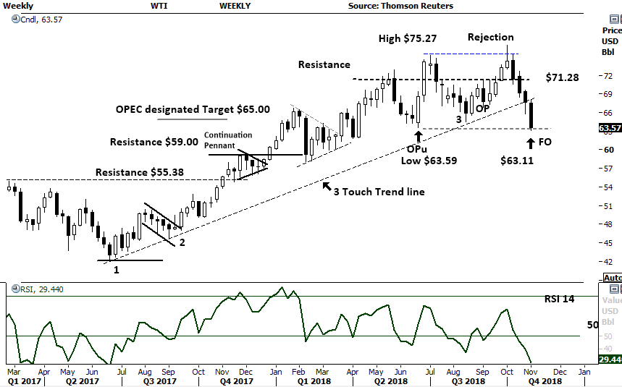
WTI Oil WEEKLY
Weekly OIL
A new trend line has developed, a retest of this line would have oil at $68.00, this saw a breakdown below this level. Currently the lower shadow of this weeks range is higher than the low at (3).
$64.00 remains the first major key support level.
$75.27 is the next key resistance level on price recovery.
Comments from last week.
The primary trend remains UP during this time of potential price consolidation the retest of $71.28 and further move down is significant.

Slide 14
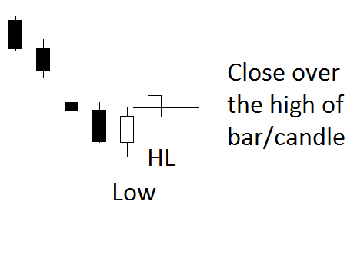

The technical setups. The Pivot point reversal
High
Can also be the
exit signal
for a short position.
HL

Slide 15
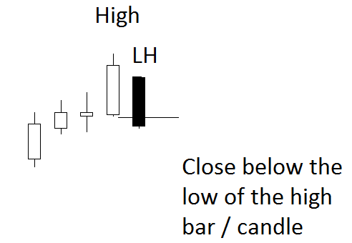
The technical setups Pivot point reversal
LH
Low
Can also be an
exit signal
for a long position.

Slide 16
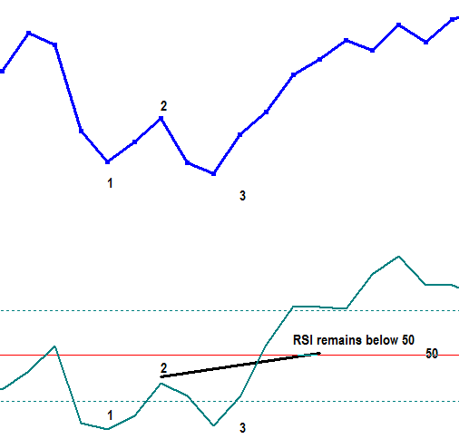
THE TECHNICAL SETUPS Relative Strength
Relative Strength Indicator
SWING BUY SIGNAL.
Market makes a low, (1) RSI swings below the 30 level. (1)
Market closes higher, (2) RSI moves higher but not over the “50” level. (2)
Market makes new lower low, (3) RSI makes a higher low (3)
The swing buy signal occurs when the RSI moves and finishes over point 2

Slide 17
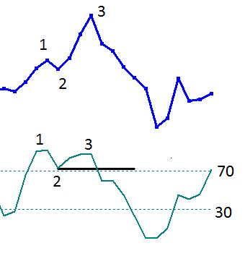
THE TECHNICAL SETUPS Relative Strength
The RSI Failure Swing 1. Market makes high price. 2. Retracement RSI remains above “50” (2) 3. Market makes higher high. 3. RSI makes lower high. (3) Must be over the 70 level. ** The Swing failure sell signal occurs as RSI swings below “2”**
Swing failure is identified with the break of point 2 on RSI

Slide 18





The technical setups Outside period Opu and OPd
A price range larger than the previous range often indicates a market turning point. (Krastins research) The outside period can mark a significant market turning point at or within 3 bars ( 93%).
Opu is an up close bar Opd is a down close bar.
The OP period comes in all shapes and sizes.

Slide 19
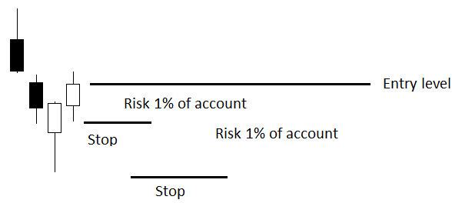
Position size and management guidelines
Position size by account size Building a trading system on simple rules requires a money management process. As an example, should 1% of the account size be risked on an individual position, the position size can be
calculated. Here is the guideline, this allows the trader to build an R- (risk) based return.
The distance-to-stop is the $ amount risk. Dividing the distance to stop into 1% of the account size gives the position size. The lower stop displayed will have a smaller position size. Profit taken on the trade can then be measured against the risk. For example:
The distance-to-stop is 20 cents and the account size is 10,000.
Using 1% ($100) of the account, divide the $100 by 20c. This gives a position size of 500 units.
The lower stop loss is 50 cents away. Using the same methodology of a 1% of account risk, the position size is 200 units.

Slide 20
Comments and Feedback: support@fpmarkets.com

Slide 21
THANK YOU

