Slide 1


IN BLACK AND WHITE 04/05/2018 A market technician’s view FX INDICES EQUITIES

Slide 2
IMPORTANT DISCLAIMER
The information in this report is of a general nature only. It is not personal financial product advice. It does not take into account your objectives, financial situation, or needs.
You should therefore consider the appropriateness of this information in light of these.
The Australian school of technical analysis ( ASTA ) recommend that you refer to the Product Disclosure Statements of any financial products which are discussed in this report before making any investment decisions.
ASTA accepts no responsibility for your actions and recommends you contact a licensed advisor before acting on any information contained in this general information report.
FP Markets does not endorse the content or make any representations to its accuracy.

Slide 3


Slide 4
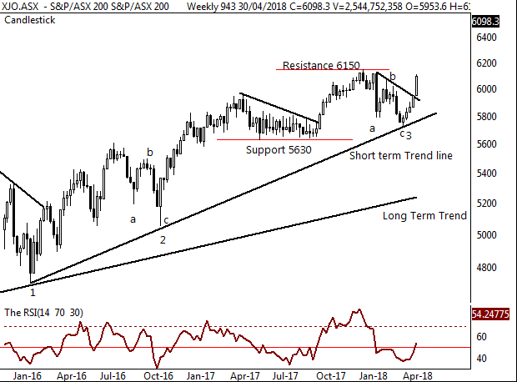
Aussie 200 index - Weekly
A retest of the trend line is now complete.
Current RSI momentum suggest further price gains with the swing over the key “50” level.
A closing break over the resistance of 6150 would confirm a potential move to 6400 points.
This would also re-affirm the primary UP trend.
Comments from last week:
A retest of the trend line is now complete.

Slide 5
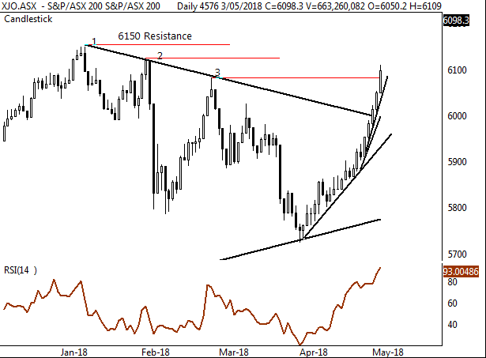
Aussie 200 index - Daily
The daily chart shows the clear breakout with an accelerating trend.
The overall move from the 5730 low is described as a “corrective” move.
Consolidation above price level (3) at 6084 points would be very bullish in the short term.
The RSI, although high, shows no loss of momentum .
Traditionally the month of May brings in selling leading into the end of financial year.
Comments last week.
The daily chart shows the primary move from the short term weekly trend line. A retest of the upper resistance line is now in play.

Slide 6
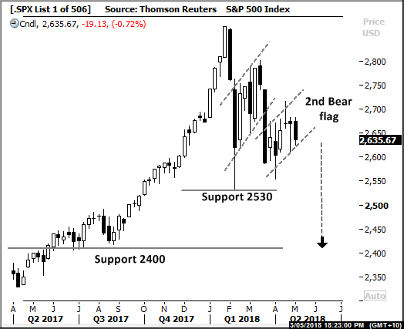
S&P 500 Index - Weekly
The 500 Index Weekly chart highlights the 2nd bearish flag a breakdown from this level shows with a further price target of 2400 points.
From the January 26th high of 2872 points the current closing level shows an 8% move, this leaves room for further weakness.
Historically the S&P can retrace up to 15% in retracement conditions.
A break below 2530 would place the index into a primary down trend.
Comments from last week.
Development of the bearish flag continues

Slide 7
FTSE 100 Index - Weekly
FTSE 100 weekly:
Following the corrective move down and RSI bullish divergence the FTSE 100 is currently moving higher into resistance at 7600.
Often periods of consolidation follow on from large corrective moves in this case 7800 to 6866 (11%) or 934 points
Only a weekly close over this level would bring 7800 resistance in to play as the next go-to level
Comments from last week:
Consolidation below 7600 would be expected

Slide 8
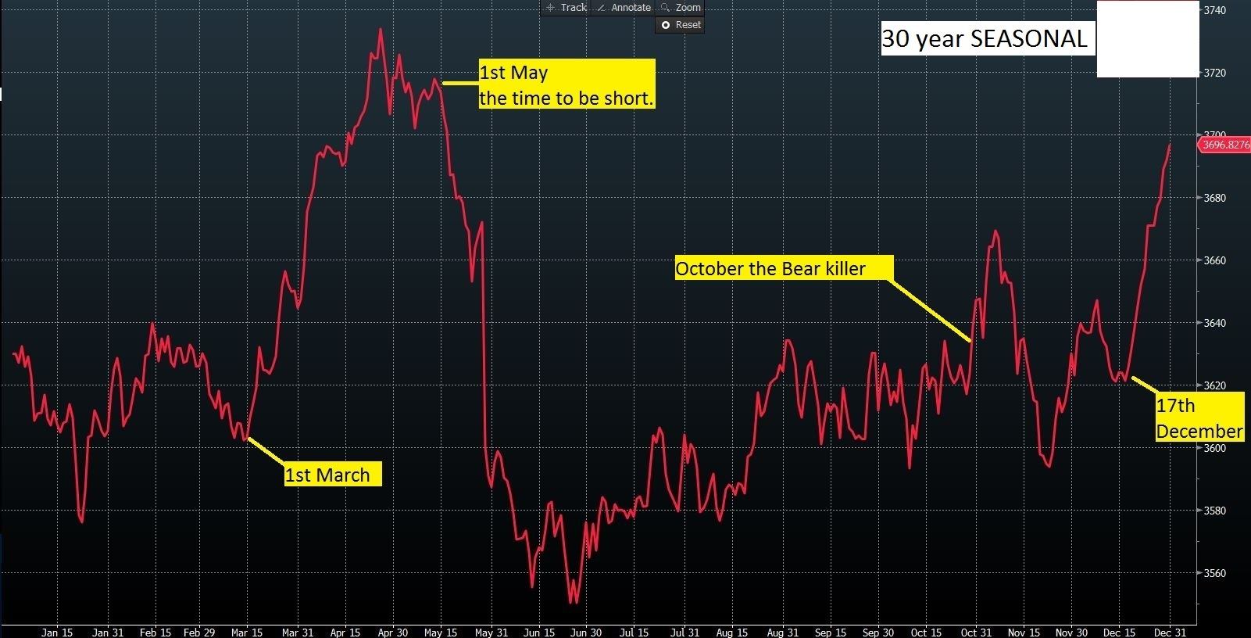
MARKET SENTIMENT
The chart below shows the 30 year average seasonality of the Aussie 200. This is the 30-year average as a percentage of gain/loss, signifying potential overall directional movement more importantly sentiment.
** It’s worth pointing out this March 2018 was down, finishing 170 points lower. This did not follow the historical average movement.

Slide 9
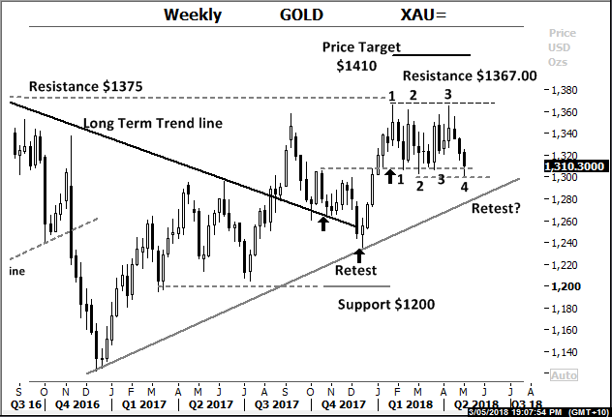
GOLD Weekly
Gold weekly: Gold remains in a new primary uptrend. The internal support level of $1300 needs to hold in this developing consolidation for the bullish case to persist.
Currently there have been 4 retests of this key level with the 4th making a new low at $1301.50
Price weakness may retest the tentative trend-line at $1280.
A test of the long term resistance level of $1400 is favoured with a further break higher as this primary up trend unfolds.
Comments from last week:
The internal support level of $1300 needs to hold.

Slide 10
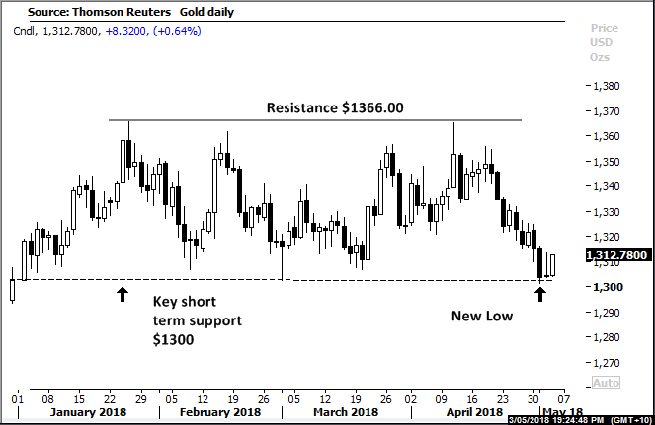
Gold Daily
Gold daily: Daily chart of Gold highlights the trading range underway.
Support is indicated with an immediate reversal with a potential retest of the upper trading range level at $1366.00
Any further price movement below this consolidation support level at $1300, would be very bearish in the near term.
Comments from last week:
A move lower potentially back too price support at $1300

Slide 11
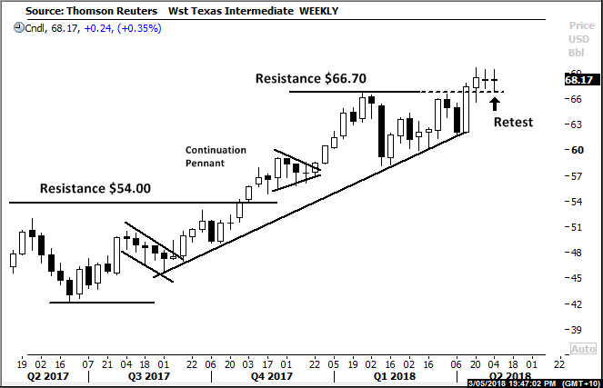
WTI Oil WEEKLY
Weekly OIL A clear primary UP trend in place.
Past 3 weeks show a very tight consolidating trading range.
Support is shown at $66.70 currently being retested following the small breakout.
A closing weekly bar below this level would signal further consolidation between $59 and $67.00
Comments from last week. Resistance shown at $66.70 is currently being retested

Slide 12
Trade Idea - GOLD
Oceana Gold displayed significant bearish price divergence during Q3 2016 leading to the long consolidation of price above the $3.30 level.
During Q4 2017 and Q1 2018 with the break of support a small triple low was put in place while the Relative strength showed Bullish divergence.
Relative Strength divergence can be highly indicative of a swing low in place.
Stops set at $3.05

Slide 13
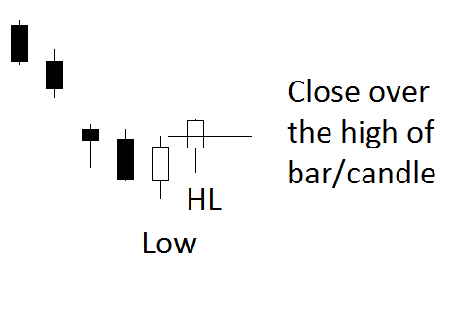

The technical setups Pivot point reversal
High
Can also be the
exit setup
for a short position
HL

Slide 14
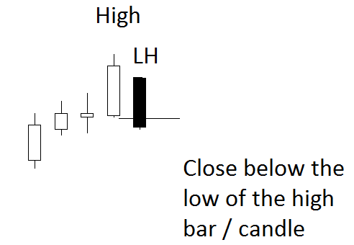
The technical setups Pivot point reversal
LH
Low
Can also be an
exit setup
for a long position

Slide 15
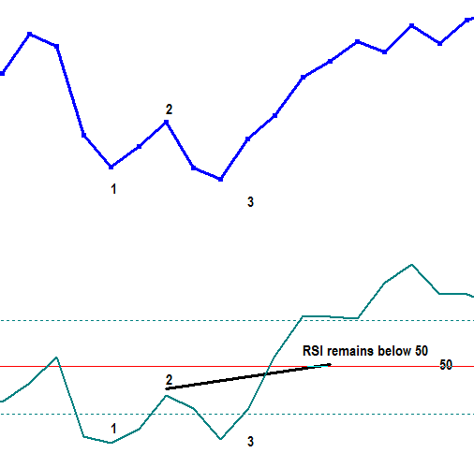
THE TECHNICAL SETUPS Relative Strength
Relative Strength Indicator
SWING BUY SIGNAL.
Market makes a low, (1) RSI swings below the 30 level. (1)
Market closes higher, (2) RSI moves higher buy not over the “50” level. (2)
Market makes new lower low, (3) RSI makes a higher low (3)
The swing buy signal occurs when the RSI moves and finishes over (2)

Slide 16
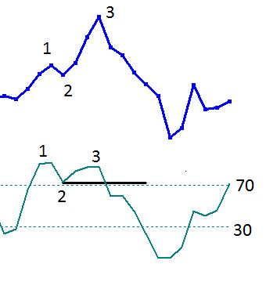
THE TECHNICAL SETUPS Relative Strength
The RSI Failure Swing 1. Market makes high price. 2. Retracement RSI remains above “50” (2) 3. Market makes higher high. 3. RSI makes lower high. (3) ** The Swing failure sell signal occurs as RSI swings below “2”**
Swing failure is identified with the beak of 2 on RSI

Slide 17





The technical setups Outside range
A price range larger than the previous range often indicates a market turning point. (Krastins research) The outside period can mark the market turning point at or within 3 bars ( 93%).

Slide 18
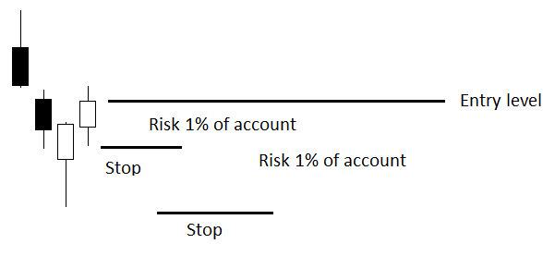
Position size and management guidelines
Position size by account size Building a trading system on simple rules requires a money management process. As an example, should 1% of the account size be risked on an individual position, the position size can be
calculated. Here is the guideline, this allows the trader to build an R- (risk) based return.
The distance-to-stop is the $ amount risk. Dividing the distance to stop into 1% of the account size gives the position size. The lower stop displayed will have a smaller position size. Profit taken on the trade can then be measured against the risk. For example:
The distance-to-stop is 20 cents and the account size is 10,000.
Using 1% ($100) of the account, divide the $100 by 20c. This gives a position size of 500 units.
The lower stop loss is 50 cents away. Using the same methodology of a 1% of account risk, the position size is 200 units.

Slide 20
Comments and Feedback: support@fpmarkets.com

Slide 21
THANK YOU

