Slide 1



Project Title
Shiva Chandhra Gone (CDS), Ahatisham Ansari (CDS), and Pandarasamy Arjunan
Motivation
Chat Applications: Emoji suggestions(auto-complete)
Social Media: Enhance content understanding and user engagement.
Objectives
Collecting data
Training the model
Converting to Tf-lite model
Deploying it on Edge Device(tiny-ml kit).
Fine tuning the model.
Dataset / Data collection
10 emojis with 5 different angles for each class
Pre processing the images for training and fro inference.
Edge AI Model
Model compression: 70 %
Model characteristics:
Size before:48 kB
after compression: 32 kB
Performance before : 1.0
Perfomance after : 0.91
Latency before : 2 ms
Latency after 1.6 ms
Hardware and Software spec.
Aurdino Nano BLE sensor
Omni vision ov7670
Prototype & demonstration
Collecting data from cam sensor.
Running the model in Arduino and sending the softmax output to laptop.
By running a python file in laptop.
We can display the output in the laptop
Code: https://github.com/shivaiisc/EDGE_AI_PROJECT

Slide 2
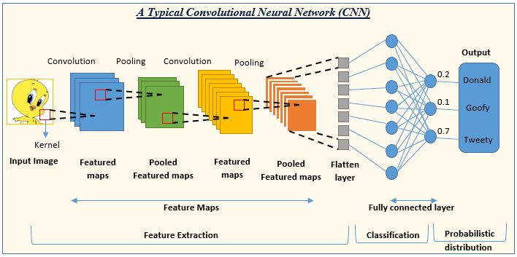
Model Architecture:

Slide 3
INPUT SHAPE ( 48*48*3)
2D CONVOLUTION ( 46 ,46,32) , Params : 896
2D MAX POOLING ( 23,23,32) , Params : 0
2D CONVOLUTION ( 21 ,21,64) , Params : 18496
2D MAX POOLING ( 10,10*,64) , Params : 0
2D CONVOLUTION ( 8 , 8 , 128) , Params : 73856
2D MAX POOLING ( 4,4,128) , Params : 0
FLATTEN ( 2048 ) , Params : 0
DENSE(4) , Params : 8196
SOFTMAX( No. of classes )

Slide 4
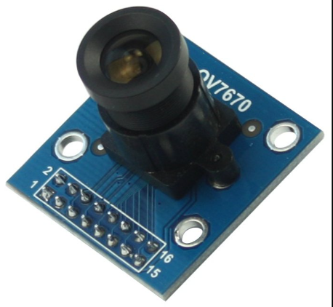


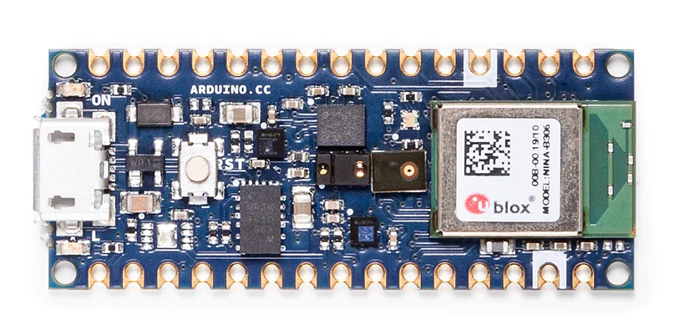
Collected Data was trained in model which was optimized to deploy on Arduino , converted it to Tflite
Using tensflow
Data Collected Using Camera Sensor, 20 samples for each,
preprocessed for training
OV7670
Arduino sketch was run , which includes image conversion to RGB and Tflite file utilized to extract weights and make prediction
Prediction data with image was sent to system from device utilizing pyserial library

Slide 5
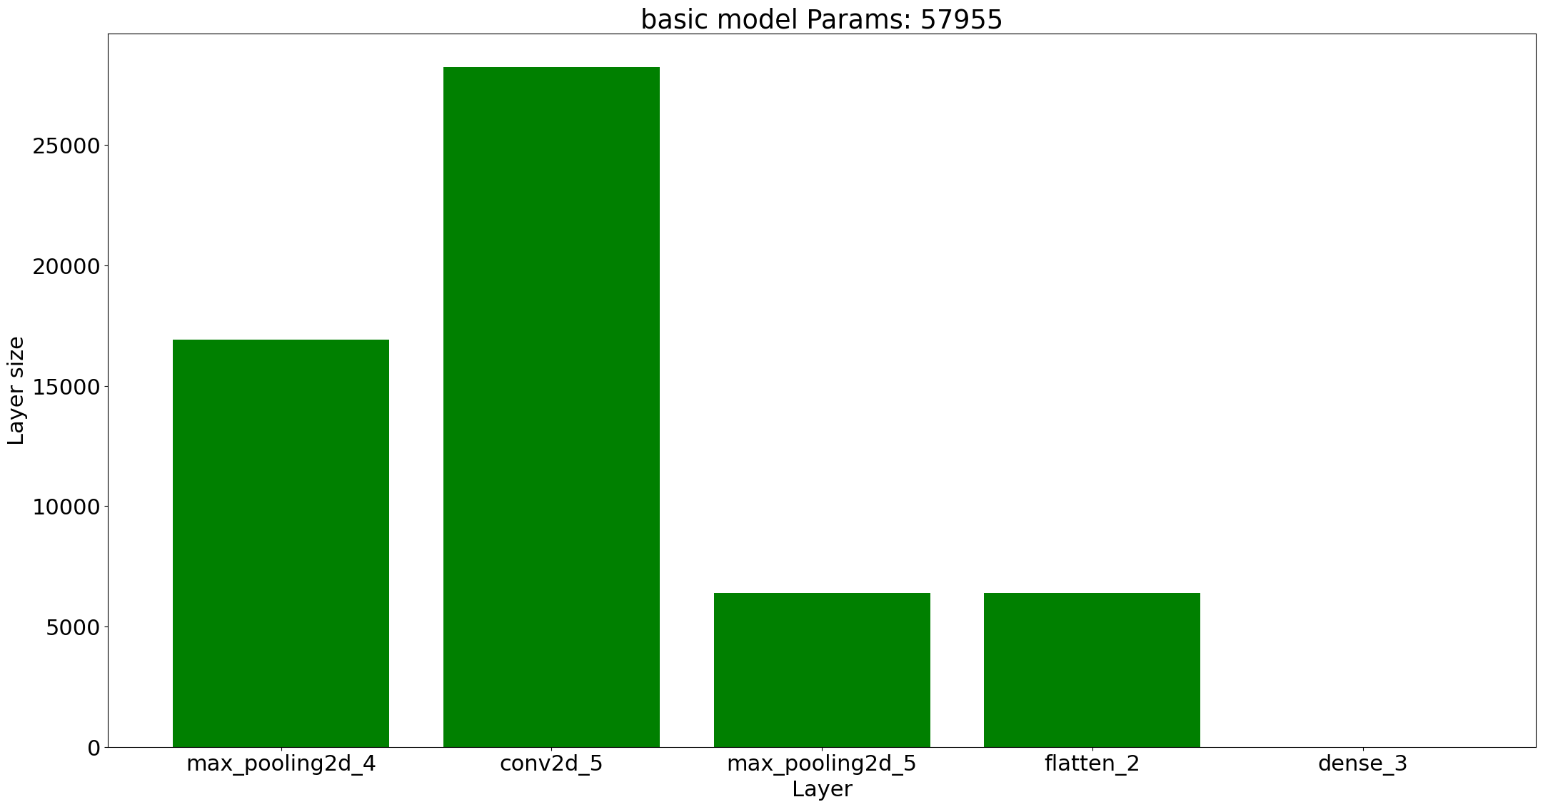
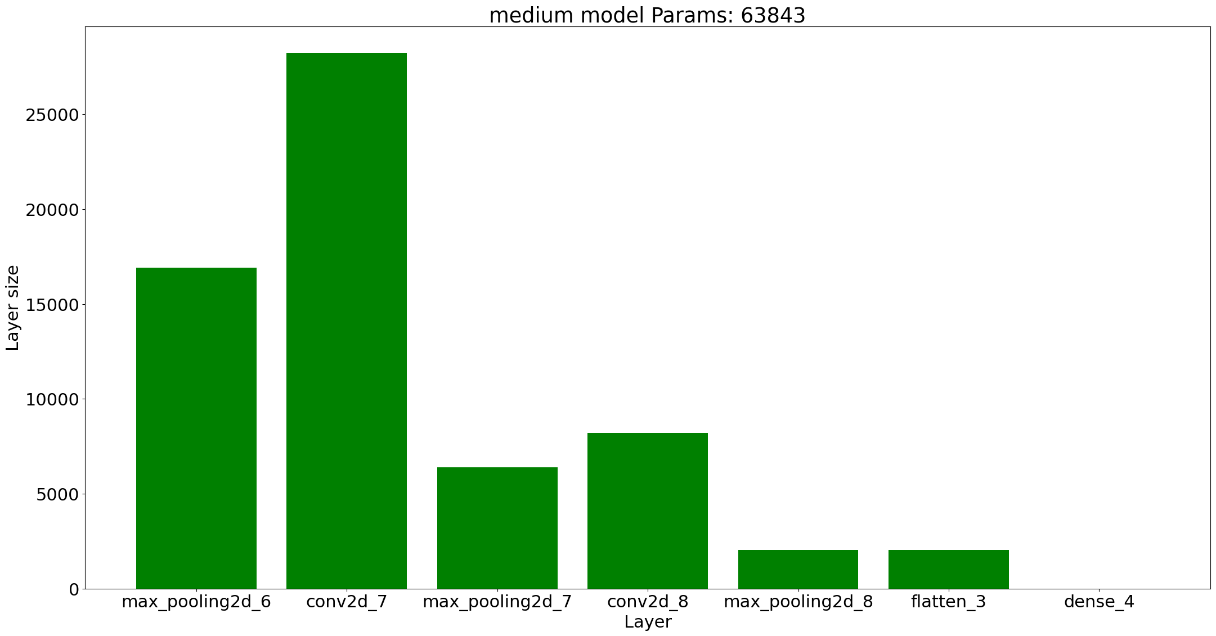
Basic Model (Light weight) :
Medium Model
(Not deep and not heavy) :

Slide 6
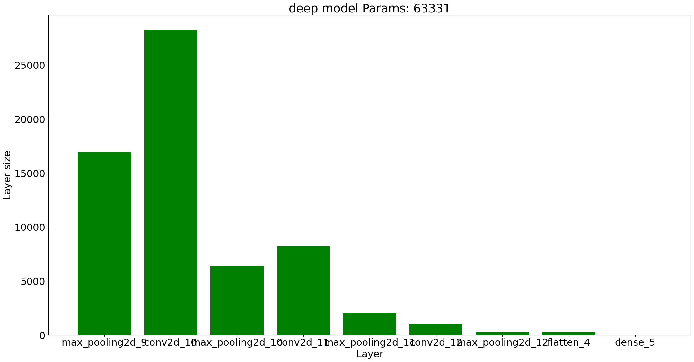
Deep Model
(deep but not heavy) :

Slide 7
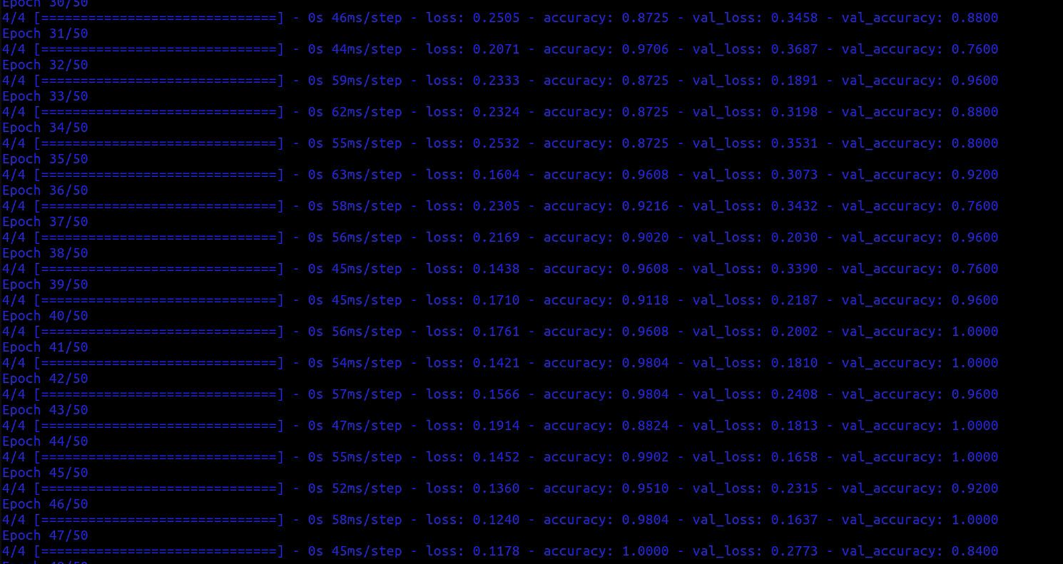

Slide 8
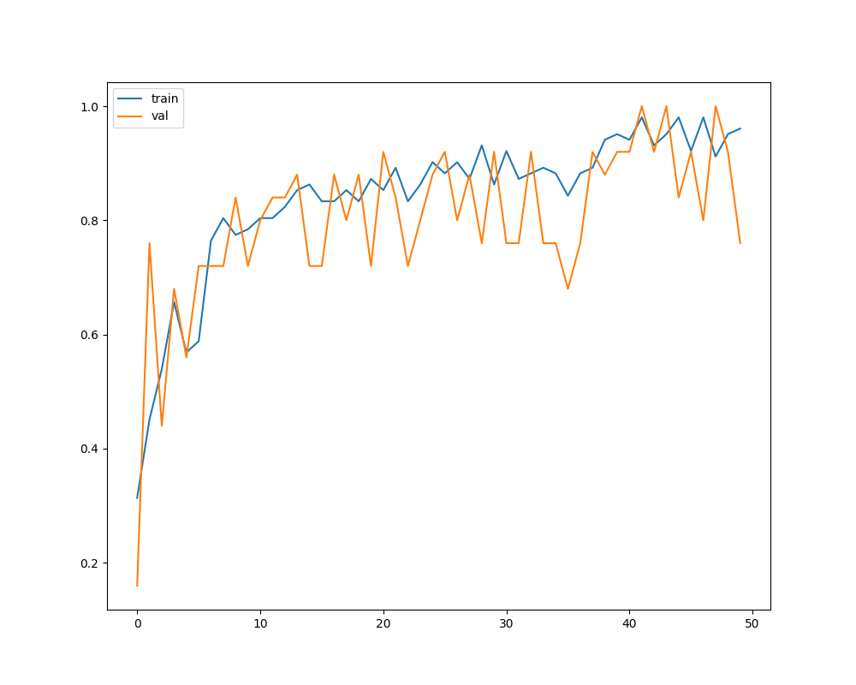
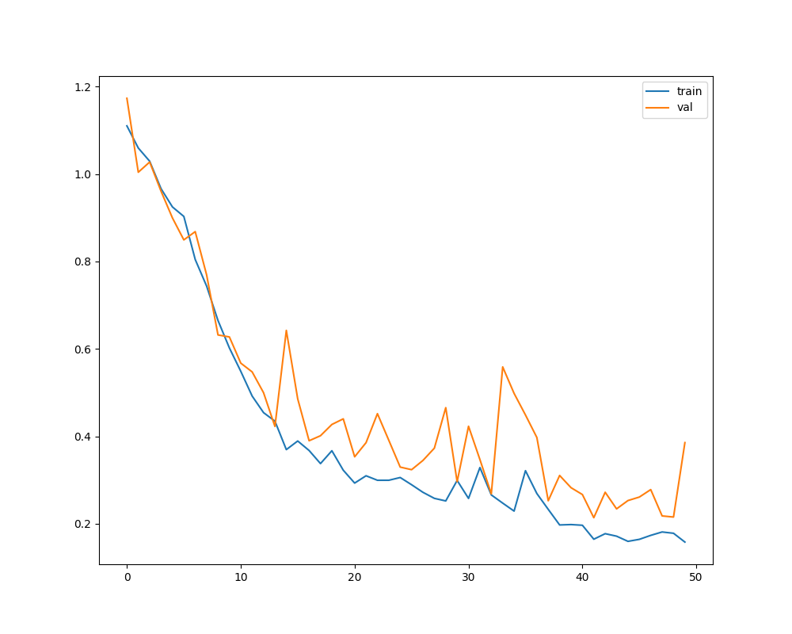
Loss: Acc:

Slide 9
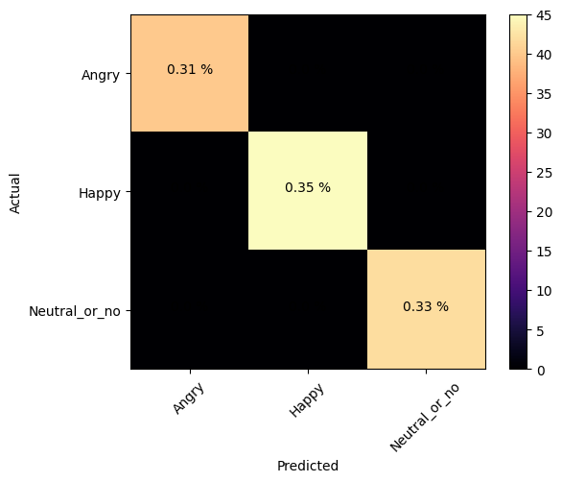
Confusion Matrix

Slide 10
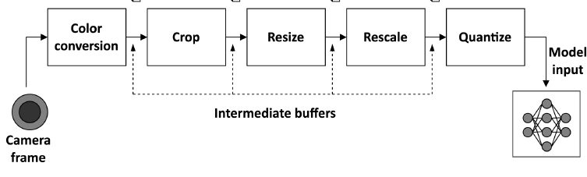

Slide 11
Thank YOu

