Slide 1


AVANI ALBEDO
Urban Heat Action Agent | Prescriptive Climate Resilience Engine
“Optimizing Albedo, Cooling the Earth.”
TEAM Avani Albedo • TEAM MEMBERS Shivaji Bodkhe, Akshatha R Prabhu, Anusha D, Niranchana
Heat maps identify the problem. Avani turns ward-level heat risk into budget-aware cooling actions.
Active development | Status snapshot: 08 October 2026 | 16 tests passing

Slide 2
Brief about the idea
From “where is it hot?” to “what should the city fund next?”
Avani Albedo is a municipal decision-support platform for turning urban heat signals into prioritized, explainable resilience plans.
01 READ THE CITY
02 RANK THE RISK
03 PLAN THE RESPONSE
Map ward-level heat, vegetation, built density and exposure indicators in an interactive GIS workspace.
Calculate a Heat Vulnerability Index (HVI), review seasonal patterns and compare neighborhoods.
Optimize interventions against a budget, then generate a practical action plan for decision-makers.
Built for planners who need an actionable next step—not just another hotspot map.

Slide 3
Opportunity: connect heat intelligence to decisions
THE GAP
OUR APPROACH
WHY IT IS DISTINCT
Many heat maps stop at detection.
Municipal teams still need to answer:
• Which wards face the greatest risk?
• Which interventions are feasible?
• How should limited funds be allocated?
Combine satellite-derived indicators, vulnerability scoring and physical constraints.
Use an OR-Tools optimizer to prioritize trees, cool roofs, shade and hydration within a chosen budget.
One workflow links ward analysis → budget-constrained choices → an explainable roadmap.
Scenario comparison and a local rule-based fallback keep the prototype usable without cloud credentials.
USP: a prescriptive resilience engine, not only a visualization layer.

Slide 4
Core features in the prototype
Dual temperature lens
Ward-level GIS
Vulnerability analysis
Distinguishes surface heat (LST) from ambient-air context in the interface.
Interactive heat map, hotspot markers, city/ward selection and map layers.
HVI combines heat, vegetation, exposure, infrastructure, density and persistence.
History & seasonal views
Budget optimization
Plans & feasibility
Timeline, heat calendar and a 2005–2025 satellite archive view.
OR-Tools allocates tree planting, cool roofs, shade and hydration scenarios.
Gemini-ready briefings with fallback; site checks include a 16 m² tree root-zone standard.
Satellite and AI services can use live credentials when configured; local calibrated composites and deterministic planning support the demo.

Slide 5
Process flow: evidence to action
A planner sets the geography, objective and budget; the engine returns a phased, explainable response.
1
Select
2
Assess
3
Optimize
4
Explain
5
Act
City • ward
Budget • objective
Heat indicators
HVI • exposure
OR-Tools
4 intervention types
Gemini plan
or local fallback
Compare scenarios
Roadmap • phases
Inputs: city + budget + policy objective
Constraints: cost + land feasibility
Outputs: allocations + rationale + phases
Live Earth Engine / Gemini integrations are optional; resilient local data and planning paths are available.

Slide 6
Planner workspace (interface sketch)
AVANI ALBEDO • CITY HEAT
LIVE MAP + ACTION PLAN
TARGET GEOGRAPHY
PRESCRIPTIVE PLAN
Bengaluru ▾
COOLING ACTIONS
Trees • roofs
BUDGET • ₹1.0 Cr
SCENARIO
Budget-fit
OPTIMIZE FOR
Public health ▾
ROADMAP
3 phases
◉ Run climate plan
Ward heat layer • hotspots • intervention sites
Schematic representation of the implemented dashboard; not a product screenshot.

Slide 7
Solution architecture: modular, resilient by default
Planner UI
FastAPI
Decision core
Google services
HTML • CSS • JS
Leaflet • Chart.js
REST endpoints
Auth • scenarios
HVI • OR-Tools
local rule fallback
Gemini • Earth Engine
Firestore • BigQuery-ready
Data in → ward cells, environmental indicators and assets • Plans out → allocations, impact estimates and implementation phases
DEFAULT / DEMO PATH
OPTIONAL LIVE PATH
Calibrated local composite + deterministic planning fallback; cloud credentials not required.
Enable Earth Engine / Gemini and configure Firebase or Firestore credentials for connected services.

Slide 8
Technology stack
INTERACTIVE FRONTEND
API & DATA MODELS
PRESCRIPTIVE ENGINE
HTML5 • CSS3 • JavaScript
Leaflet mapping • Chart.js
Python • FastAPI • Pydantic
REST endpoints • typed schemas
Google OR-Tools
Budget-constrained intervention solver
GENERATIVE AI
EARTH OBSERVATION
CLOUD-READY SERVICES
Gemini 2.5 Flash / Vertex AI path
Rule-based fallback when unavailable
Landsat • Sentinel-2 • Earth Engine
Calibrated composite is default
Firebase Auth • Firestore • BigQuery-ready
Docker / Cloud Run deployment path

Slide 9
Implementation cost: deployment-aware, not guessed
No production cost estimate was supplied; actual spend depends on deployment region, traffic and live-service usage.
PROTOTYPE TODAY
CLOUD COST DRIVERS
BEFORE DEPLOYMENT
Runs locally with calibrated data and a deterministic fallback.
Cloud services are optional for the core demo.
Cloud Run requests and compute
Gemini model calls
Firestore reads / writes
Earth Engine and analytics usage
Set quotas and budgets; secure keys; choose the region and data plan; then measure real usage.
Cloud deployment is pending.
No fabricated pricing • production estimate TBD

Slide 10
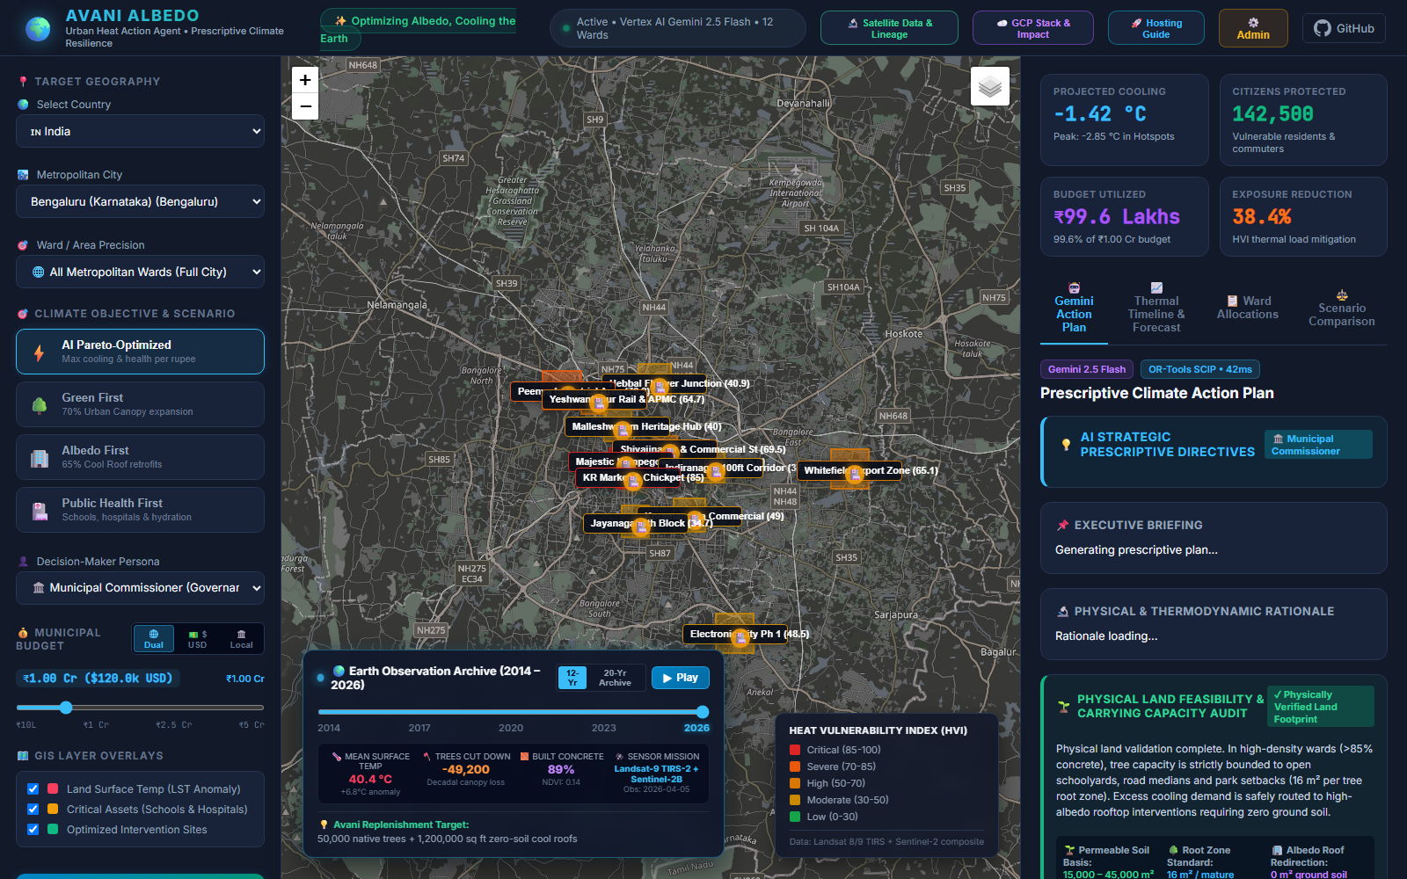
Prototype snapshot: interactive heat-planning dashboard
GEOGRAPHY
City and ward selection with a map-first view.
SCENARIOS
Budget and objective controls feed intervention planning.
DECISION SUPPORT
Heat layers, vulnerability context and plan panels in one workspace.
Local prototype capture • simulation / fallback configuration • 15 Oct 2026

Slide 11
Prototype validation & performance evidence
16 / 16 TESTS PASSING
12 BENGALURU WARDS
LOCAL FALLBACK
Automated suite covers API endpoints, HVI calculations, optimization and related services.
Sample dataset supports city-scale heat and intervention review in the demo.
Dashboard, APIs and deterministic action planning run without live cloud credentials.
Evidence supports functional readiness for a hackathon demo—not production load capacity.
Automated tests: PASS
Load test: not reported
Cloud services: credentials/config dependent

Slide 12
Next steps to production readiness
01 DEPLOY & PUBLISH
02 CONNECT LIVE DATA
Complete Cloud Run / Firebase hosting, configure a public demo URL and confirm judge access.
Validate Earth Engine permissions, live satellite processing and data provenance end to end.
03 HARDEN OPERATIONS
04 FINISH THE DEMO
Finalize authentication, quotas, secret handling, monitoring and performance/load testing.
Record the 3-minute walkthrough; validate live city/ward guidance and municipal recommendations.

Slide 13
Project links & judge access
SOURCE REPOSITORY
LOCAL DEMO
STATUS & VIDEO
https://github.com/shivajibodkhe/Avani_Albedo
Repository visibility needs confirmation before external judging.
Dashboard
http://localhost:8000
API docs
http://localhost:8000/docs
Status API
http://localhost:8000/api/status
Demo video: pending
Important: localhost links work only on the machine running the app. GitHub reports this repository as private; make it public or grant reviewer access before submission.
Final public product URL: pending cloud deployment.

Slide 14
Project status snapshot | 08 October 2026
ACTIVE DEVELOPMENT
16 / 16 TESTS PASS
CLOUD DEPLOY: PENDING
DEMO VIDEO: PENDING
IMPLEMENTED IN THE PROTOTYPE
REMAINING BEFORE PUBLIC DEMO
Interactive frontend • API endpoints • heat / HVI analysis
Historical and timeline views • optimization • admin interface
Local calibrated-data and deterministic fallback paths
Cloud deployment and public product URL
Live service credentials and production configuration
Public repository / judge-access confirmation
Recorded walkthrough and final presentation sign-off
Stable and tested for demonstration preparation; cloud services are configuration-dependent and deployment is not yet complete.

Slide 15


