Slide 1
Artificial Intelligence
Introduction

Slide 2
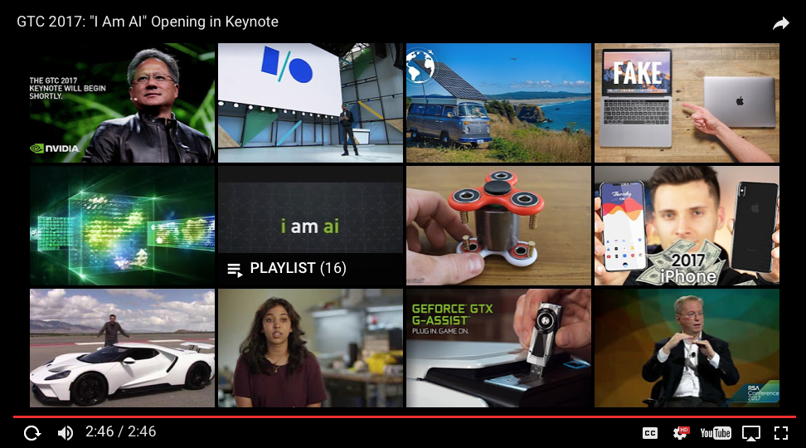
Artificial Intelligence

