Slide 1
Link-wise Artificial Compressibility Method (part 1)
by Yifan Yang
With supervisor Thomas Zeiser 27.01.2015

Slide 2
Outline
project plan
Intro to LWACM
C implementation
results

Slide 3
seminar plan
Two presentations:
C implementation of Lwacm
code optimization and parallelization
All sources and data are available on Github:
http://github.com/cosailer/lwacm
Based on paper:
http://www.sciencedirect.com/science/article/pii/S0021999114004823

Slide 4
artificial compressibility method
The artificial compressibility method (ACM), is a numerical approach for solving the incompressible Navier–Stokes equations (INSE).

Slide 5
Link-wise formulation
The LW-ACM is a discrete formulation of the ACM within a framework similar to the one of the LBM. It operates on a regular Cartesian spatial mesh of mesh size δx with a regular time step δt. In accordance with the established practice of LBM, we shall express all following quantities in terms of lattice units, i.e. adopt δx as unit of length and δt as unit of time

Slide 6
15
12
5
11
N_Z+2
16
8
3
2
7
10
4
1
N_Y+2
9
14
17
N_X+2
6
13
Calculation domain
18
D3Q19 stencil

Slide 7
single-step LW-ACM
for all time step t do
for all mesh point x do
for all index α do
load ρ(x-ξα, t)and u(x-ξα, t)
compute f(e)α(x-ξα, t)
compute f(e,o)α(x-ξα, t)
end for
for all index α do
compute fα(x, t+1)
end for
compute ρ(x, t+1)
compute u(x, t+1)
store ρ(x, t+1) and u(x, t+1)
end for
End for

Slide 8
C implementation
>> Main array:
double p[2][N_X+2][N_Y+2][N_Z+2]
double u[2][N_X+2][N_Y+2][N_Z+2][3]
Array size can be really large if we increase domain size

Slide 9
>> Main loop:
for( t = 0; t < T_MAX; t++)
for( x = 1; x < N_X+1; x++)
| for( y = 1; y < N_Y+1; y++)
| for( z = 1; z < N_Z+1; z++)
| alpha_0_call();
| alpha_1_call();
| ...
| alpha_18_call();
|
| // step 11, compute p(x, t+1)
| // step 12, compute u(x, t+1)
|
|__end for
// set boundary condition
// store p(x, t+1)

Slide 10
>> Function call for alpha loop:
void alpha_0_call()
{
//load p(x-xia) and u(x-xia)
p_load = p[t_now][x][y][z];
u_load[0] = u[t_now][x][y][z][0];
u_load[1] = u[t_now][x][y][z][1];
u_load[2] = u[t_now][x][y][z][2];
u_xi = 0;
u_2 = u_load[0]*u_load[0] + u_load[1]*u_load[1] + u_load[2]*u_load[2];
u_x_xi = 0;
// step 5, compute f(e)(x-xi[0], t)
f_e = 1.0/3.0 * p_load * ( 1 + 3*u_xi + 4.5*u_xi*u_xi - 1.5*u_2 );
f_e_o = 3.0 * 1.0/3.0 * p_load * u_xi; // Eq.10
f_x_t = 3.0 * 1.0/3.0 * p[t_now][x][y][z] * u_x_xi;
// step 9, compute f(x, t+1)
f[0] = f_e + 2*( omega-1/omega )*( f_x_t - f_e_o ) ;
}

Slide 11
Results
Performance Measurement
>> runtime: CPU timer, wall clock
>> time step t = (Domain size) / (N_X* N_Y* N_Z)
 | Domain size | Runtime (avg) | Stream results
Atom 450 | 31 250 000 | 58.57 | 5232 MB/S
Exynos 5250 | 24 000 000 | 21.48 | 3258 MB/S
I7 2600 | 200 000 000 | 39.62 | 12420 MB/S

Slide 12
Operation per lattice update
Assume N_X = N_Y = N_Z = N
>> 543 * N³ * t (FPOPs)
>> (338 * N³ + 24 * N² + 48 * N) * t (mem OPs)

Slide 13
Performance
FPOPS:
543 N³ t / T
= 543 * MLUPS
Memory speed:
(338 N³ + 24 N² + 48 N) t / T
= (338 D + 24 N² t + 48 N ) / T
= 338 * MLUPS
D: domain size T: program runtime

Slide 14
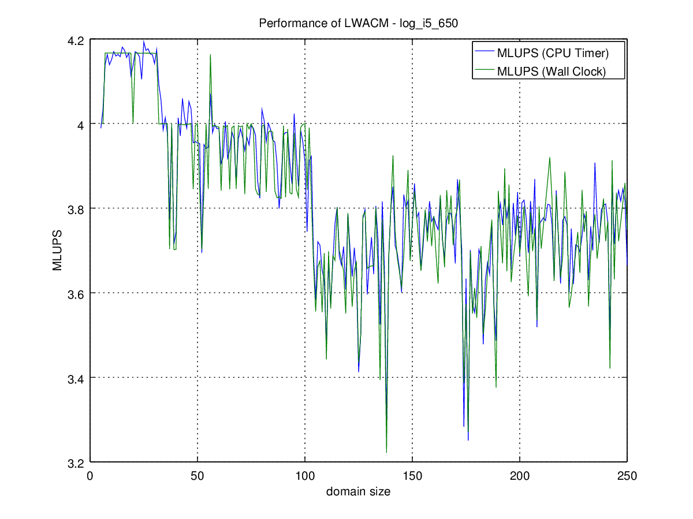

Slide 15
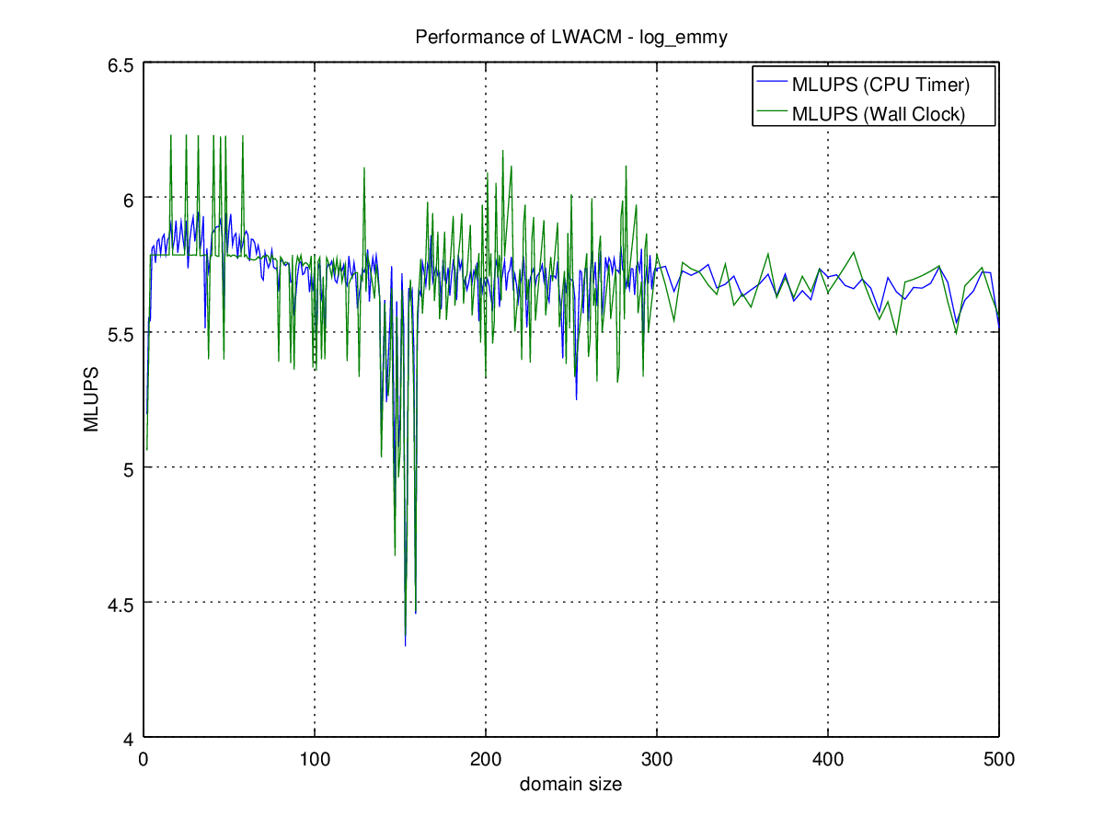

Slide 16
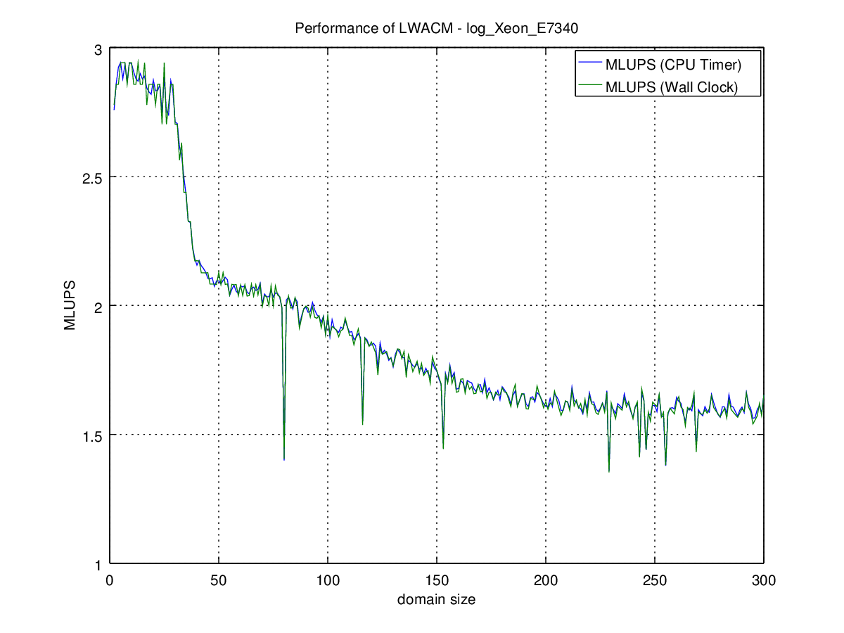

Slide 17
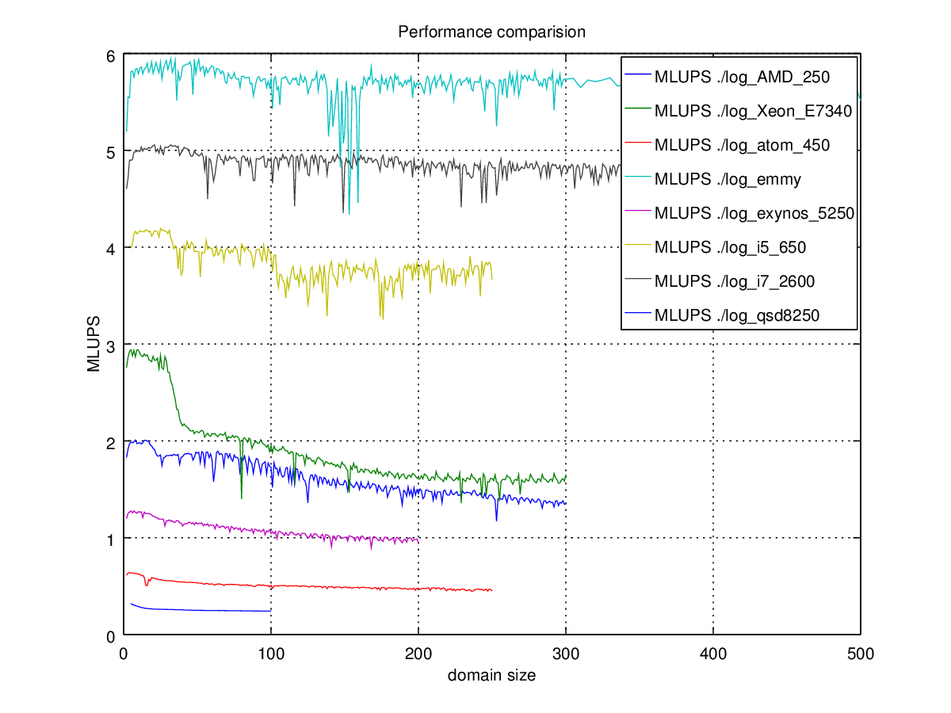

Slide 18
Thank you for your time ! See you in part 2

