Slide 1
CS585
PROJECT PRESENTATION

Slide 2
HELLO!
I am Shivaji Panam
Graduate Student - A20551677
Email: spanam@hawk.iit.edu
What is this about?
Walk through of the steps taken to classify sentiments using Naive Bayes and Logistic Regression models.
Details of how dataset was preprocessed, applied machine learning models, and evaluated their performance using various metrics.

Slide 3
DATASET INFORMATION
1

Slide 4
Dataset Information
What is it?
76,450 Tweets collected
42,626 after pre-processing
4 Major labels(reduced to 2)
Training 80%
Testing 20%
Major data cleaning steps
Drop rows with missing or inconsistent data
Handle case, special characters
Drop irrelevant cols
Lemmatize
Remove stop words
Shuffle

Slide 5
LABEL DISTRIBUTION
2

Slide 6
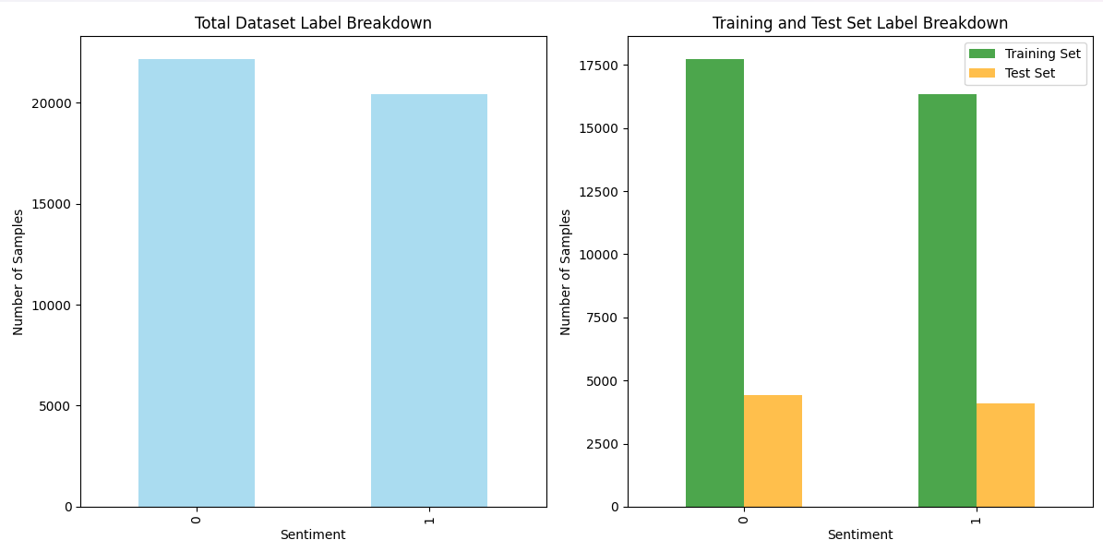
Label Summary
Notes:
data length: 42626
Train set length: 34100
Test set length: 8526

Slide 7
Model Approach & Methodology
3

Slide 8
Model Approach
Data Preprocessing
Model Training
Model Testing
Evaluation & Reporting

Slide 9
Model Pseudocode
Naive Bayes
Tokenization, Normalization
Non binary bag of words vectorization (Tried TF-IDF vectorization)
Experiment with laplace smoothing(0.1)
Build vocabulary of top 200 freq words
Initialize prior probabilities for Naive Bayes
Find posterior probabilities on the training set using term-frequency vectors.
Classify sentiments based on the model's probabilities.
Evaluate
Logistic Regression
Tokenization, Normalization
Non binary bag of words vectorization with laplace smoothing
Initialize weights for scikit-learn Logistic Regression.
Set max_iter=1000 and solver=‘saga’
Train the model on the training set using term-frequency vectors.
Classify sentiments based on the model's probabilities.
Evaluate

Slide 10
MODEL EVALUATION
4

Slide 11
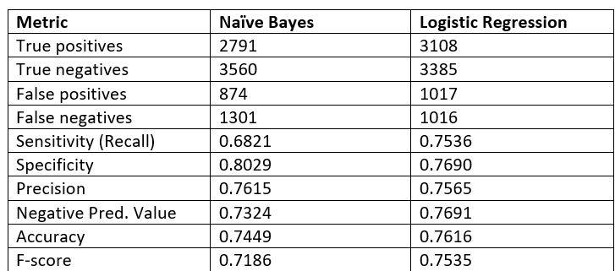
Metrics comparison

Slide 12
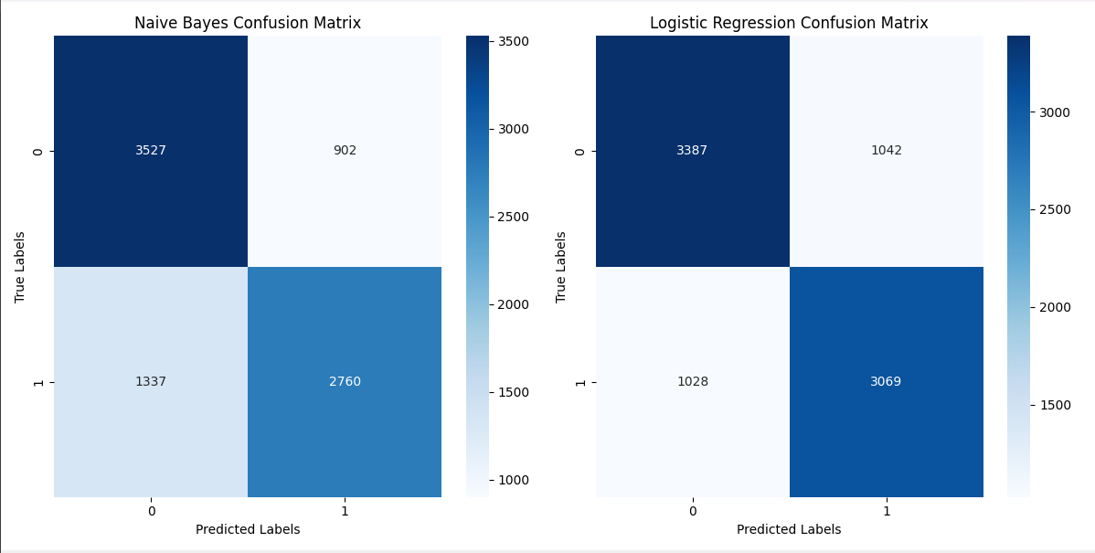
Confusion Matrix
Place your screenshot here

Slide 13
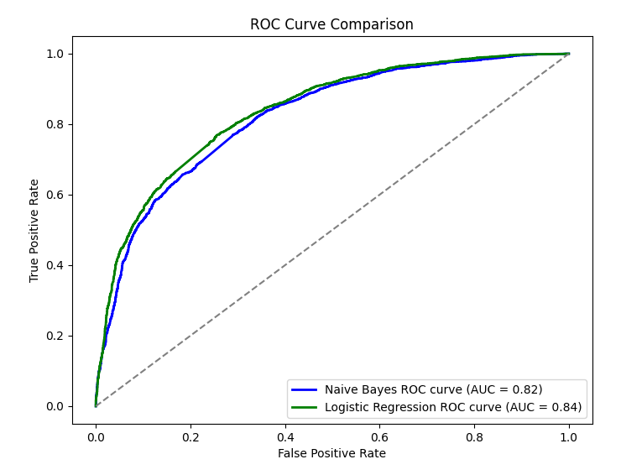
ROC Curves

Slide 14
CONCLUSION & SUMMARY
5

Slide 15
THIS IS A SLIDE TITLE
Two classifiers were trained, Naïve Bayes and Logistic Regression,
With extensive preprocessing applied to improve data quality.
Logistic Regression outperformed Naïve Bayes, achieving higher accuracy (76.16% vs. 74.49%), sensitivity (75.36% vs. 68.21%), and F-score (75.35% vs. 71.86%).
Key techniques included Laplace smoothing adjustments, Log-Sum Exp trick, and limiting solver iterations for convergence on large datasets.

Slide 16
THANKS!
Any questions?
You can find me at
www.linkedin.com/in/spanam & spanam@haw.iit.edu

Slide 17
INSTRUCTIONS FOR USE
Pre execution
Download the file and data into the same folder
If the location of data is different, change it in line no. 28 and 29.
Follow execution steps
Execution
Just execute python filename.py 0 for Naive Bayes, 1 for Logistic Regression, 3 for comparison code that I used for these slides.
You can also provide percentage of train as second argument

