Slide 1

SQL Project on Online Book store

Slide 2
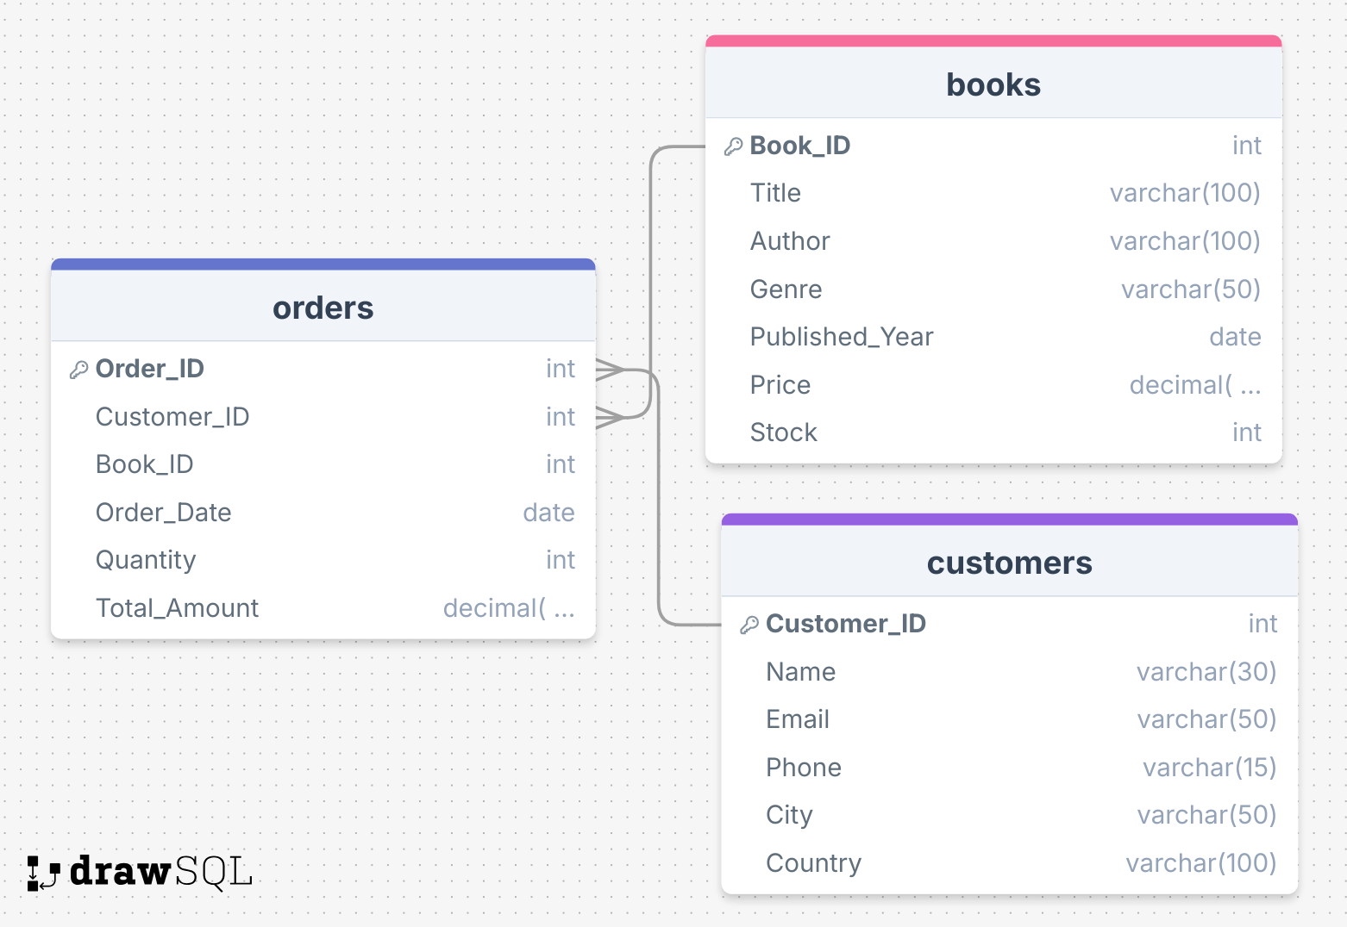
Schema

Slide 3

Basic Queries
Retrieve all books in the "Fiction" genre
Find books published after the year 1950
List all customers from the Canada
Show orders placed in November 2023
Retrieve the total stock of books available
Find the details of the most expensive book
Show all customers who ordered more than 1 quantity of a book
Retrieve all orders where the total amount exceeds $20
List all genres available in the Books table
Find the book with the lowest stock
Calculate the total revenue generated from all orders

Slide 4

Advance Queries
Retrieve the total number of books sold for each genre
Find the average price of books in the "Fantasy" genre
List customers who have placed at least 2 orders
Find the most frequently ordered book
Show the top 3 most expensive books of 'Fantasy' Genre
Retrieve the total quantity of books sold by each author
List the cities where customers who spent over $30 are located
Find the customer who spent the most on orders
Calculate the stock remaining after fulfilling all orders

