Slide 1
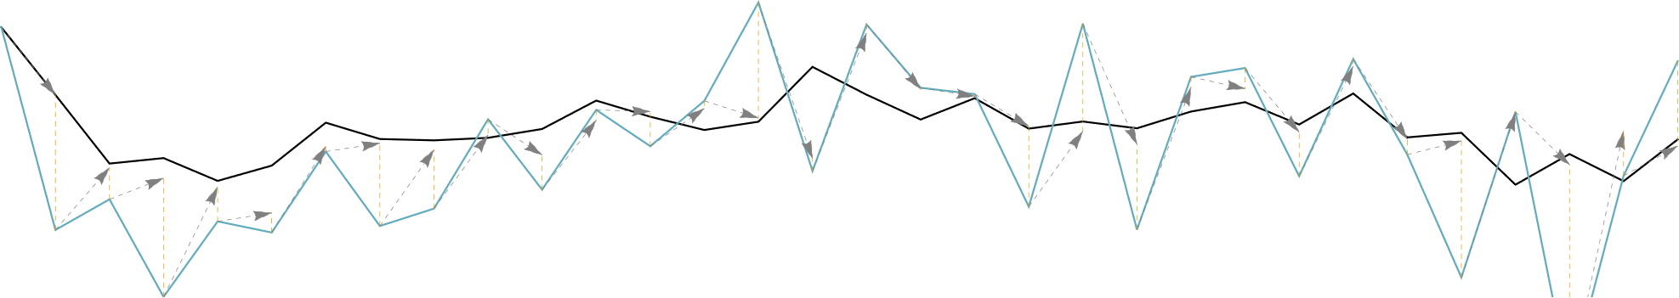
Linear Dynamical Systems as a Core Computational Primitive
Shiva Kaul (CMU)
skkaul@cs.cmu.edu

Slide 2


takes
time
Nonlinear dynamical systems are hard to analyze

Slide 3


parallel
takes
time
with higher approximation
Built from (tractable) linear dynamical systems

Slide 4
states
inputs
Nonlinear RNN

Slide 5
states
inputs
Linear Dynamical System

Slide 6
RNN

Slide 7
Stack of MIMO LDS
RNN
approximation

Slide 8
Stack of MIMO LDS
Combined SIMO LDS
RNN
approximation

Slide 9
Stack of MIMO LDS
Combined SIMO LDS
(Parallel) Linear Recurrence
RNN
approximation
entrywise product
diagonalization

Slide 10

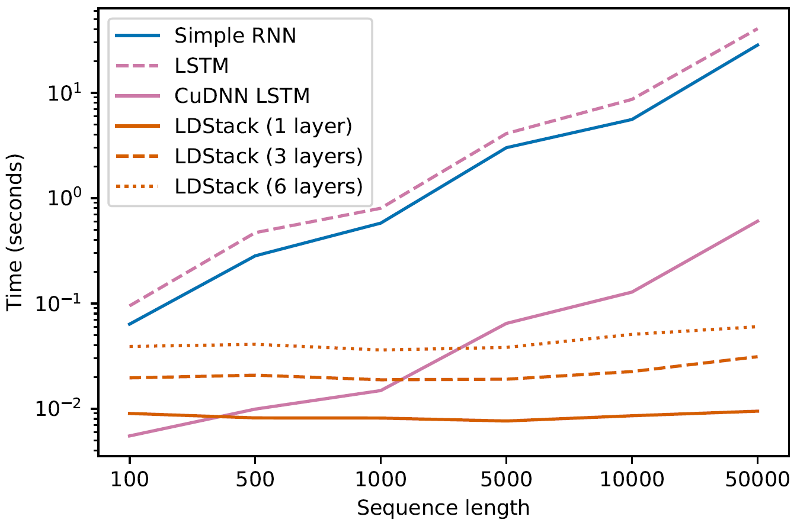

Notably faster for large T…
..even as research code

Slide 11
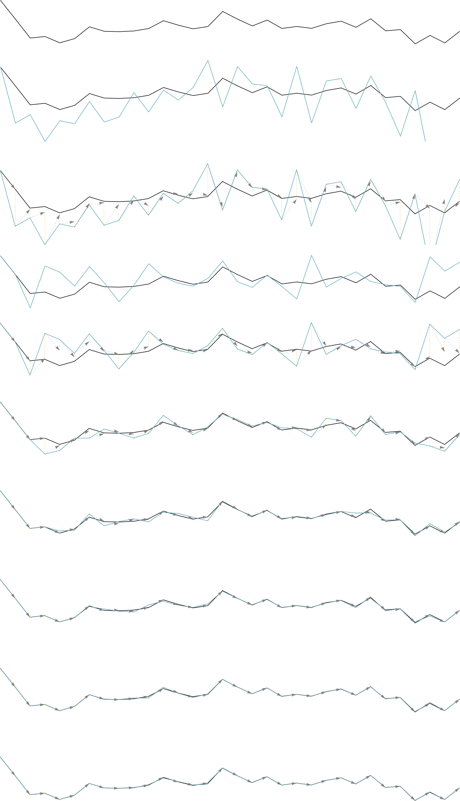
RNN

Slide 12
RNN
plain LDS

Slide 13
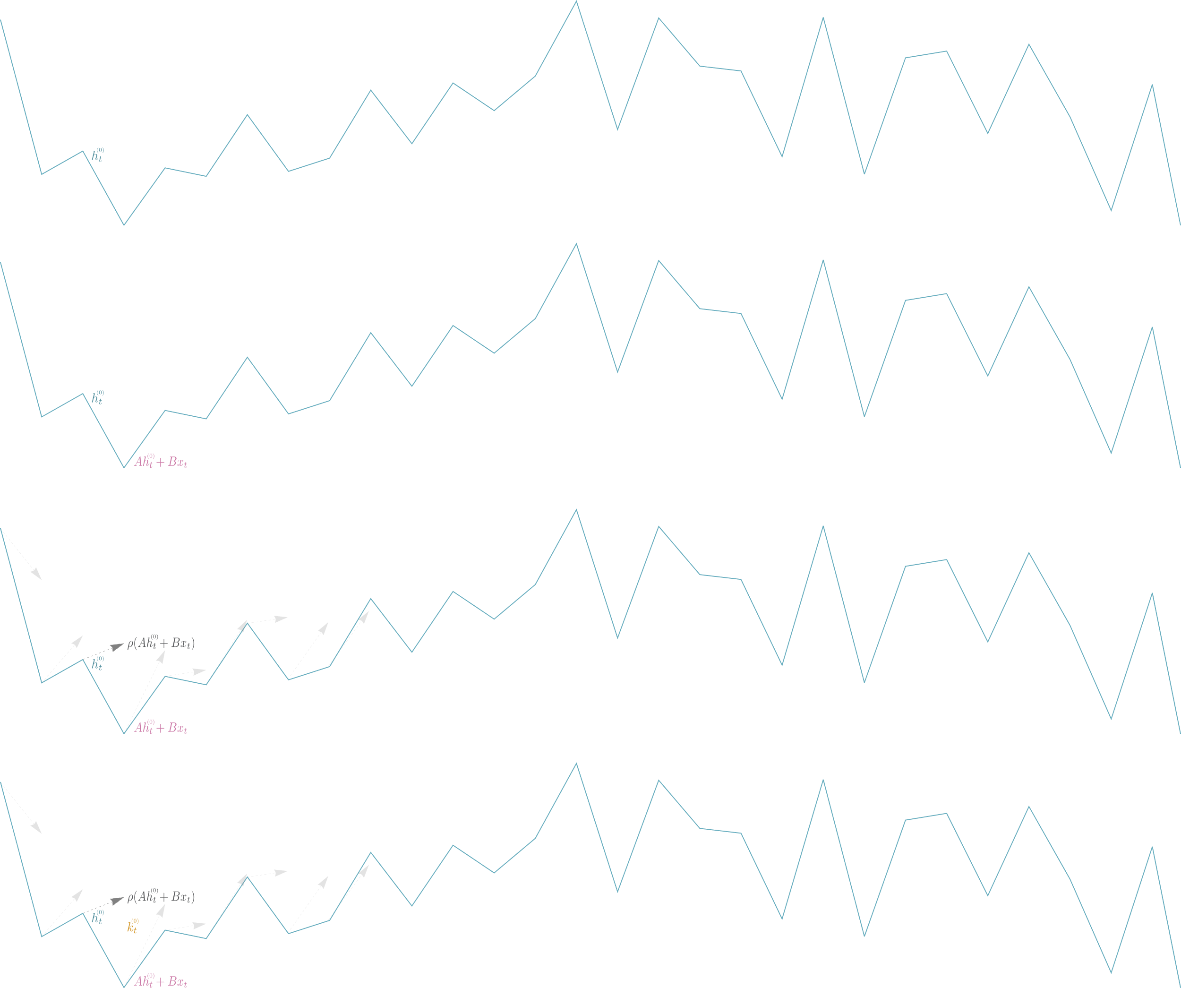

Slide 16
Locally correct deviation between nonlinear and linear steps

Slide 17
plain LDS

Slide 18
RNN
corrected LDS

Slide 19
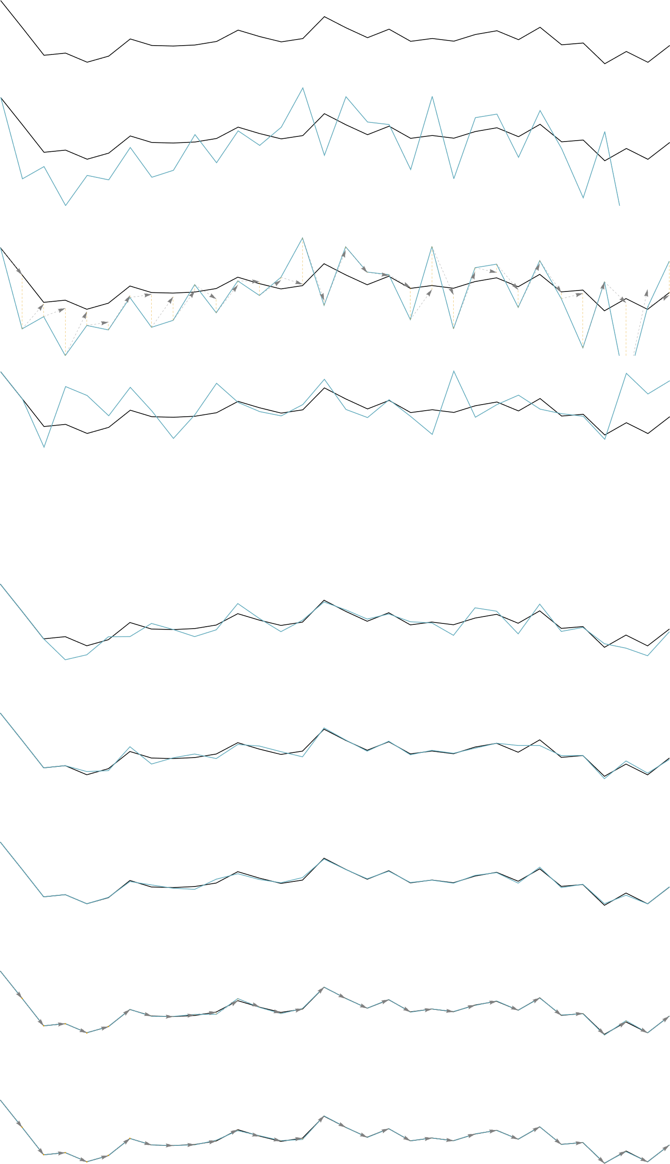

Slide 21
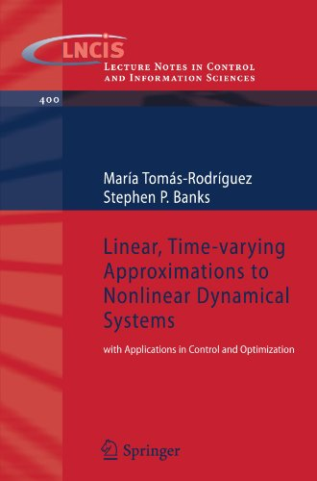
Multiplicative variant:
analyzes nonlinear dynamical systems

Slide 22
MIMO SIMO via
Random Projection

Slide 23
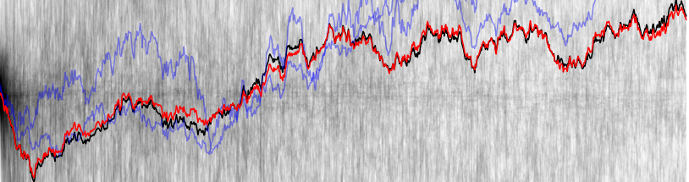
MISO LDS, individual projections, small averages, big average

Slide 24
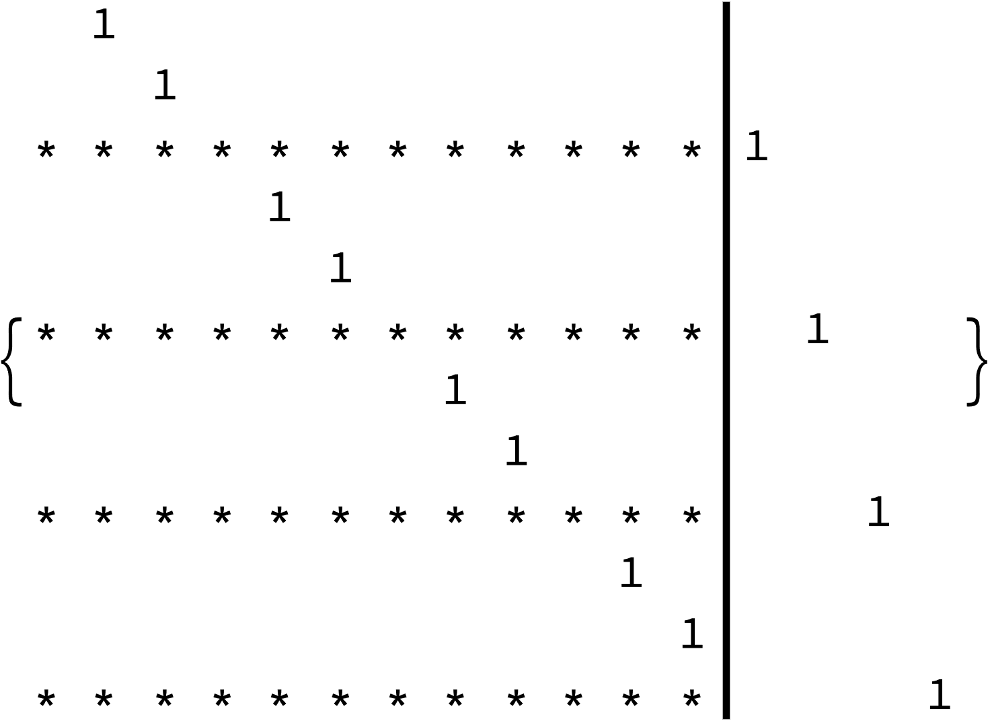
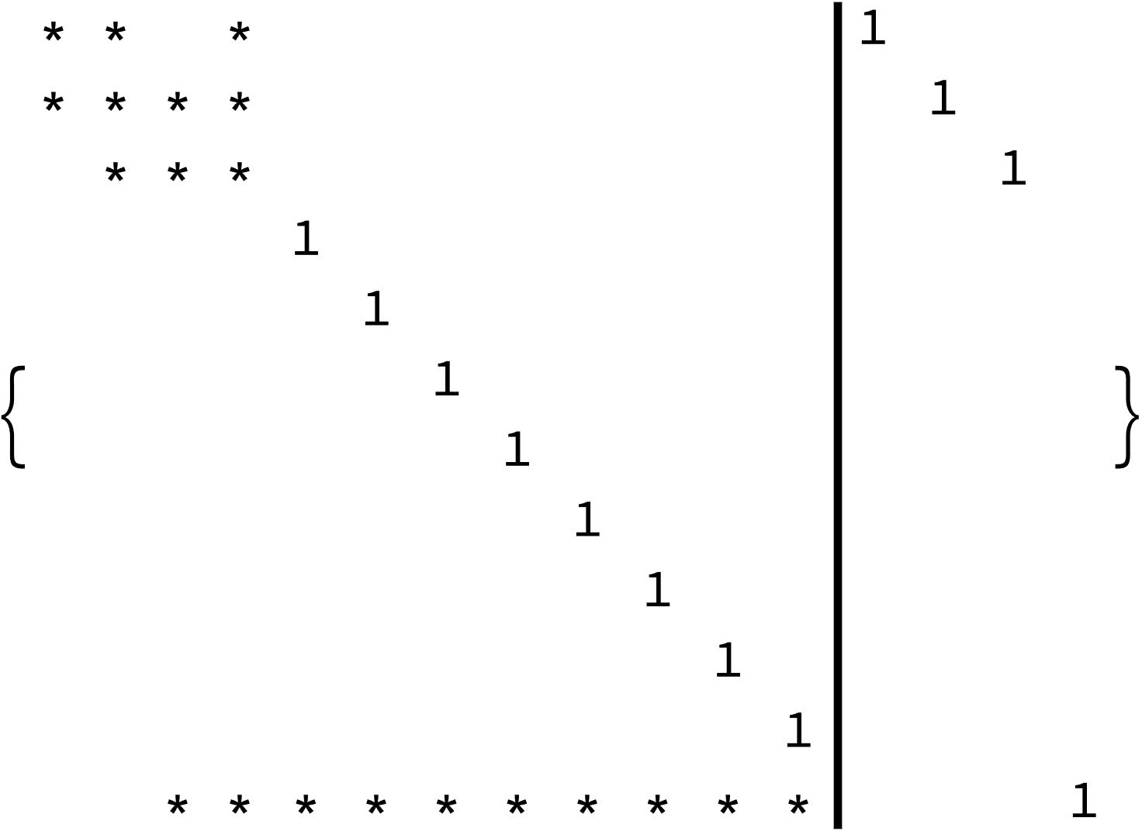
MIMO SIMO via
Perturbed Luenberger Form

Slide 25
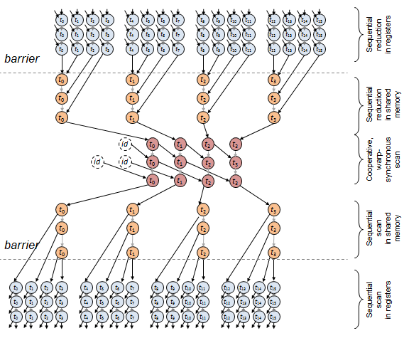
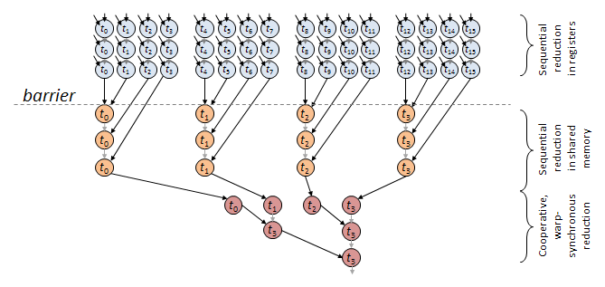
SIMO LDS in time, weights

Slide 26
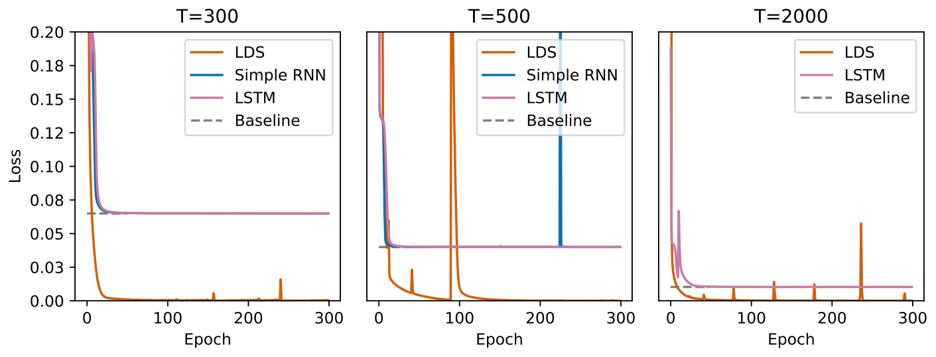
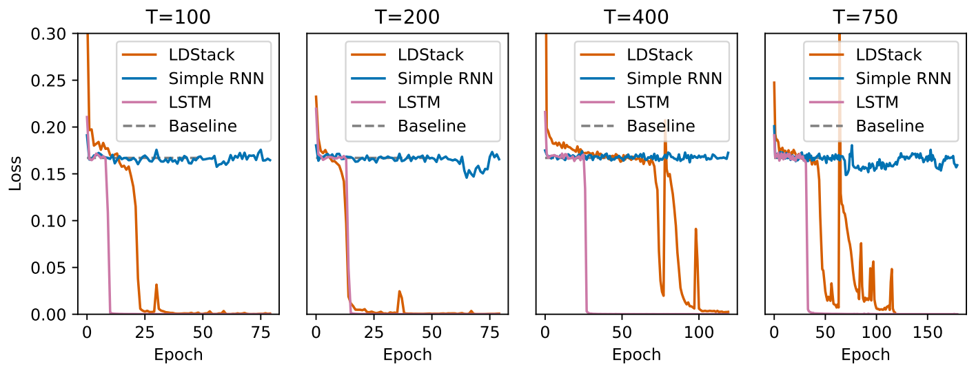
Copy problem
Add problem

