Slide 1
CYBER SECURITY INTERNSHIP | WEEK 9
SOC Introduction
& Lab Setup
Building a monitoring environment with an IDS on Ubuntu Server
Prepared by : Pooja G Shivakalimath
Notes:
Intro: this week covers SOC fundamentals and a hands-on IDS lab.

Slide 2
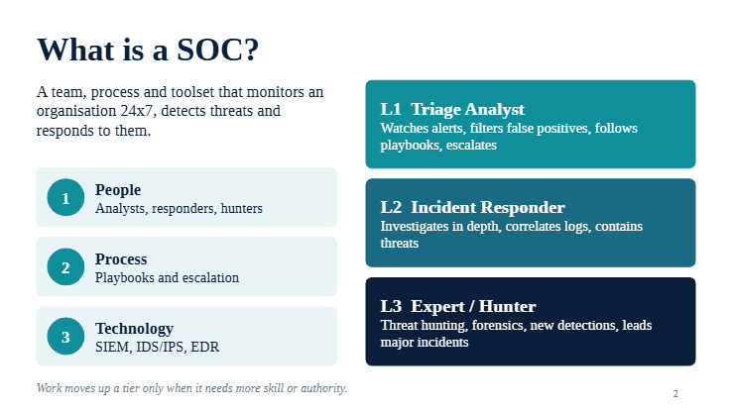

Slide 3
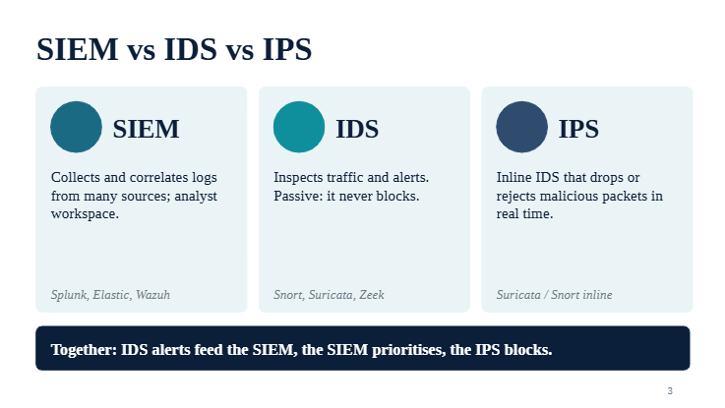

Slide 4
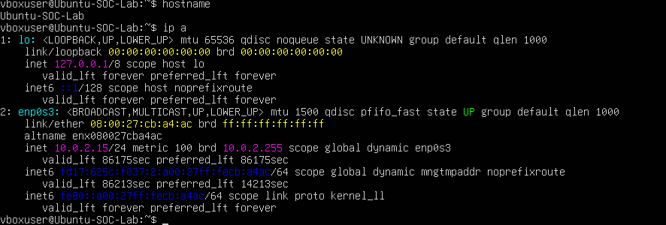
Lab setup
1
VirtualBox VM
Isolated, free, snapshot-friendly
2
Ubuntu Server 26.04.1 LTS
Command-line only, lightweight
3
System updated
apt update and apt upgrade
4
Hostname: Ubuntu-SOC-Lab
Verified with hostname
5
Network: 10.0.2.15/24
enp0s3 UP, NAT via DHCP
ip a: enp0s3 is UP with 10.0.2.15/24

Slide 5
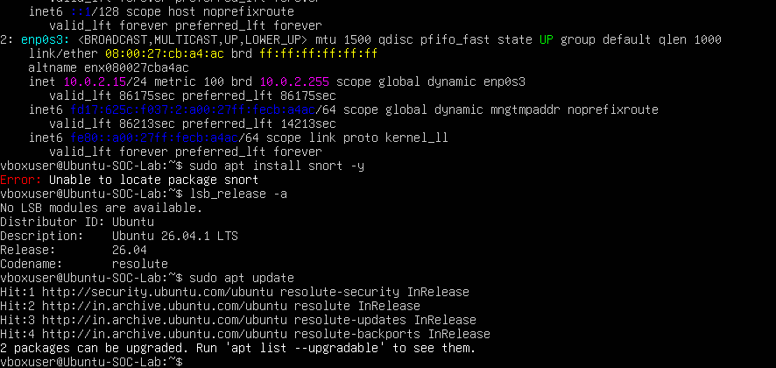
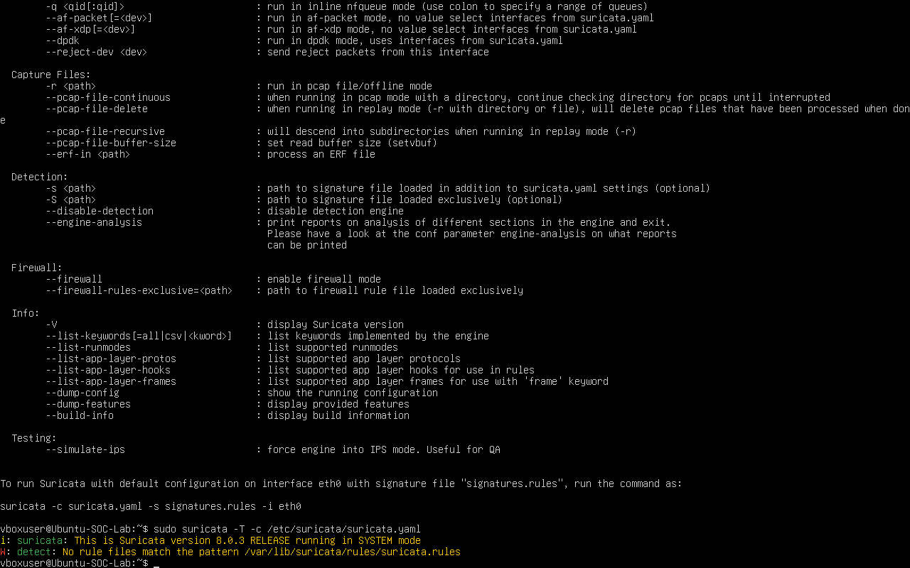
Installing the IDS
Snort not available
apt: Unable to locate package snort on Ubuntu 26.04
1
Checked everything
Release, sources, apt update, apt search snort
2
Suricata 8.0.3
Free IDS, Snort-compatible rules, in the repo
3
sudo suricata -T -c /etc/suricata/suricata.yaml
Notes:
Snort is not packaged for Ubuntu 26.04, so Suricata was used. Test mode confirmed the engine and config load.

Slide 6

Custom rules
alert icmp any any -> any any (msg:"ICMP Ping Detected"; sid:1000001; rev:1;)
alert http any any -> any any (msg:"HTTP Traffic Detected"; sid:1000002; rev:1;)
Action
Protocol
Src IP / port
->
Dst IP / port
Options
ICMP rule: fires on echo request and reply
HTTP rule: fires on any decoded HTTP traffic
sid 1,000,000+ is reserved for local rules
local.rules in nano, one rule per line

Slide 7
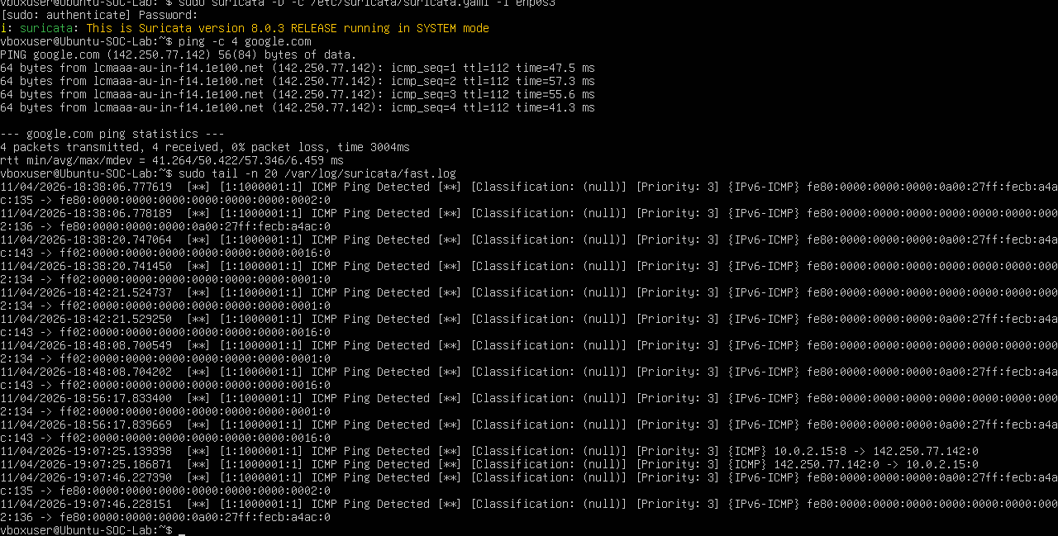
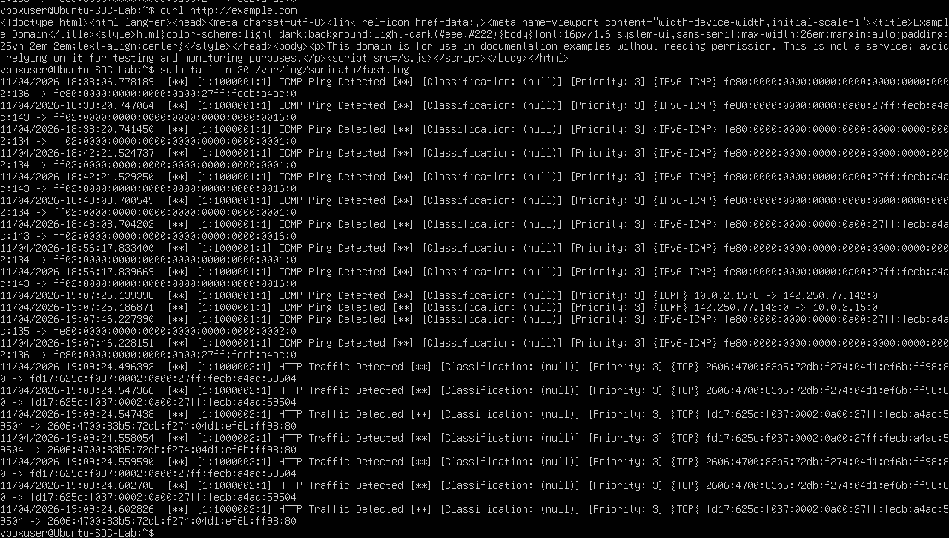
Testing and alerts
ping google.com
ICMP alerts: request type 8 and reply type 0 (sid 1000001)
curl example.com
HTTP Traffic Detected over TCP port 80 (sid 1000002)
IPv6 background
ICMPv6 chatter also matches: broad rules are noisy

Slide 8
Key takeaways
2
8.0.3
2
custom rules written
Suricata version running
test types detected
Check that a tool exists for your OS release; know a compatible alternative
Test mode (-T) finds config and rule errors early
Broad rules prove the pipeline but need tuning
Next: feed alerts into a SIEM such as Wazuh

