Slide 1
WEEK 4 CYBERSECURITY INTERNSHIP
Network Scanning, Web Server Access & Packet Analysis
Kali Linux: 192.168.56.101
Metasploitable 2: 192.168.56.102
VirtualBox Host-Only Network: 192.168.56.0/24
Prepared by : Pooja G Shivakalimath

Slide 2
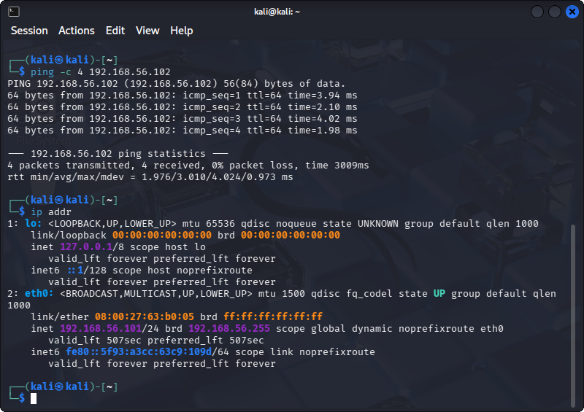
1. Lab Setup & Connectivity
• Kali Linux used as the security testing machine.
• Metasploitable 2 used as the intentionally vulnerable target.
• Both systems were connected to an isolated Host-Only network.
• Ping confirmed 0% packet loss between the VMs.
Connectivity and Kali network configuration

Slide 3
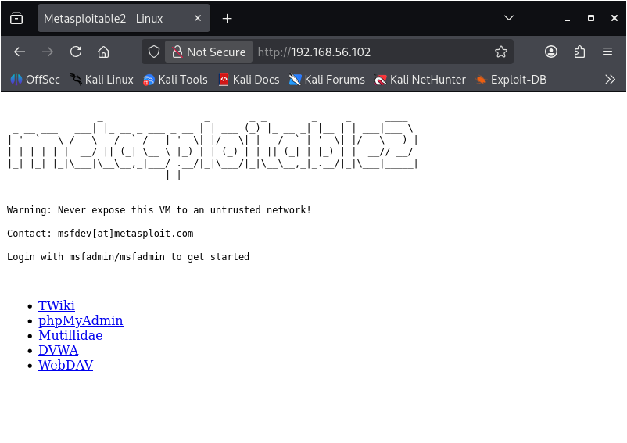
• Apache web service was started on Metasploitable 2.
• Kali Firefox accessed http://192.168.56.102.
• The Metasploitable web page loaded successfully.
• The HTTP session was later observed in Wireshark.
2. Apache Web Server Verification
Apache web page accessed from Kali

Slide 4
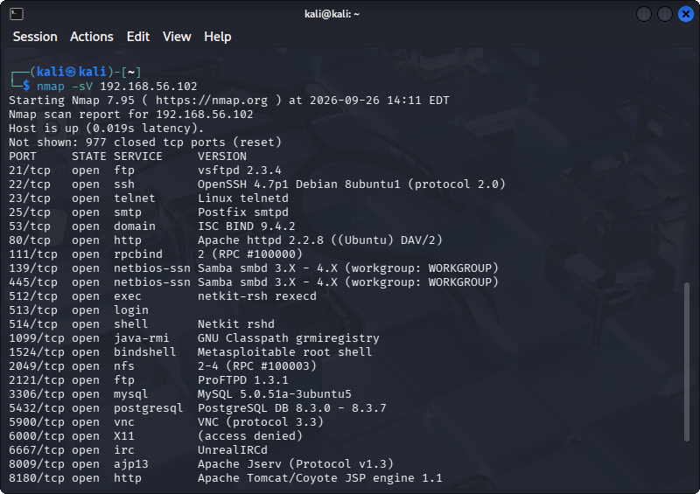
3. Nmap Service Discovery
• Nmap identified many open TCP ports.
• Service/version detection provided software details.
• Examples: FTP 21, SSH 22, Telnet 23, HTTP 80.
• Database and remote-access services were also exposed.
Nmap -sV service/version results

Slide 5
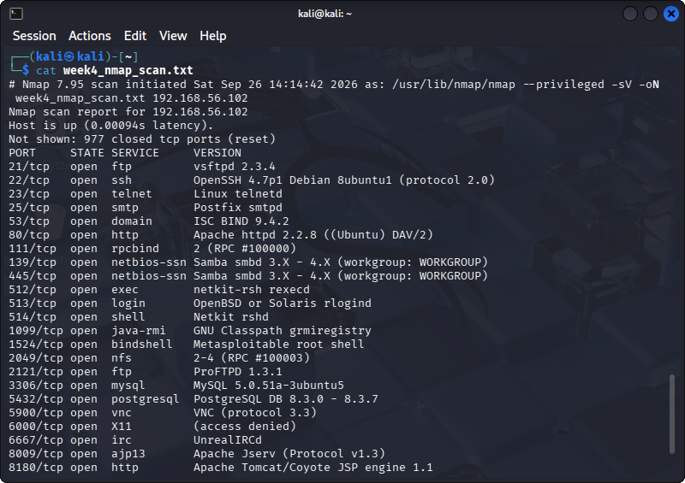
4. Important Nmap Findings
• 21/tcp — vsftpd 2.3.4
• 22/tcp — OpenSSH 4.7p1
• 23/tcp — Telnet
• 80/tcp — Apache 2.2.8
• 3306/tcp — MySQL 5.0.51a
• 5432/tcp — PostgreSQL 8.3.x
• 5900/tcp — VNC
Saved Nmap service inventory

Slide 6
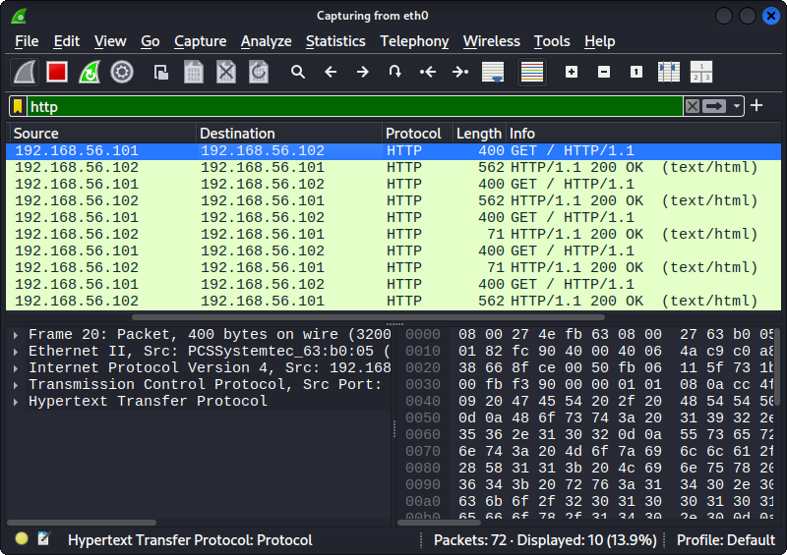
5. Wireshark Protocol Analysis
• ICMP: Echo Request / Echo Reply packets.
• HTTP: GET requests and HTTP 200 OK responses.
• ARP: local IP-to-MAC address resolution.
• DNS: query and server-failure response for google.com.
• Display filters were used to isolate each protocol.
HTTP packet capture in Wireshark

Slide 7
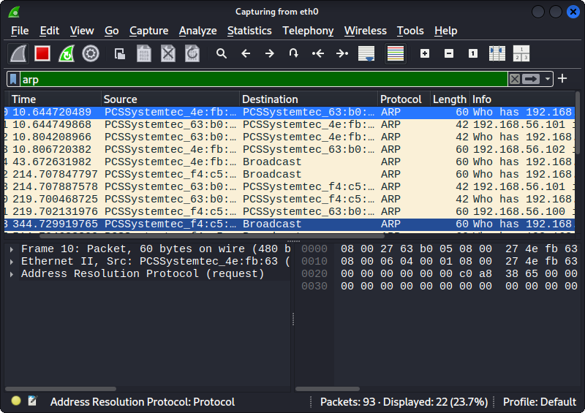
6. Security Observations & Hardening
• Reduce attack surface by disabling unnecessary services.
• Replace legacy clear-text administration such as Telnet.
• Keep service software patched and supported.
• Restrict database, VNC and administrative services.
• Use firewalls, segmentation and traffic monitoring.
ARP traffic captured on the isolated network

Slide 8
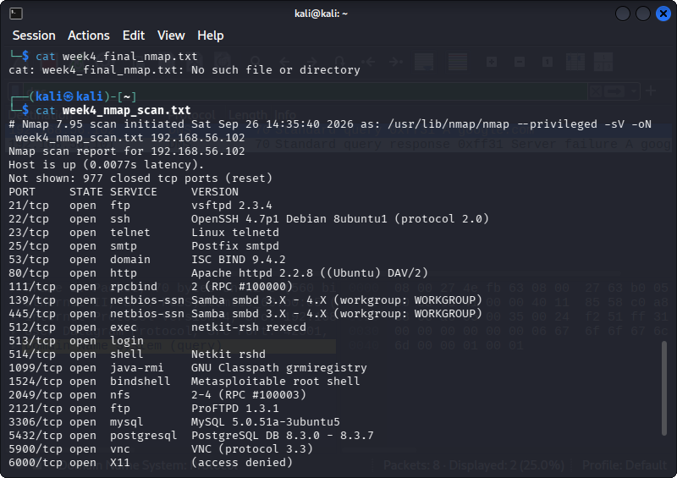
7. Conclusion
• Completed connectivity, web-server, Nmap and Wireshark tasks.
• Practiced identifying exposed services and observing protocols.
• Used an isolated, authorized training environment.
• The exercise builds practical foundations for cybersecurity analysis and interviews.
Final Nmap evidence from the saved scan file

