Slide 1
WEEK 7 – VAPT: WEB APPLICATION TESTING
Web Application Testing with Burp Suite
Local lab: Kali Linux + DVWA • Evidence-based practical report
Burp Suite • SQL Injection • XSS • Dirsearch
Prepared by: Pooja G Shivakalimath
Notes:
Introduce the practical: web application testing on a local DVWA lab using Burp Suite and Dirsearch.

Slide 2
Objectives & Scope
Configure Burp Suite and intercept HTTP requests.
Explore the application and identify request parameters.
Test SQL Injection and Cross-Site Scripting (XSS) in the authorized lab.
Use Dirsearch to find accessible paths and files.
Document evidence, possible impact, and recommended fixes.
DVWA running locally at http://127.0.0.1/DVWA/ only — Low security mode, authorized practice lab.
Notes:
DVWA is intentionally vulnerable. All testing stayed on localhost.

Slide 3
Tools, Lab Setup & Methodology
Component | Details
Operating system | Kali Linux
Target application | DVWA (Damn Vulnerable Web Application)
Target URL | http://127.0.0.1/DVWA/
Proxy & testing tool | Burp Suite Community Edition
Enumeration tool | Dirsearch
Browser | Burp Suite built-in browser
Notes:
Explain the environment and the five-step method followed in the practical.

Slide 4
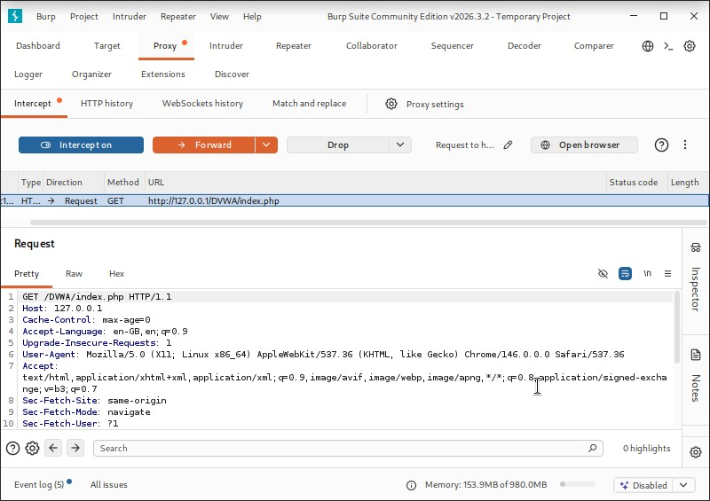
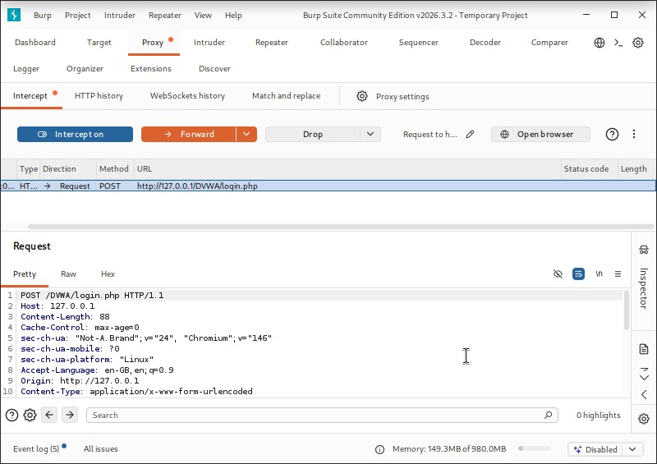
Task 22: Burp Suite Setup & Request Interception
Opened the DVWA login page through the Burp Suite browser.
Used Proxy interception to capture the page request and the login request.
Result: method, path, headers and login parameters were visible for inspection.
Fig 1: HTTP request intercepted in Burp Suite
Fig 2: DVWA login request captured
Notes:
Show that Burp sits between the browser and DVWA so every request can be viewed.

Slide 5
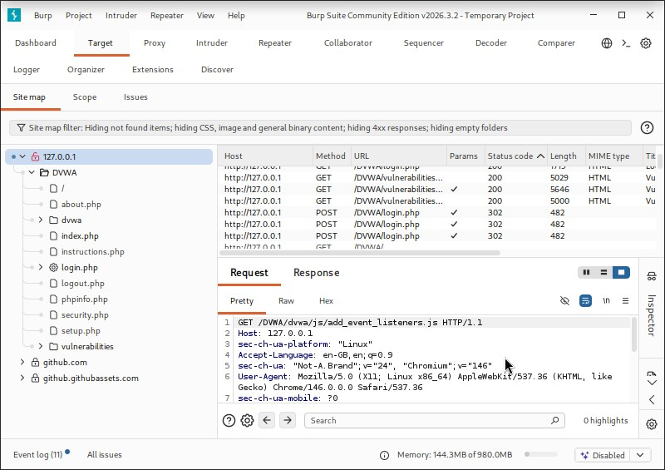
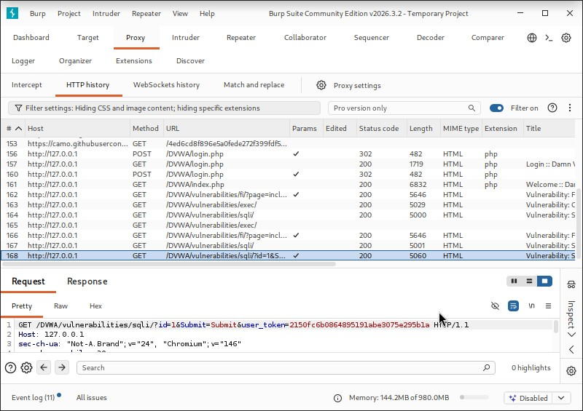
Task 23: Application Mapping (Proxy + Target Tab)
Used the Burp Target site map to explore DVWA pages.
Submitted a normal input on the SQL Injection page. Parameters seen: id, Submit, user_token.
Result: pages and parameters identified; id chosen for the next test.
Fig 3: DVWA pages in the Burp site map
Fig 4: SQL Injection request parameters
Notes:
Mapping helped me pick which input to test.

Slide 6
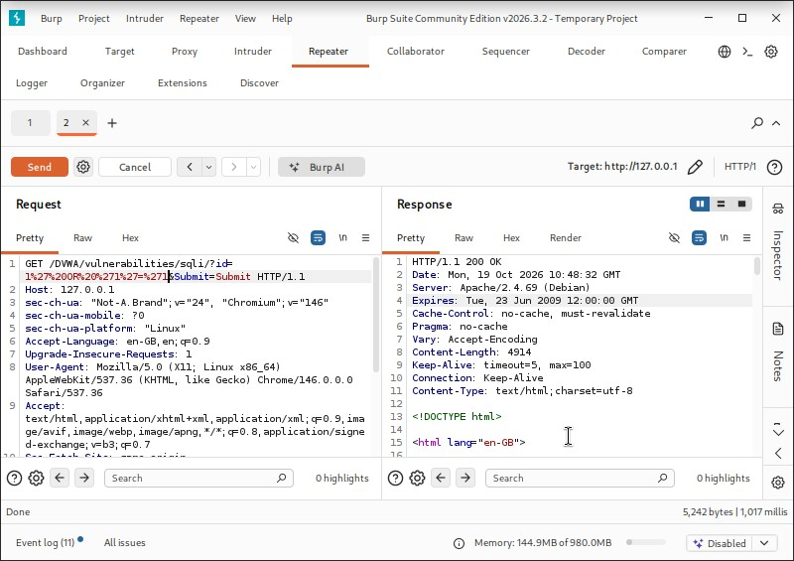
Task 24: SQL Injection (Low Security)
Sent a normal request and reviewed it in Burp Repeater.
Modified the id parameter with the test payload.
Compared the response with the normal request.
1 ‘ OR ‘1’=‘1
Result
Multiple database records returned, including different users – the input changed the query.
Fix
Prepared statements, server-side validation, least-privilege DB account, hide detailed DB errors.
Fig 6: SQL Injection test evidence
Notes:
Figures 5 and 6 in the report: Low security level, then the modified request. Payload was the tautology 1' OR '1'='1.

Slide 7
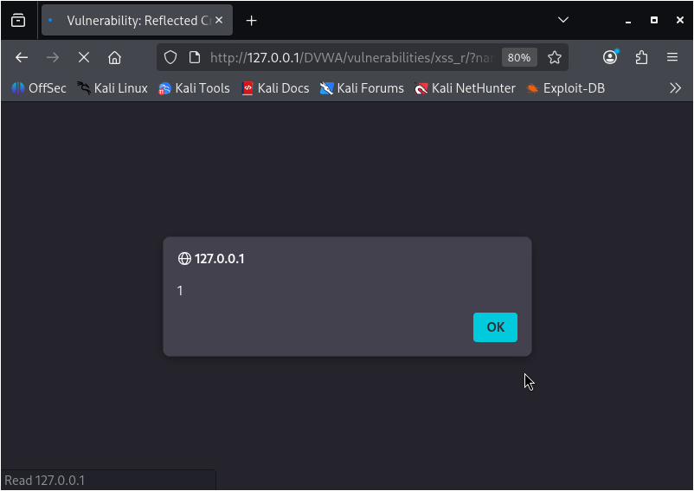
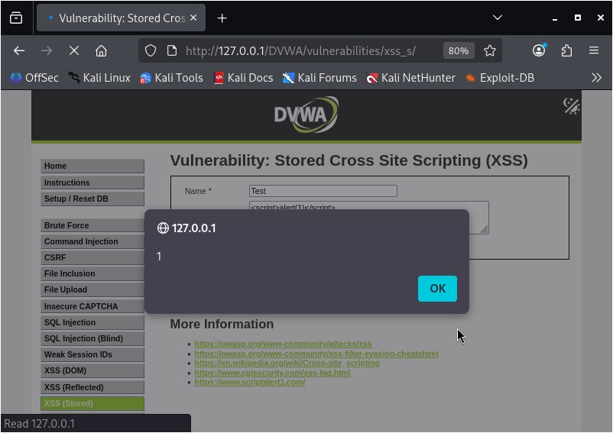
Task 24: Reflected & Stored XSS
Reflected XSS
Stored XSS
Page: Reflected XSS module
Input: <script>alert(1)</script>
Result: alert showing 1 – script ran
Page: Stored XSS (guestbook)
Payload submitted as the message
Result: alert shown when entry processed
Fig 7: Alert in Reflected XSS test
Fig 9: Alert in Stored XSS test
Notes:
Reflected: input returned in the response. Stored: input is saved in the guestbook and runs later.

Slide 8
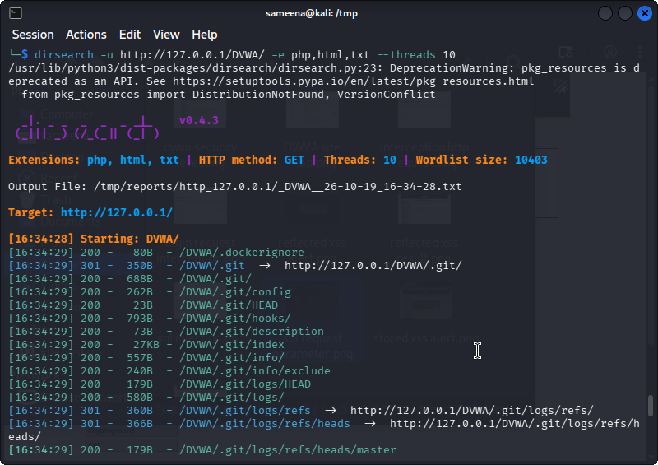
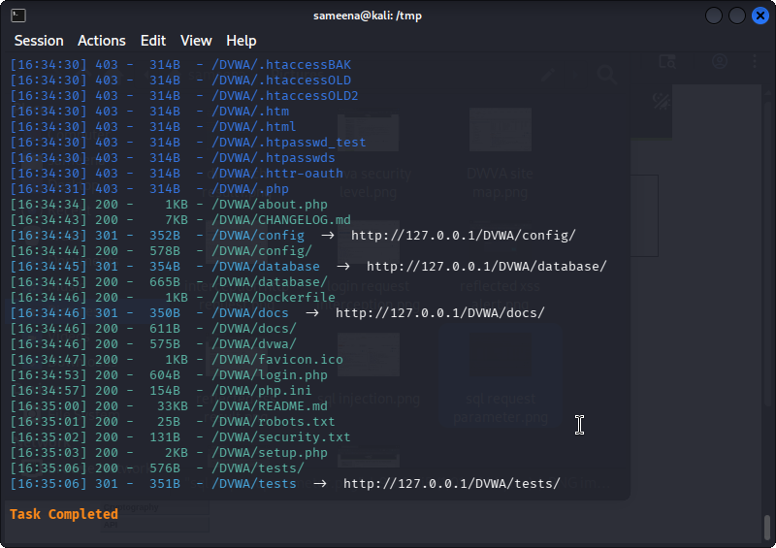
Task 25: Directory & Endpoint Discovery (Dirsearch)
dirsearch -u http://127.0.0.1/DVWA/ -e php,html,txt --threads 10
Several paths and files returned HTTP 200; some returned 403 Forbidden.
Scan reported .git and .git/config as accessible.
Potential information disclosure – evidence must be reviewed before calling it a finding.
Fig 11: Dirsearch scan results
Fig 12: Additional Dirsearch results
Notes:
Extensions php, html, txt and 10 threads. Results describe the local lab only.

Slide 9
Conclusion
Intercepted HTTP requests and mapped the application with Burp Suite.
Confirmed SQL Injection, Reflected XSS and Stored XSS in DVWA.
Dirsearch reported accessible .git metadata – check deployment files and restrict repository data.
Learned to observe requests, reproduce issues, collect evidence and suggest basic fixes.
Notes:
Wrap up with the main learning outcome.

