Slide 1
DG INTERNS HUB • CYBER SECURITY INTERNSHIP
ADVANCED VAPT
Attack Chain & Full Exploitation Project
Target: OWASP Juice Shop (local lab)
Evidence-led testing • Burp Suite • Risk & remediation
Prepared by : Pooja G Shivakalimath

Slide 2
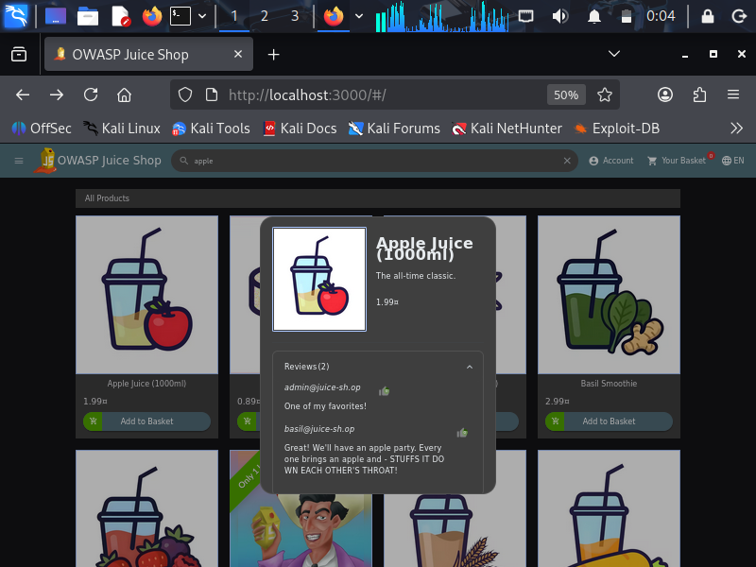
Scope & attack surface
Authentication
Product flows
HTTP APIs
Login, registration, password reset and session handling.
Catalogue, search, product details, reviews and basket actions.
Observed local API requests and JSON responses; authorization needs validation.
Target: localhost:3000
In scope: local OWASP Juice Shop and its browser/API traffic.
Out of scope: public sites, destructive tests and real-user data.

Slide 3
Testing workflow
01
02
03
04
Browse
Capture
Replay
Compare
Use the local app normally to identify entry points.
Review requests in Burp Proxy HTTP history.
Send selected requests to Repeater for controlled tests.
Check status, headers, response fields and session context.
Evidence principle
A screenshot of a request is not proof of a vulnerability. Confirm behavior with paired request/response evidence and a repeatable test.

Slide 4
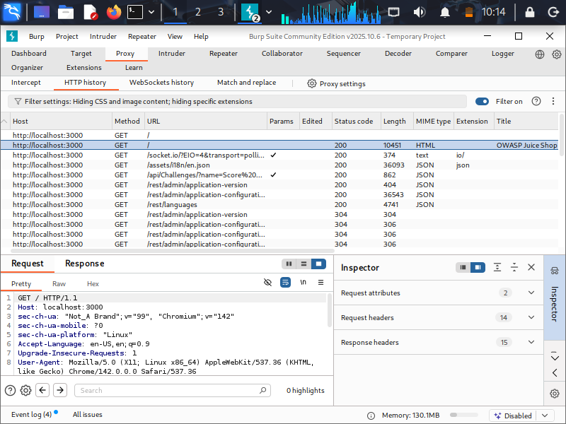
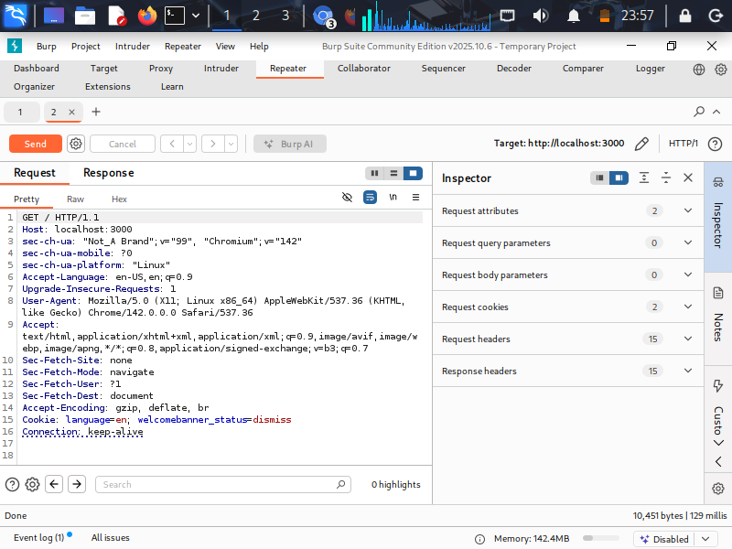
Burp Suite: traffic inspection
Proxy / HTTP history
Repeater / request review

Slide 5
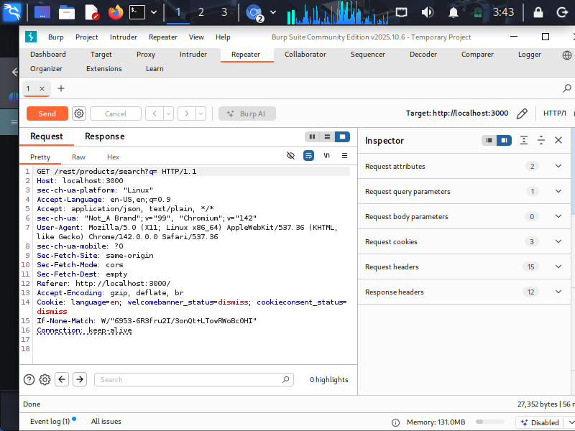
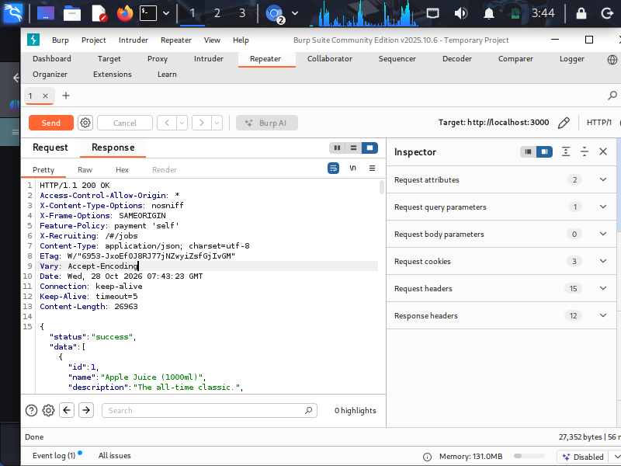
Product-search API: what the evidence shows
Request
Response
Search route and query parameter captured in Repeater.
JSON product data returned; public catalogue data is not automatically a flaw.

Slide 6
Attack-chain validation plan
1. Map entry points
2. Test one control
3. Compare sessions
4. Confirm impact
Login • search • basket • APIs
Parameter / business-rule validation
Logged out vs. normal lab account
Minimum proof, no unrelated data
Status: validation plan, not a confirmed exploit chain
Current screenshots show traffic inspection and product JSON. Add repeatable before/after proof before claiming authentication bypass, IDOR, or privilege escalation.

Slide 7
Risk, impact & remediation
Authentication
Access control
Business logic
Rotate/invalidate sessions, secure cookies, rate-limit login and recovery.
Enforce object-level authorization server-side on every request.
Recalculate price, quantity, ownership and workflow state on the server.
API data minimization
Retest
Return only required fields and apply consistent validation/error handling.
Replay the same requests after fixes; verify that unauthorized behavior is blocked.
Severity depends on verified exploitability and real impact—not on the endpoint name alone.

Slide 8
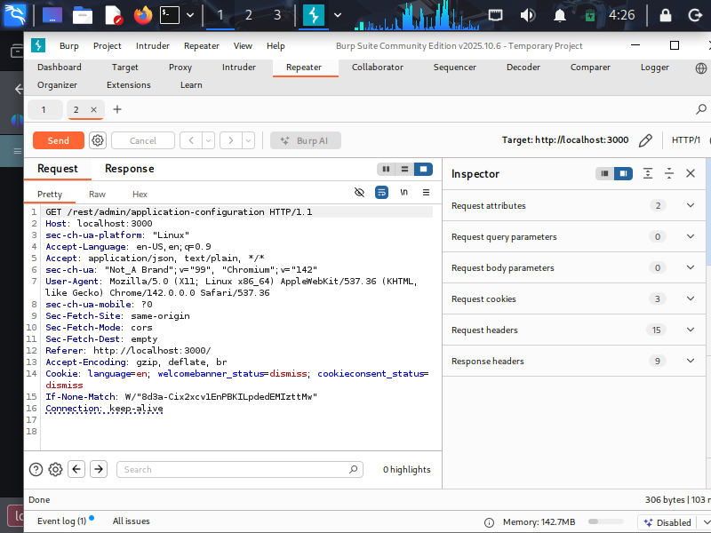
KEY TAKEAWAYS
Inspect. Validate. Prove. Fix.
The supplied evidence demonstrates hands-on use of OWASP Juice Shop and Burp Suite to capture requests and inspect API responses.
Next step: add exact paired request/response evidence for each confirmed issue and document the retest.
Thank you
DG Interns Hub • Cyber Security Intern

