Slide 1
WEEK 5 — VAPT TOOLS
Cybersecurity Internship | Practical Learning
✓ Nmap reconnaissance
✓ Nikto troubleshooting
✓ Burp Suite HTTP inspection
AUTHORIZED TARGET
testphp.vulnweb.com
Prepared by : Pooja G Shivakalimath

Slide 2
1. Objectives
• Perform basic VAPT reconnaissance using Nmap.
• Identify exposed ports and understand service-detection output.
• Understand limitations of aggressive OS/service detection.
• Use Burp Suite to capture and inspect HTTP requests.
• Document only evidence-supported security observations.

Slide 3
2. Tools & Workflow
A simple VAPT workflow
01
Nmap
Discover ports & services
02
Nikto
Attempt web-server
assessment
03
Burp Suite
Inspect HTTP requests
04
Report
Document evidence &
limitations

Slide 4
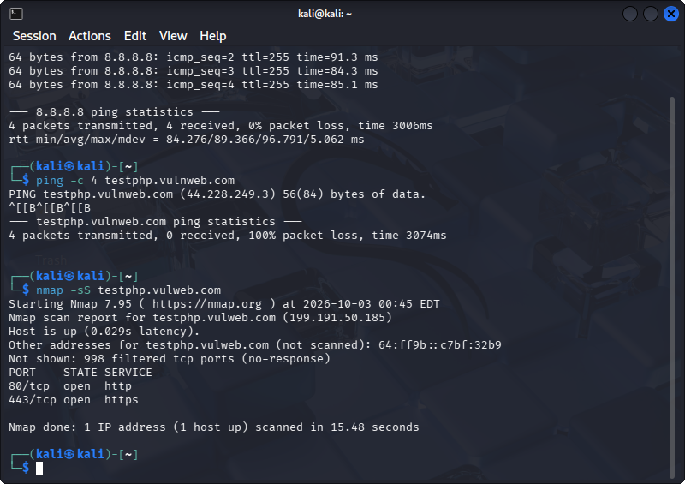
3. Nmap SYN Scan (-sS)
80/tcp HTTP and 443/tcp HTTPS were observed open.

Slide 5
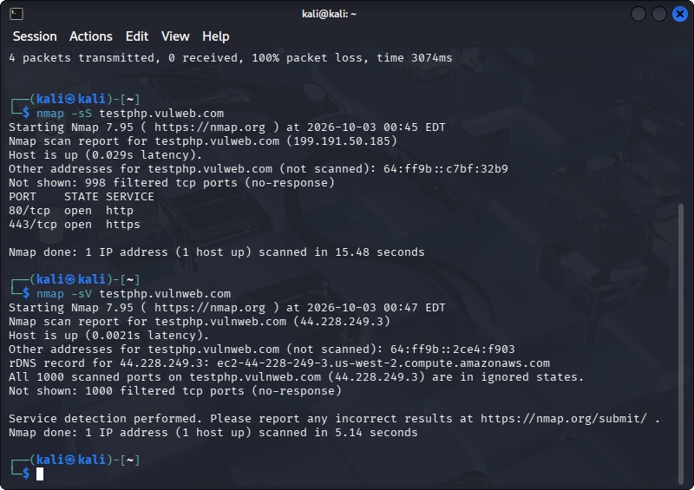
4. Nmap Service Detection (-sV)
Service detection completed; detailed versions were limited by target responses.

Slide 6
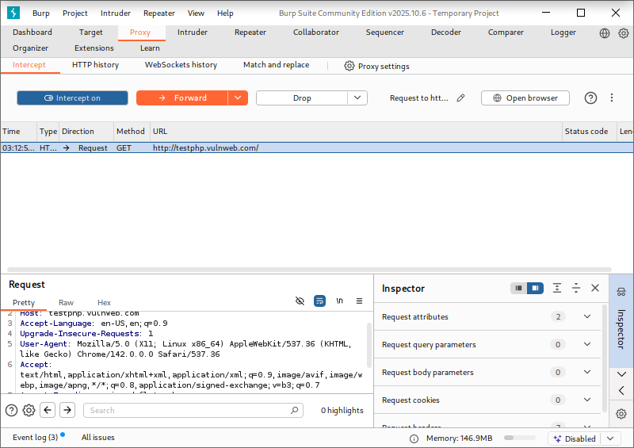
5. Nmap Aggressive Scan (-A)
Nmap warned that OS guesses may be unreliable under the observed port conditions.

Slide 7
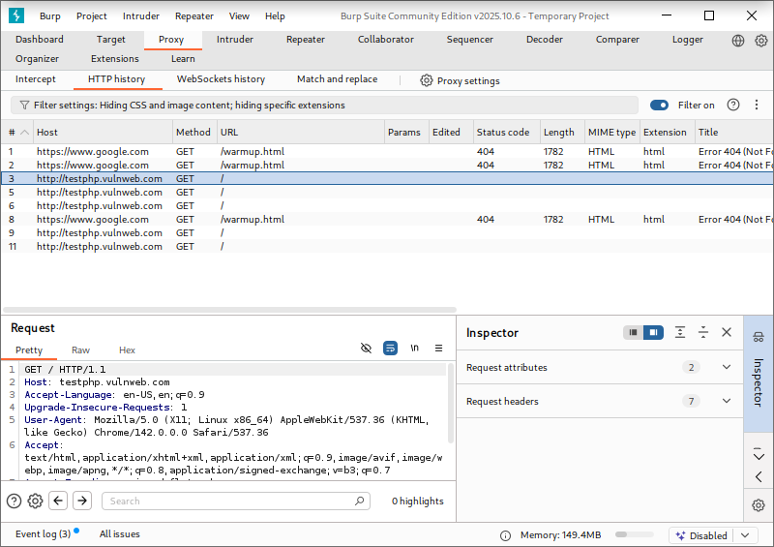
6. Burp Suite — Captured Request
A GET request and HTTP headers were successfully intercepted.

Slide 8
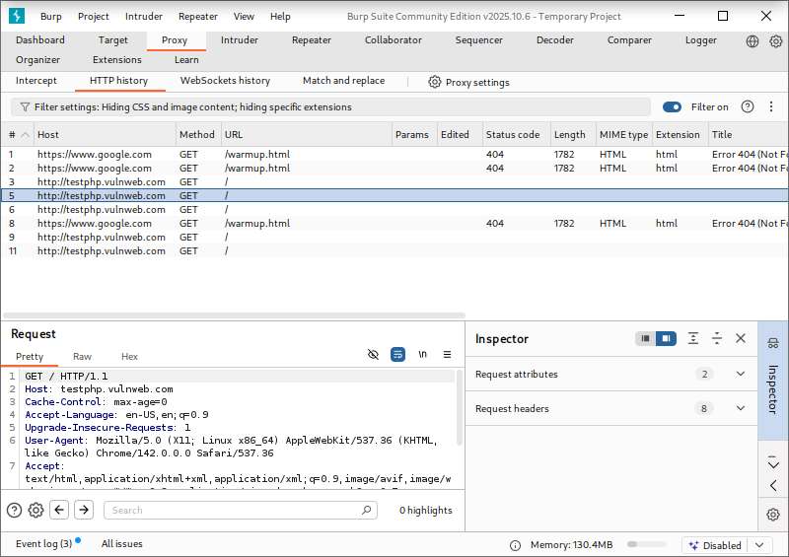
7. Burp Suite — HTTP History
Multiple requests to the authorized training site were recorded.

Slide 9
8. Security Observations
Evidence-based findings
01
HTTP exposed
Nmap -sS
Port 80/tcp was open.
02
HTTPS exposed
Nmap -sS
Port 443/tcp was open.
03
Requests inspectable
Burp Suite
GET requests and headers were visible.

Slide 10
9. Nikto — Challenge & Handling
• Nikto did not complete the host test in the Kali environment.
• Additional connection/name-resolution/proxy checks were attempted.
• The result was documented as a tooling/connectivity limitation.
• No Nikto vulnerability was invented or reported.
• Recommended next step: repeat the scan in a stable network/proxy environment if required.

Slide 11
10. Learning & Conclusion
• Nmap can be used in different modes for different assessment goals.
• Filtered ports can reduce confidence in automated service and OS detection.
• Burp Suite provides visibility into browser-to-server HTTP communication.
• Security findings should be based on evidence rather than assumptions.
• Troubleshooting and accurate documentation are important parts of practical cybersecurity.

