Slide 1
WEEK 6: OWASP & VAPT BASICS
Web Security & Vulnerability Testing
Cybersecurity Internship – DG Interns Hub
Local lab: XAMPP + DVWA • Evidence-based learning report
Prepared by :Pooja G Shivakalimath

Slide 2
Objectives & Scope
Learn key OWASP web application risks, especially SQL injection and XSS.
Set up a local, deliberately vulnerable DVWA environment using XAMPP.
Observe test behaviour and document evidence, risk, and mitigations.
Review Burp Suite HTTP history and identify remaining work.
Scope limited to localhost / authorized training lab — not public systems.

Slide 3
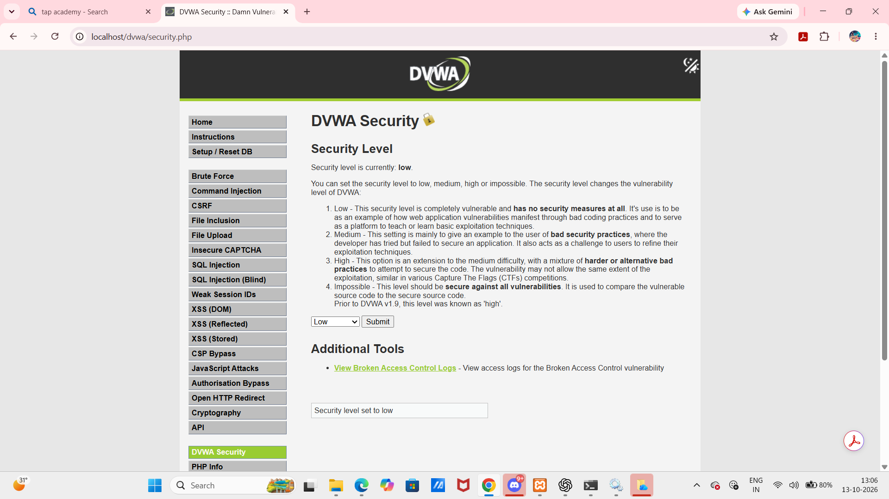
Tools & Lab Setup
XAMPP: local Apache + database stack; dashboard loaded successfully.
DVWA: intentionally vulnerable training application in htdocs.
DVWA security level shown as Low for controlled demonstrations.
Burp Suite Community Edition: HTTP history inspected.
OWASP ZAP: planned scan and export were not completed.
DVWA security page: level set to Low

Slide 4
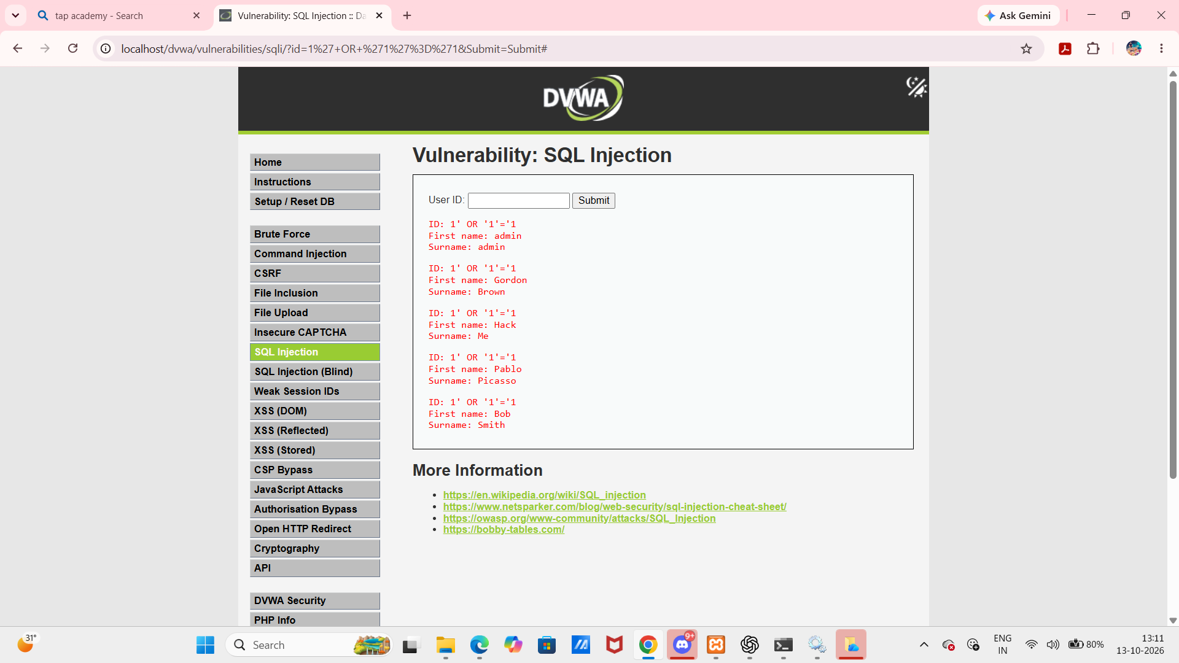
Test 1: SQL Injection
Baseline input (ID 1) returned the admin record.
A controlled tautology test returned multiple records.
This demonstrates unsafe query construction in the DVWA lab.
Prevention: prepared statements, least-privilege DB access, safe input handling.
Observed output: multiple records in DVWA

Slide 5
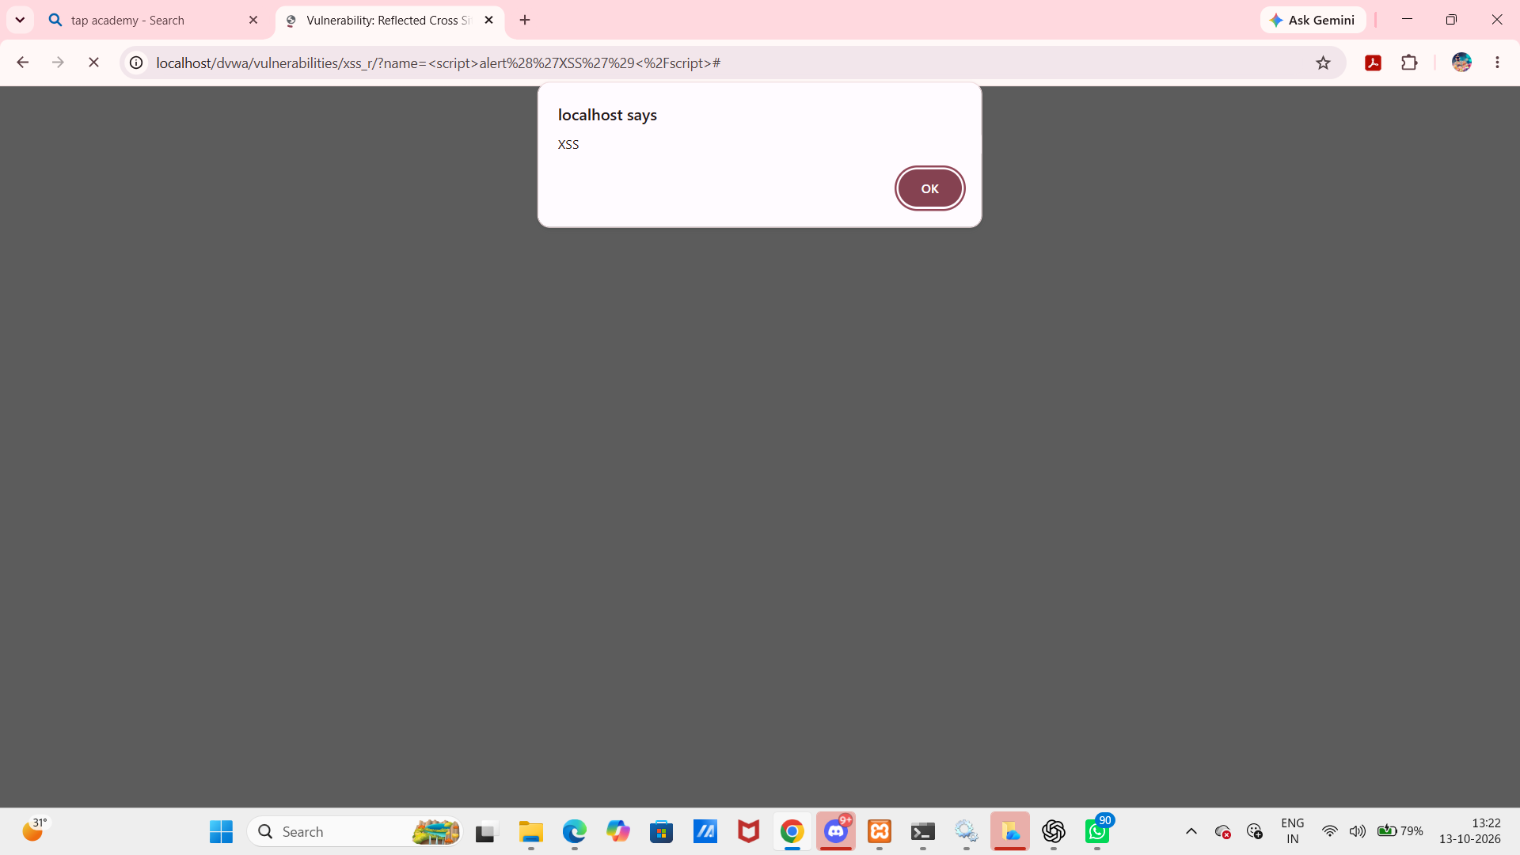
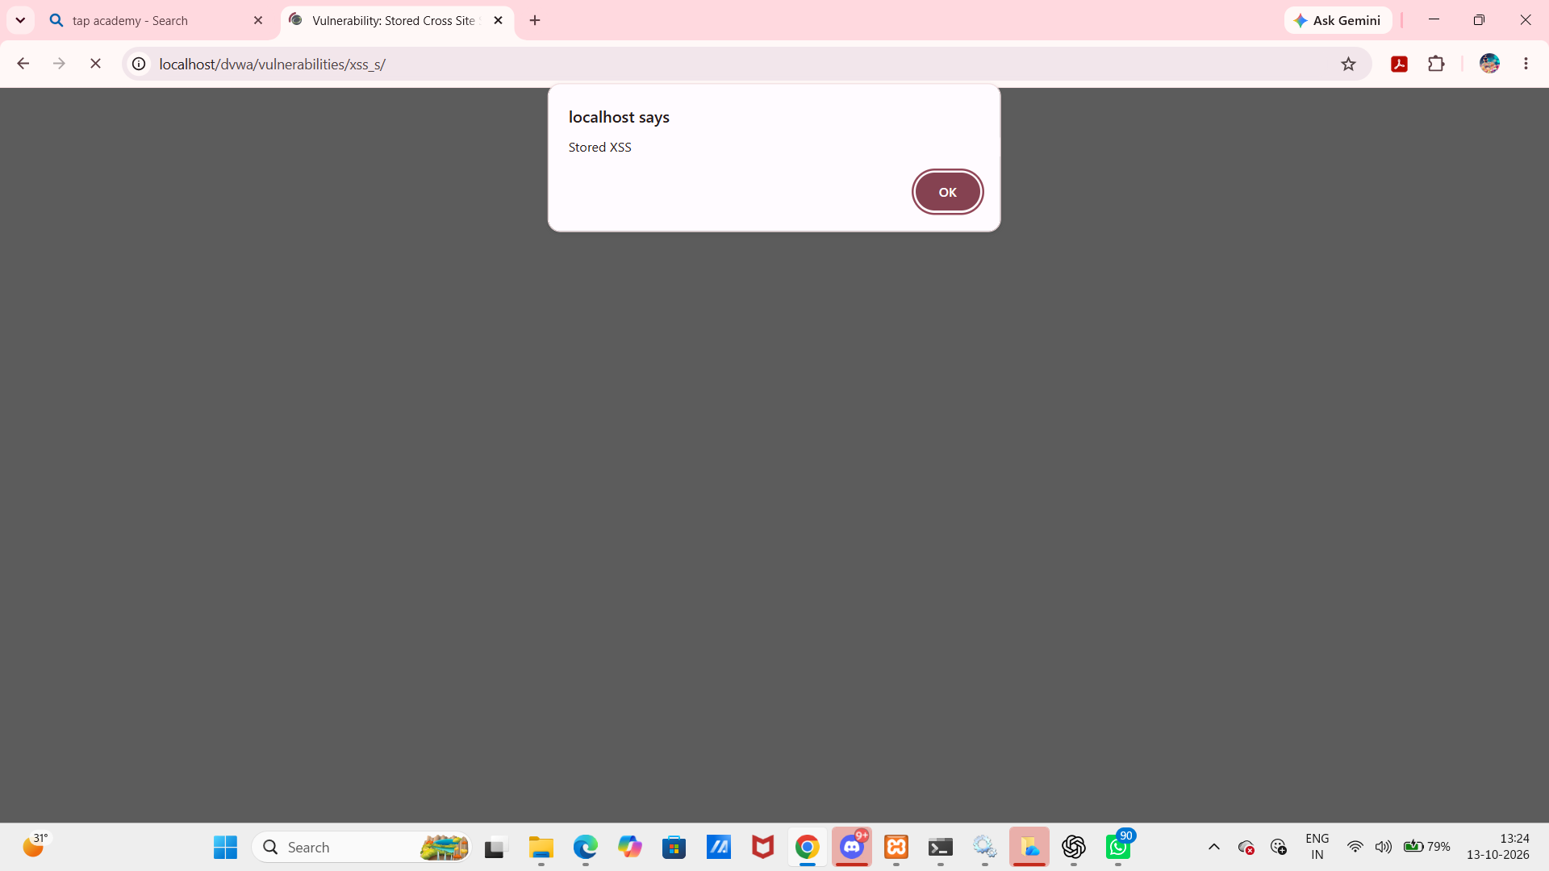
Test 2: Reflected & Stored XSS
Reflected XSS: test input triggered an alert in the browser.
Stored XSS: stored test content triggered an alert.
Risk: script may execute in a user's browser context.
Prevention: context-aware output encoding, safe templating, sanitization, CSP as defense in depth.

Slide 6
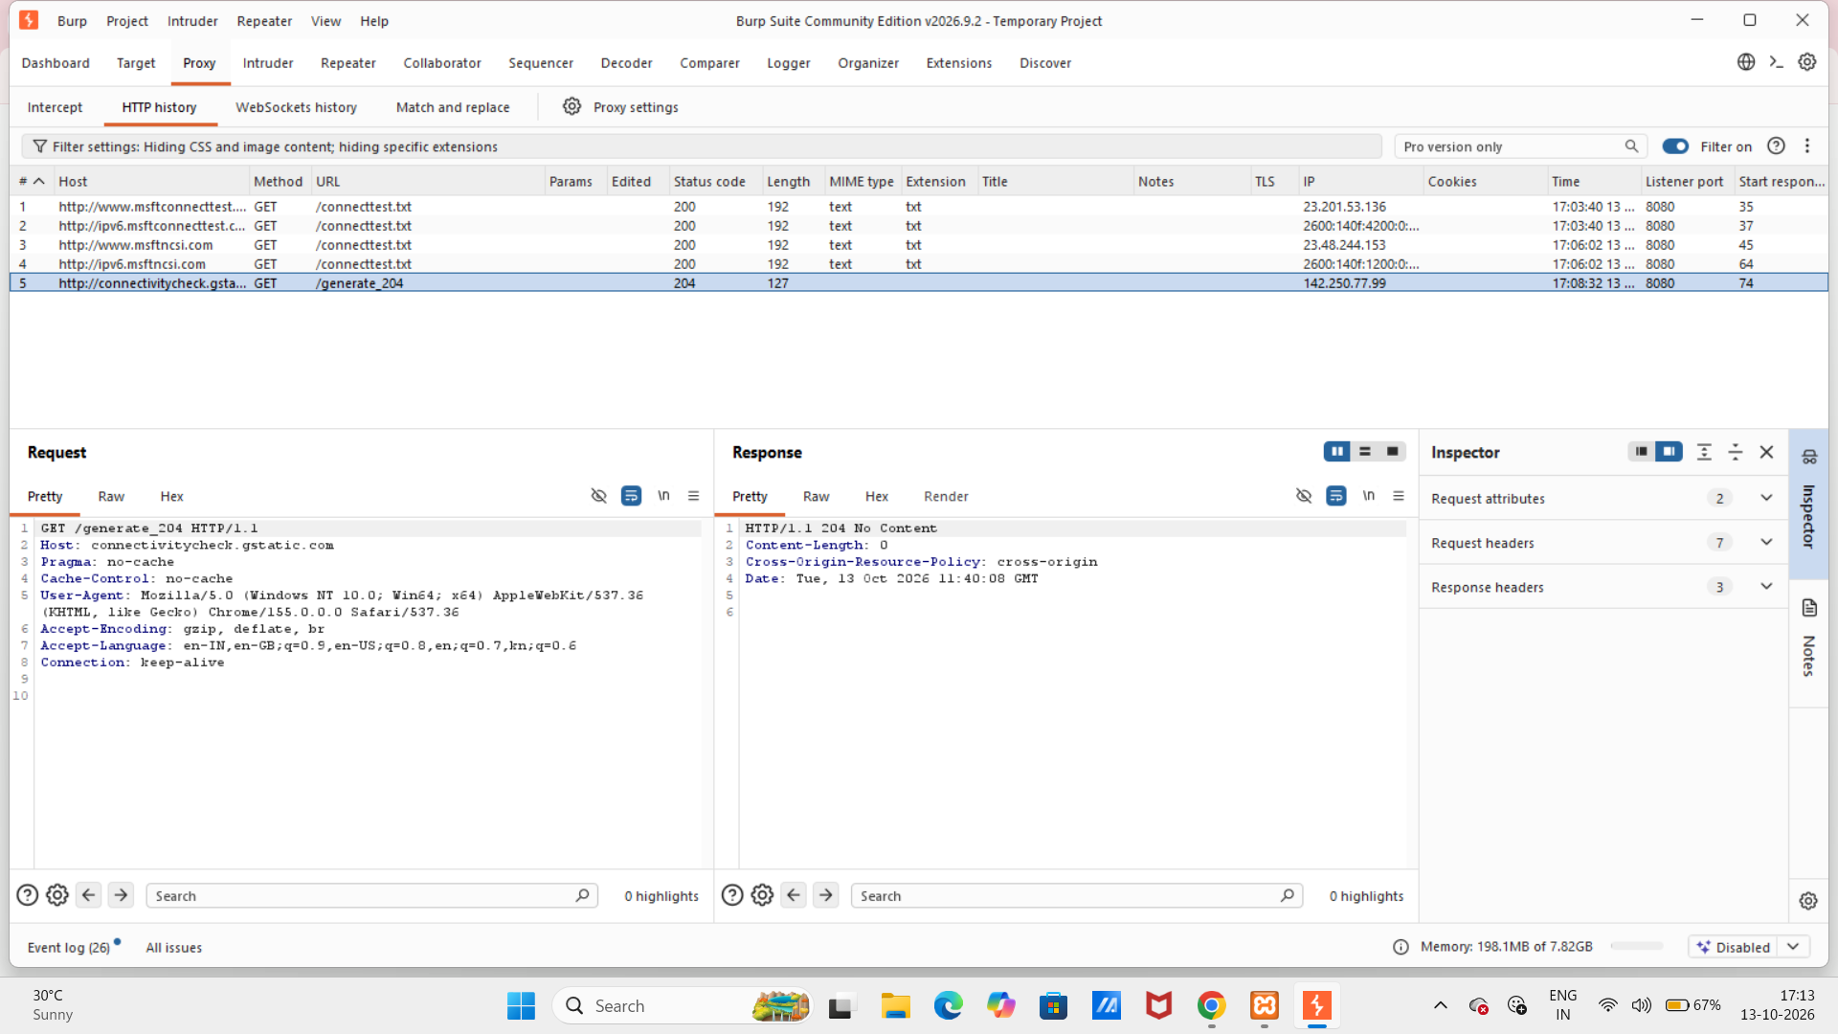
Burp Suite: Evidence Review
HTTP history was reviewed.
Screenshot shows connectivity-check traffic, not localhost/DVWA.
A DVWA-specific request/response capture is not evidenced.
Next step: configure proxy and verify a localhost request appears.

Slide 7
OWASP ZAP: Task Limitation
Planned: automated scan of DVWA and export of the scan report.
Not completed: the file intended for this task was reported as malicious/unsafe.
The file was not opened or executed; no security warning was bypassed.
No ZAP results are claimed because no scan/export evidence exists.
Safe next step: use a trusted ZAP installation and scan only the local authorized lab.
Status: Not completed — recorded transparently for safety and accuracy.

Slide 8
Findings, Mitigations & Conclusion
SQL injection — demonstrated in DVWA; use parameterized queries and least privilege.
Reflected/stored XSS — demonstrated in DVWA; encode output and sanitize allowed content.
Burp — opened and history reviewed; DVWA capture remains pending.
ZAP scan/export — pending because the intended file was reported unsafe.
Learning: test only with authorization, preserve evidence, report limitations, and never run suspicious files.

