Slide 1
FinRisk-AI
Financial News
AI-Powered Financial Risk Intelligence and Tactical Index Rebalancing
AI Risk Signal
Turning financial news into portfolio action in seconds
S&P Global & Crisil Campus Hackathon
Portfolio Weights
Presented by
Shivakant Kurmi
VIT Bhopal University
From unstructured news to explainable portfolio decisions

Slide 2
The Problem: Markets Move Faster Than Manual Analysis
Financial markets react instantly to:
Macroeconomic announcements
Geopolitical events
Corporate earnings and guidance
Interest-rate and inflation signals
CHALLENGE
Financial news is largely unstructured, arrives continuously, and often contains information that is difficult to translate into consistent, actionable risk signals.
Manual analysis is time-consuming, difficult to scale, and susceptible to inconsistent interpretation. Traditional sentiment analysis alone may also fail to capture the significance of specific events and their potential market impact.
Manual review is slow, inconsistent, and difficult to scale.
Portfolio teams need more than a sentiment label. They need an explainable signal connected to an investment action.
News article
Manual review delay
Missed reaction

Slide 3
The Solution: FinRisk-AI
FinRisk-AI converts financial news into structured risk intelligence:
1
Ingest financial news from NewsAPI or synthetic fallback data
2
Detect sentiment from -1.0 to +1.0 using FinBERT
3
Classify the event using zero-shot NLP
4
Calculate an explainable impact score from 1 to 10
5
Rebalance a 10-stock tactical index and normalize weights to 100%
One pipeline connects information, intelligence, and portfolio action.
INGEST
ANALYZE
CLASSIFY
SCORE
REBALANCE

Slide 4
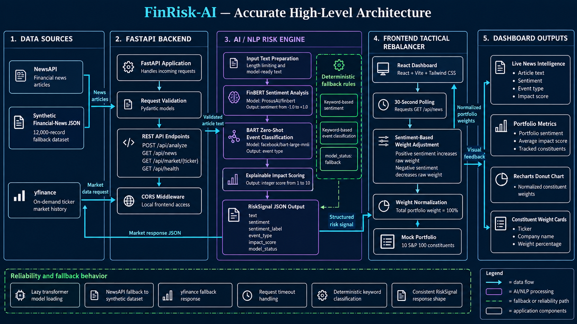

Slide 5
Module A: Tactical Index Rebalancer
Starting point:
10 S&P 100 constituents with equal baseline exposure
Rebalancing logic:
Positive sentiment increases a stock's raw weight
Negative sentiment decreases a stock's raw weight
Neutral sentiment keeps the adjustment close to baseline
Final weights are normalized so the portfolio always totals 100%
100%
Equal baseline: 10 stocks × 10%
POSITIVE SIGNAL
Technology earnings:
+0.72
Action: increase tactical exposure
NEGATIVE SIGNAL
Geopolitical tensions:
-0.68
Action: reduce tactical exposure
The dashboard shows the reason behind every allocation change: sentiment + event type + impact score

Slide 6
Results, Reliability, and Domain Impact
-1.0 to +1.0
1 to 10
100%
10 stocks
Sentiment
Impact score
Portfolio allocation
Tactical index
STRUCTURED OUTPUT
RELIABILITY
DOMAIN IMPACT
Sentiment: -1.0 to +1.0
Event type: Geopolitical, Macroeconomic, Earnings, and more
Impact score: 1 to 10
Portfolio allocation: exactly 100%
Synthetic fallback data keeps the demo usable without an API key
Deterministic fallback classification works when models are unavailable
Input validation and request timeouts protect the API
The dashboard polls the risk engine every 30 seconds
Faster tactical allocation with a transparent and auditable reason for every portfolio adjustment.
FinRisk-AI does not promise returns. It demonstrates a faster, explainable reaction mechanism for market risk.

Slide 7
Demo, Future Roadmap, and Call to Action
LIVE DEMO
Financial article
FastAPI
AI risk signal
Portfolio weight
NEXT STEPS
FinRisk-AI turns market information into timely, explainable risk decisions.
Historical backtesting and model performance evaluation
Sector, liquidity, and concentration constraints
Analyst feedback loops and richer event taxonomy
Authenticated cloud deployment and monitoring
Thank you
Shivakant Kurmi | VIT Bhopal University | FinRisk-AI
Repository: https://github.com/shivakantkurmi/VITBhopal-ShivakantKurmi-hackathon

