Slide 1

STOCK PRICE PREDICTION S&P 500 (^GSPC)
Shivaramakrishna Reddy
MG67053

Slide 2
Introduction:
Stock price prediction is a crucial aspect of financial markets, playing a pivotal role for investors, traders, and financial institutions. The ability to forecast stock prices helps stakeholders make informed decisions, optimize investment strategies, and manage risks effectively.
Understanding potential future price movements allows investors to implement effective risk management strategies.
Investors heavily depend on accurate stock price predictions to inform their decisions on buying, selling, or holding assets. These predictions play a crucial role in maximizing returns and minimizing losses, empowering investors to strategically navigate the dynamic financial market landscape.

Slide 3
Dataset source : Yahoo Finance (S&P 500 (^GSPC)) Dataset historical Data For Past 10 years
Link: https://finance.yahoo.com/quote/%5EGSPC/history?period1=1550188800&period2=1707955200&interval=1d&filter=history&frequency=1d&includeAdjustedClose=true
Size : 25 - 65 MB
Rows: 2516(All files together)
Columns:6

Slide 4
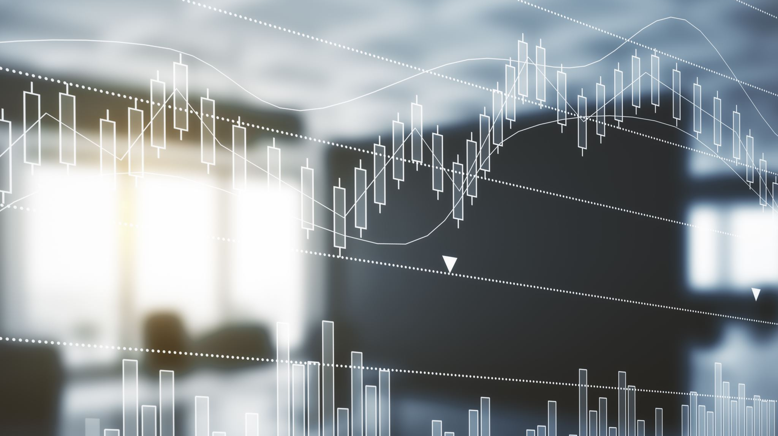
Data Preprocessing
Handled missing values using various techniques like replacing by average value of column
Casting data type
Created new features with existing features
Identified and removed outliers using visualization techniques

Slide 5

We Use following Models
1) Linear Regression
11) K-Nearest Neighbours
111) Auto ARIMA
IV) Prophet FB
V)Moving Averages
VI) Long Short Term Memory

Slide 6

Thank You

