Slide 1



Slide 2
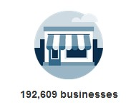
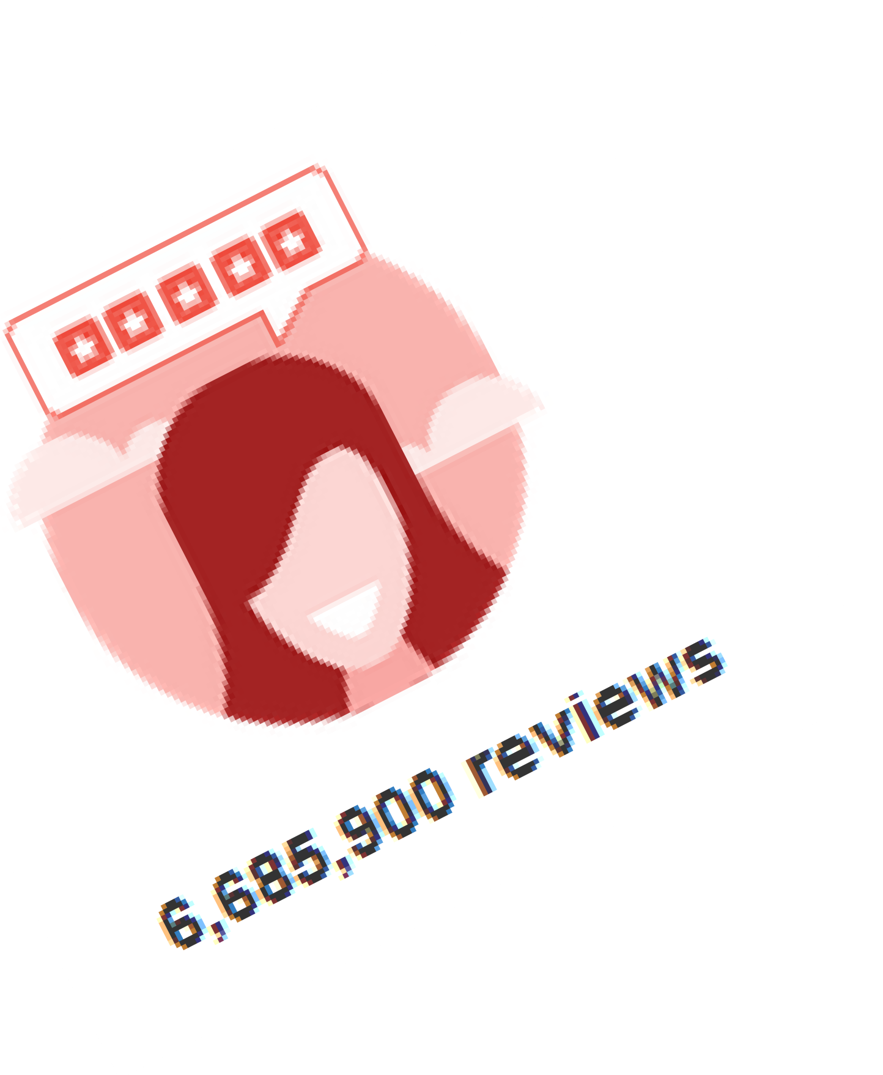
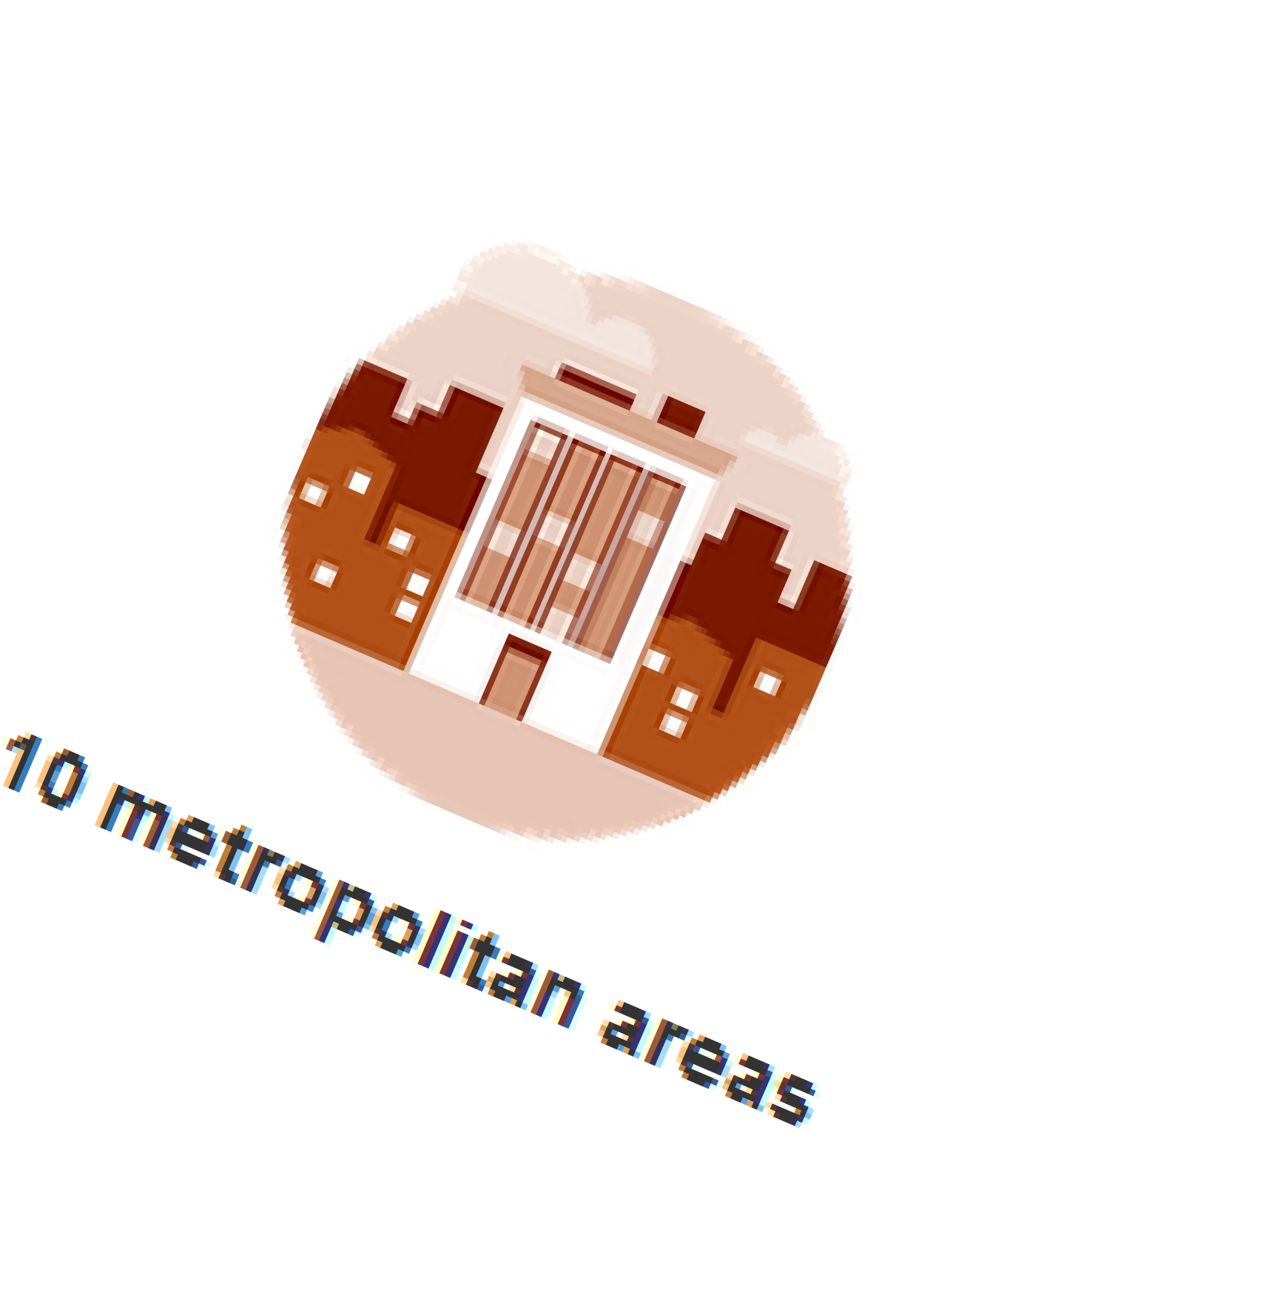

Notes:
Motivation: What is the dataset ? What was the end game?

Slide 3
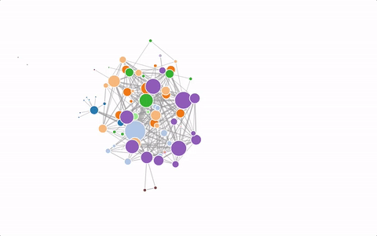
Modelling the Network
Social Network
Review Network
Connected Subcomponents
Tools Used

Slide 4
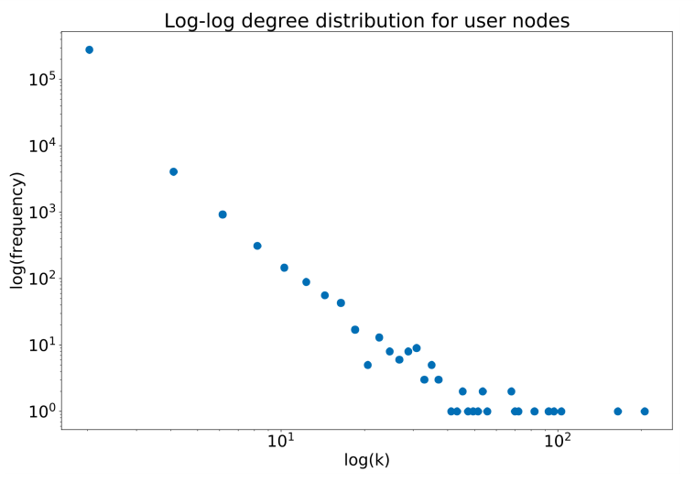
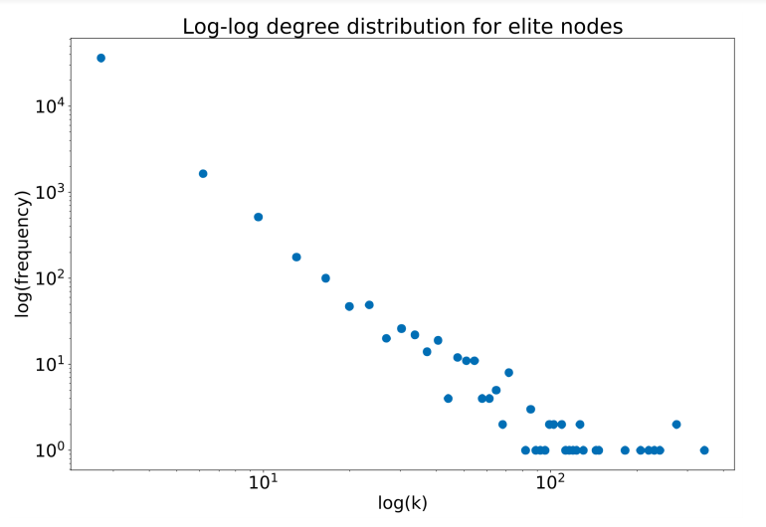
Degree Distributions for Influencer and Regular Users: Social Network

Slide 5
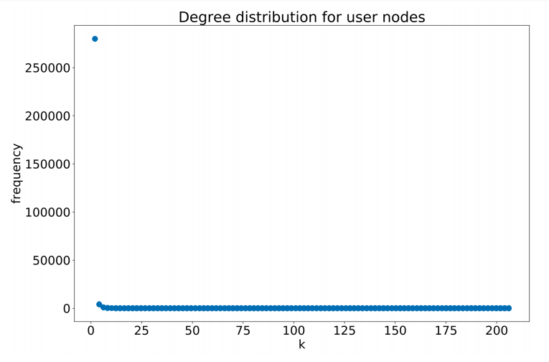
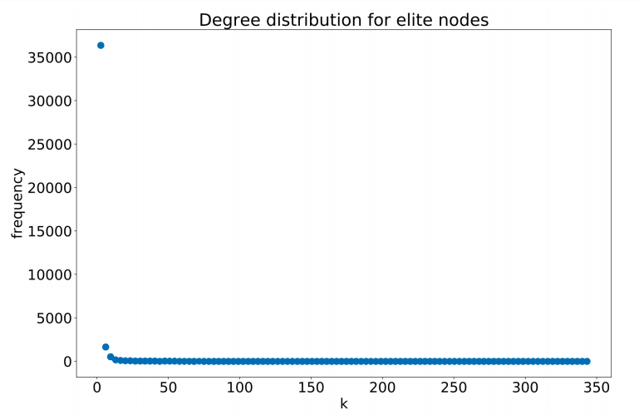
Degree Distributions for Influencer and Regular Users: Review Network

Slide 6
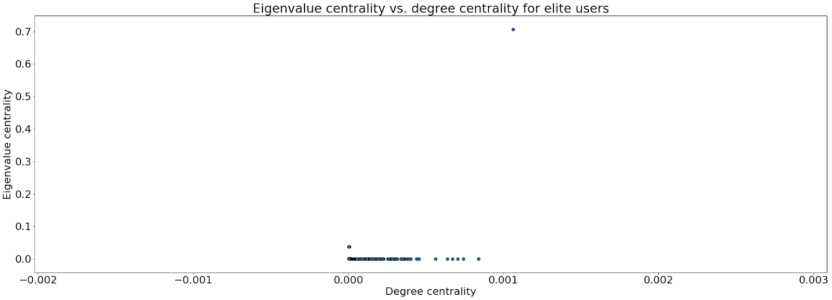
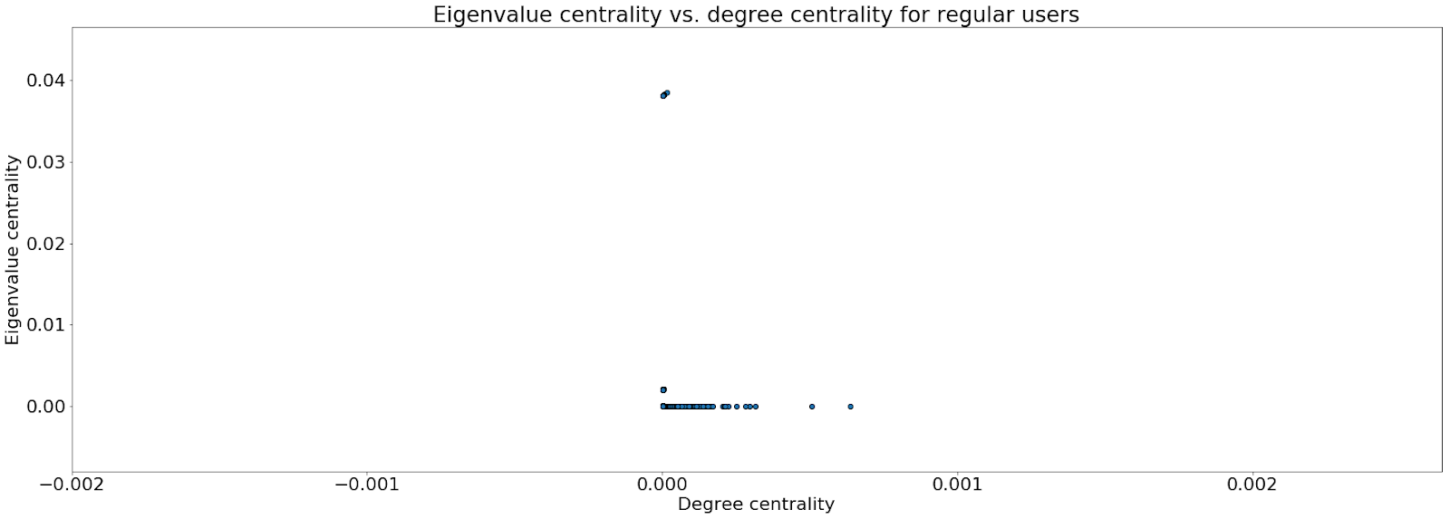
Eigen Vector Centrality
For users, indicates to which degree they have reviewed restaurants with many reviews.
For restaurants, indicates how many reviews come from users who themselves have given a lot of reviews

Slide 7
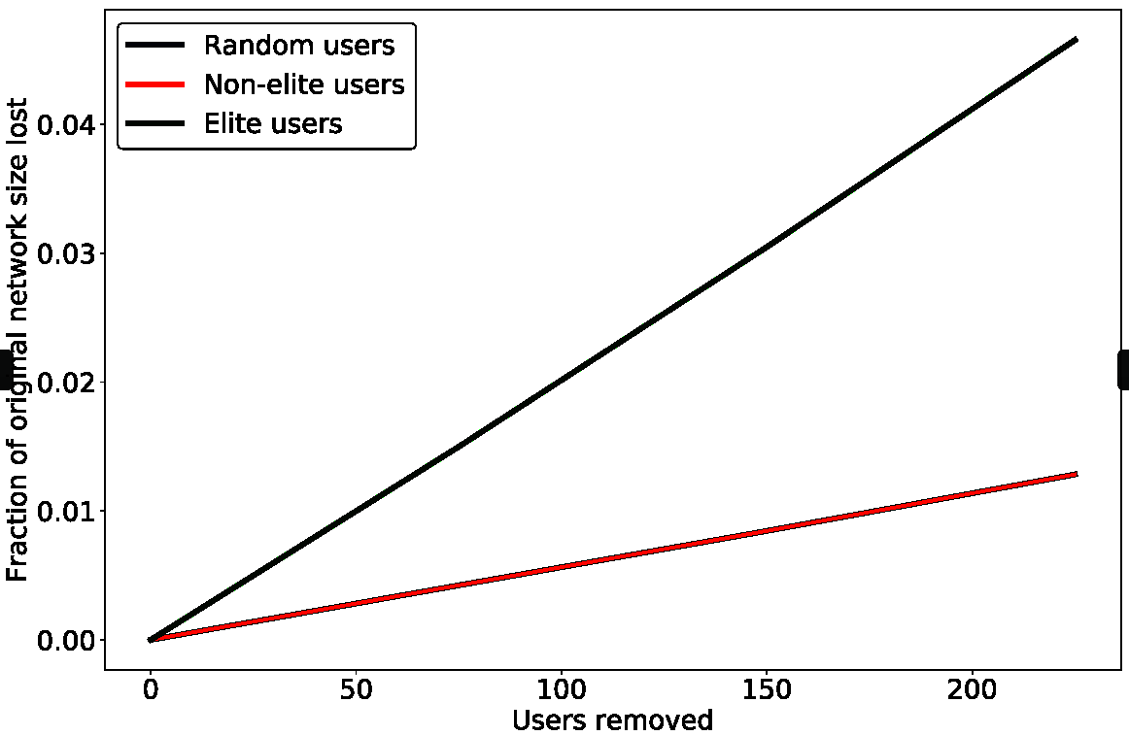
Robustness Analysis
Assessed impact of influencer nodes on the graphs
Reduction of around 61% of the original size of the network if influencer nodes are removed from the network.

Slide 8
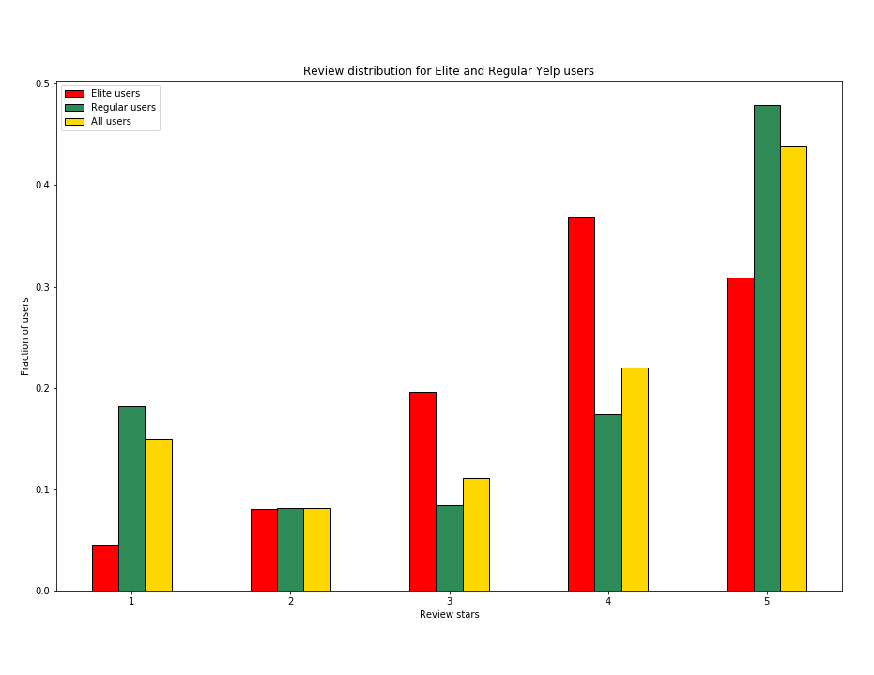
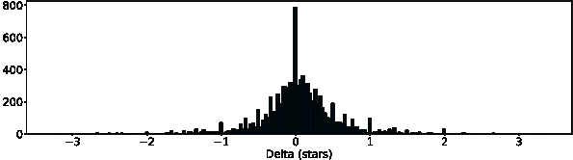
Overall Rating and Review Distributions
Influencers are representative of the reviews for the community of users of which they make up only 31%.
Influencers give more balanced reviews than regular

Slide 9
Quantifying a measure for influence

Slide 10
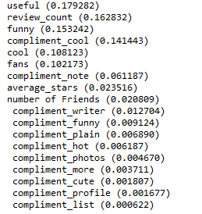
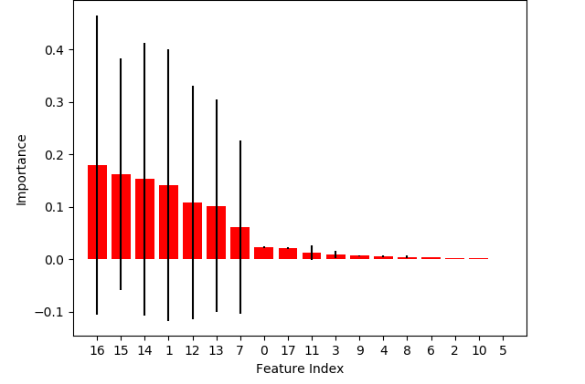

Slide 11
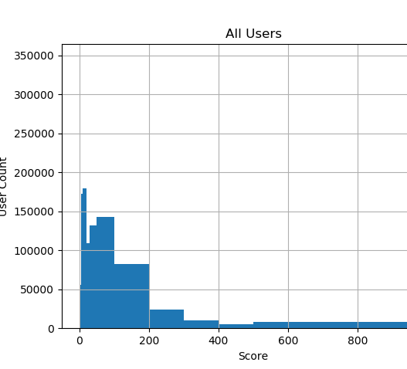
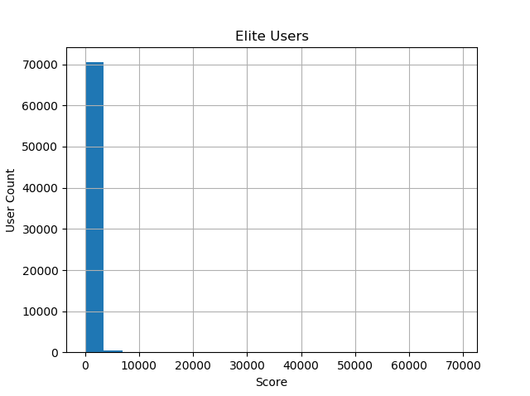

Slide 12
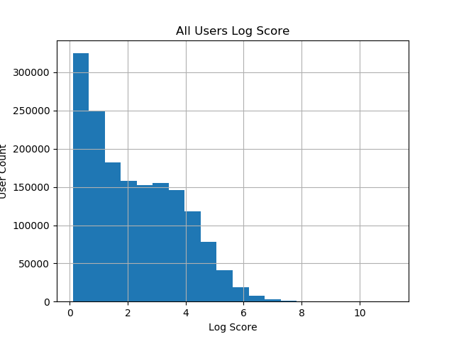

Slide 13
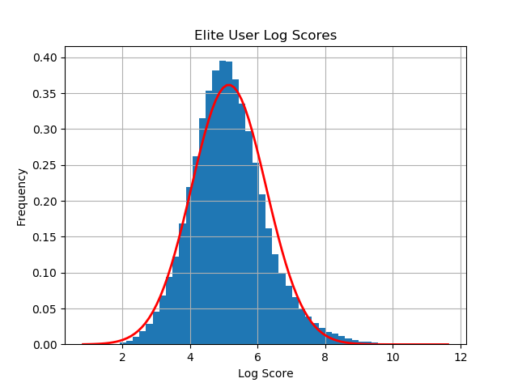

Slide 14
Thank you

