Slide 1
Firm Feedback Survey 2020

Slide 2
Survey Questions
Q1 | The PRA has an appropriate understanding of the sector my firm operates in and its business models.
Q2 | My firm has a clear understanding of the regulatory objectives of the PRA.
Q3 | The PRA has clearly articulated what it sees as the key risks my firm poses to its objectives and is clear about mitigation expectations.
Q4 | My firm is clear about the specific actions the PRA expects us to take.
Q5 | Challenge from the PRA has influenced my firm’s strategy, its execution and/or business operation.
Q6 | My firm has an effective relationship with the PRA.
Q7 | My firm has adequate access to the right people at the PRA.
Q8 | Communication from the PRA is clear, timely and appropriate for my firm.
Q9 | The PRA explains clearly why it is requesting data and information from my firm.
Q10 | Deadlines for requests for data and information from the PRA are generally reasonable.
Q11 | Information channels (e.g. publications, speeches, BoE website) are effective at informing our firm of the PRA’s expectations.
Q12 | The PRA and FCA are appropriately coordinated in their supervision of my firm taking account of their respective regulatory objectives.
Q13 | The PRA and overseas regulators are appropriately coordinated in their supervision of my firm taking account of their respective regulatory objectives.

Slide 3
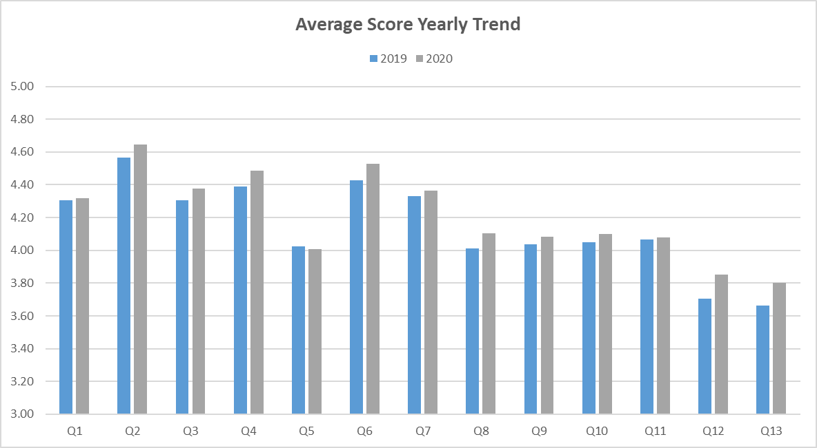
2019 and 2020 average score comparison
The graph below compares the results for all firms from 2019 with 2020. 239 firms were invited to complete the survey and 189 firms (79%) responded. In reading the graph, a score of 5 is the most favourable and equates to ‘strongly agree’, 4 is ‘agree’, 3 is ‘neither agree nor disagree’, 2 is ‘disagree’ and 1 is ‘strongly disagree’. Please note that the graphs axis does not include 1 or 2 as averaging did not yield any scores less than 3.

Slide 4
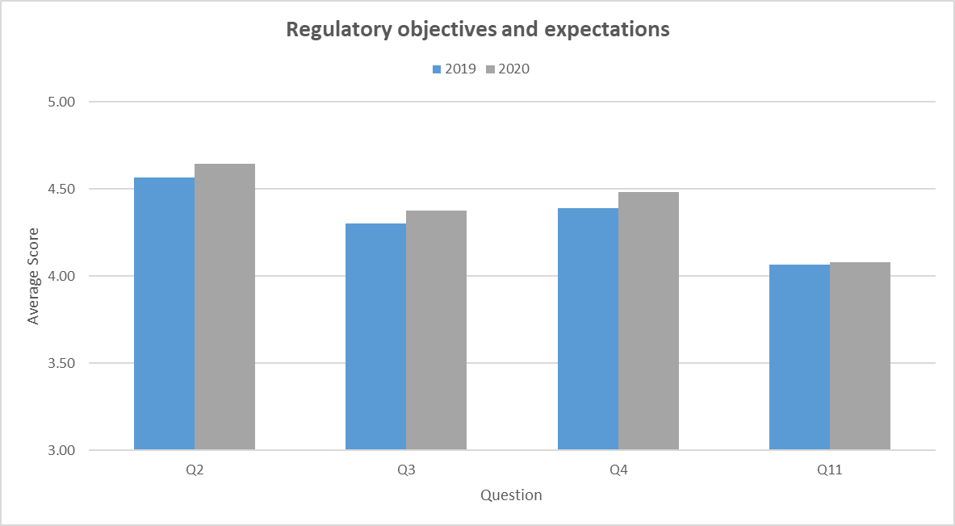
Regulatory objectives and expectations
The graph below provides a breakdown of responses to questions on the PRA’s regulatory objectives and expectations.
Q2 | My firm has a clear understanding of the regulatory objectives of the PRA.
Q3 | The PRA has clearly articulated what it sees as the key risks my firm poses to its objectives and is clear about mitigation expectations.
Q4 | My firm is clear about the specific actions the PRA expects us to take.
Q11 | Information channels (e.g. publications, speeches, BoE website) are effective at informing our firm of the PRA’s expectations.

Slide 5
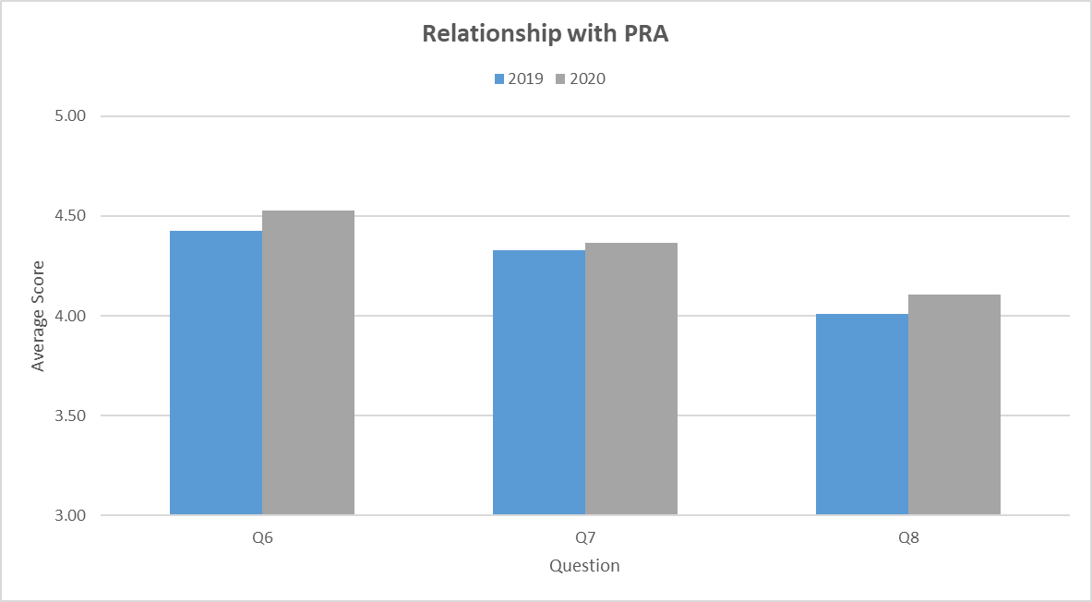
Relationship with the PRA
The graph below provides a breakdown of responses to questions relating to firms’ relationships with the PRA,
Q6 | My firm has an effective relationship with the PRA.
Q7 | My firm has adequate access to the right people at the PRA.
Q8 | Communication from the PRA is clear, timely and appropriate for my firm.

Slide 6
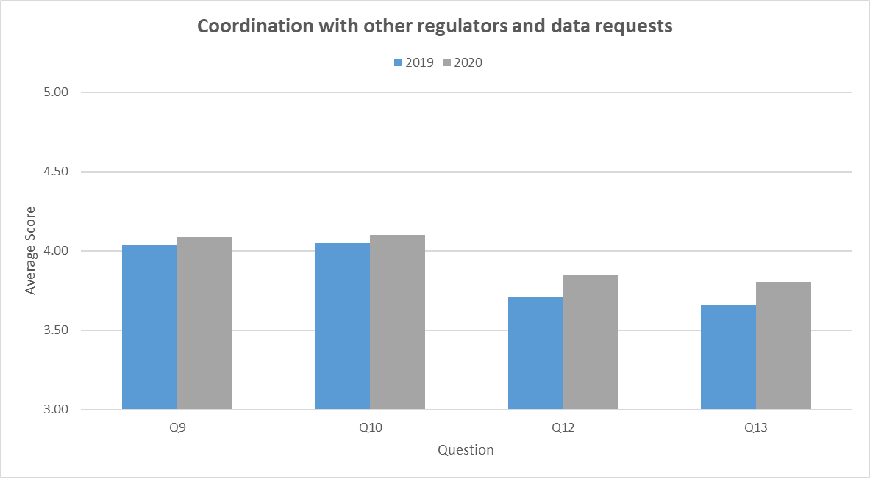
Coordination with other regulators and data requests
The graph below provides a breakdown of responses to questions focused on data requests and the PRA’s coordination with other regulators.
Q9 | The PRA explains clearly why it is requesting data and information from my firm.
Q10 | Deadlines for requests for data and information from the PRA are generally reasonable.
Q12 | The PRA and FCA are appropriately coordinated in their supervision of my firm taking account of their respective regulatory objectives.
Q13 | The PRA and overseas regulators are appropriately coordinated in their supervision of my firm taking account of their respective regulatory objectives.

Slide 7
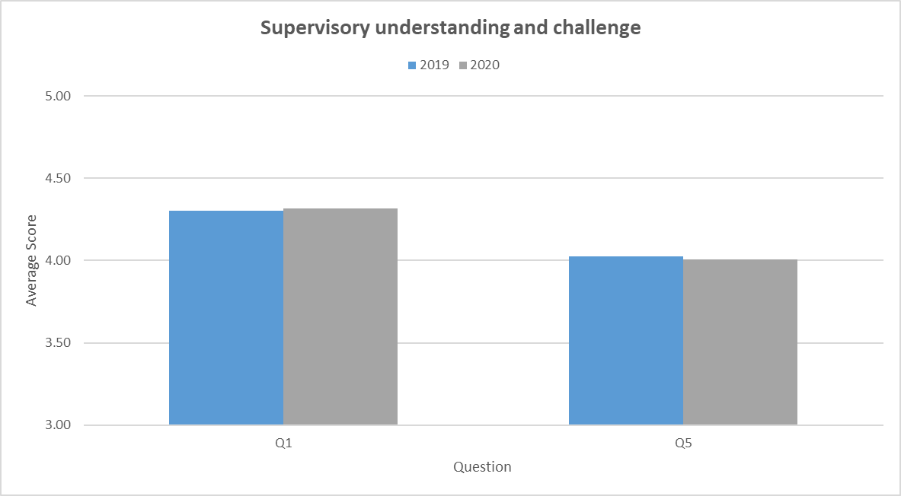
Supervisory understanding and challenge
The graph below provides a breakdown of questions regarding challenge from the PRA and the PRA’s understanding of a firm’s sector and business model.
Q1 | The PRA has an appropriate understanding of the sector my firm operates in and its business models.
Q5 | Challenge from the PRA has influenced my firm’s strategy, its execution and/or business operation.

