Slide 1
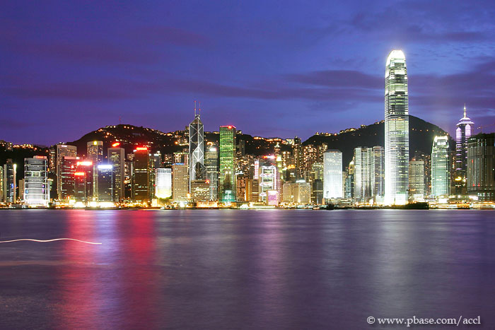
Suspicious Transaction Reports for banking sector
John TSE
Chief Inspector of Police
Deputy Head of Joint Financial Intelligence Unit

Slide 2
Contents
Part 1 – Overview of JFIU & Obligations to file STR
Part 2 – Updated STR Statistics
Part 3 – ‘SAFE’ Approach (Case Examples)
Part 4 – Crime Report Vs STR (Case Example)
Part 5 – E-Reporting via STREAMS Vs Manual Reporting

Slide 3
Joint Financial Intelligence Unit
Established in 1989 (when FATF established)
40+ 9 Rs -> R.26 – Establish a FIU
Jointly operated by Police and C&E
Housed in Police Headquarters
Manpower ↑from 29 to 44
JFIU’s functions
  Primarily receive, analyze and disseminate STR to law enforcement agencies
  Contact points
  Outreach
  Feedback

Slide 4
Regulatory obligation to make STR
Guideline on Prevention of Money Laundering (issued by HKMA on 2000)
If an AI has a suspicion of Money Laundering activity regarding a transaction of whatever amount, it should report the suspicious transaction to JFIU.
Notes:
UNDER ALL THREE RELATED PIECES OF LEGISLATION
DTROP
OSCO
UNATMO
THE PROVISIONS ARE ESSENTIALLY THE SAME
A POSITIVE REQUIREMENT UPON THE PUBLIC TO REPORT SUSPICION OF MONEY LAUNDERING OR TERRORIST FINANCING
PERSONS REQUIRED TO REPORT SUSPICION OR KNOWLEDGE OF CRIME PROCEEDS OR TERRORIST PROPERTY TO AN AUTHORISED OFFICER I.E. JFIU
THIS IS THE ONLY PIECE OF LEGISLATION IN HK, I CAN THINK OF, WHICH PLACES A POSITIVE OBLIGATION ON THE PUBLIC TO REPORT SUSPICION OF CRIME
THE REQUIREMENT IS VERY BROAD “ANY PERSON” A LOT BOARDER IN APPLICATION THAN OTHER COUNTRIES WHERE THE REQUIREMENT S RESTRICTED TO THE FINANCIAL SECTOR ALONE
NOTE THE PENALTY

Slide 5
Legal obligation to make reports
and relevant ML laws
Laws of HK | Cap.405 | Cap.455 | Cap.575
ML / TF Offence | S.25 | S.25 | S.7, S.8
STR | S.25A(1) | S.25A(1) | S.12(1)
Exemption
- Criminal L | S.25A(2) | S.25A(2) | S.12(2)
- Civil L | S.25A(3) | S.25A(3) | S.12(3)
Confidentiality | S.26 | S.26 | S.12(5)

Slide 6
Legal obligation to make reports
s.25A(1) of DTROP / OSCO , s.12 of UNATMO
Any person who knows or suspects any property represents the proceeds of crime or terrorist property shall make a report to an authorized officer.
Notes:
UNDER ALL THREE RELATED PIECES OF LEGISLATION
DTROP
OSCO
UNATMO
THE PROVISIONS ARE ESSENTIALLY THE SAME
A POSITIVE REQUIREMENT UPON THE PUBLIC TO REPORT SUSPICION OF MONEY LAUNDERING OR TERRORIST FINANCING
PERSONS REQUIRED TO REPORT SUSPICION OR KNOWLEDGE OF CRIME PROCEEDS OR TERRORIST PROPERTY TO AN AUTHORISED OFFICER I.E. JFIU
THIS IS THE ONLY PIECE OF LEGISLATION IN HK, I CAN THINK OF, WHICH PLACES A POSITIVE OBLIGATION ON THE PUBLIC TO REPORT SUSPICION OF CRIME
THE REQUIREMENT IS VERY BROAD “ANY PERSON” A LOT BOARDER IN APPLICATION THAN OTHER COUNTRIES WHERE THE REQUIREMENT S RESTRICTED TO THE FINANCIAL SECTOR ALONE
NOTE THE PENALTY

Slide 7
Statutory Defence to ML/TF
s.25A(2) DTROP/OSCO, s.12(2) UNATMO
If a person deals with property & STR relates to that act, that person has a defence to ML/TF, provided:-
(i) STR made before act & act done with the consent of an authorized officer; or
(ii) STR made - after the act - on his own initiative - as soon as reasonably practicable

Slide 8
Part 2 – Updated STR figures

Slide 9
No. of STR

Slide 10
STR Figures by Sectors
compare with 2008 1st quarter
Notes:
THIS IS SELF EXPLANATORY. THE VAST MAJORITY OF STRS ORIGINATE FROM THE BANKING SECTOR.
IN 2004, 96%.
THE NEXT BIGGEST PROVIDER OF STRS AFTER THE BANKING SECTOR IS RA/MC SECTOR.
VERY FEW ARE RECEIVED FROM PROFESSION SUCH AS ACCOUNTANTS OR LAWYERS.
IT COULD BECAUSE THEIR STRS ARE OF HIGHER QUALITY AS THAT ARE MOREL LIKELY TO HAVE A GREATER ‘FACE TO FACE’ KNOWLEDGE OF THEIR CLIENTS THAN OTHER PROFESSIONS.
CURRENTLY THE VAST MAJORITY OF DISCLOSURES RECEIVED ARE POST TRANSACTION REPORTS.
CONSENT IS THEREFORE NOT AN ISSUE.
PRE-TRANSACTION DISCLOSURES
FIRSTLY I NEED TO EMPHASISE THAT JFIU UTILISES THE ‘NO CONSENT’ MECHANISM VERY SPARINGLY AND ONLY WHEN ABSOLUTELY NECESSARY AND WHEN SUFFICIENT EVIDENCE EXISTS.
RESTRAINT ORDERS ARE USUALLY SOUGHT VERY QUICKLY
FOR INSTANCES WHERE ‘NO CONSENT’ LETTERS ARE ISSUED TO BANKS, WE HAVE DEVELOPED A POLICY WITH HK ASSOCIATION OF BANKS AND HKMA, WHEREBY WE WILL INSTRUCT THE BANK THAT SHOULD THE CLIENT ATTEMPT TO DEAL WITH THE PROPERTY, HE SHOULD BE REFERRED TO JFIU.
THIS HELPS TO DEAL WITH THE GREY AREA WHERE A ‘NO CONSENT LETTER’ HAS BEEN ISSUED AND THE BANK CANNOT EXPLAIN TO THE CLIENT WHY THEY CANNOT OPERATE THE ACCOUNT.
IF CIRCUMSTANCE REQUIRE URGENT PRE-TRANSACTION DISCLOSURES, JFIU ARE QUITE HAPPY TO ACCEPT REPORTS VERBALLY BY PHONE DURING OFFICE HOURS.
WHILST NO STATUTORY TIME FRAME IN WHICH TO ISSUE CONSENT LETTERS, WE ENDEAVOUR TO PROVIDE A VERY QUICK RESPONSE, DEPENDING ON THE CIRCUMSTANCES AND THE INITIAL INFORMATION PROVIDED.

Slide 11
Statistics of STR filed by Banks in 2008

Slide 12
Part 3 – ‘SAFE’ Approach
S
A
F
E
“Screen” the account for suspicious indicators: Recognition Of Suspicious Indicator(s)
“Ask” the customer appropriate questions
“Find” out the customer's records : Review Of Information Already Known When Deciding If The Apparently Suspicious Activity Is To Be Expected
“Evaluate” all the above information : Is The Transaction Suspicious?

Slide 13
Case Example 1
Bank A “Screened” out an account of a non-resident Mr. B recorded a transfer deposit of HK$36M from a locally listed company C after the account was opened for two weeks.
Upon receipt, 2/3 of the deposits was immediately disbursed by means of cheque payment to a RA.
S
A
F
E
Bank A did not approach and “Ask” Mr. B any
question.
Bank A did “Found” out the Mr. B's records but no details of his occupation were recorded.
Bank A “Evaluated” the above information and felt suspicion because of the large amount involved.

Slide 14
Case Example 1 (Cont.)
JFIU found in the open source that the listed company C had made a HKSE acquisition disclosure two days prior to the transfer. The listed company C purchased a company from Mr. B for HK$3.6M in cash. If…….when……
S
A
F
E
Bank A “Screened” out an account of a non-resident Mr. B recorded a transfer deposit of HK$36M from a locally listed company C after the account was opened for two weeks.
Bank A approached and “Asked” Mr. B the source of the fund.
Bank A should conduct proper CDD on Mr. B’s background, intended use of the account and the source of the funds.
Having “Evaluated” the above information, the payment was therefore legitimate. No STR is required.

Slide 15
Case Example 2
Bank X “Screened” out an account of a Mainlander Mr. K recorded numerous transfers amounting to HK$10M from various individuals after the account was opened for 3 months.
Upon receipt, the deposits were immediately disbursed by means of transfers to another account.
S
A
F
E
Bank X “Asked” Mr. K for a valid identity document several times. Mr. K instructed to close the account.
Bank X “Found” out the Mr. K's records stating that he is a Mainland businessman. However, copy of the foreign passport submitted as identity document was found to be expired.
Bank A “Evaluated” the above information and filed STR

Slide 16
Case Example 2 (Cont.)
Bank X adopted the ‘SAFE’ Approach properly in Case Example 2.
JFIU confirmed that the foreign passport submitted to Bank X as the identity document was forged.
It however shows the poor “Customer Due Diligence” on the part of Bank X, because the Guideline of Prevention of Money Laundering mentioned that:
An AI should not in general establish a business relationship until the due diligence is satisfactorily completed. It may be acceptable to allow an account to be opened pending completion of the verification of identity ……… In such case, an AI should not allow funds to be paid out of the account to a 3rd party before the identity of the customer is satisfactorily verified.

Slide 17
Part 4 – Crime Report Vs STR
JFIU is not a crime reporting center nor is it an investigative unit. It does not investigate suspicious transactions. The role of the Unit is to receive, analyze and store suspicious transactions reports (STRs) and to disseminate them to the appropriate investigative unit.

Slide 18
Case Example 3
Day 1 p.m. – HK resident Mr. A phoned Bank X stating that he was kidnapped by a few Mainland business partners and forcibly imprisoned in China. He sought Bank X’s assistance to cut off his banking facilities. Bank X then failed to contact Mr. A. | If Bank X called ‘999’ immediately. Police would take over the case within a hour.
Day 2 p.m. – Bank X filed a STR with JFIU stating that Mr. A’s bank account is intended to be used in connection with a ‘kidnapping’ case. | There will be no time delay due to data input process.
JFIU urgently referred the case to Regional Crime Unit (RCU) to take over the ‘kidnapping’ case. | There will be no time delay in the STREAMS queue.
RCU confirmed that Mr. A was released and came back to HK at Day 1 evening. | A Lucky Case!

Slide 19
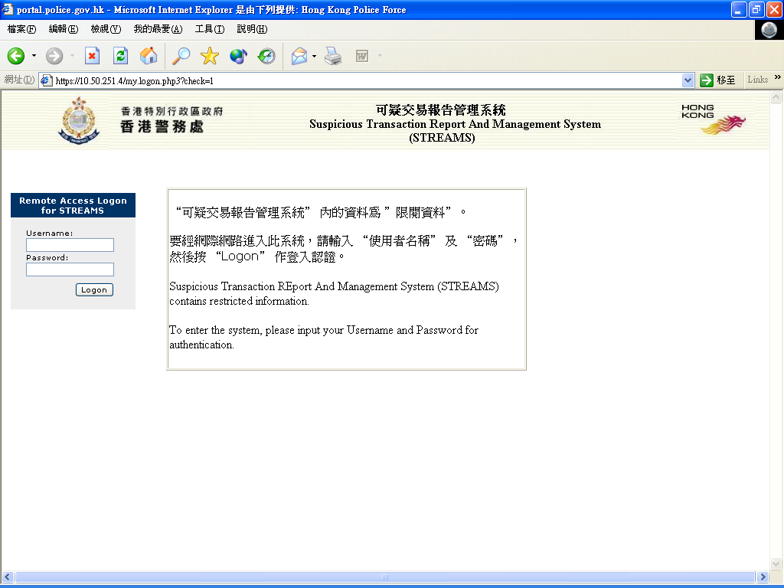





Part 5 – E-Reporting Vs Manual Reporting
Web based Platform – Suspicious Transaction Report and Management System (STREAMS)
e-Acknowledge/Result
e-STR
STREAMS
JFIU (STREAMS)
Encrypted
Internet
e-form
Data Input
e-STR
XML format
STR by mail/fax

Slide 20
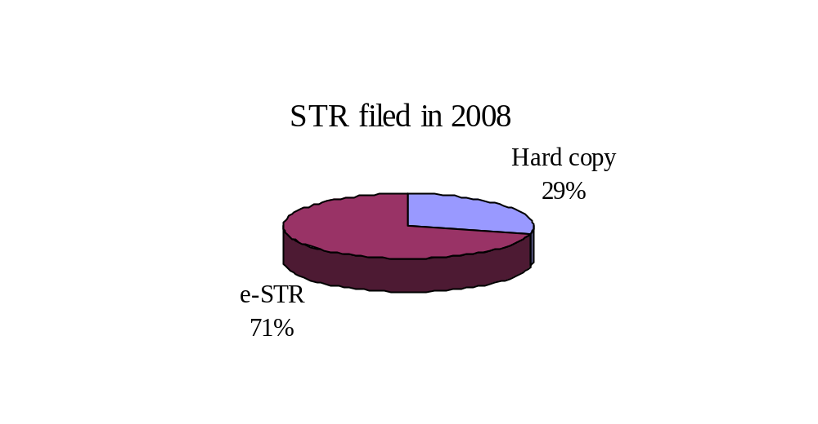
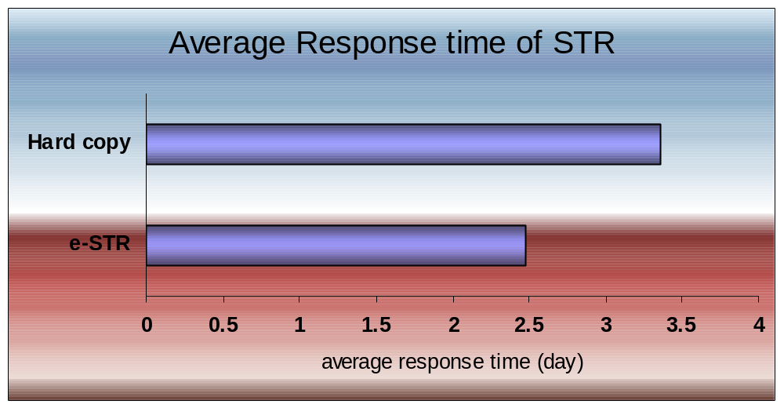
Statistics of STR Reporting Methods
and Response Time in 2008

Slide 21
For more information,
please visit our Website :-
www.jfiu.gov.hk

Slide 22
John TSE, Chief Inspector of Hong Kong Police Force
Office Tel: 2860 3402
16/F, Arsenal House West Wing
Police Headquarters, Arsenal Street,
Wanchai, Hong Kong.
JFIU : 2866 3366
Fax : 2529 4013
GPO Box : 6555
Email : jfiu@police.gov.hk

