Slide 1
HONG KONG MONETARY AUTHORITY
Refinements to the Operation of the Linked Exchange Rate System

Slide 2
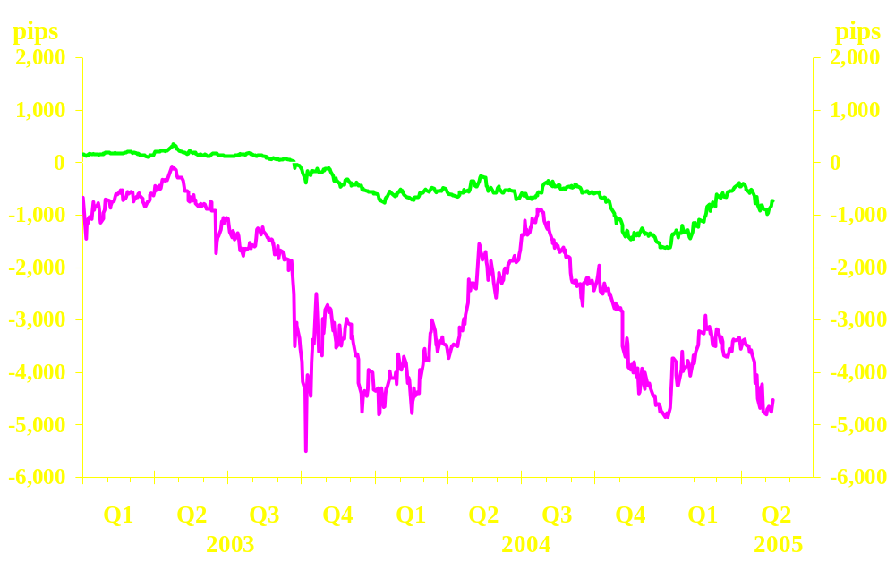
REVIEW OF MONETARY CONDITIONS (I)

Slide 3
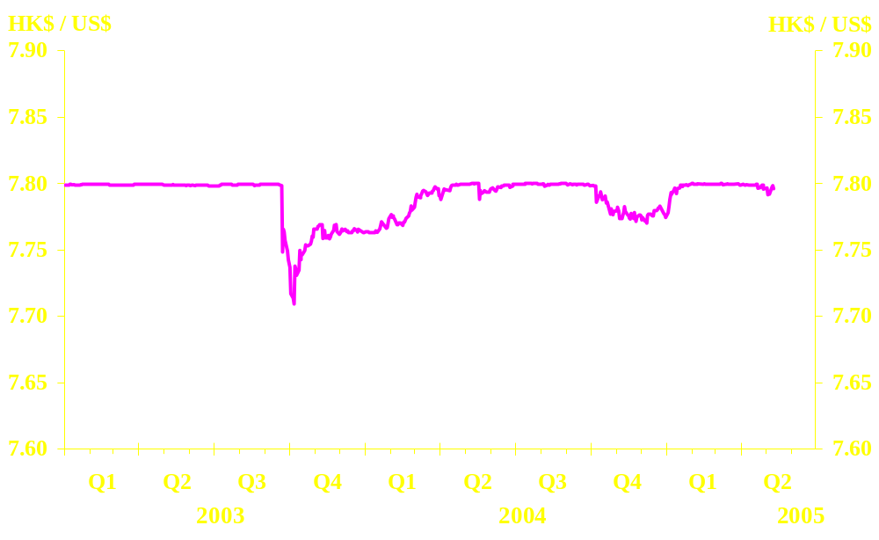
REVIEW OF MONETARY CONDITIONS (II)
Spot exchange rate

Slide 4
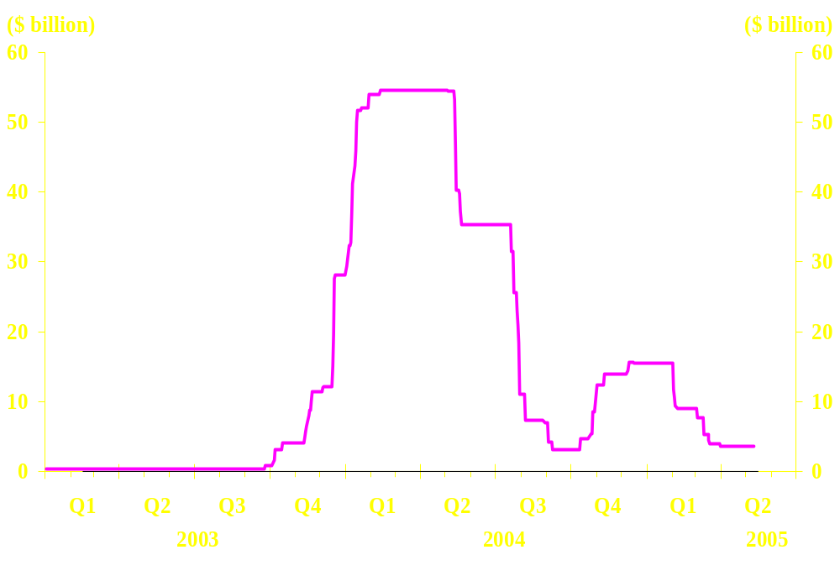
REVIEW OF MONETARY CONDITIONS (III)
Aggregate Balance

Slide 5
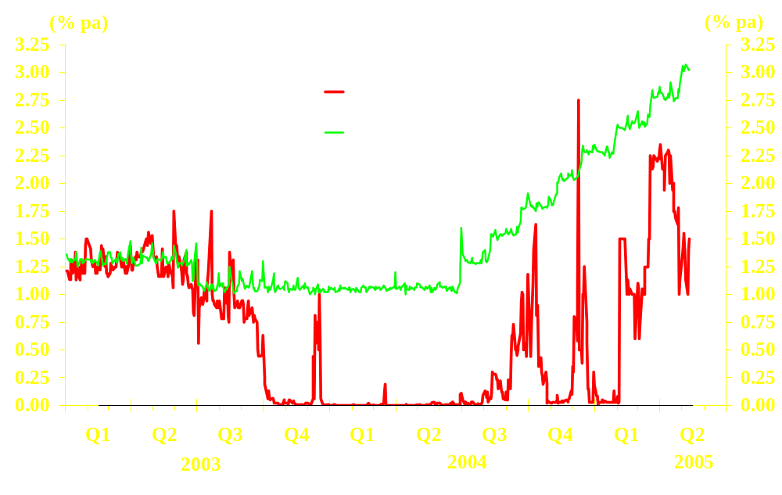
REVIEW OF MONETARY CONDITIONS (IV)

Slide 6
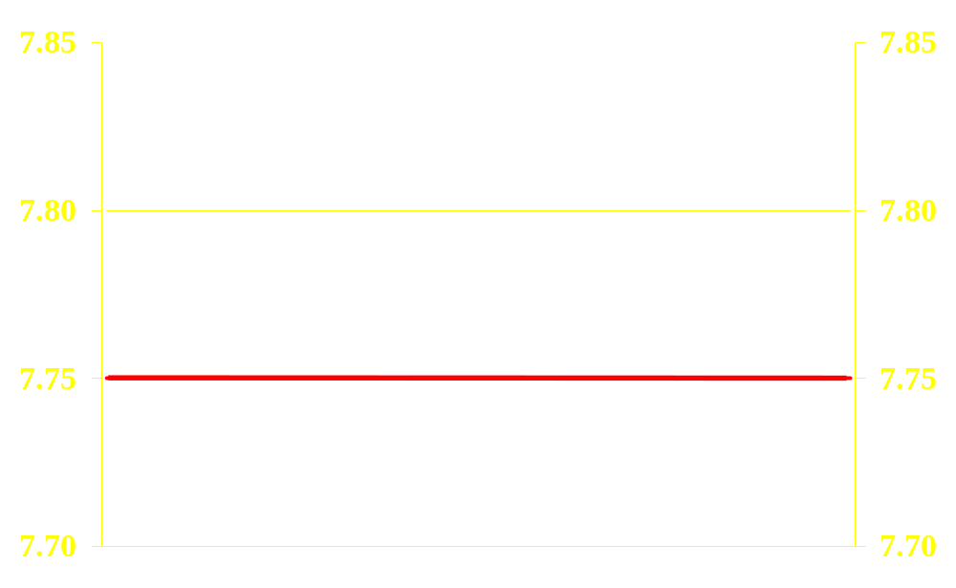
THREE REFINEMENTS TO THE OPERATION OF THE LINKED EXCHANGE RATE SYSTEM (I)
A strong-side Convertibility Undertaking by the HKMA to buy US dollars from Licensed Banks at 7.75

Slide 7
THREE REFINEMENTS TO THE OPERATION OF THE LINKED EXCHANGE RATE SYSTEM (II)
Shifting the weak-side Convertibility Undertaking by the HKMA to sell US dollar to Licensed Banks from 7.80 to 7.85 in a gradual manner (100 pips per week from 23 May 2005 to 20 June 2005)
7.90
7.90
7.85
7.85
7.80
7.80
7.75
7.75
7.70
7.70
23/5
20/6

Slide 8
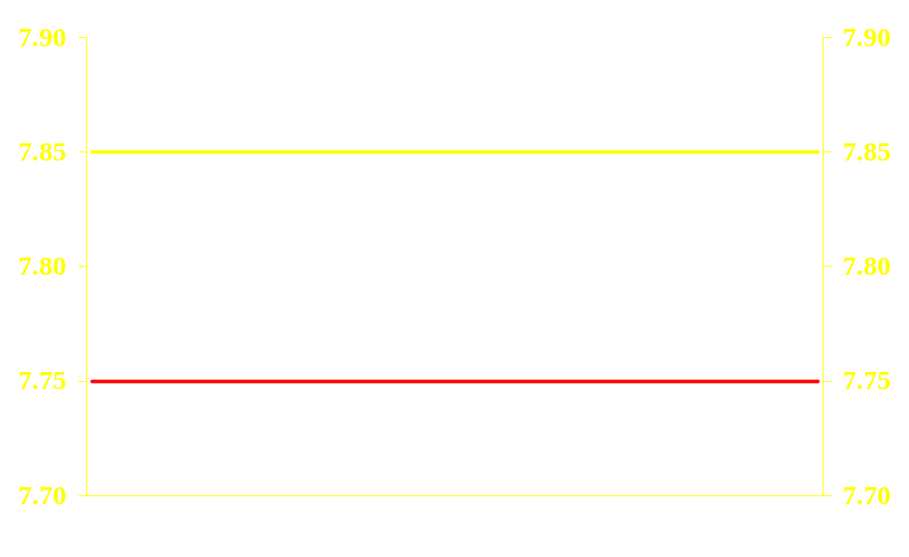
THREE REFINEMENTS TO THE OPERATION OF THE LINKED EXCHANGE RATE SYSTEM (III)
Introduction of a Convertibility Zone within which market operations may be conducted consistent with Currency Board principles
Convertibility Zone

